Slide 1
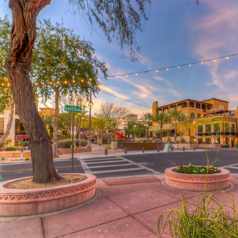
UNIT 1
Lesson 3
Saltillo
is a small city, but has great places to visit.
LESSON OBJECTIVE:
Learn what is a landmark.
Remind the use of is and has.
Learn and practice the use of conjuctions.

Slide 2
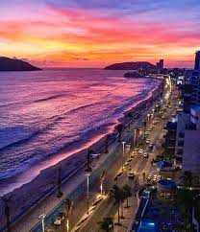
Speaking practice “Landmarks”
Talk about a local landmark in your country
Give some sentences, use is or has to give a description.
Mazatlan is a city the mexico, Is a very popular city in the tourist, the city is a famous for the beach an the stores and buildings. Mazatlan has a many beautiful sunsets in the beach.

Slide 3
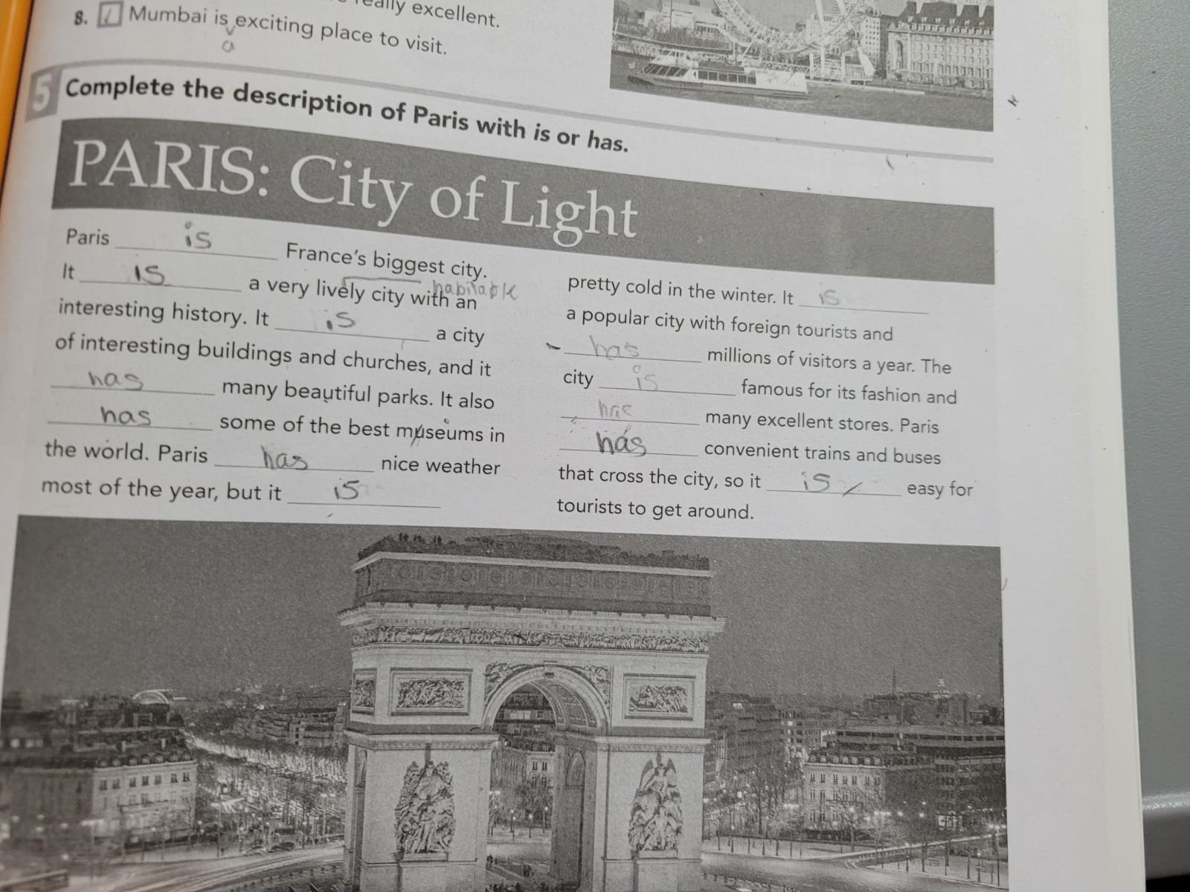
Grammar practice
Workbook pg 3 ex 5
Complete the description of Paris with is or has.

Slide 4
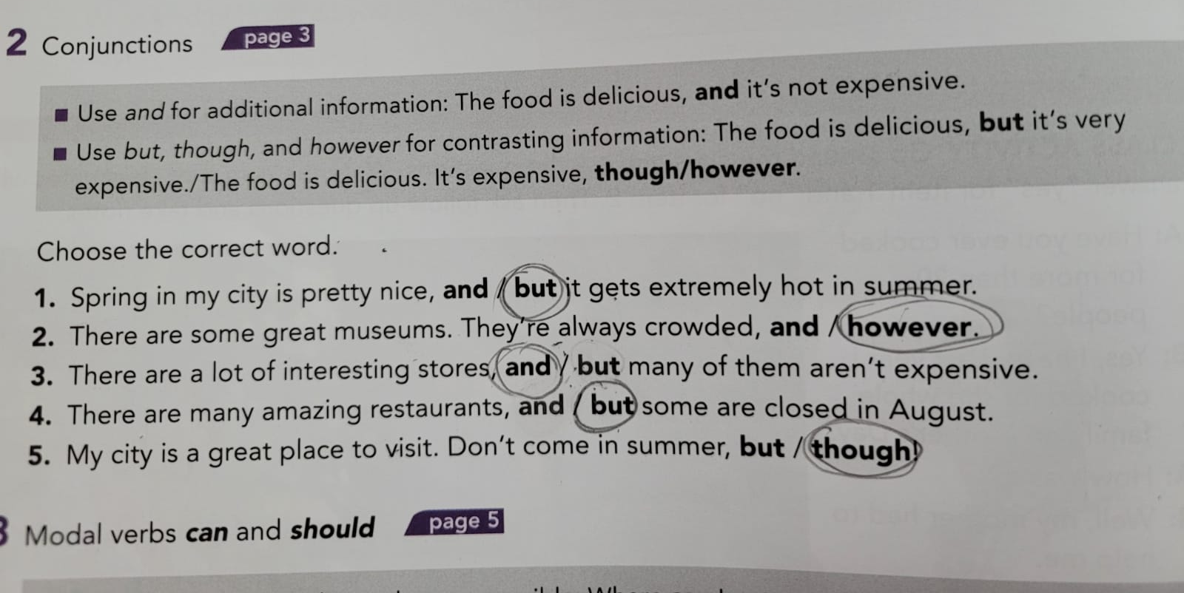
Grammar practice
Studentbook pg 82 ex 2

Slide 5
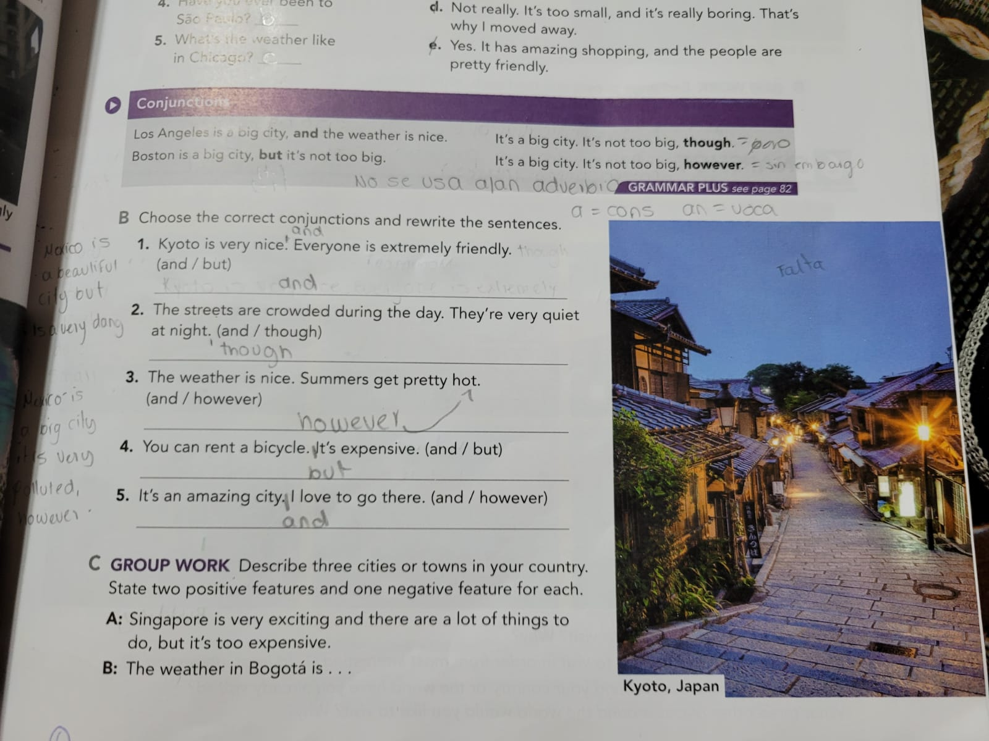
Grammar practice
Studentbook pg 3 ex B
Choose the correct conjuctions and rewrite the sentences.

Slide 6
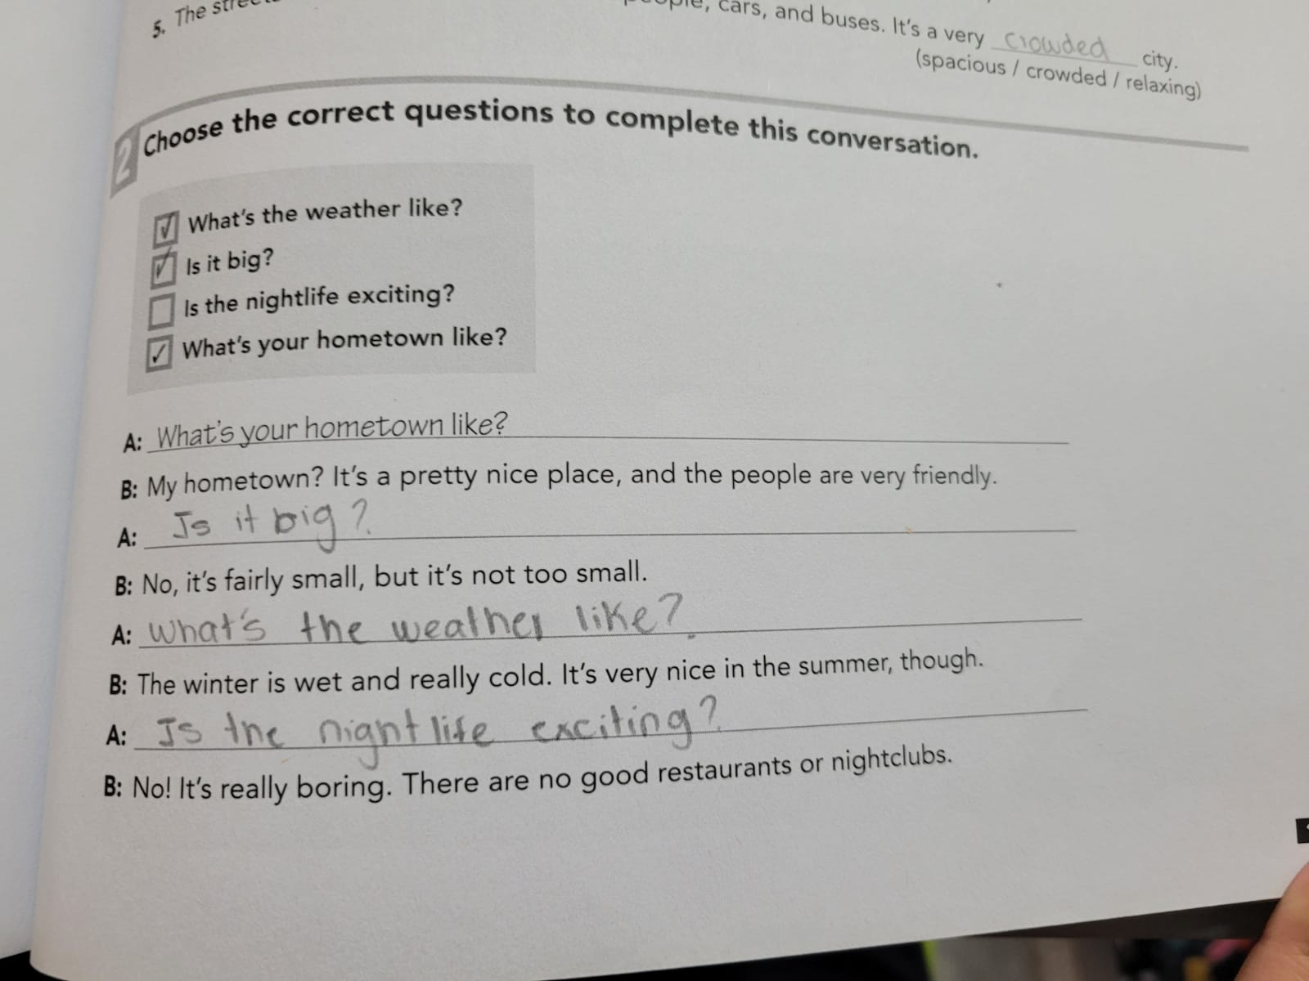
Grammar practice
Workbook pg 1 ex 2
Choose the correct questions to complete this conversation. Circle the conjuctions you find.

Slide 7
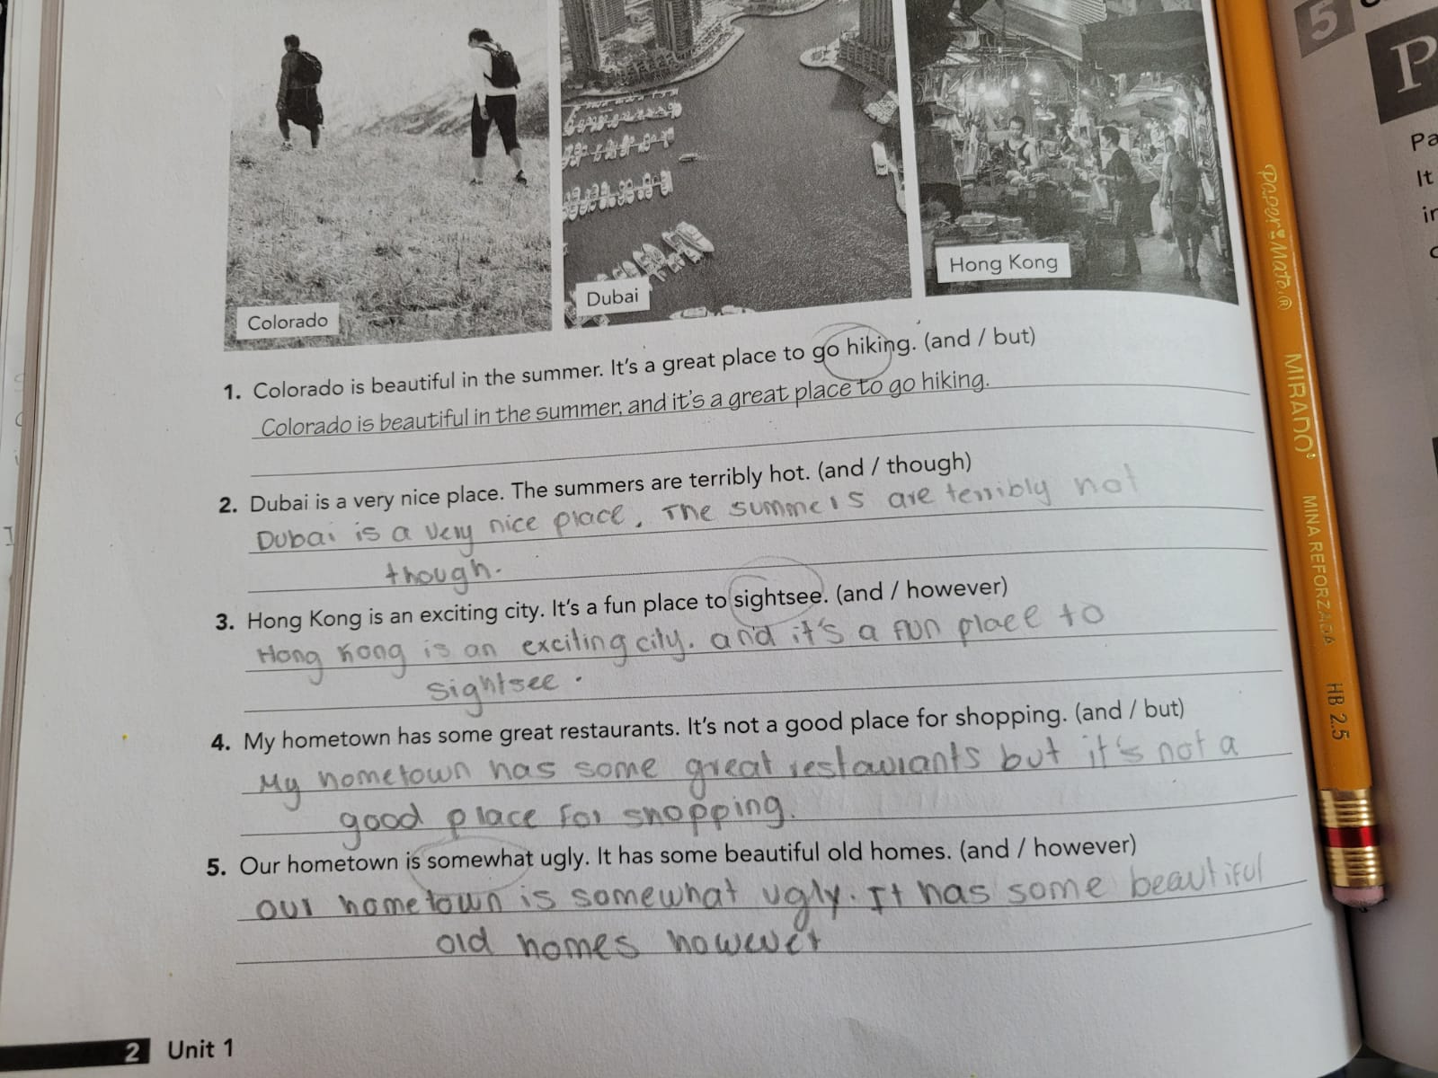
Grammar practice
Workbook pg 2 ex 3
Choose the correct conjuctions and rewrite the sentences.

Slide 8
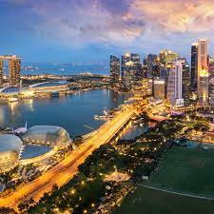
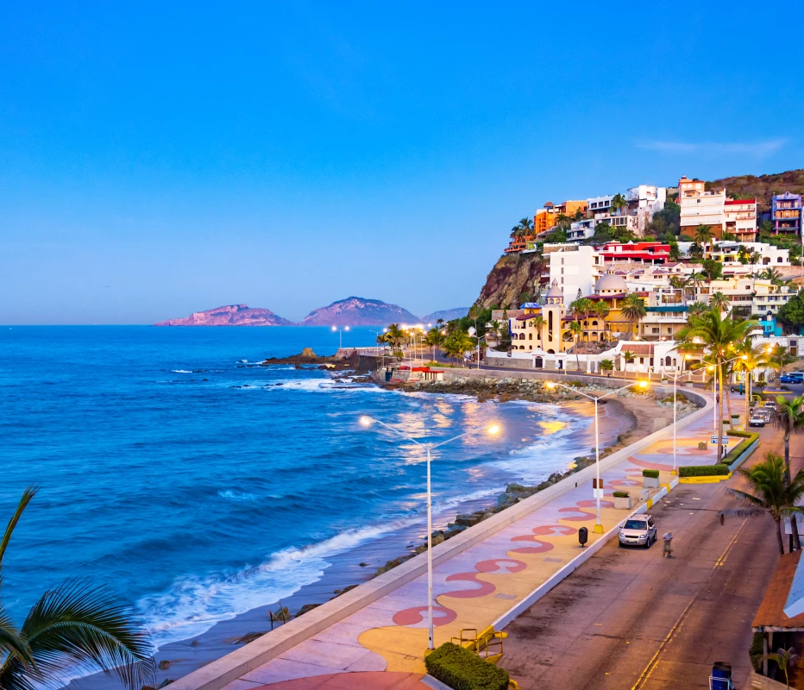
Writing practice
Studentbook pg 3 ex C
Describe one city or town in your country. State two positive features and one negative. (remind to use connectors to add or contrast information)
Example.-
Your description:
1- Mazatlan is very pretty and the beach is very big, but the weather is hot.
2- Arteaga is a really peaceful place and the restaurants are Delicious, It’s not too big place though.
3- New York is too noisy and the towers is very big and the stores is nice.

Slide 9
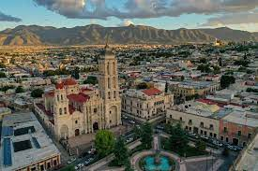
Writing practice “ A great place to live”
Studentbook pg 4 ex 5
Write about interesting places for tourists to visit in your hometown.
Example.-
Your description:
- Saltillo is a very beautiful city in Mexico. It has famous museums, and the restaurants are delicious, the people are very friendly but the weather is hot in the summer and cold in the winter. The buildings are very interesting and the shops are nice and cheap. Downtown Saltillo is a very popular place because there are shops, restaurants, a church, coffee shops, parks, etc.

