Slide 1
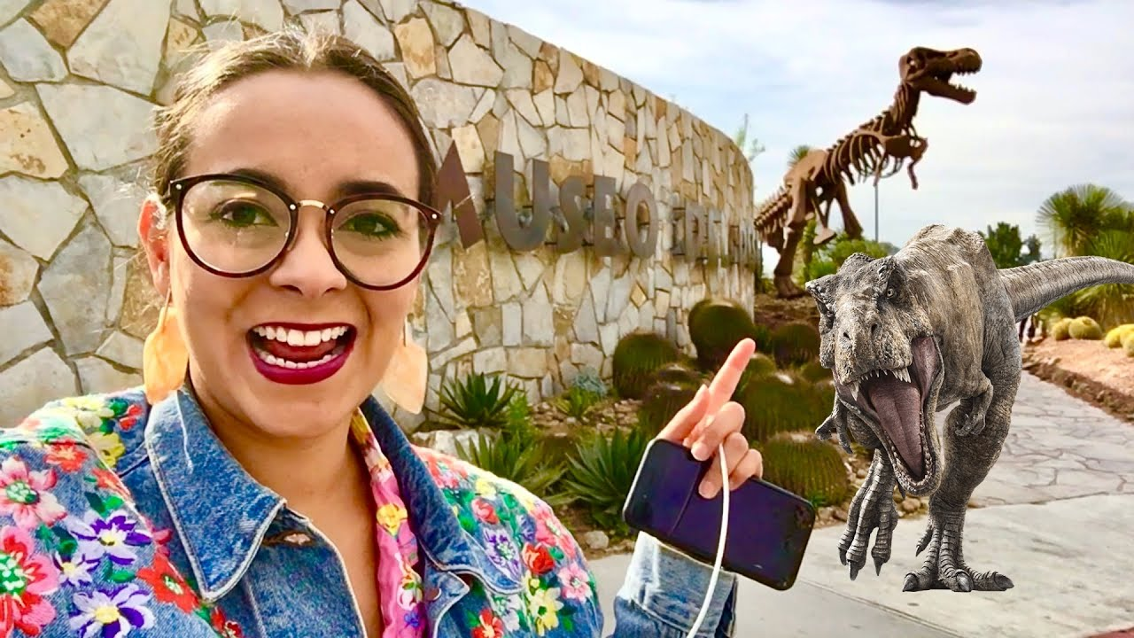
UNIT 1
Lesson 4
You should visit the desert museum.
LESSON OBJECTIVE:
Learn and practice the modal verbs can and should to give suggestions about sightseeing

Slide 2
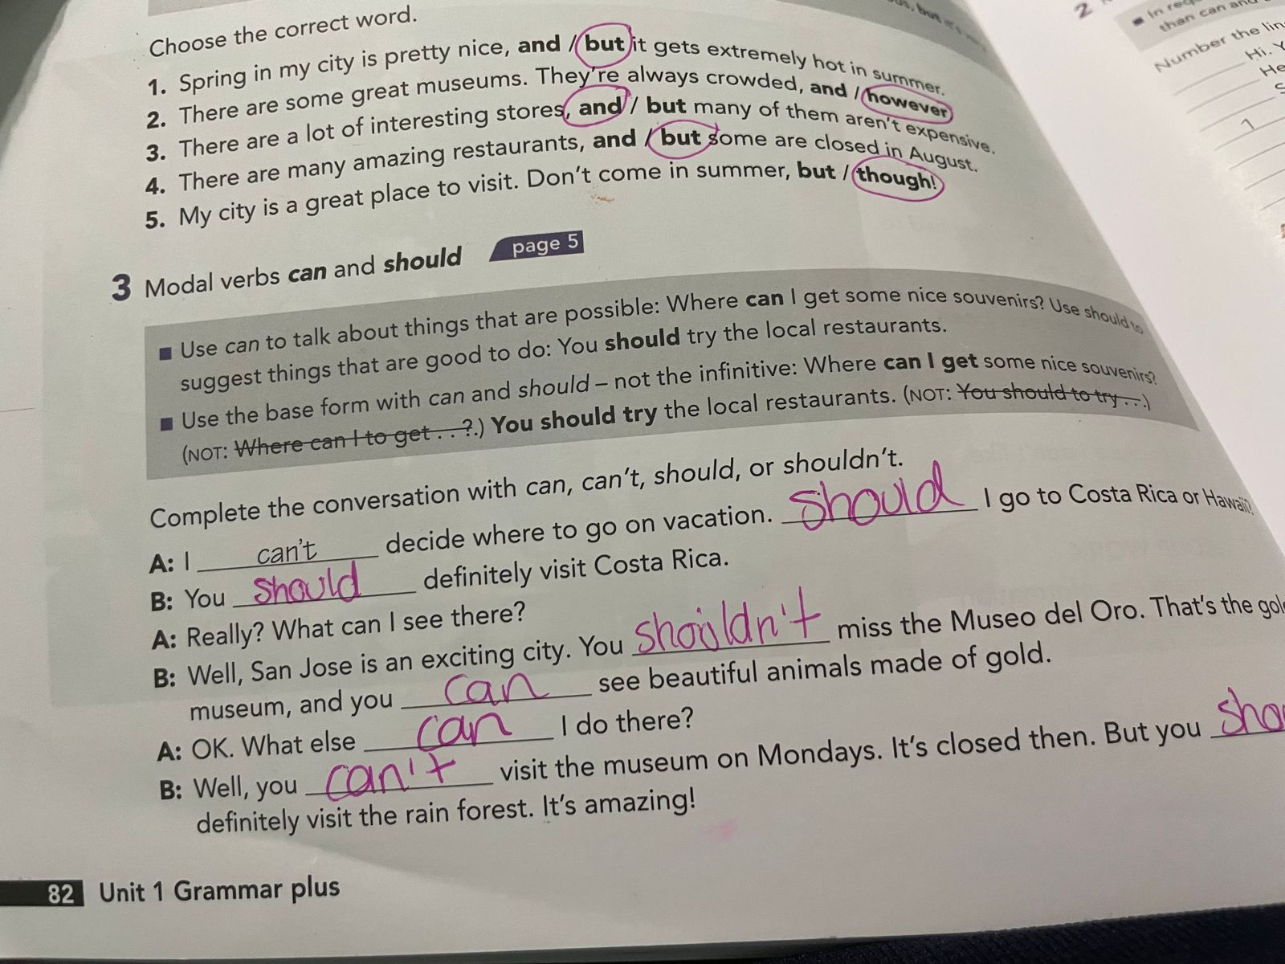
Grammar practice
Studentbook pg 82 ex 3

Slide 3
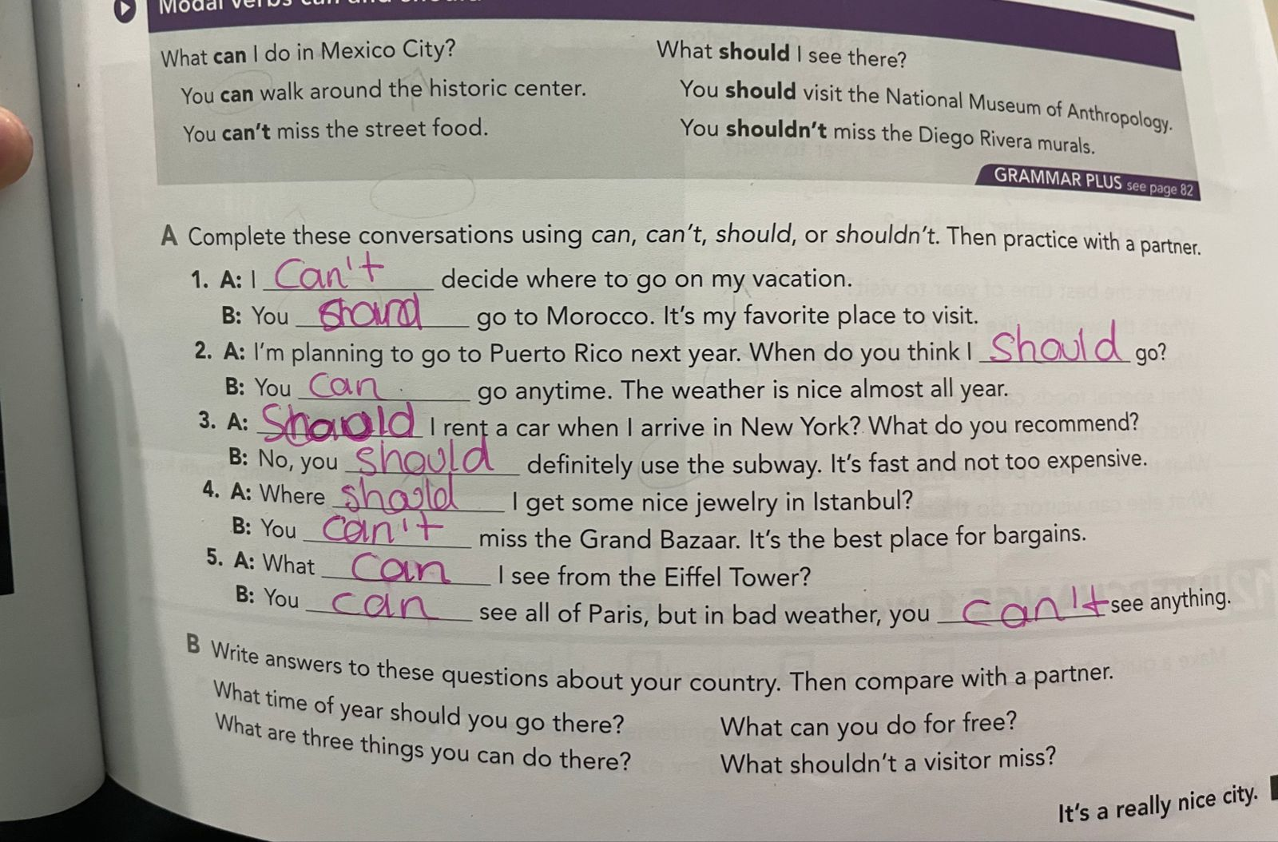
Grammar practice
Studentbook pg 5 ex 8

Slide 4
Grammar practice
Studentbook pg 5 ex 8
What time of year should you go there?
Yo can go visit saltillo on december, its a beautiful city
What are three things you can do there?
You should visit the museo del desierto
You should go to eat in las Brazas
You should go to stadium of baseball
What can you do for free?
You can go to the Parks
What should´t a visitor miss?
You should´t miss the mirador

Slide 5
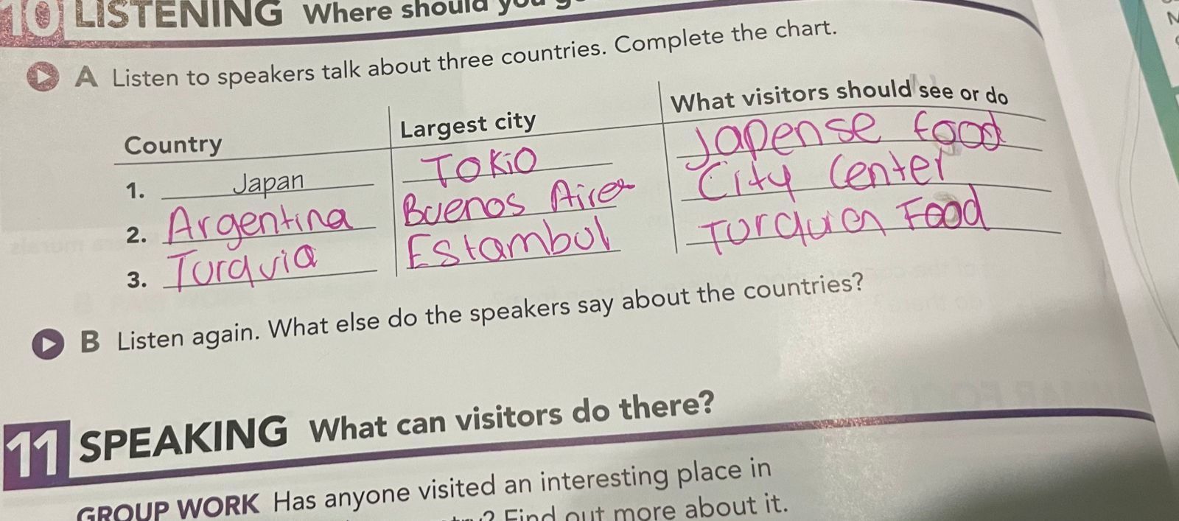
Grammar practice Where should you go?
Studentbook pg 6 ex 10
A.- Listen to speakers talk about three countries. Coplete the chart.

Slide 6
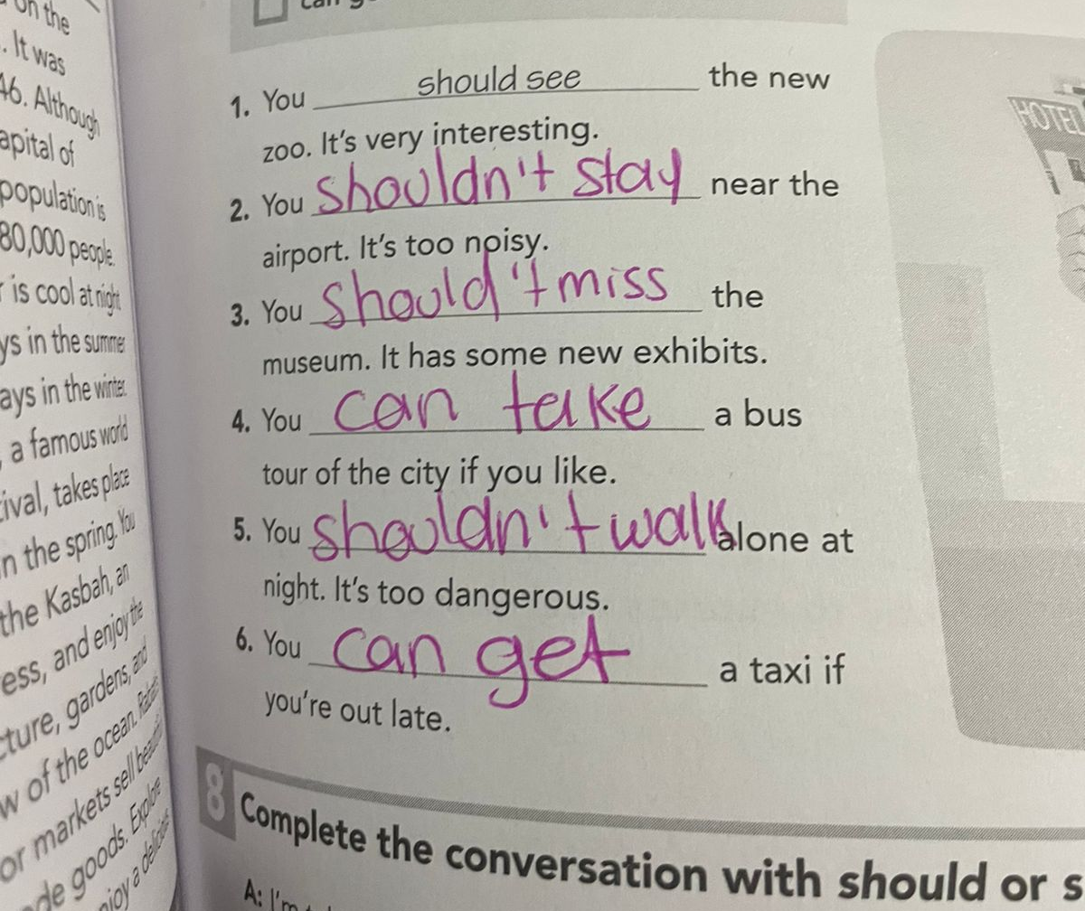
Grammar practice
Workbook pg 5 ex 7
Complete the sentences. Use the phrases from the box.

Slide 7
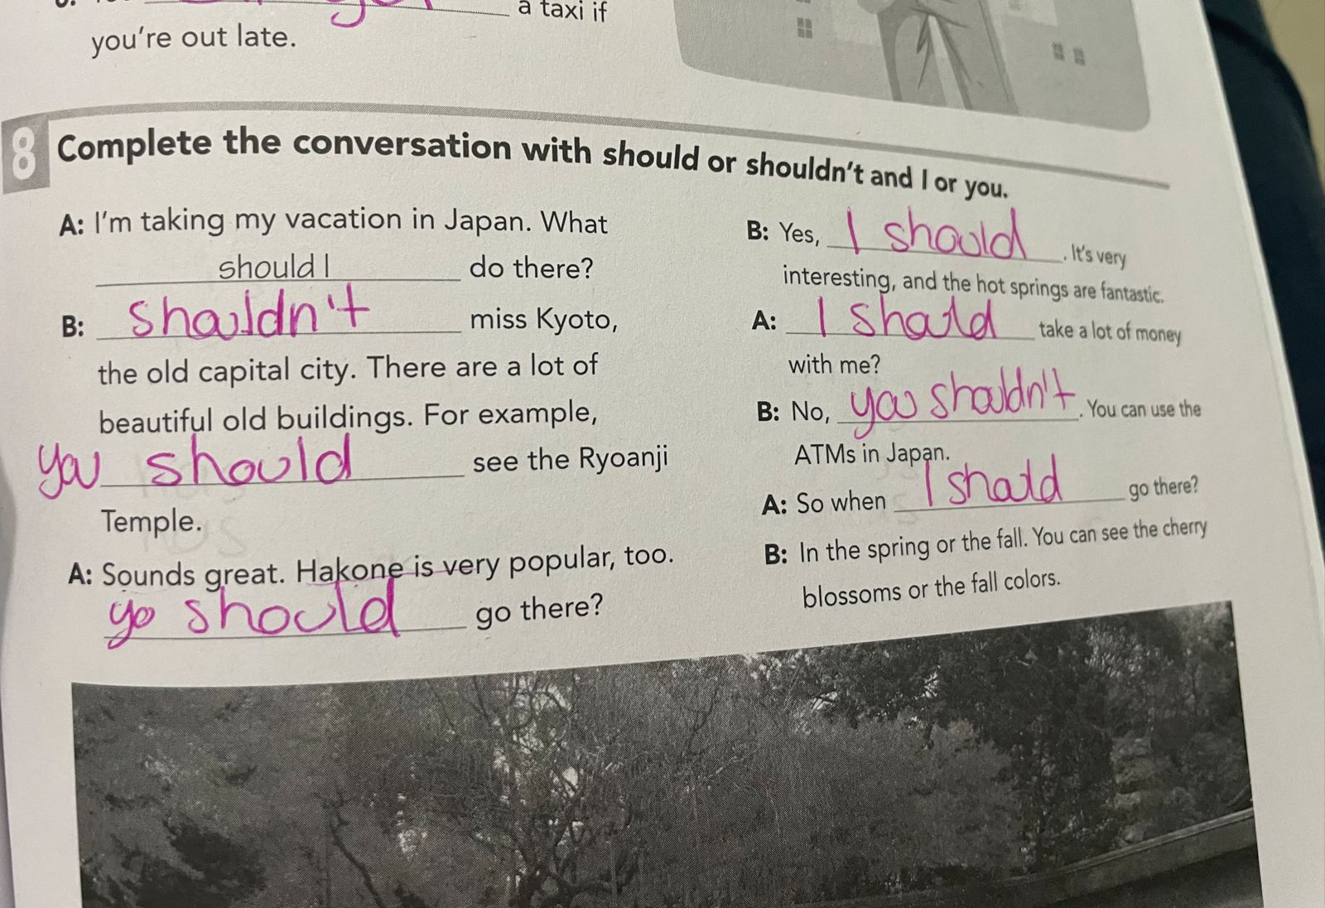
Grammar practice
Workbook pg 5 ex 8
Complete the conversation with should or shouldn´t and I or you.

Slide 8
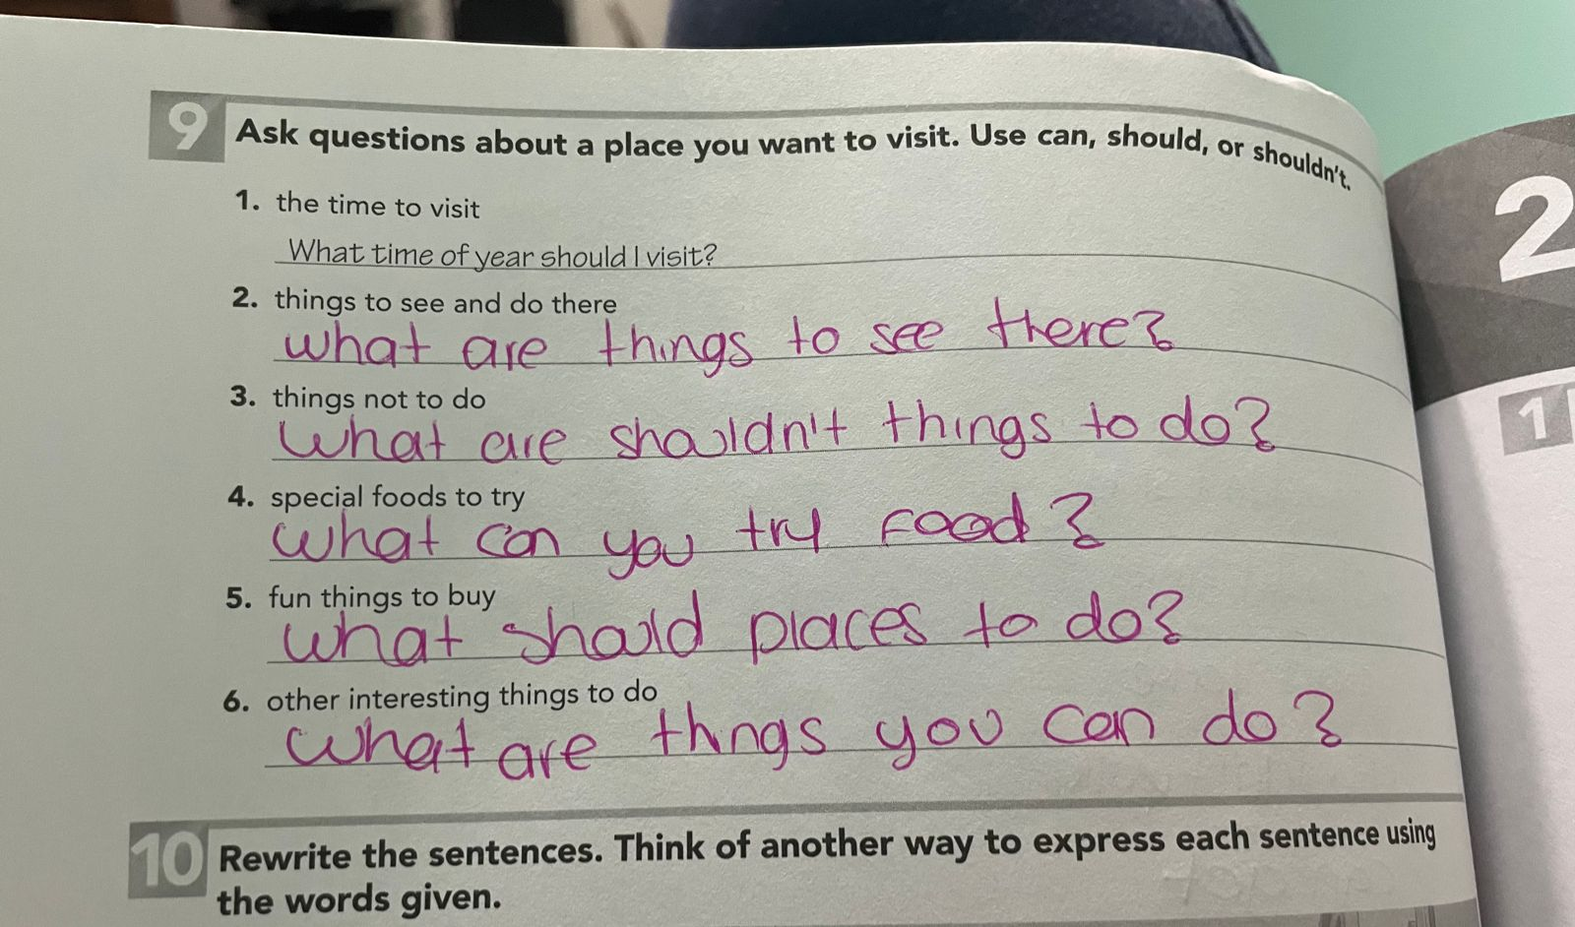
Grammar practice
Workbook pg 6 ex 9
Ask questions about a place you want to visit. Use can, should or shouldn´t

