Slide 1
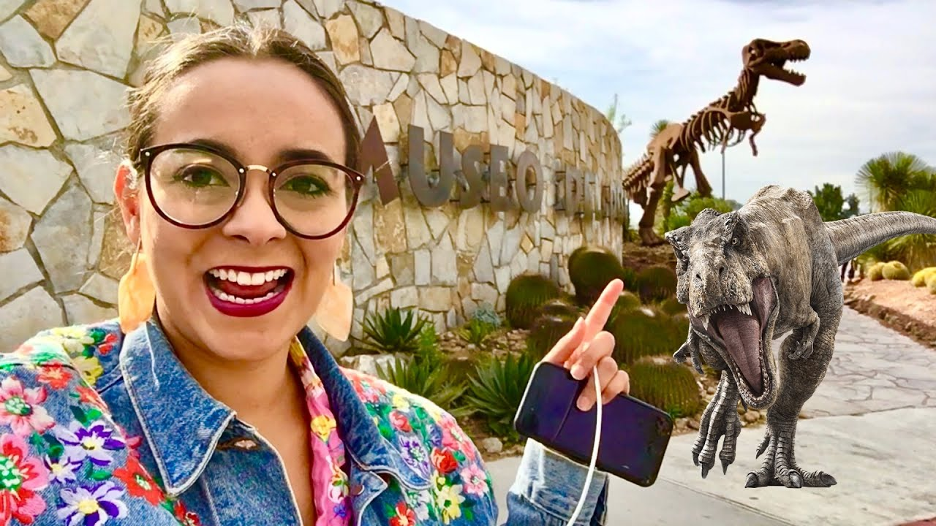
UNIT 1
Lesson 4
You should visit the desert museum.
LESSON OBJECTIVE:
Learn and practice the modal verbs can and should to give suggestions about sightseeing

Slide 2
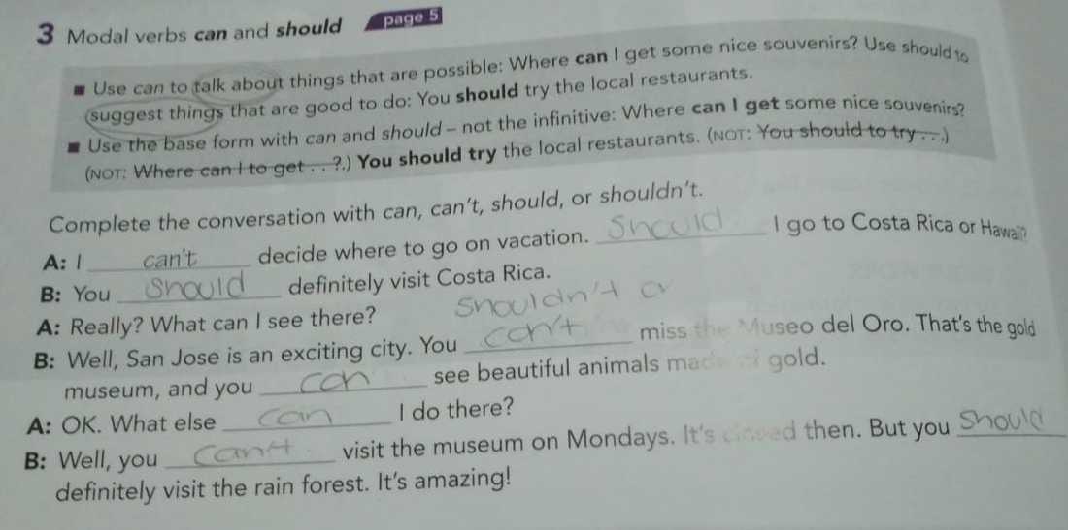
Grammar practice
Studentbook pg 82 ex 3

Slide 3
Grammar practice
Studentbook pg 5 ex 8

Slide 4
Grammar practice
Studentbook pg 5 ex 8
What time of year should you go there? You should go in summer. The weather is pretty beautiful.
What are three things yo can do there? You can visit the museums, go to restaurants and walk to the downtown
What can you do free? You can go to the parks or museums
What shouldn´t a visitor miss? You should vsit the fair in August. It’s very amazing.

Slide 5
Grammar practice Where should you go?
Studentbook pg 6 ex 10
A.- Listen to speakers talk about three countries. Coplete the chart.
Country | Largest City | What visitors should see or do
Japan | Tokio | Japanese food and Mount Fuji
Argentina | Buenos Aires | Downtown área
Turkey | Istambul | Souvenirs

Slide 6
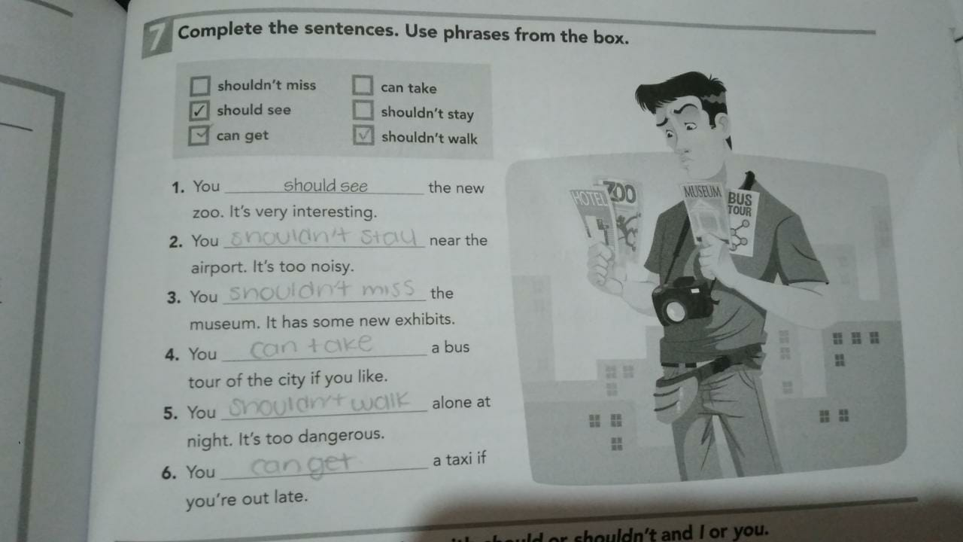
Grammar practice
Workbook pg 5 ex 7
Complete the sentences. Use the phrases from the box.

Slide 7
Grammar practice
Workbook pg 5 ex 8
Complete the conversation with should or shouldn´t and I or you.

Slide 8
Grammar practice
Workbook pg 6 ex 9
Ask questions about a place you want to visit. Use can, should or shouldn´t

