Slide 1
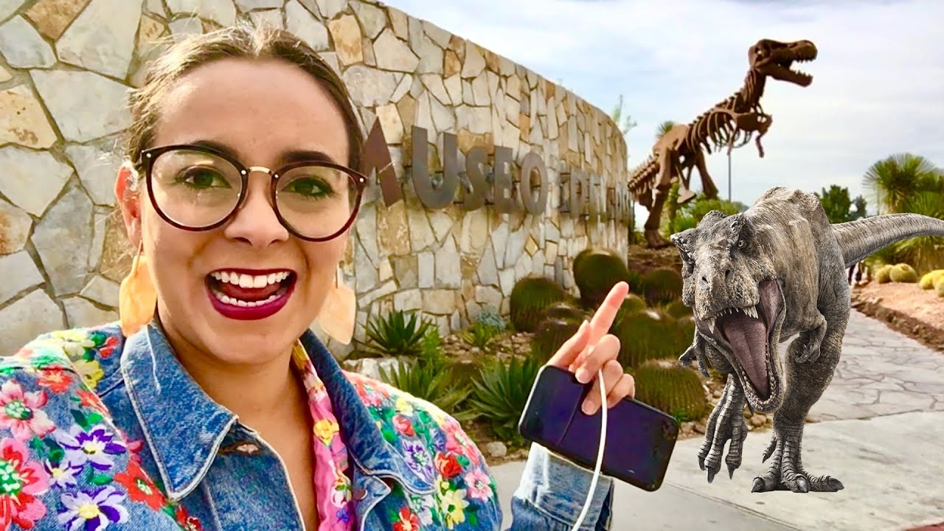
UNIT 1
Lesson 4
You should visit the desert museum.
LESSON OBJECTIVE:
Learn and practice the modal verbs can and should to give suggestions about sightseeing

Slide 2
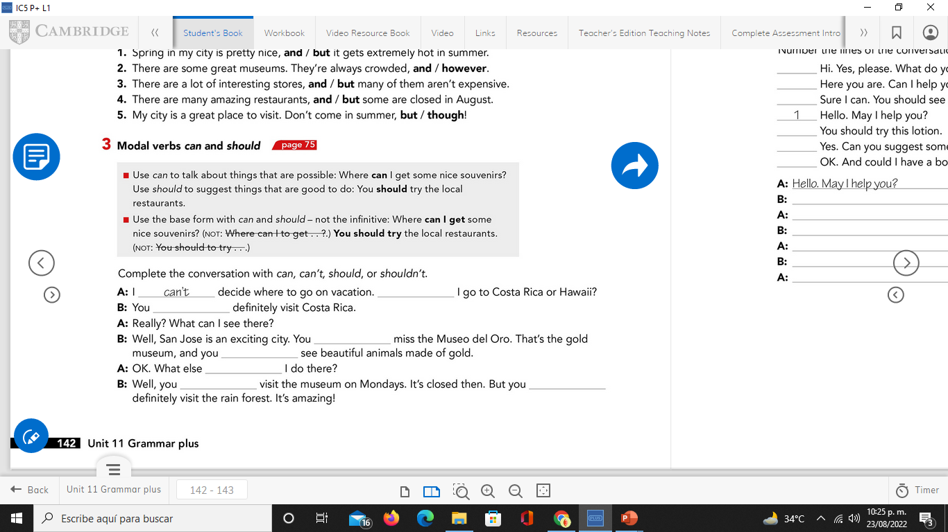
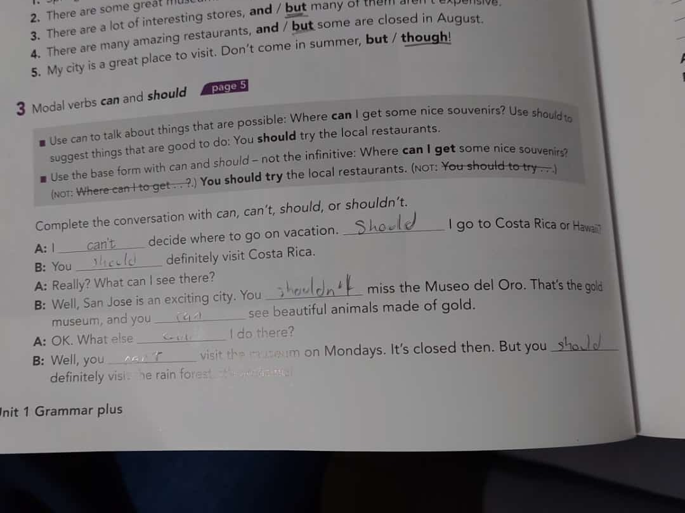
Grammar practice
Studentbook pg 82 ex 3

Slide 3
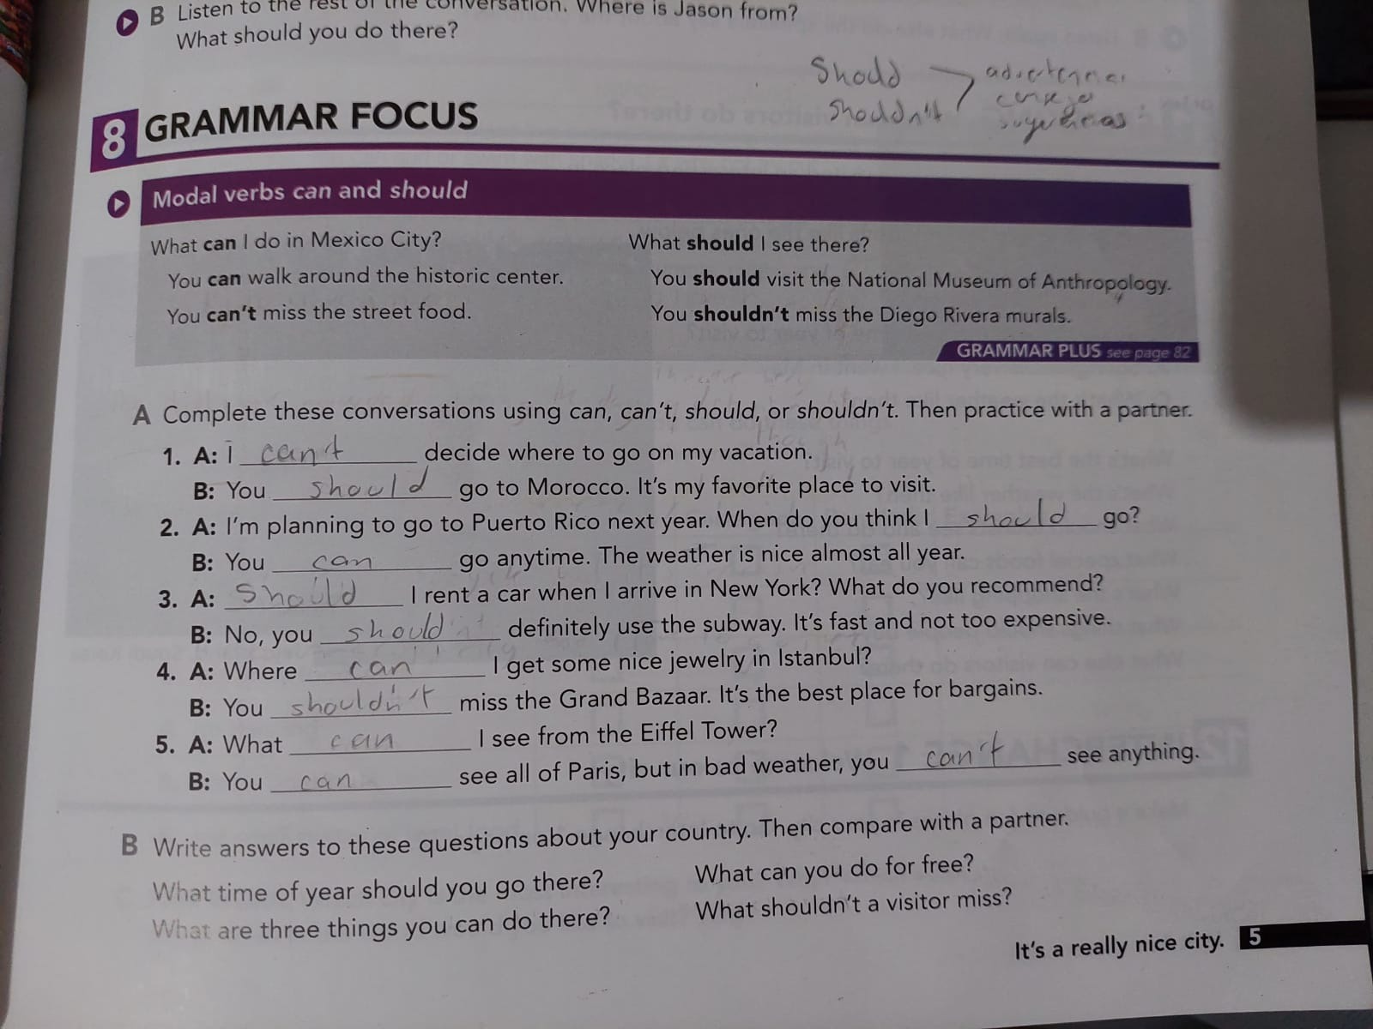
Grammar practice
Studentbook pg 5 ex 8

Slide 4
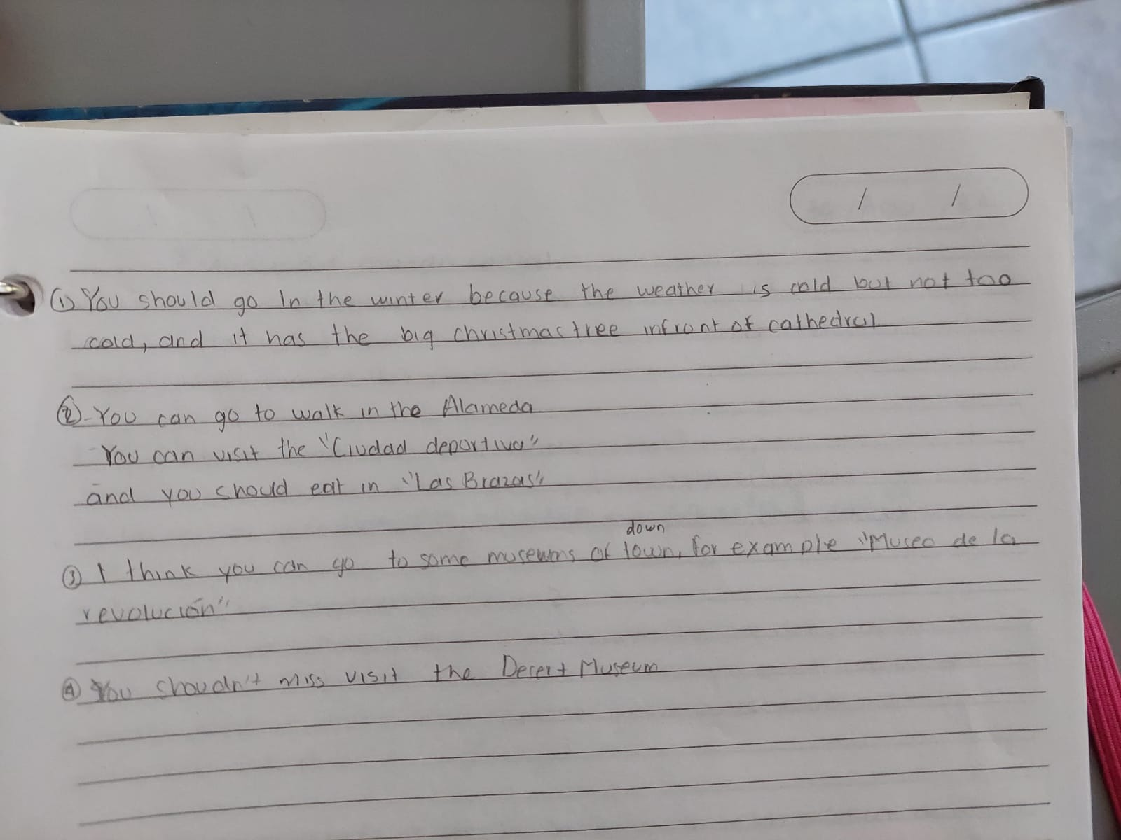
Grammar practice
Studentbook pg 5 ex 8

Slide 5

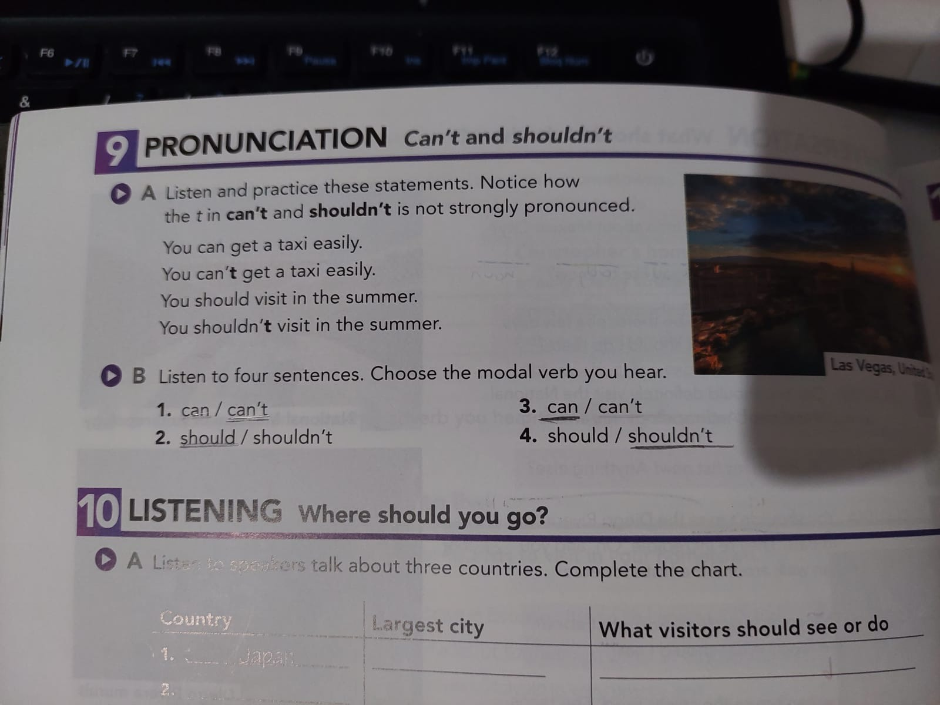
Grammar practice Where should you go?
Studentbook pg 6 ex 10
A.- Listen to speakers talk about three countries. Coplete the chart.

Slide 6
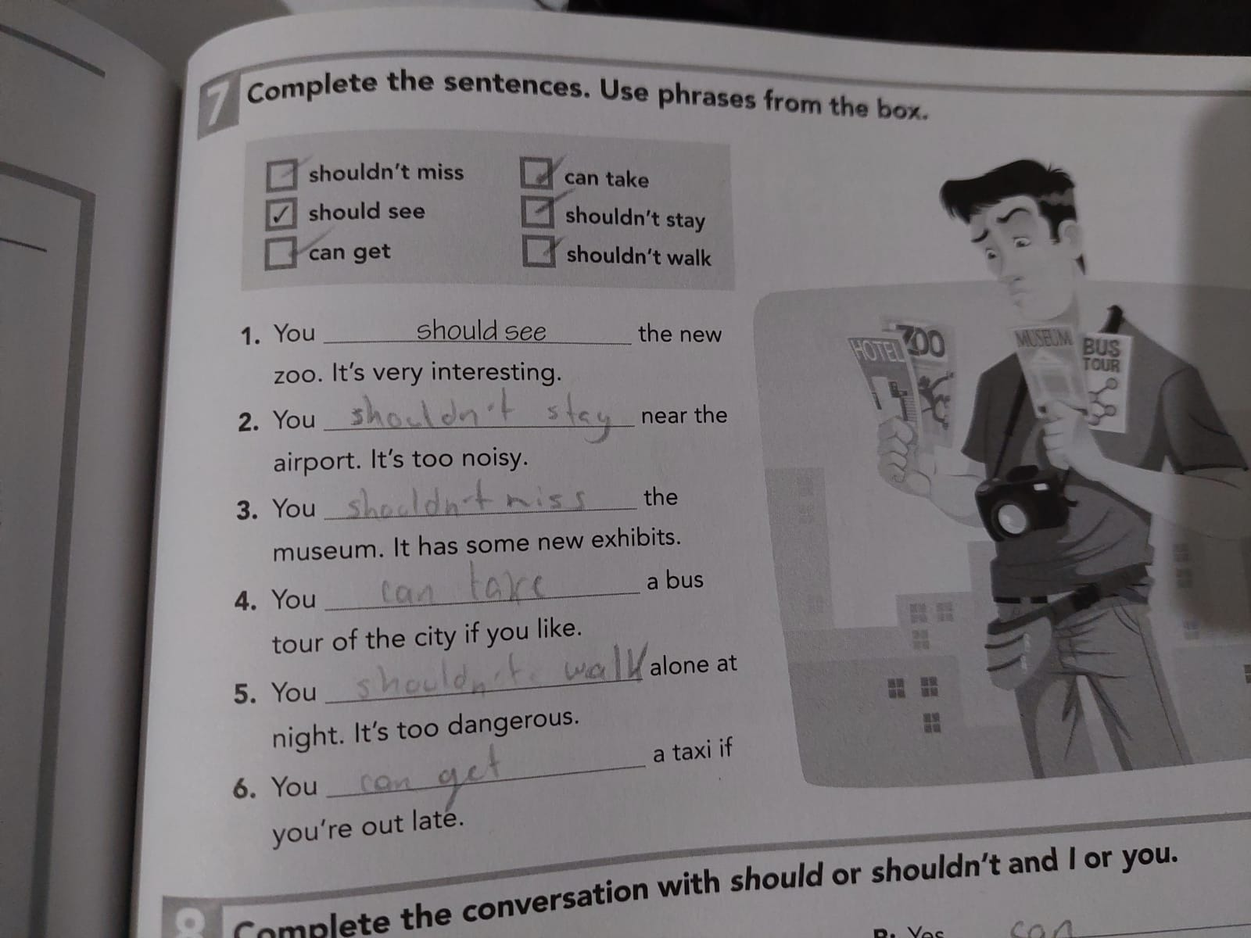
Grammar practice
Workbook pg 5 ex 7
Complete the sentences. Use the phrases from the box.

Slide 7
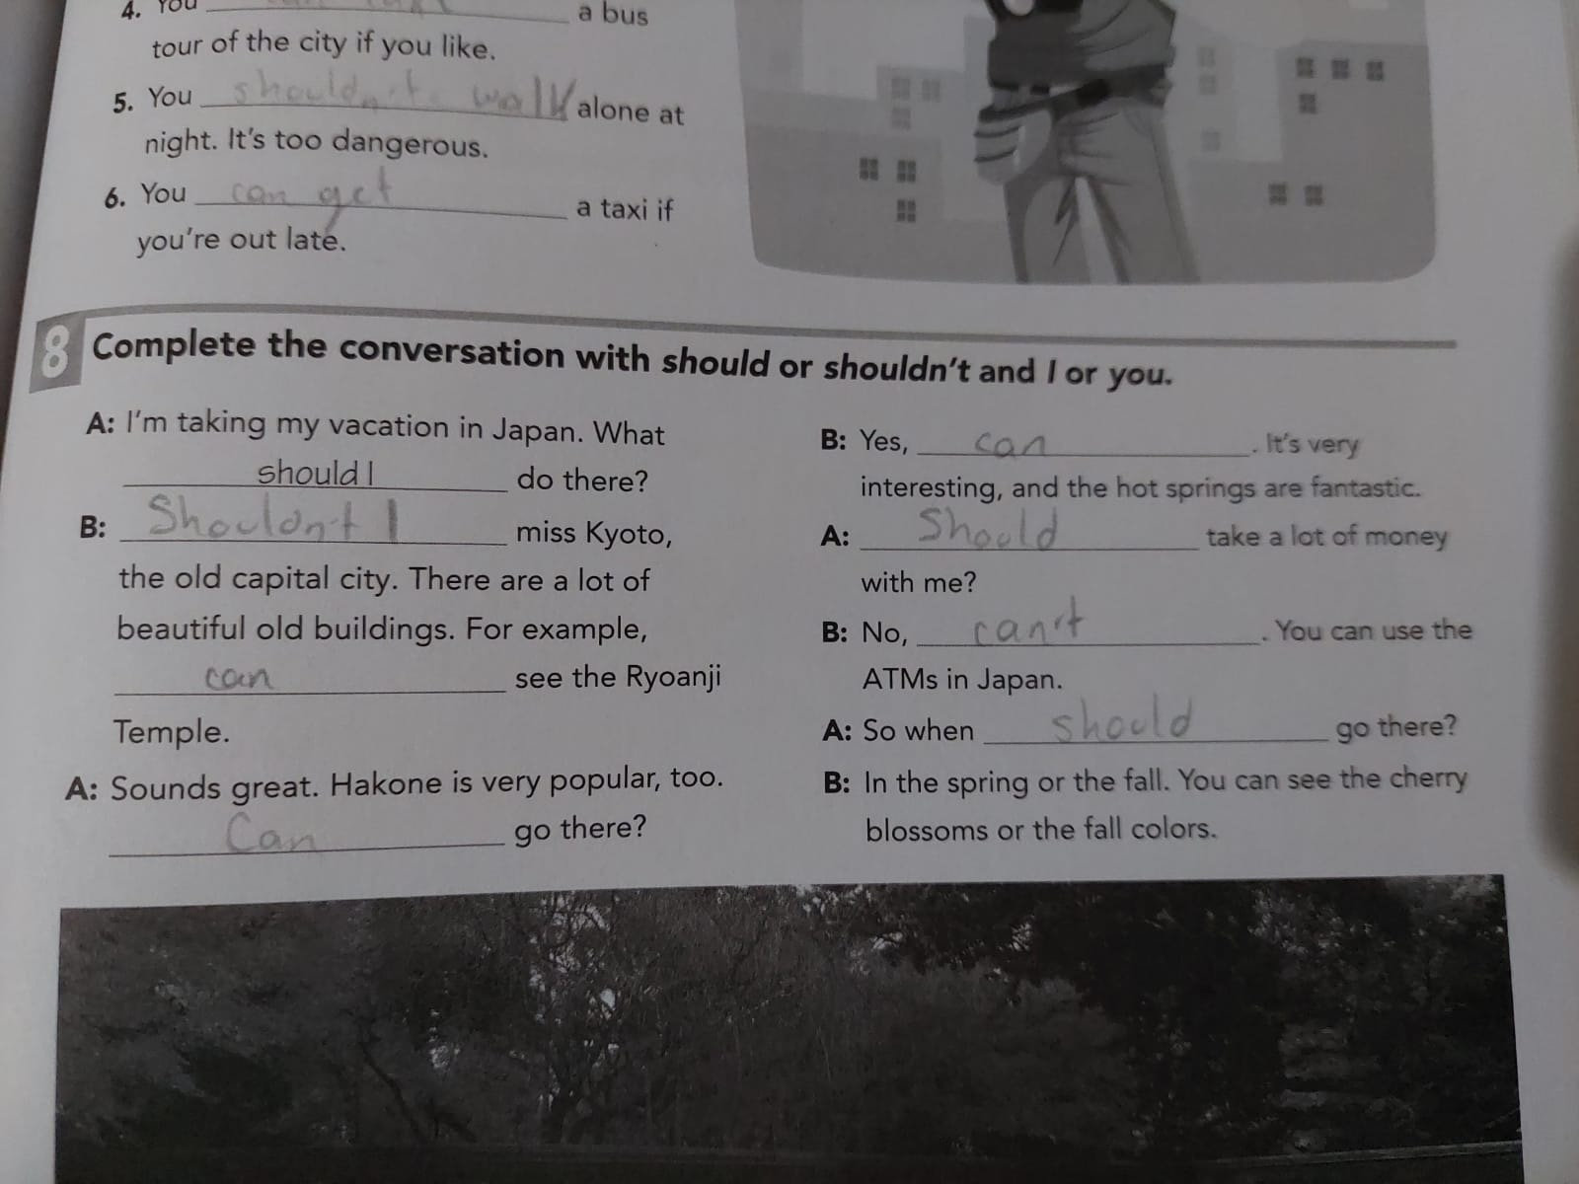
Grammar practice
Workbook pg 5 ex 8
Complete the conversation with should or shouldn´t and I or you.

Slide 8
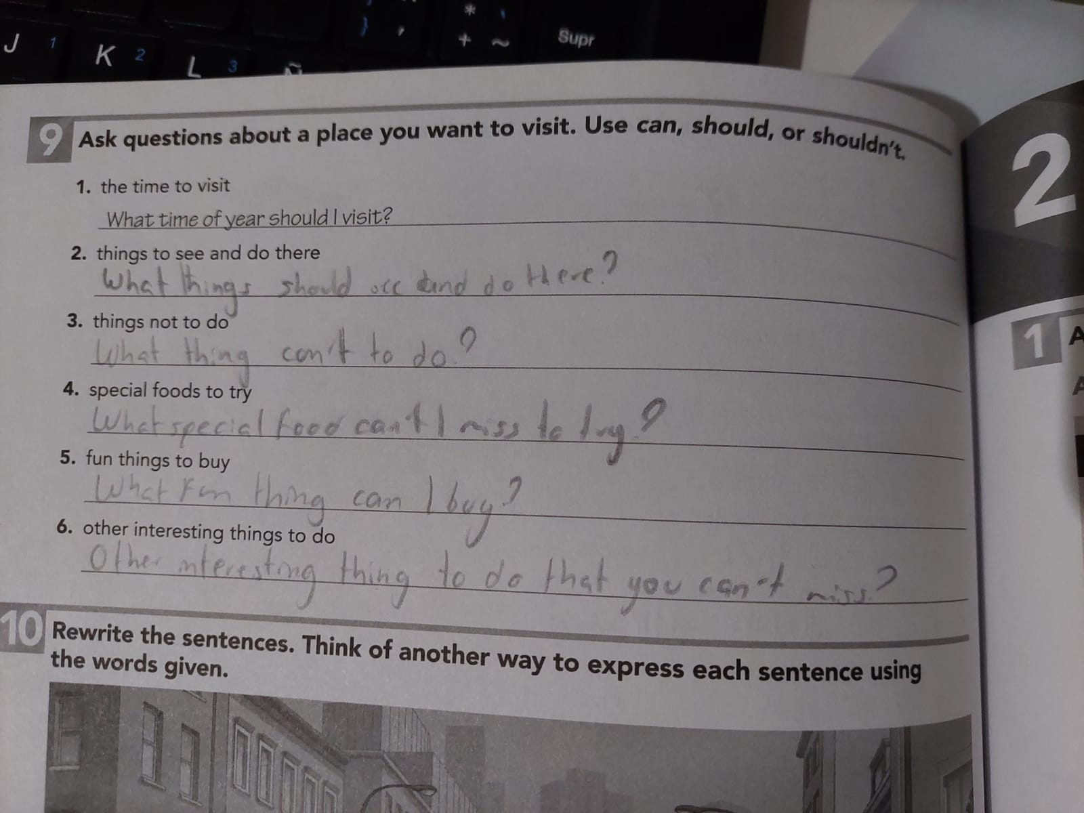
Grammar practice
Workbook pg 6 ex 9
Ask questions about a place you want to visit. Use can, should or shouldn´t

