Slide 1
Learning unit 1 project
THIS IS ME!

Slide 2
STEP 1 . PLAN
Get to know your classmates. Use these questions and write five more.
What’s your name?
What do people call you?
Where are you from?
What’s your last name?
How old are you?
What is your favorite food?
What is your favorite color?
What is your favorite subject?
When is your birthday?
What’s your family like?

Slide 3
STEP 2 . interview
Interview one of your classmates and write the answers to the questions.
Her name is Aneyra
The people call her Ane
She is from Mexico
Her last name is Echeverria
She is 19 years old
Her favorite food is enchiladas
Her favorite color is green
Her favorite subject is English
Her birthday is in March 1st
Her family is big

Slide 4
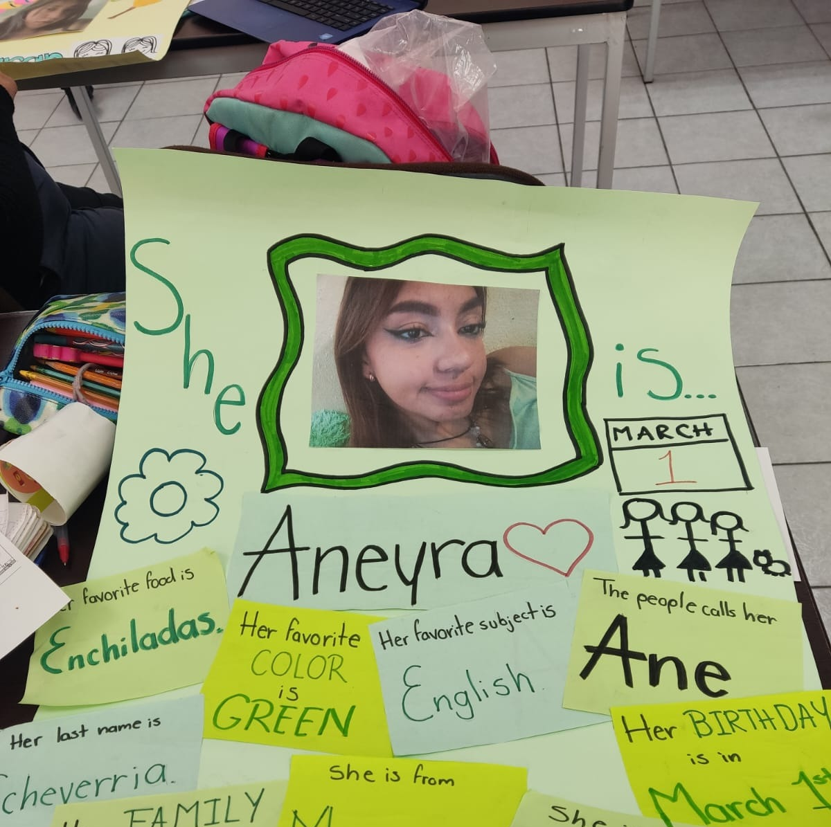
Step 3. poster
Make a poster with your classmate’s information.
Use magazines, pictures, and your own words to describe your partner.
PASTE A PICTURE OF YOUR POSTER HERE!

Slide 5

Step 4. presentation
Introduce your partner to the class.
Show your poster.

Slide 6
rubric

Slide 7

LEARNING UNIT 1 TEST
MONDAY, SEPTEMBER 26TH, 2022

