Slide 1
Learning unit 1 project
THIS IS ME!

Slide 2
STEP 1 . PLAN
Get to know your classmates. Use these questions and write five more.
What’s your name?
What’s your last name?
How old are you?
Where are you from?
When is your birthday?
How many children do you have?
What is your phone number?
What is your favorite color?
What is your favorite hobby?
What is your favorite Singer?

Slide 3
STEP 2 . interview
Interview one of your classmates and write the answers to the questions.
Her name is Liliana
Her last name is Esquivel
She is 32 years old
She is from Saltillo
Her birthday is october 5
She has 3 sons
Her number is 8444440974
Her favorite color is purple, pink and yellow
Her favorite hobby is watching k-dramas
Her favorite Singer is Taeyung Kim

Slide 4
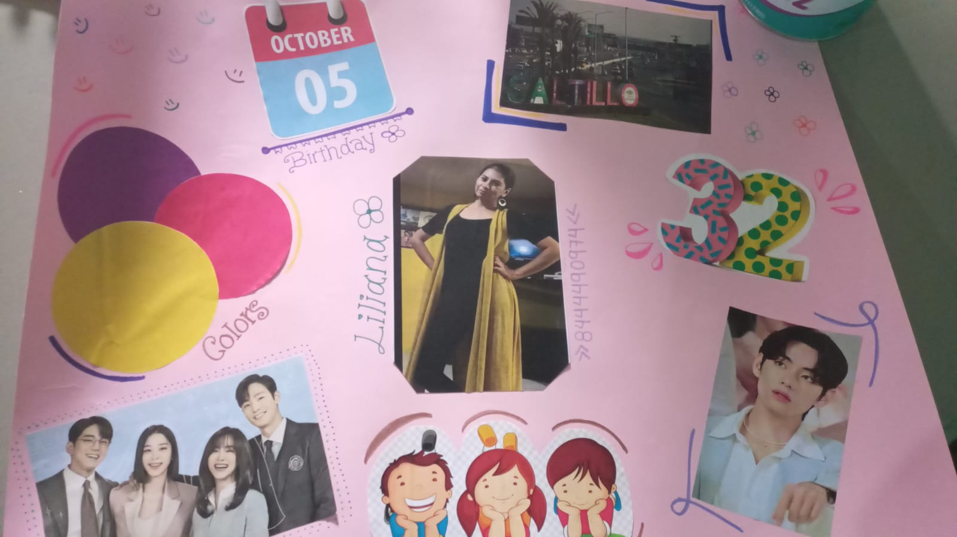
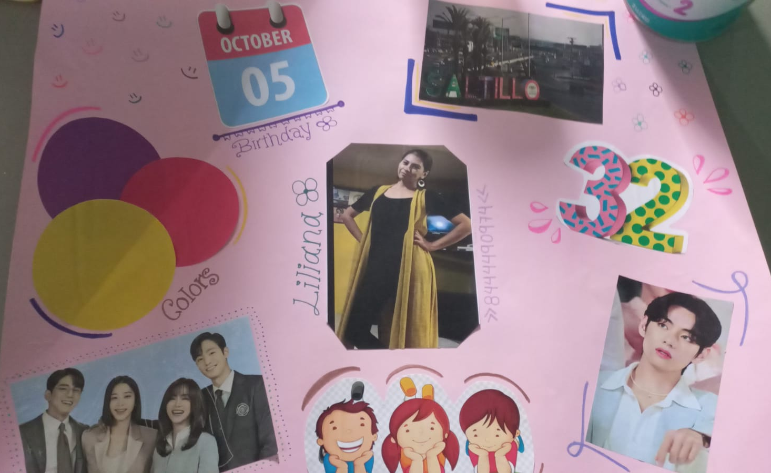
Step 3. poster
Make a poster with your classmate’s information.

Slide 5

Step 4. presentation
Introduce your partner to the class.
Show your poster.

Slide 6
rubric

Slide 7

LEARNING UNIT 1 TEST
MONDAY, SEPTEMBER 26TH, 2022

