Slide 1
Learning unit 1 project
ESCUELA NORMAL DE EDUCACIÓN PREESCOLAR
LICENCIATURA EN EDUCACIÓN PREESCOLAR
THIS IS ME!
Student:
Karen Alondra Hernández Rodríguez
Teacher: Cristina Aracely Alvarado Chavarría

Slide 2
STEP 1 . PLAN
Get to know your classmates. Use these questions and write five more.
What’s your name?
What do people call you?
Where are you from?
What’s your last name?
How do you spell it?
Who is your Best Friend?
How old are you?
What is your favorite color?
What is your favorite subject?
How many pets do you have?

Slide 3
STEP 2 . interview
Interview one of your classmates and write the answers to the questions.
Her name is Vianney Hdz.
She likes to be calles Vianney
She is from Saltillo
Her Last name is Hernández
H-E-R-N-A-N-D-E-Z
Her best friend is Fátima
She is 23 Years Old
Her Favorite color is Orange
Her Favorite subject is History
She has two pets. (Cat and dog)

Slide 4
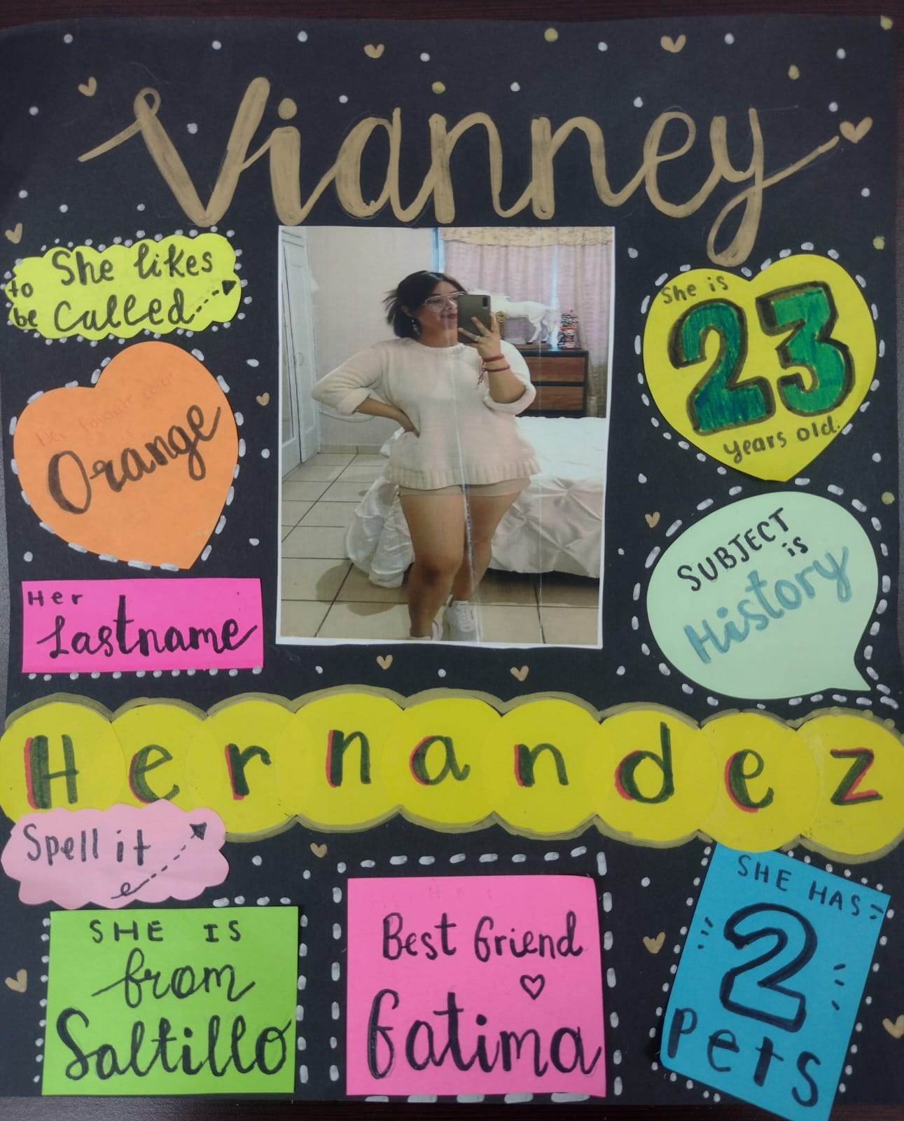
Step 3. poster

Slide 5

Step 4. presentation
Introduce your partner to the class.
Show your poster.

Slide 6
rubric

