Slide 1
Learning unit 1 project
THIS IS ME!
Aylin Yadhira Almaguer Jordán#1

Slide 2
STEP 1 . PLAN
Get to know your classmates. Use these questions and write five more.
What’s your name? Her name is Marisol
What do people call you? Her Friends calls her mar and sol.
Where are you from? She is from Saltillo
What’s your last name? Her last name is perez
How do you spell it? P-E-R-E-Z
Where do you work? She Works in MC Donal´s
what is your favorie color? Her favorie color is red and green
what is your favorie series?Her favorite series Grey´s anaomy
when is your birthay? Her birhay is 3 october
how many brothers and sisers do you have? She has one sister.

Slide 3
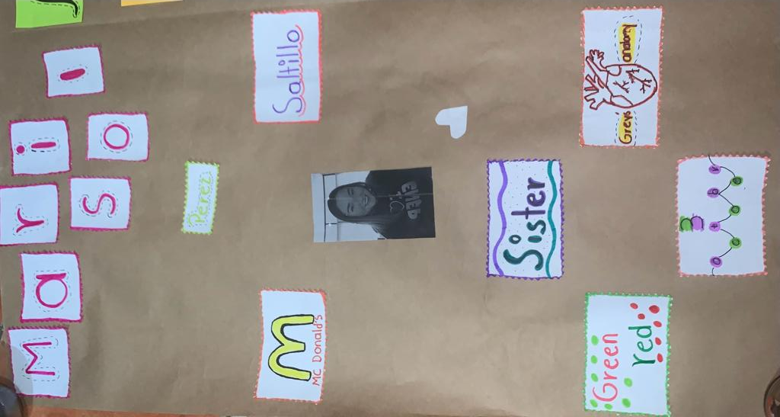

Slide 4
rubric

Slide 5

LEARNING UNIT 1 TEST
MONDAY, SEPTEMBER 26TH, 2022

