Slide 1
Learning unit 1 project
THIS IS ME!
Karla sarai Marines Vaquez

Slide 2
STEP 1 . PLAN
Get to know your classmates. Use these questions and write five more.
What’s your name?
What do people call you?
Where are you from?
What’s your last name?
How do you spell it?
How ald are you?
Who is your best friend
What is your favorite Singer?
What is your favorite color ?
What is your favorite subjet?

Slide 3
STEP 2 . interview
Interview one of your classmates and write the answers to the questions.
Sahory
sao
Monterrey
Gil
G-I-L
20
Debany and Keren
BTS
Blue
Probability

Slide 4
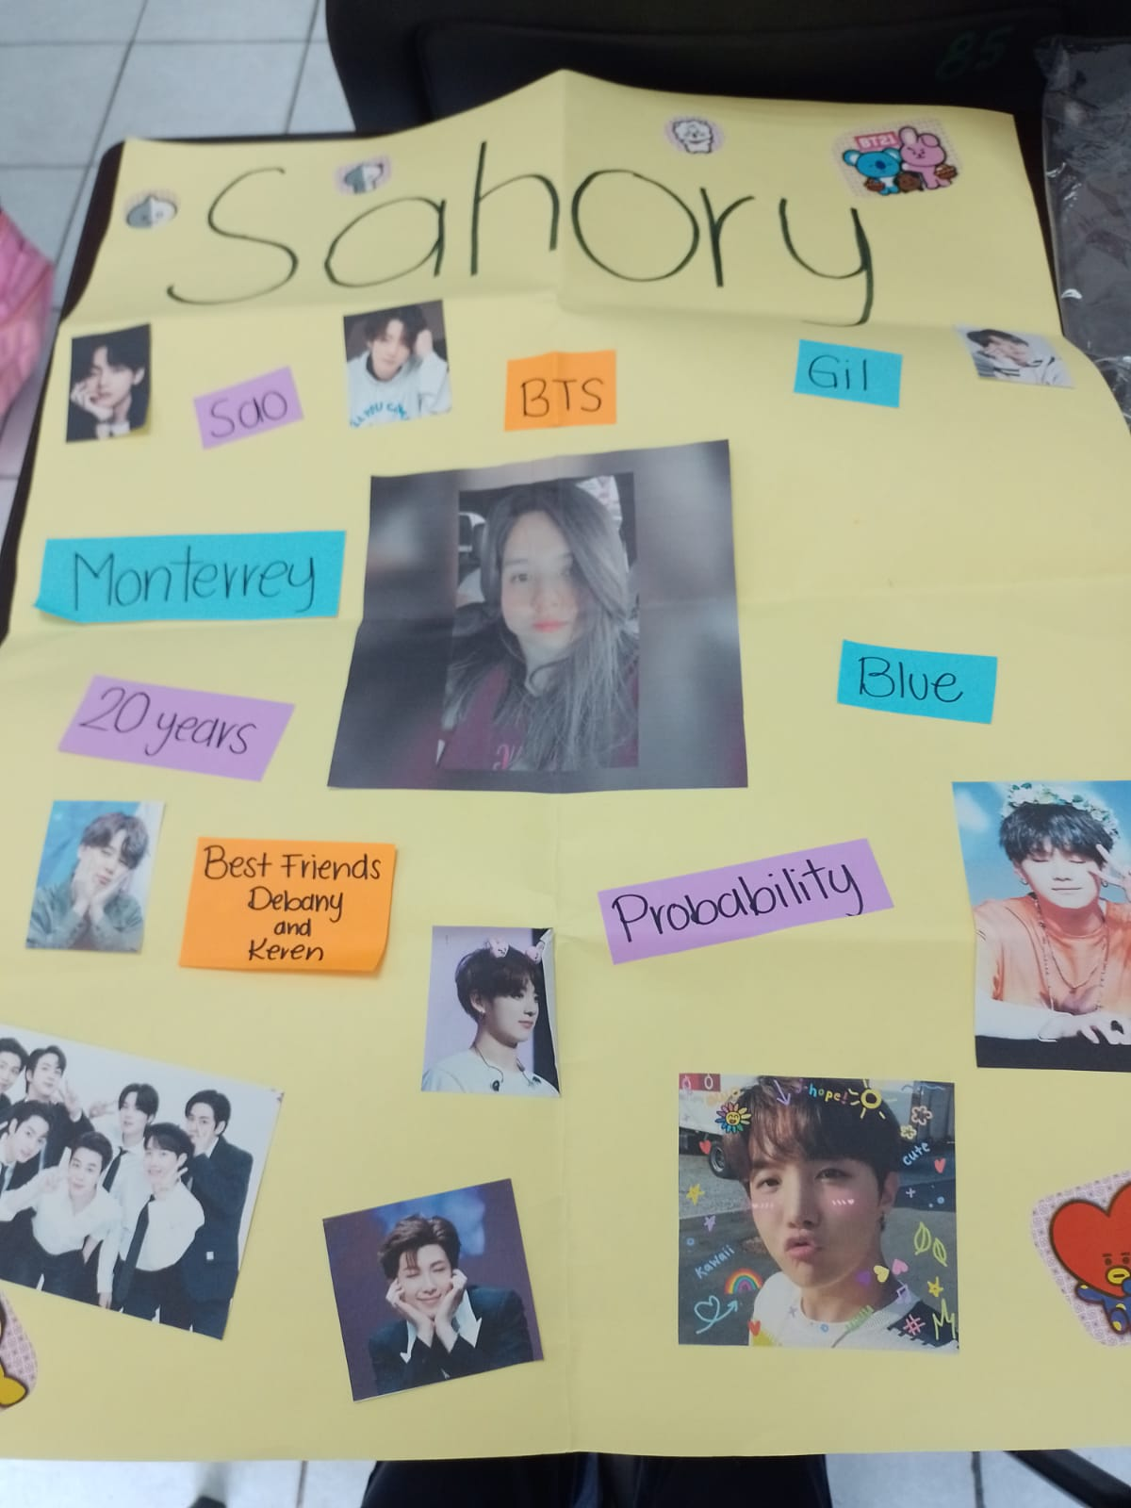
Step 3. poster
Make a poster with your classmate’s information.
Use magazines, pictures, and your own words to describe your partner.
PASTE A PICTURE OF YOUR POSTER HERE!

Slide 5

Step 4. presentation
Introduce your partner to the class.
Show your poster.

Slide 6
rubric

Slide 7

LEARNING UNIT 1 TEST
MONDAY, SEPTEMBER 26TH, 2022

