Slide 1
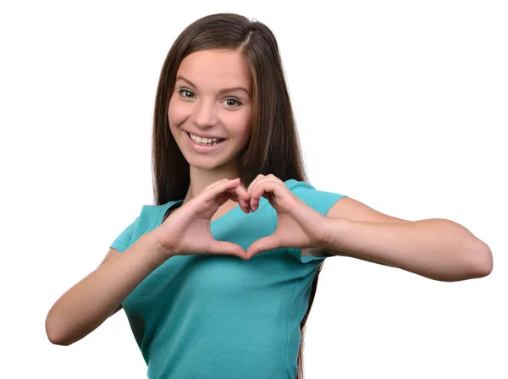
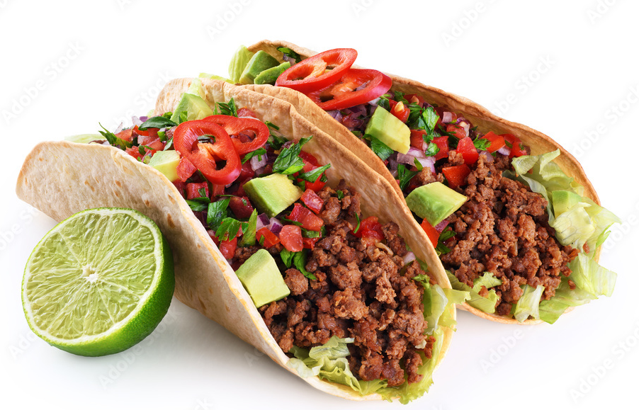
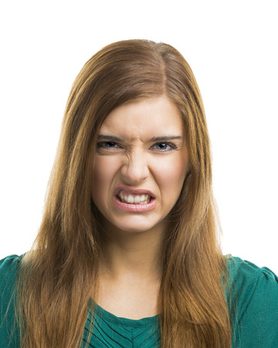
UNIT 3
Lesson 3
I love
Really? I don´t !
LESSON OBJECTIVE:
Learn and practice expressions to disagree.

Slide 2
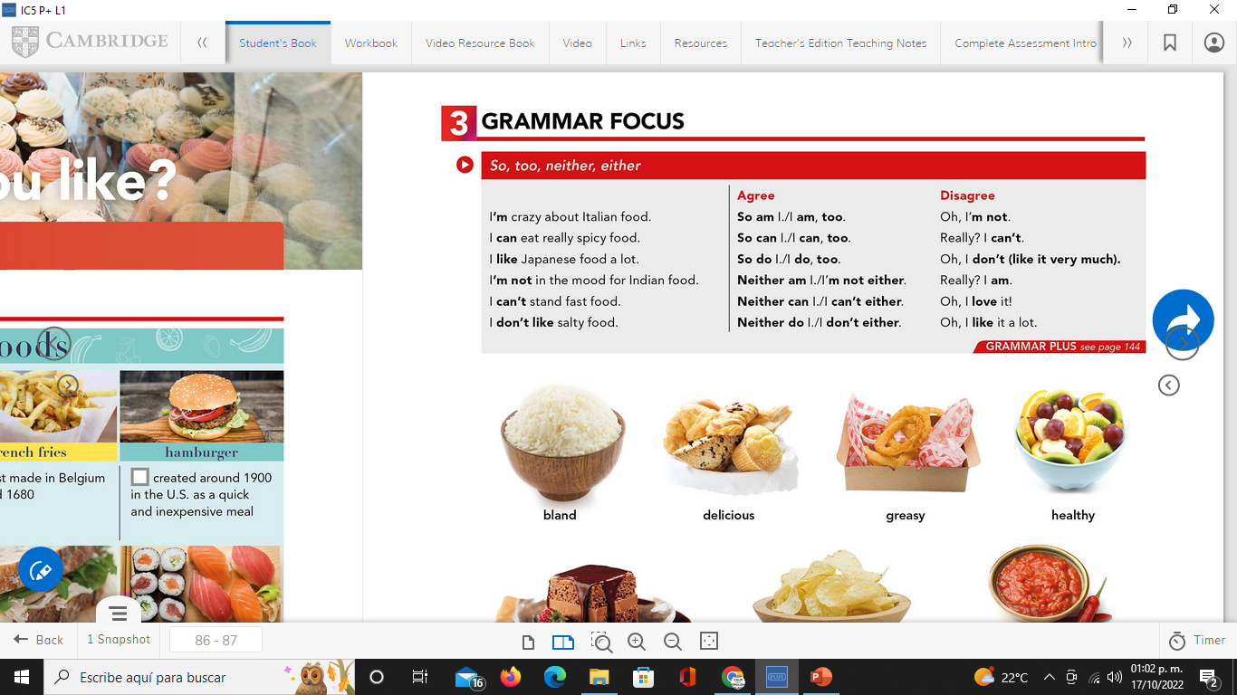
GRAMMAR FOCUS “To disagree” studentbook pg 17
We use expressions as oh, or really?. To introduce our opinion, that may differ from the other person.
Disagree

Slide 3

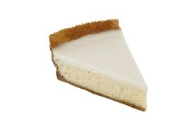
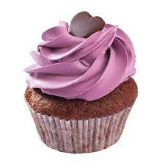
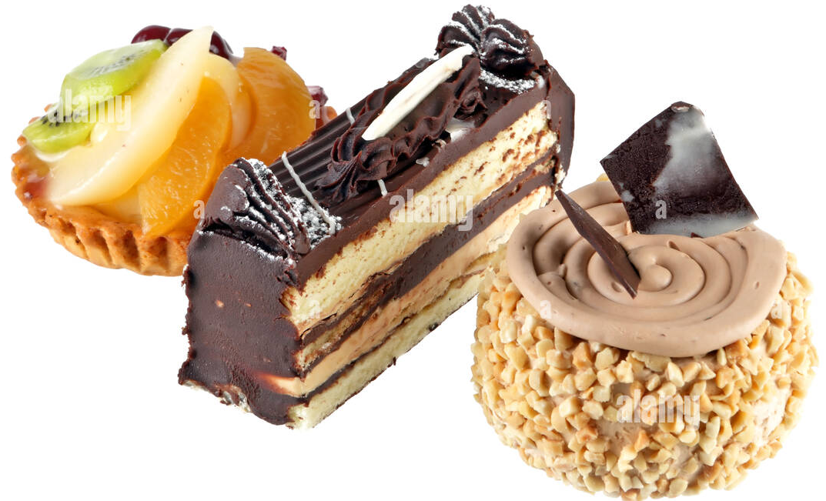
GRAMMAR FOCUS “To disagree”
GRAMMAR FOCUS “To disagree”
We use expressions as oh, or really?. To introduce our opinion, that may differ from the other person.
I´m crazy about…
Really? I´m not

Slide 4

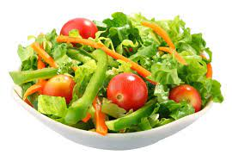

GRAMMAR FOCUS “To disagree”
GRAMMAR FOCUS “To disagree”
We use expressions as oh, or really?. To introduce our opinion, that may differ from the other person.
I love
Oh, I don´t like it very much!

Slide 5
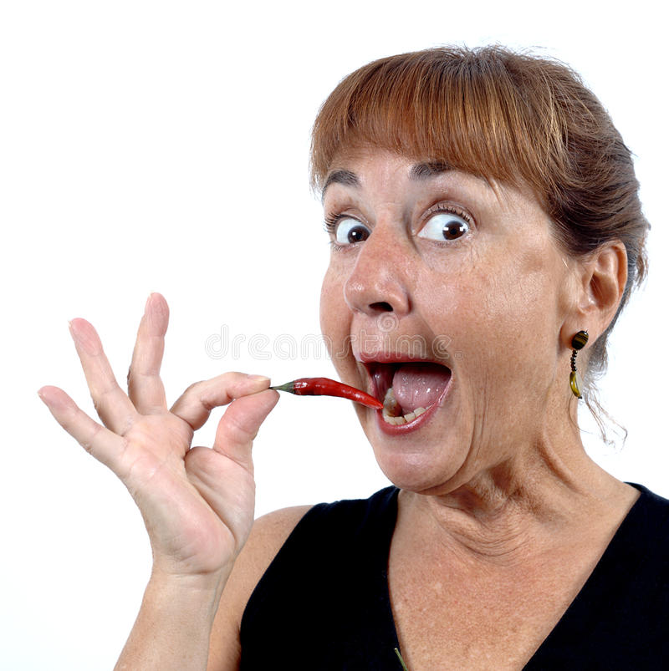
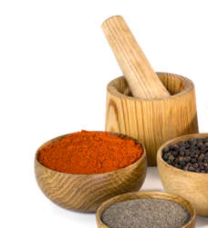
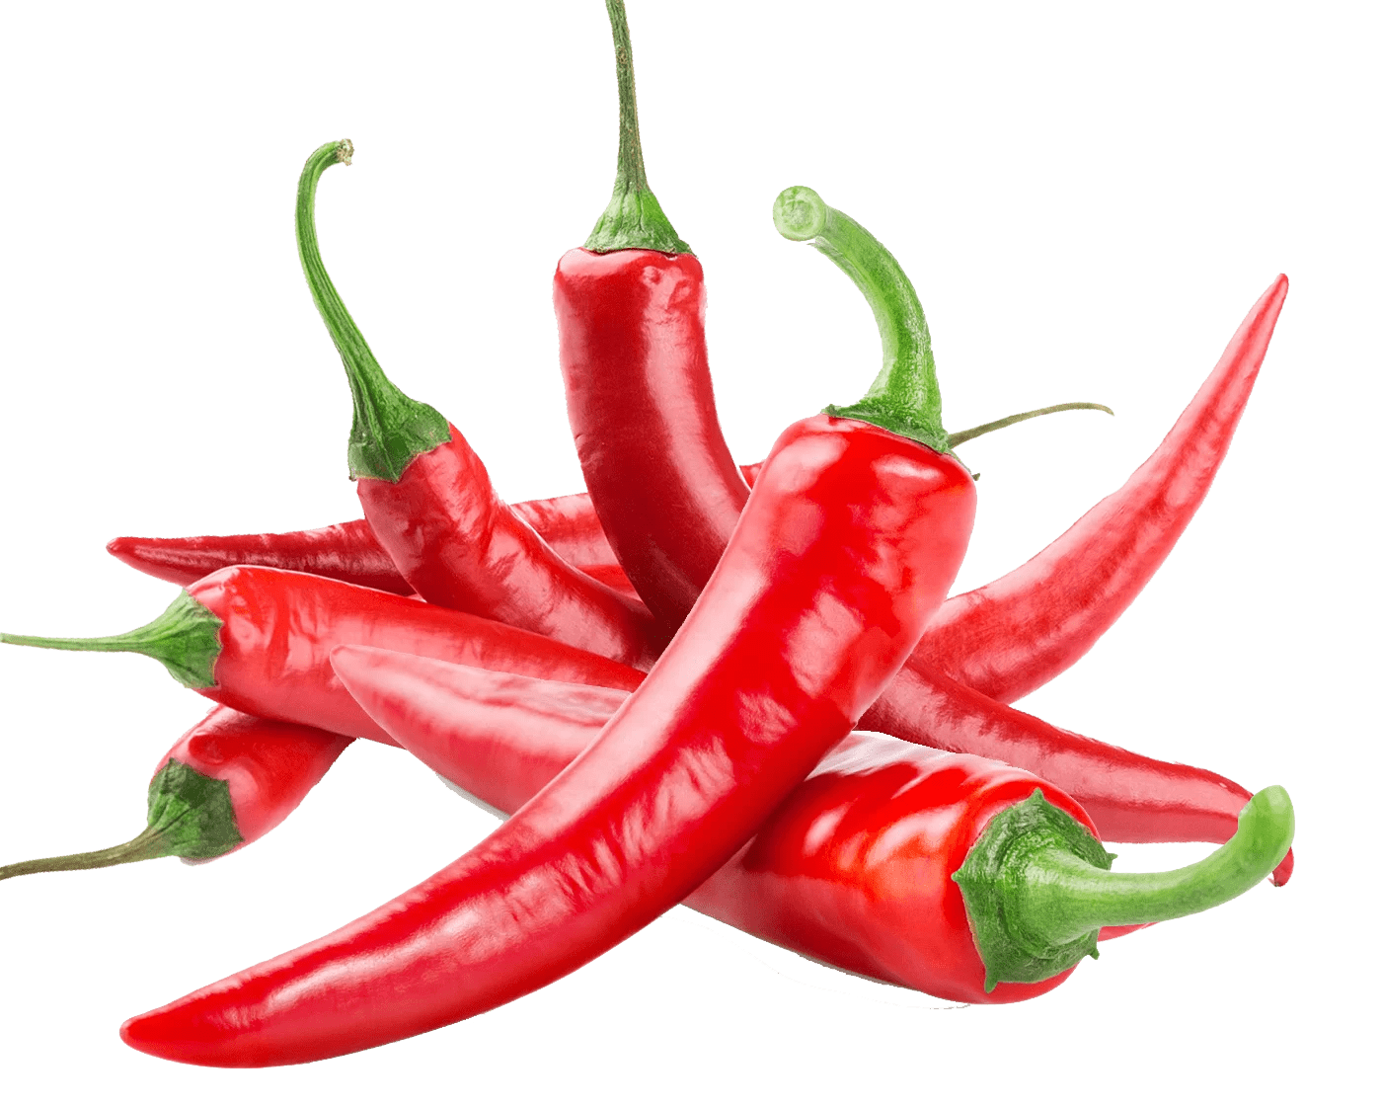

GRAMMAR FOCUS “To disagree”
GRAMMAR FOCUS “To disagree”
We use expressions as oh, or really?. To introduce our opinion, that may differ from the other person.
I can eat spicy ……food !
Really? I can´t eat spicy food at all.

Slide 6
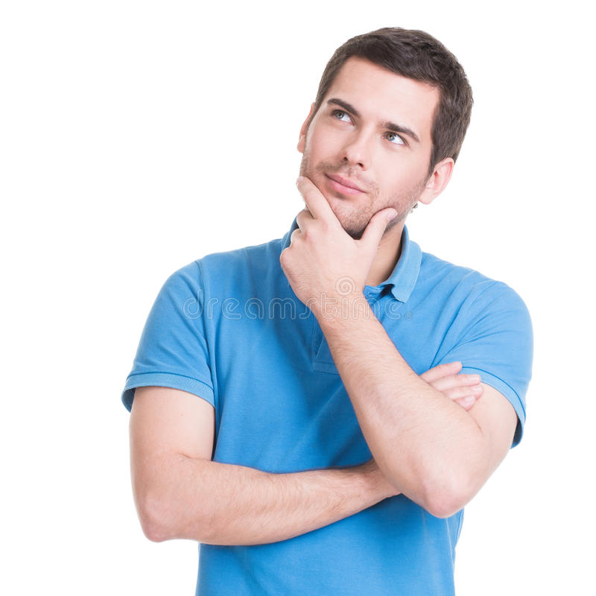
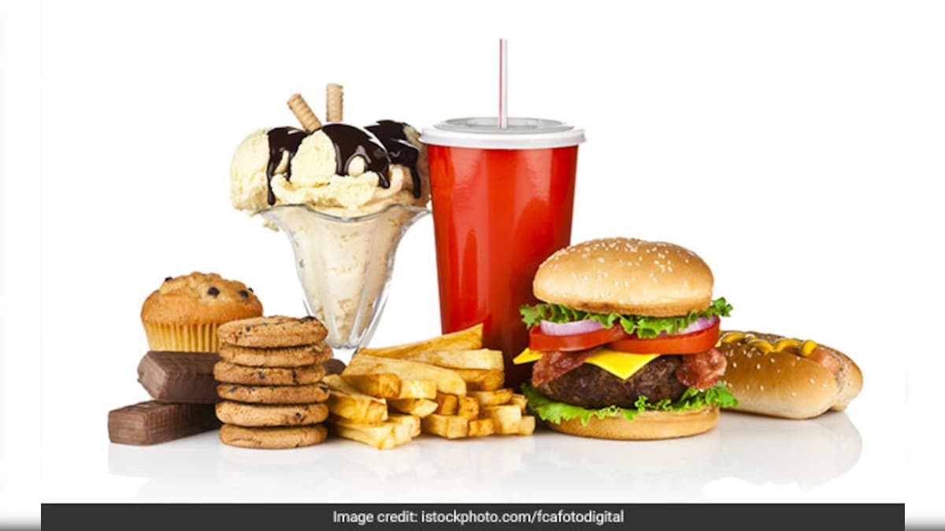
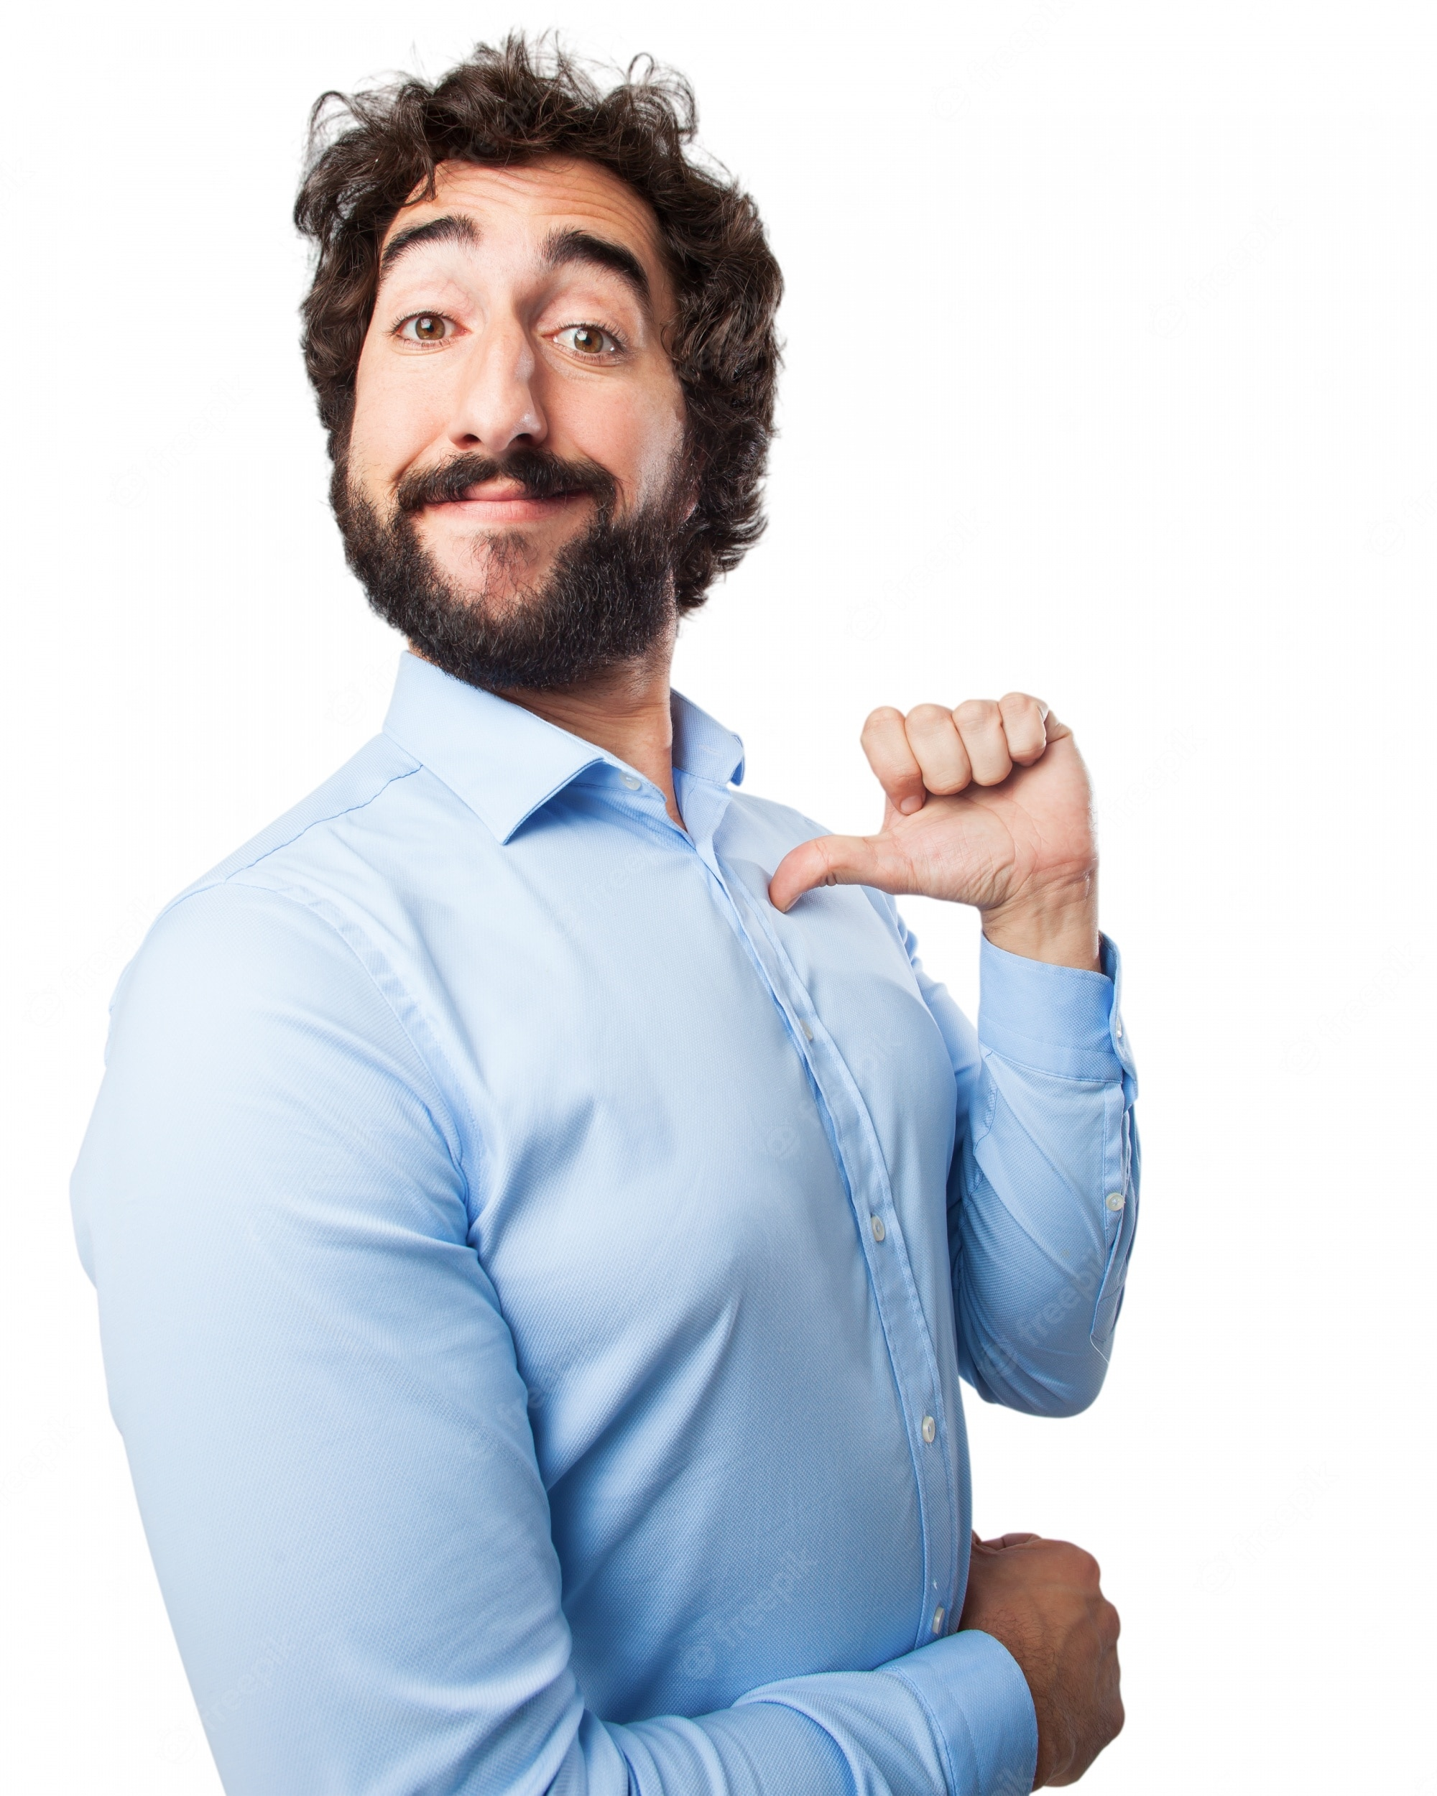
GRAMMAR FOCUS “To disagree”
GRAMMAR FOCUS “To disagree”
We use expressions as oh, or really?. To introduce our opinion, that may differ from the other person.
I´m not
in the mood of
Well, I am

Slide 7

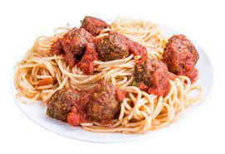
GRAMMAR FOCUS “To disagree”
GRAMMAR FOCUS “To disagree”
We use expressions as oh, or really?. To introduce our opinion, that may differ from the other person.
I don´t like italian food!
Really? I love it!

Slide 8
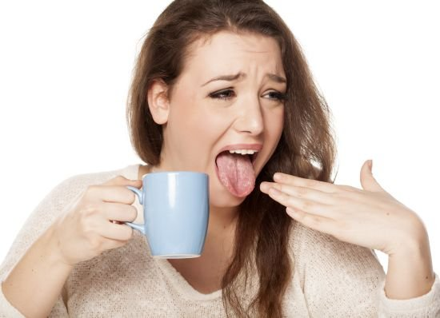
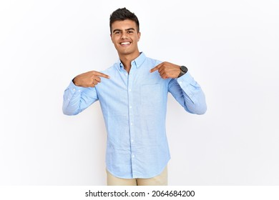
GRAMMAR FOCUS “To disagree”
GRAMMAR FOCUS “To disagree”
We use expressions as oh, or really?. To introduce our opinion, that may differ from the other person.
I can´t drink hot things
Well, I do!

Slide 9
Writing/Speaking Practice
Write statements, give a different opinión showing disagree to the following statements.
I´m on a diet.
I´m a very serious person.
I love onions.
I´m in the mood of octopus coctail.
I can´t eat meat.
I hate hamburguers.
I can play the guitar
Really? I’m not
Oh, I’m not
Well, I hate onions
Actually I am
Really? I love it
Oh, I’m crazy about hamburguers
Well, I can

Slide 10
Writing/Speaking Practice
Write statements, give a different opinión showing disagree to the following statements.
I´m not in the mood of tacos.
I´m keeon on homemade pizza!
I love garlic.
I like shrimp coctail.
I can´t stand chocolate cake.
I hate ice cream.
I can speak english very well.
Actually I am
Oh, I’m not
I hate it
Really? I don’t like shrimp coctail
Well, I love chocolate cake
Really? I love it
Well, I can’t

Slide 11

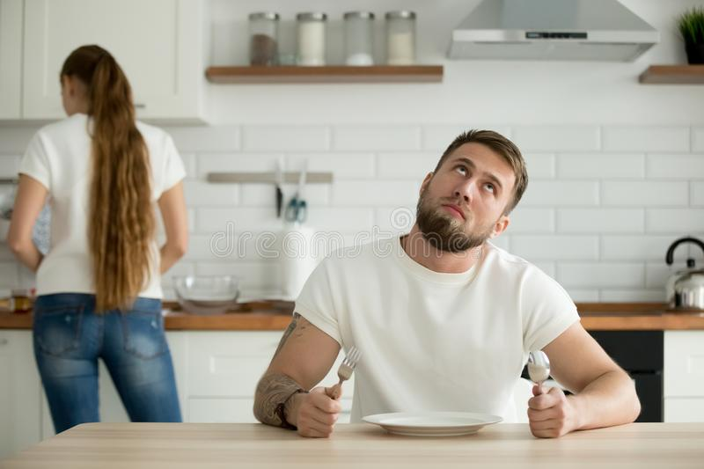
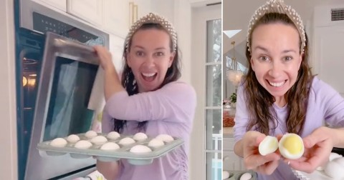
Listening/Speaking Practice
Workbook pg 18
Listen the following conversation. Fill in the blanks with the missing words.
Then take turns and role-play.
Maria: I feel tired tonight. I ______________to cook.
Courtney: ___________Let´s order out. _________Chinese food?
Maria: It´s Delicious! ____________!
Courtney: __________. It´s my favorite. Let´s call Beijing Express for home delivery.
Maria: _______________! Their food is always Good. I eat there a lot.
Courtney: _____________. Well what would you like tonight?
Maria: ______________for some soup.
Courtney: _____________I. And I think I will have orange chiken and fried rice.
Maria:Ok, Let´s order. Oh, wait. They ________credit cards, and I don´t have any __________.
Courtney: Neither________ I. Too bad! What _________ we do?
Maria: Well, let´s look in the refrigerator. Hmm. ___________boiled eggs?
Courtney: I __________ !
Maria: Actually, _____________ I.
really don’t want
Neither do I
Do You like
I love it
I do too
Great idea
So do I
I’m in the mood
So am I
Don’t take
cash on me
do
should
Do you like
can’t stand them
neither can

Slide 12

Listening Practice “I´m tired of shopping” studentbook pg 16
A. Listen and practice the following conversation. Fill in the blanks with the missing words.
Alan: Hey, ____________to get something to eat?
Kate: Sure. _____________of shopping.
Alan: ___________. What do you think of Thai food?
Kate: I _______, but I´m ___________________for it today.
Alan: Yeah. ____________, I guess. It´s a bit__________.
Kate: ____________Japanese food?
Alan: ________me! __________Japanese food.
Kate: ________. There´s a great restaurant on the first floor. It´s _________ Kyoto Garden.
Alan: Perfect! ____________it.
do you want
I’m tired
So am I
love it
not really in the mood
I’m not either
spicy
What about
Fine by
I love
So do I
Called
Let’s go try

Slide 13
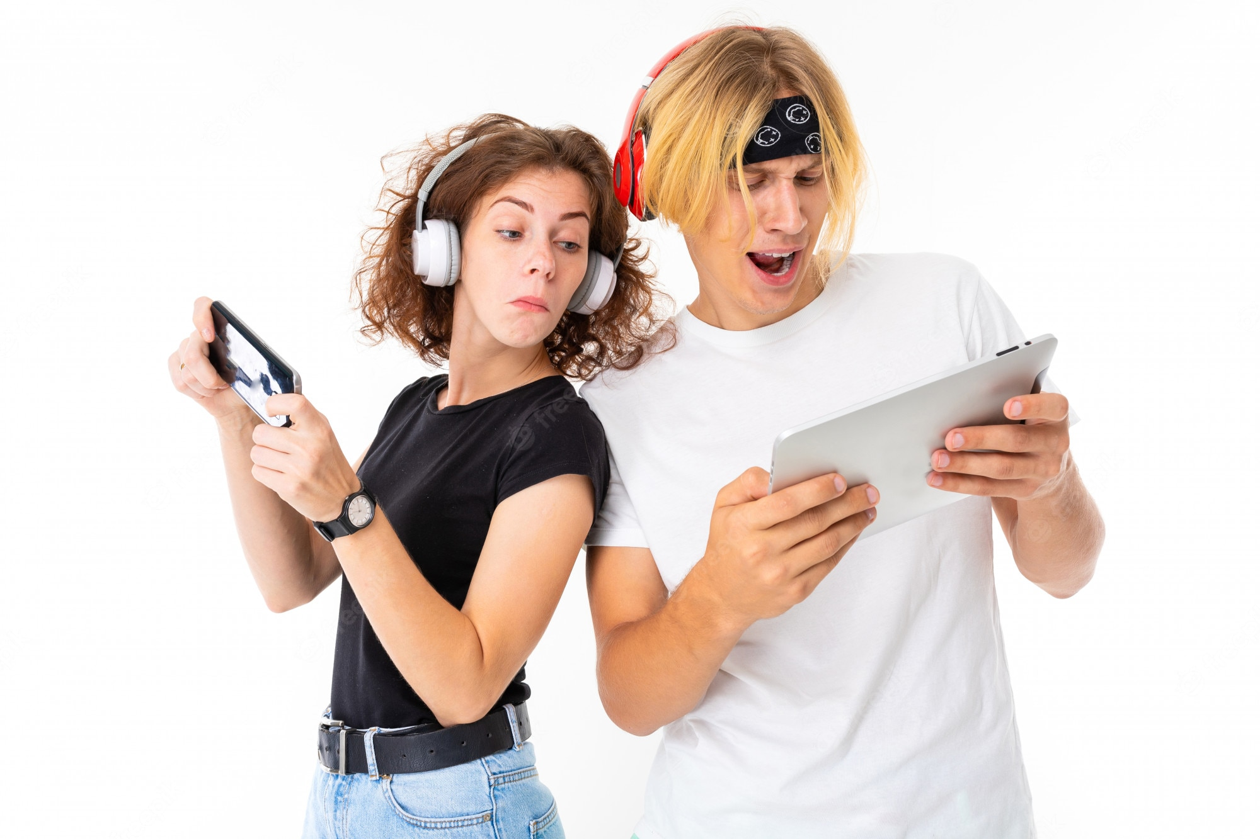
Speaking Practice
Put in order the dialogue, write the numbers from 1 to 7 Then in pairs roleplay the conversation.
5 | Really? Who´s your favorite singer?
 | Sugman Pokhrel. How about you? Do you like him?
7 | He´s OK. But I´m fond of Nima Rumba.
 | Do you like folk music Tina?
 | Well I love pop music a lot.
3 | Yes, I love it. Kumar Basnet is my favorite Singer. What kind of music do you like?
 | No, I don´t like it very much, Do you?
6
1
4
2

Slide 14

Speaking Practice
Unscramble the following statements. Paste them in the following conversation chart.
Cheescake is fine by me!. What about lasagna? I´m crazy about it!
You know what? I don´t like apples very much. I prefer cheescake pie instead.
Perfect! So, see you in a while!
Good Idea, I´ll bring the salad. I like The Cesar Salad!
Hello Chrys!. Would you like to come around tonight?
Actually, I´m sick of fast food, I prefer homemade food!
Well, I´m not keen on lasagna! But I´m fine with just the salad.
I do too! It´s my favorite! Then I´ll bake an apple pie!
Great! What about ordering something for dinner?

Slide 15
Speaking Practice
Put in order the dialogue, Then in pairs roleplay the conversation.
Hello Chrys!. Would you like to come around tonight?
Matt:
Chrys:
Matt:
Chrys:
Matt:
Chrys:
Matt:
Chrys:
Matt:
Chrys:
Matt:
Great! What about ordering something for dinner?
Actually, I´m sick of fast food, I prefer homemade food!
Good Idea, I´ll bring the salad. I like The Cesar Salad!
I do too! It´s my favorite! Then I´ll bake an apple pie!
You know what? I don´t like apples very much. I prefer cheescake pie instead.
Cheescake is fine by me!. What about lasagna? I´m crazy about it!
Well, I´m not keen on lasagna! But I´m fine with just the salad.
Perfect! So, see you in a while!

Slide 16
Writing/Speaking Practice
Write a short conversation, talk about your preferences in food. Use expressions to show like, dislikes, agreement and disagreement.
Dulce: Hey, would you like to eat something out?
Michel: Sure, what do You think about hamburguers?
Dulce: I love them, but I'm not in the mood of hamburguers.
Michel: Really? I am. What about pasta? I'm crazy about pasta.
Dulce: So am I. I will get an ice cream, I like vainilla flavor, what about You?
Michel: Oh, I don't like it. I prefer Apple pie
Dulce: Ok, we can try both.
Michel: Fine by me. I love it.
Dulce: So do I.
Michel: Perfect. Let's go.

