Slide 1
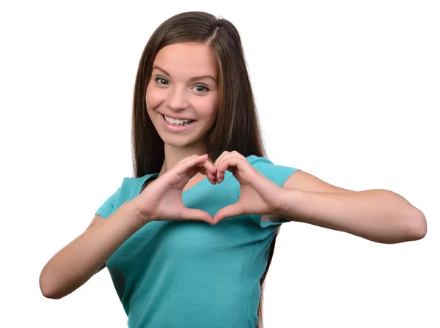
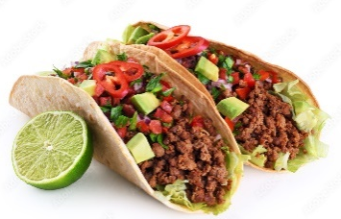
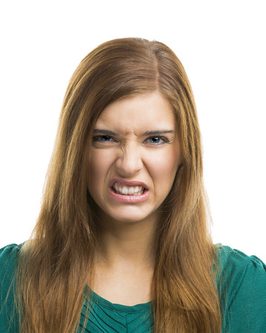
UNIT 3
Lesson 3
I love
Really? I don´t !
LESSON OBJECTIVE:
Learn and practice expressions to disagree.

Slide 2
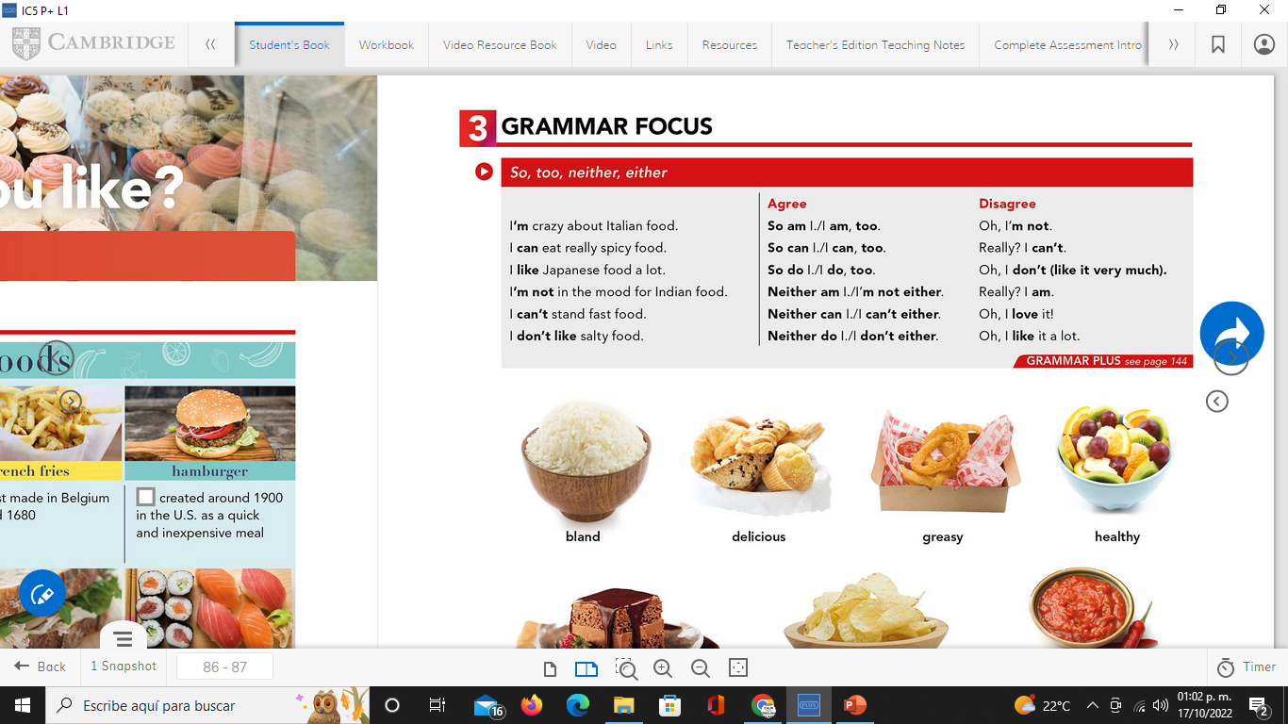
GRAMMAR FOCUS “To disagree” studentbook pg 17
We use expressions as oh, or really?. To introduce our opinion, that may differ from the other person.
Disagree

Slide 3

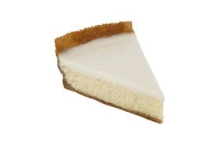
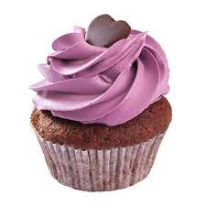
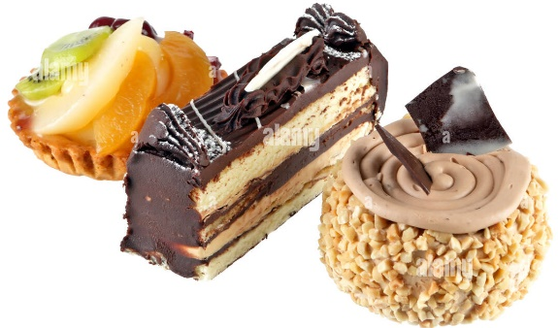
GRAMMAR FOCUS “To disagree”
GRAMMAR FOCUS “To disagree”
We use expressions as oh, or really?. To introduce our opinion, that may differ from the other person.
I´m crazy about…
Really? I´m not

Slide 4

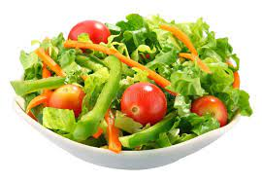

GRAMMAR FOCUS “To disagree”
GRAMMAR FOCUS “To disagree”
We use expressions as oh, or really?. To introduce our opinion, that may differ from the other person.
I love
Oh, I don´t like it very much!

Slide 5
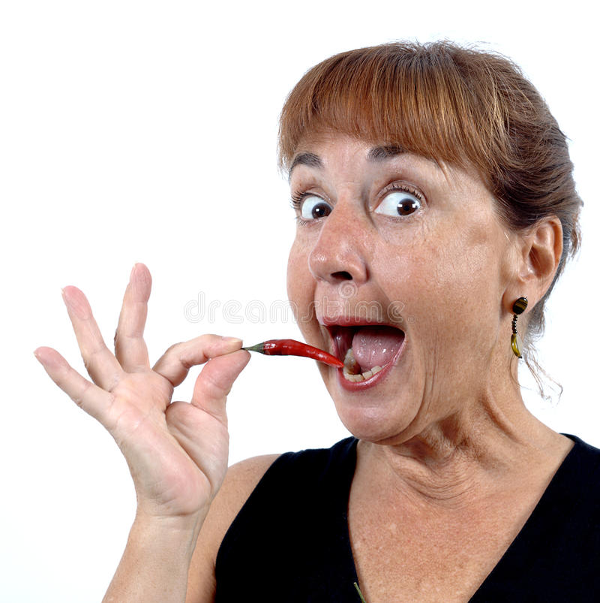
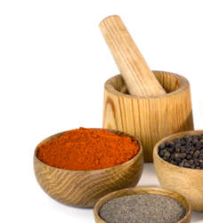
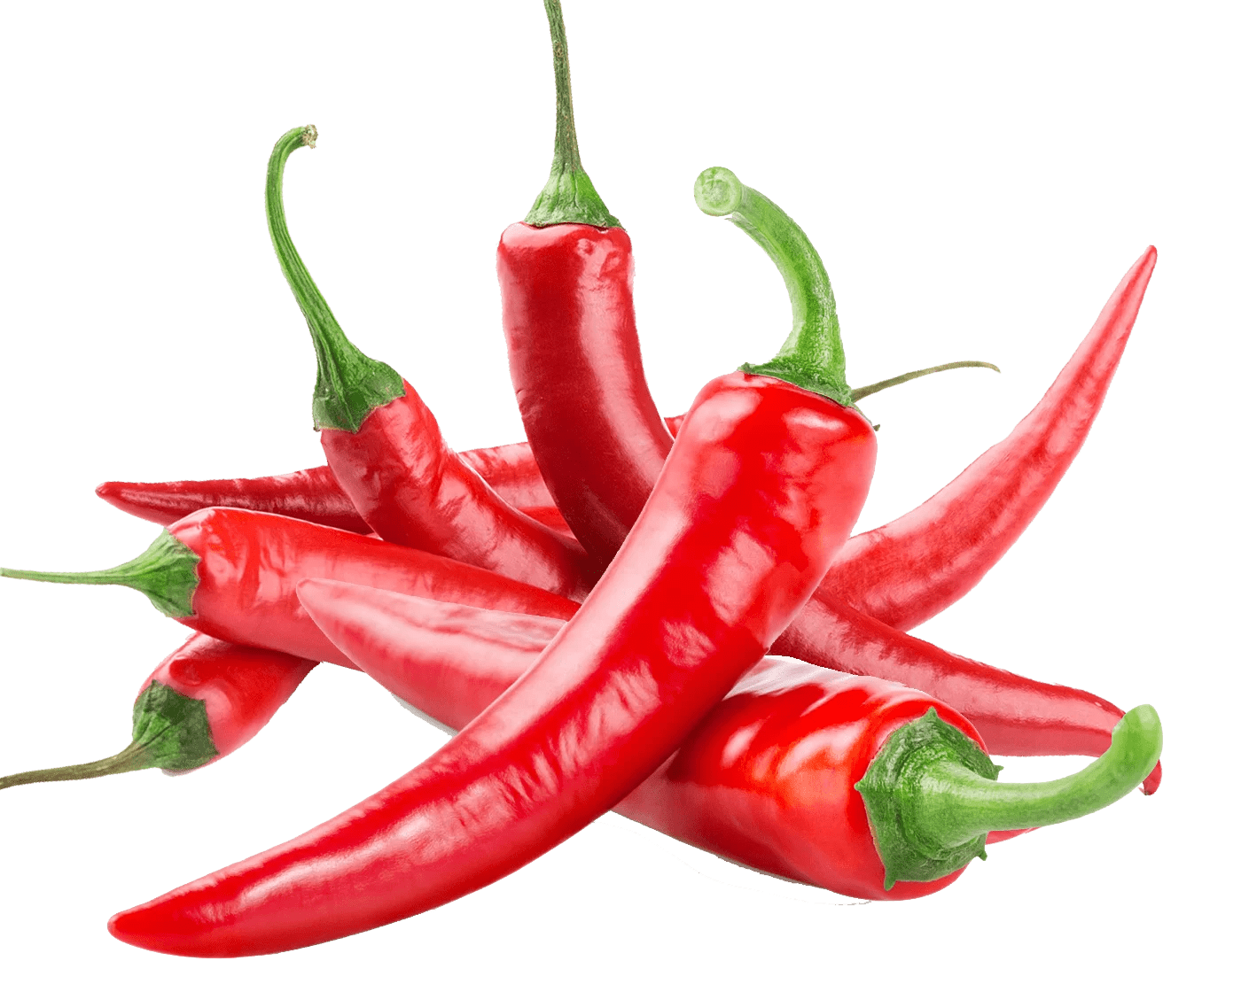

GRAMMAR FOCUS “To disagree”
GRAMMAR FOCUS “To disagree”
We use expressions as oh, or really?. To introduce our opinion, that may differ from the other person.
I can eat spicy ……food !
Really? I can´t eat spicy food at all.

Slide 6
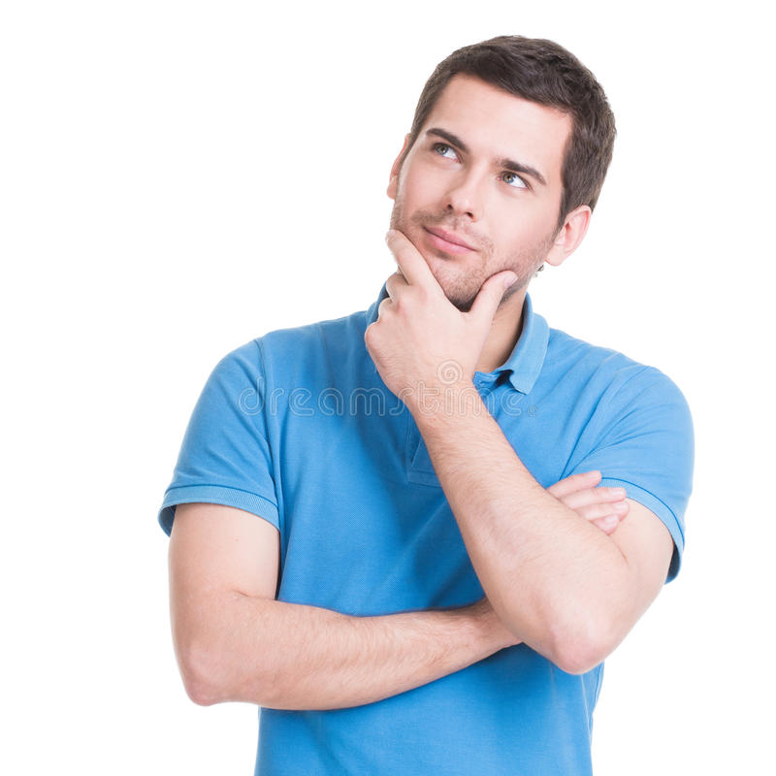
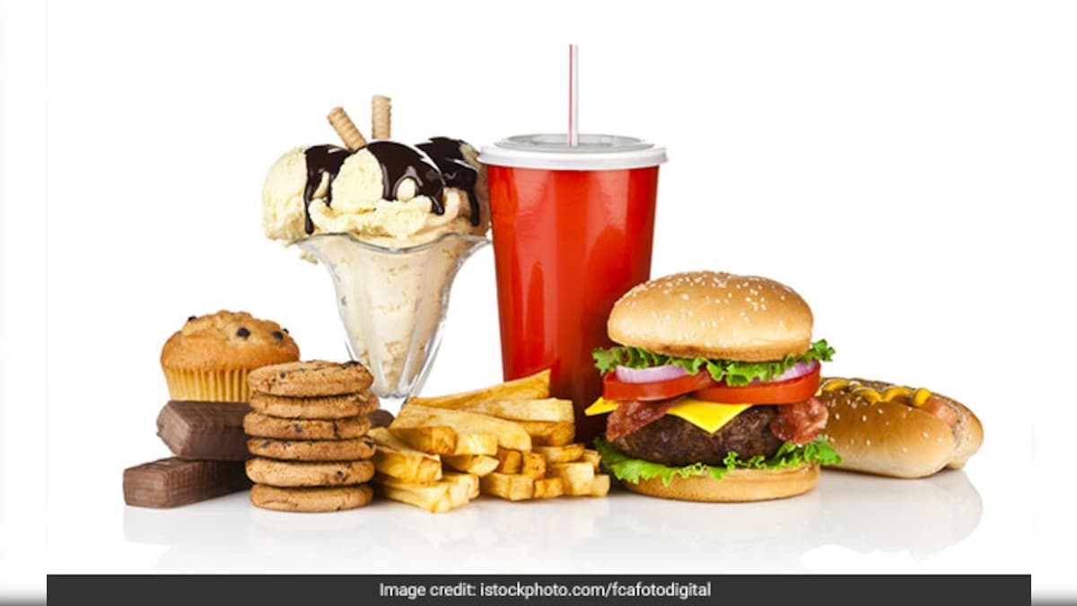
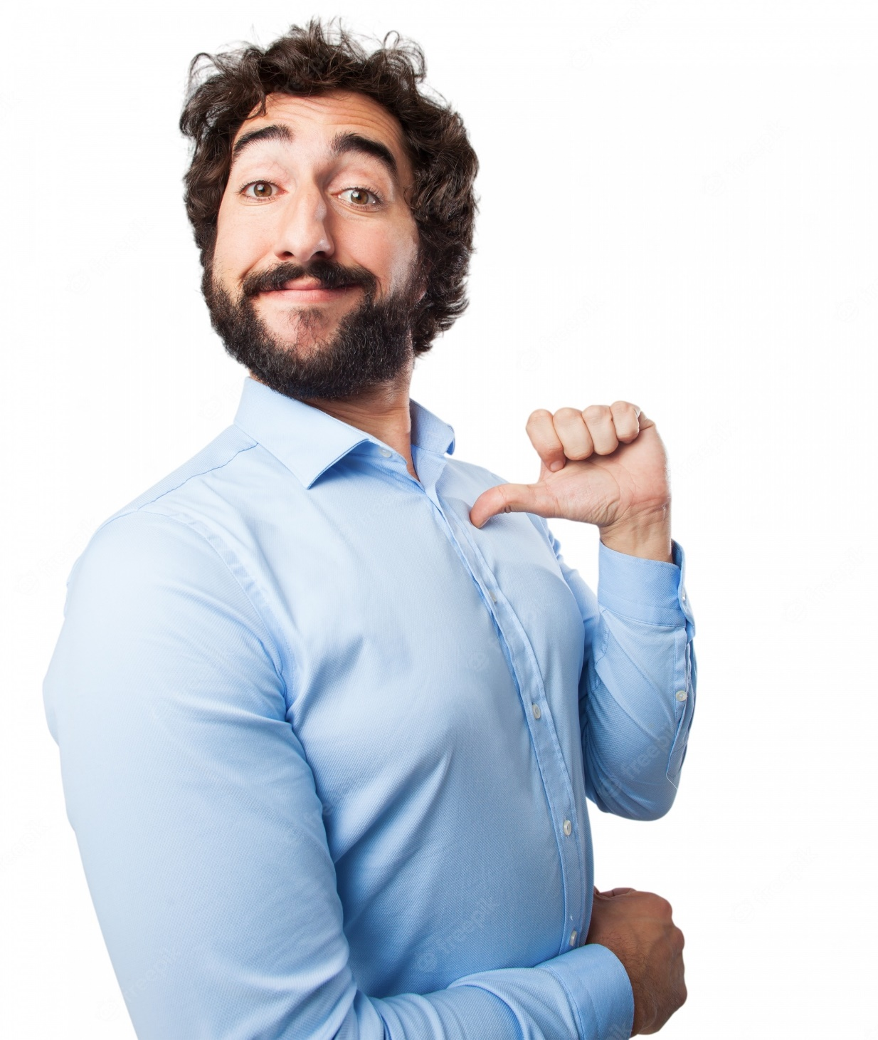
GRAMMAR FOCUS “To disagree”
GRAMMAR FOCUS “To disagree”
We use expressions as oh, or really?. To introduce our opinion, that may differ from the other person.
I´m not
in the mood of
Well, I am

Slide 7

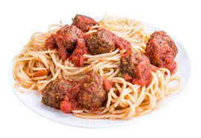
GRAMMAR FOCUS “To disagree”
GRAMMAR FOCUS “To disagree”
We use expressions as oh, or really?. To introduce our opinion, that may differ from the other person.
I don´t like italian food!
Really? I love it!

Slide 8
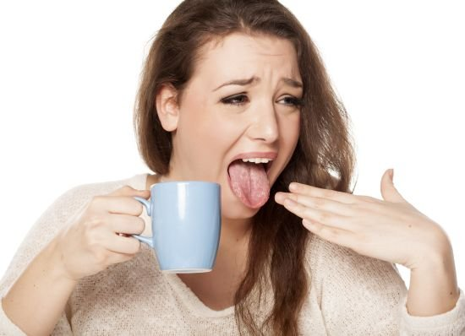
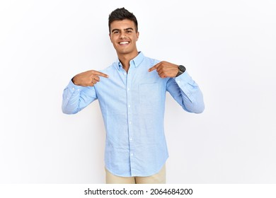
GRAMMAR FOCUS “To disagree”
GRAMMAR FOCUS “To disagree”
We use expressions as oh, or really?. To introduce our opinion, that may differ from the other person.
I can´t drink hot things
Well, I do!

Slide 9
Writing/Speaking Practice
Write statements, give a different opinión showing disagree to the following statements.
I´m on a diet. | Really I am not
I´m a very serious person. | Oh, well, I´m not
I love onions. | Oh, I don´t like it very much!
I´m in the mood of octopus coctail. | Really, I am not
I can´t eat meat. | Oh, I love it
I hate hamburguers. | Accually, I like it a lot
I can play the guitar | Really? I can’t

Slide 10
Writing/Speaking Practice
Write statements, give a different opinión showing disagree to the following statements.
I´m not in the mood of tacos. | Really?, I am
I´m keeon on homemade pizza! | Oh, I am not
I love garlic. | Oh, I don´t like it very much
I like shrimp coctail. | Really? I dont like it
I can´t stand chocolate cake. | Well, I can’t
I hate ice cream. | Really?, I love it
I can speak english very well. | Really?, I can’t

Slide 11

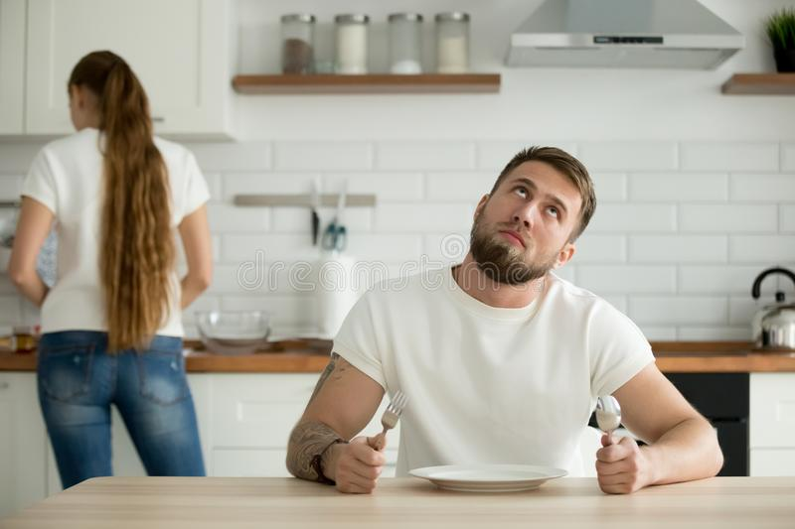
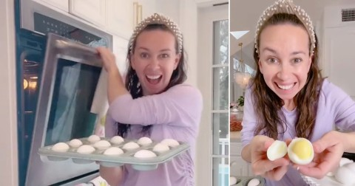
Listening/Speaking Practice
Workbook pg 18
Listen the following conversation. Fill in the blanks with the missing words.
Then take turns and role-play.
Maria: I feel tired tonight. I really don’t want to cook.
Courtney: _Neither do I_Let´s order out. Do you like Chinese food?
Maria: It´s Delicious! I love it!
Courtney: I am too. It´s my favorite. Let´s call Beijing Express for home delivery.
Maria: _Great idea___! Their food is always Good. I eat there a lot.
Courtney: _So do I__. Well what would you like tonight?
Maria: _I am not on the mood__for some soup.
Courtney: So_am I. And I think I will have orange chiken and fried rice.
Maria:Ok, Let´s order. Oh, wait. They _don’t take_ credit cards, and I don´t have any.
Courtney: Neither do I. Too bad! What _should_ we do?
Maria: Well, let´s look in the refrigerator. Hmm. Do you like boiled eggs?
Courtney: I _cant stand_ !
Maria: Actually, _can__ I.

Slide 12

Listening Practice “I´m tired of shopping” studentbook pg 16
A. Listen and practice the following conversation. Fill in the blanks with the missing words.
Alan: Hey, _Did you_want__ to get something to eat?
Kate: Sure. _Im tired of shopping.
Alan: _So i am. What do you think of Thai food?
Kate: I love it, but I´m not on the mood_for it today.
Alan: Yeah. I’m not either , I guess. It´s a bit spicy.
Kate: _What about _ Japanese food?
Alan: Fine by me! I love Japanese food.
Kate: So do I. There´s a great restaurant on the first floor. It´s called Kyoto Garden.
Alan: Perfect! Lets go tried it.

Slide 13
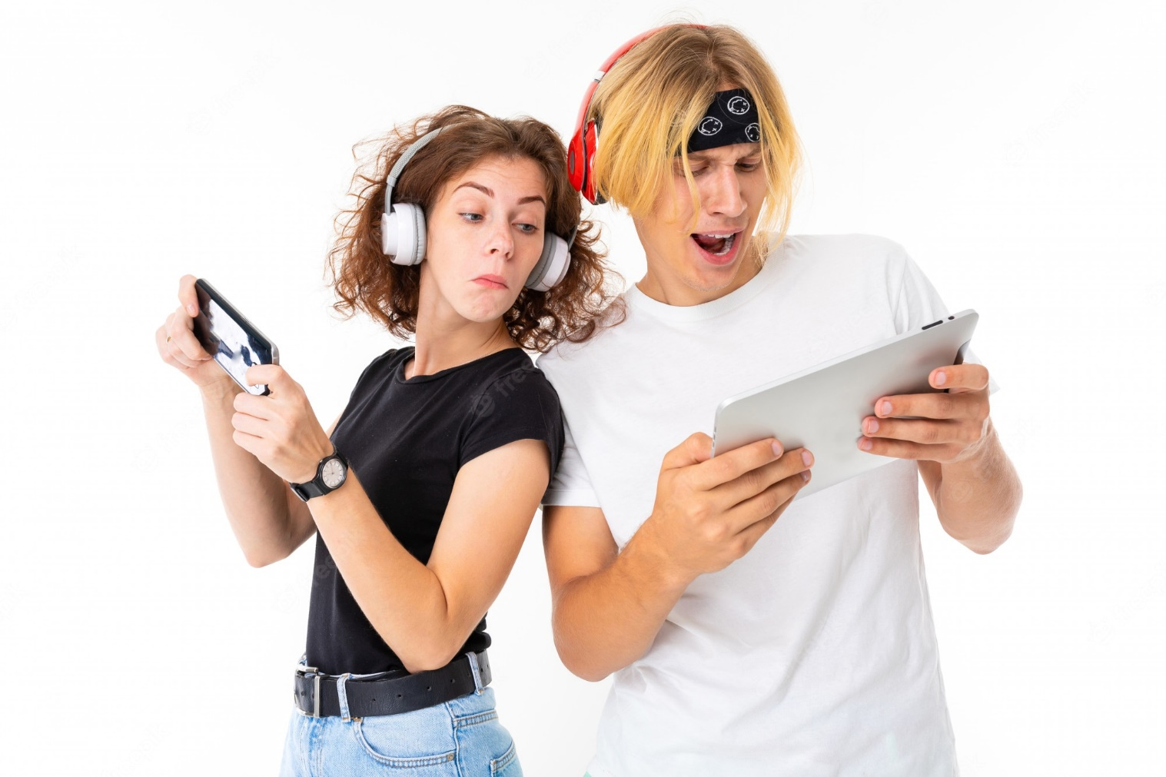
Speaking Practice
Put in order the dialogue, write the numbers from 1 to 7 Then in pairs roleplay the conversation.
5 | Really? Who´s your favorite singer?
6 | Sugman Pokhrel. How about you? Do you like him?
7 | He´s OK. But I´m fond of Nima Rumba.
1 | Do you like folk music Tina?
4 | Well I love pop music a lot.
3 | Yes, I love it. Kumar Basnet is my favorite Singer. What kind of music do you like?
2 | No, I don´t like it very much, Do you?

Slide 14

Speaking Practice
Unscramble the following statements. Paste them in the following conversation chart.
Put in order the dialogue, Then in pairs roleplay the conversation.
Matt: Hello Chrys!. Would you like to come around tonight?
Chrys: Great! What about ordering something for dinner?
Matt: Actually, I´m sick of fast food, I prefer homemade food!
Chrys: Good Idea, I´ll bring the salad. I like The Cesar Salad!
Matt: I do too! It´s my favorite! Then I´ll bake an apple pie!
Chrys: You know what? I don´t like apples very much. I prefer cheescake pie instead.
Matt: Cheescake is fine by me!. What about lasagna? I´m crazy about it!
Chrys: Well, I´m not keen on lasagna! But I´m fine with just the salad.
Matt: Perfect! So, see you in a while!

Slide 15
Writing/Speaking Practice
Write a short conversation, talk about your preferences in food. Use expressions to show like, dislikes, agreement and disagreement.
Hello, Do you want to get something to eat?
Yes, I love junk food
Mmm, really? I don´t like very much, What do you think about healthy food? I am diet
Oh I can´t, What about spicy food, like indian food?
Yes, I love indian food, I know some healthy dishes
Okay, and What type of desserts are there?
There are many desserts and I´m crazy about specially chocolate cake.
I am not on the mood of chocolate cake, I like ice cream better
Okay lets go.

