Slide 1
UNIT 5
Lesson 2
How about having dinner?
LESSON OBJECTIVE:
Learn language function; make, accept and decline invitations

Slide 2
VOCABULARY “Events”
Workbook pg 25 ex1
Match the words in columns A and B. Write the names of the events
party
race
reunion
appointment
concert
match

Slide 3
VOCABULARY “Events”
Studentbook pg 31 ex4
Complete the chart with words and phrases from the list.
A soccer game
A birthday party
A rock concert
A video game tournament
A barbecue
A film festival
A car race
A class reunion
A hip-hop dance
A baseball game
A wedding
A musical

Slide 4
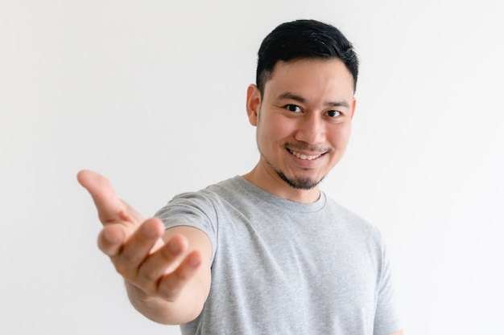
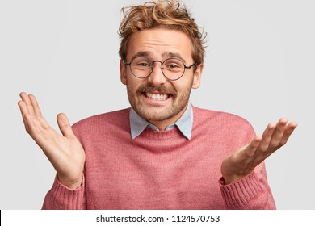
GRAMMAR FOCUS “Make and accept invitations”
Formal and informal ways to make invitations.
Polite Form: Would you like to go out on Friday?
Casual Form: Do you want to go out on Friday?
Why don´t we go out on Friday?
Informal Form: How about going out on Friday?
Let´s go out on Friday.
Formal and informal ways to accept invitations.
Polite Form: Yes, I´d love to.
Casual Form: Sure, what time?
Informal form: That sounds great!
Formal and informal ways to decline invitations.
Polite Form: I appreciate the invite, unfuntunately I can´t go.
I´m sorry, but I have plans.
Casual Form: Maybe another day, I´m busy these days.
Informal Form: Can I take a rain check?
You can apologize
and add an excuse to justify the refuse.

Slide 5
Language functions Practice
studentbook pg 30 ex 1
Read the following article, practice some expressions to decline an invitation politely.
sometimes when is necessary
I have a lot of homework
when i say i don't feel well

Slide 6
Accept or Decline invitations

Slide 7
SpeakingPractice
studentbook pg 30 ex 2
Practice the following conversation. “Are you doing anything tomorrow?
Where are Alicia and Mike going to have dinner? | Korean house
Who are they going to meet for dinner? | Garrett

Slide 8
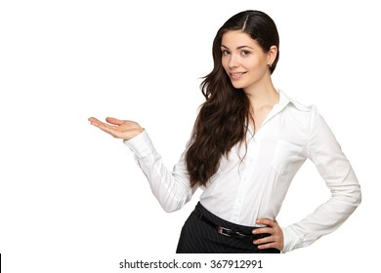
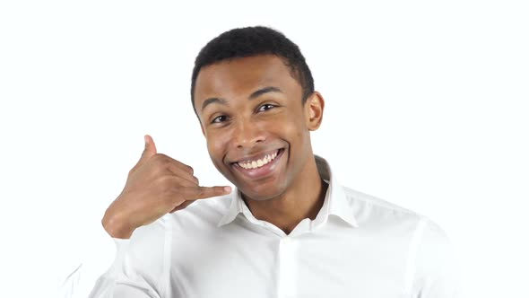
GRAMMAR FOCUS “Make and accept invitations”
Write invitations and acceptances in the blanks.
would you like to go to the cinema with me?
Would you like to dinner with me, tonight?
Yes, I’d love to
Yes, when?
would you like to go shopping with me?
Would you like to have a coffee in the afternoon?
That sounds great
yes, what time?

Slide 9
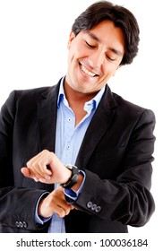
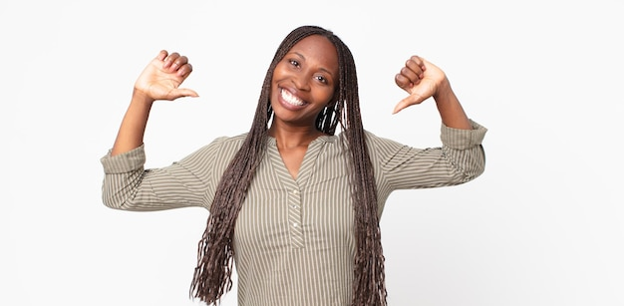
GRAMMAR FOCUS “Make and decline invitations”
Write invitations and refusements in the blanks.
Would you like to go to my mother´s house?
would you like to go eat tomorrow?
sorry i can’t today
sorry i have other plans
would you like to go with me to the park?
Would you like to go to a party on Friday?
Can I take a time check
I'm sorry, but I'll study for my exam

Slide 10
Listening/SpeakingPractice
Listen, complete and practice the following conversations.
1.- A: Hey Lisa, I’m going to the new art gallery on the weekend. Would you like to come with me?
B:Sorry, I can´t I have to study for exams on the weekend.
2.- A: Some of my friends and I going to sing karaoke tonight. Do you want to join us?
B: Thanks, I’d love too, it sounds like fun
3.- A: There’s a technology show at the International Convention Centre. Would you like to go ?
B: Yes. I’d love too. Will they have smartphones? I need a new one.
4.- A: Hey Jim, where a concert tonight at the stadium? I was wondering if you like to go?
B: Thanks for asking. But I have to work tonight.

Slide 11
Vocabulary Practice
Online activity
Click on the links and practice. Then share your results of your practice.
https://www.liveworksheets.com/cg246212to
Insert here your results
https://wordwall.net/es/resource/5496724/friendship/8-s%c4%b1n%c4%b1f-ingilizce-1-%c3%bcnite-friendship-invitation
Insert here your results
https://wordwall.net/es/resource/16860711/accepting
Insert here your results

