Slide 1

UNIT 5
Lesson 2
How about having dinner?
LESSON OBJECTIVE:
Learn language function; make, accept and decline invitations

Slide 2
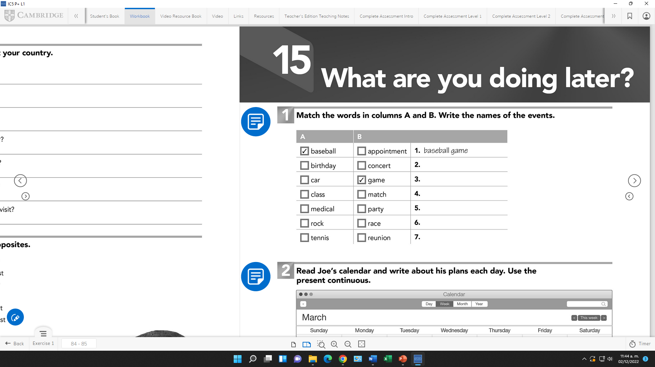
VOCABULARY “Events”
Workbook pg 25 ex1
Match the words in columns A and B. Write the names of the events
Birthday party
Car race
Class Reunion
Medical appointment
Rock concert
Tennis match

Slide 3
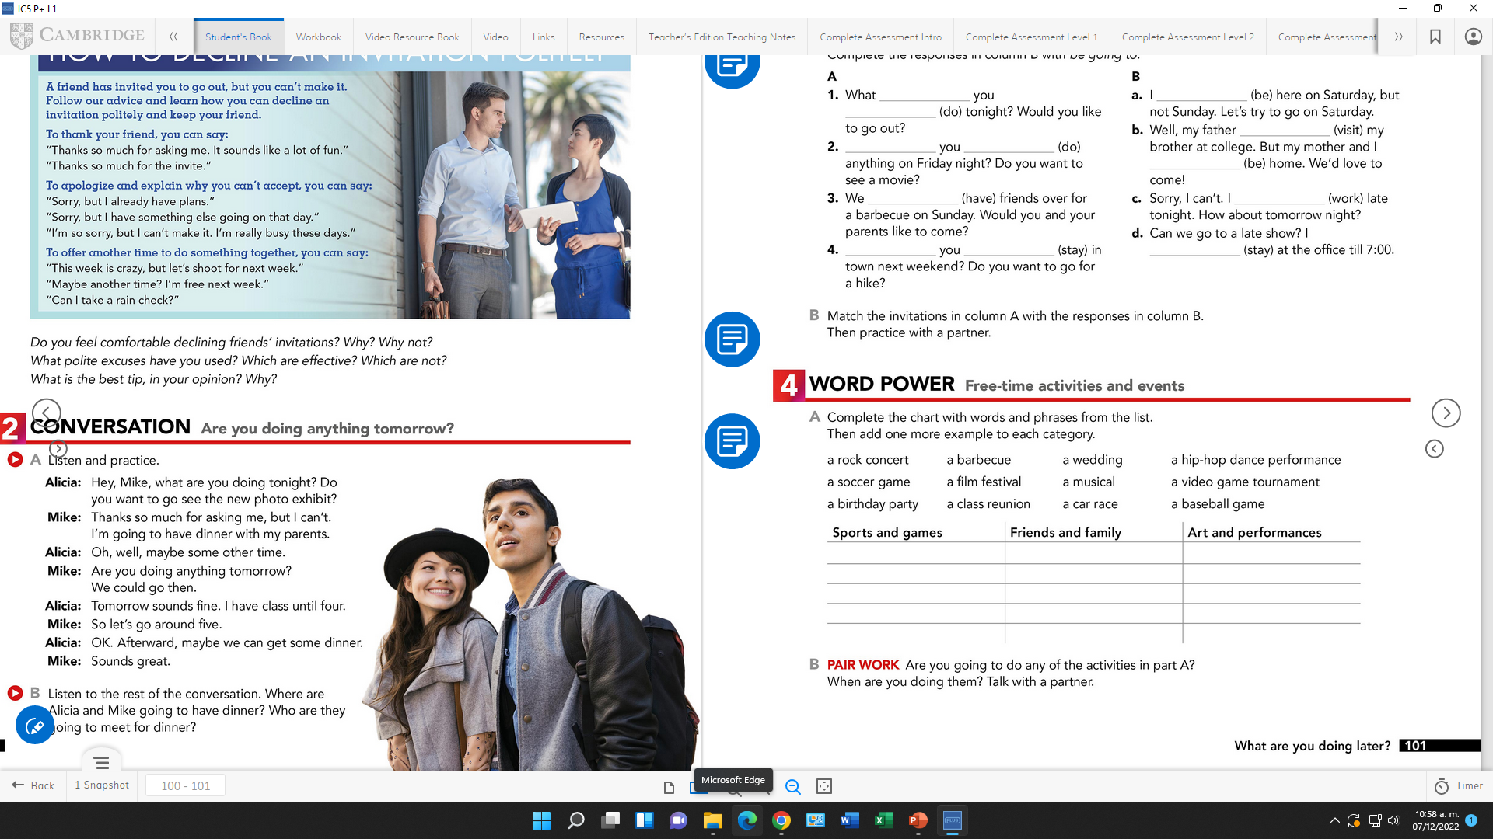
VOCABULARY “Events”
Studentbook pg 31 ex4
Complete the chart with words and phrases from the list.
A baseball game
A soccer game
A vídeo Game tournament
A car race
A barbecue
A wedding
A birthday party
A class reunion
A rock concert
A film festival
A hip hop dance performance
A musical

Slide 4
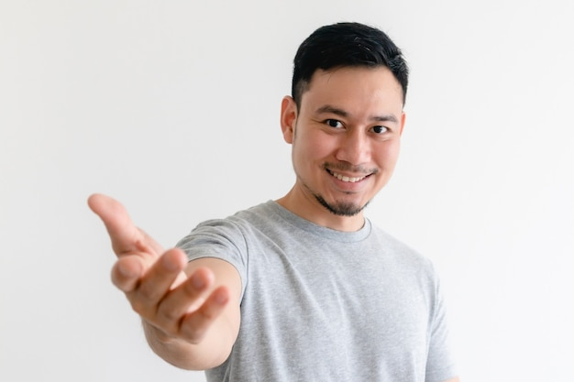

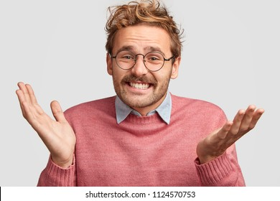
GRAMMAR FOCUS “Make and accept invitations”
Formal and informal ways to make invitations.
Polite Form: Would you like to go out on Friday?
Casual Form: Do you want to go out on Friday?
Why don´t we go out on Friday?
Informal Form: How about going out on Friday?
Let´s go out on Friday.
Formal and informal ways to accept invitations.
Polite Form: Yes, I´d love to.
Casual Form: Sure, what time?
Informal form: That sounds great!
Formal and informal ways to decline invitations.
Polite Form: I appreciate the invite, unfuntunately I can´t go.
I´m sorry, but I have plans.
Casual Form: Maybe another day, I´m busy these days.
Informal Form: Can I take a rain check?
You can apologize
and add an excuse to justify the refuse.

Slide 5
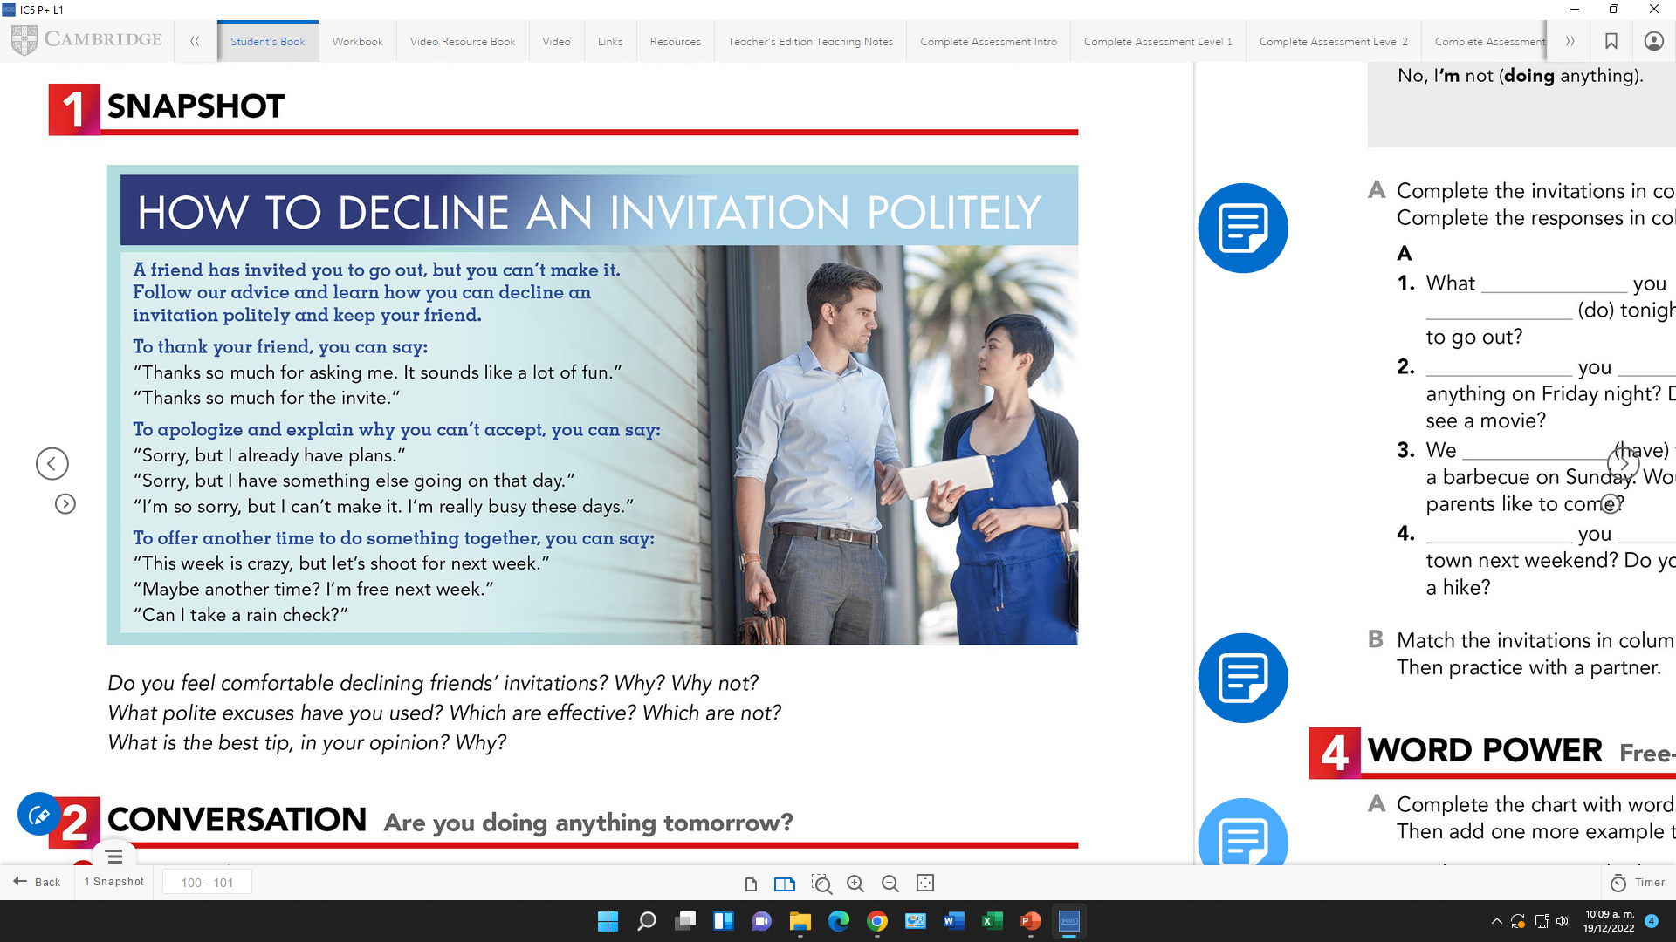
Language functions Practice
studentbook pg 30 ex 1
Read the following article, practice some expressions to decline an invitation politely.

Slide 6
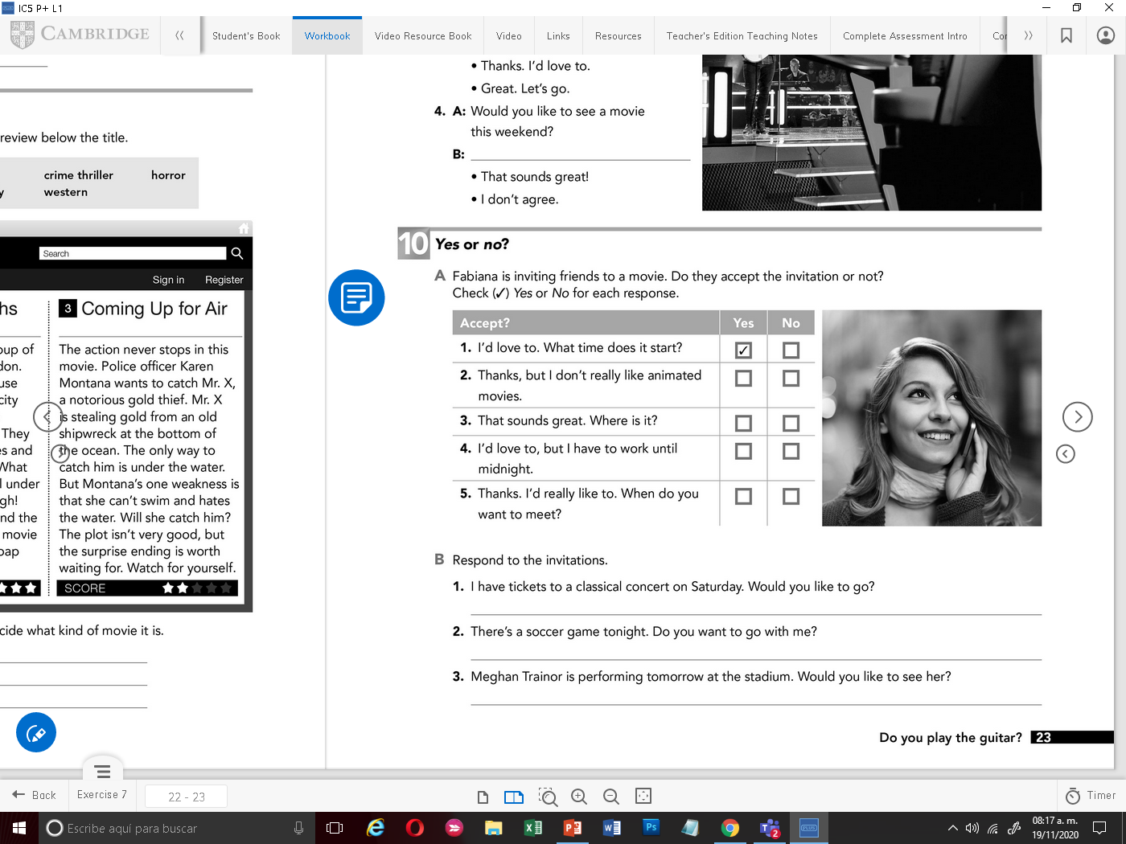
Accept or Decline invitations

Slide 7
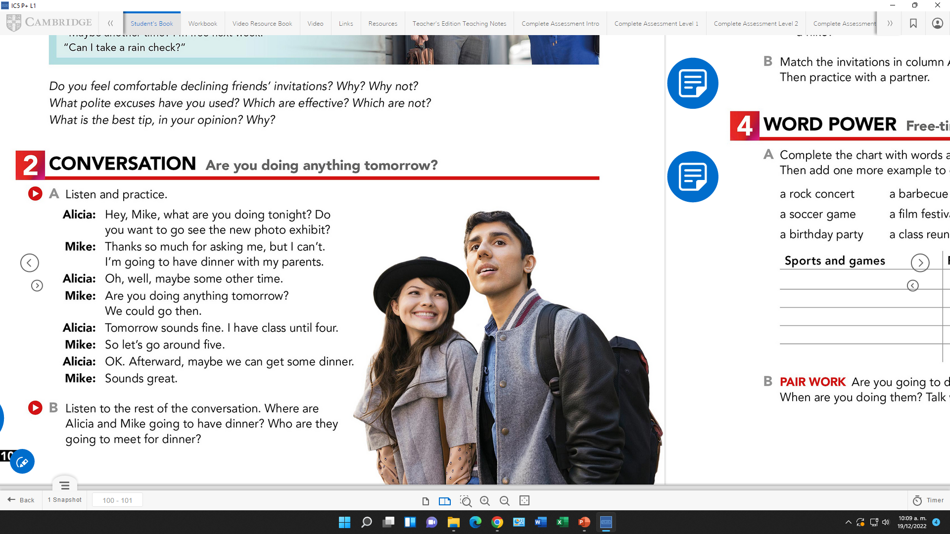

SpeakingPractice
studentbook pg 30 ex 2
Practice the following conversation. “Are you doing anything tomorrow?
Where are Alicia and Mike going to have dinner? | The Korean House
Who are they going to meet for dinner? | Jared

Slide 8
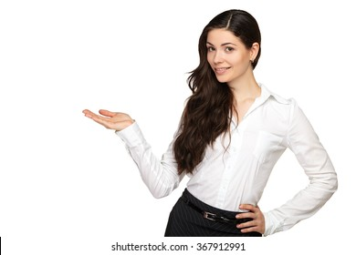
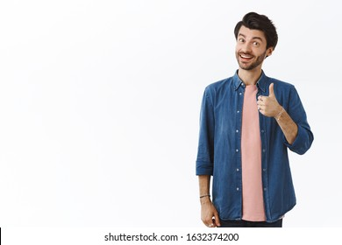
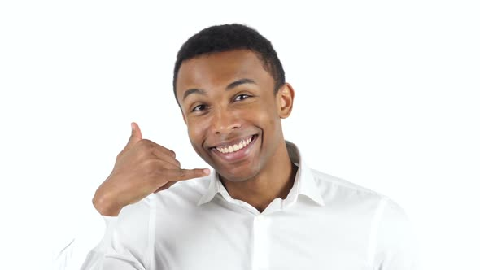
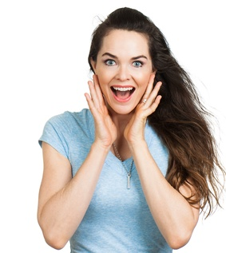


GRAMMAR FOCUS “Make and accept invitations”
Write invitations and acceptances in the blanks.
Let’s go out on friday
Would You like to drink a coffe with me?
That sounds grate
Yes. I’d love to.
Let’s go out on thursday
Do You want to go out on Monday?
Sure, what time?
That sounds grate

Slide 9
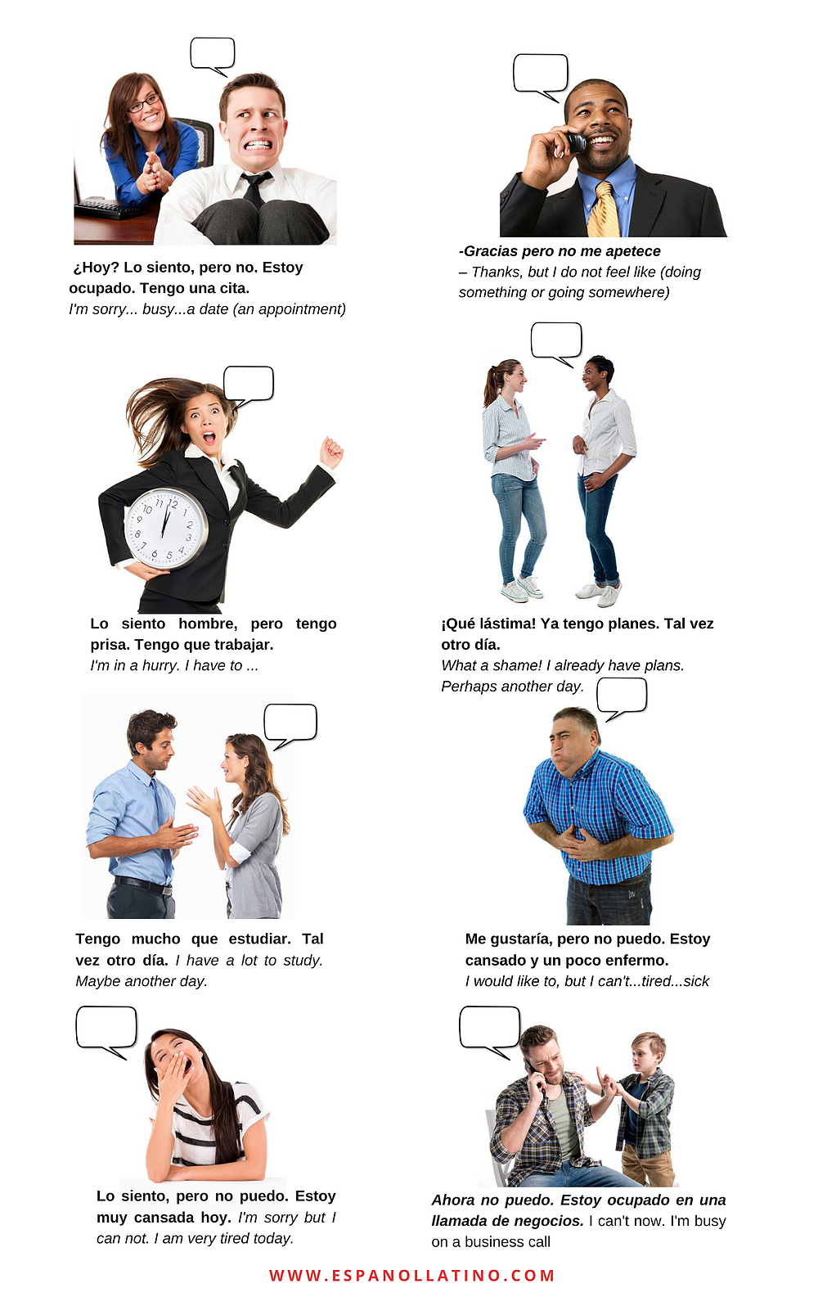
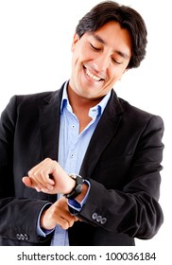

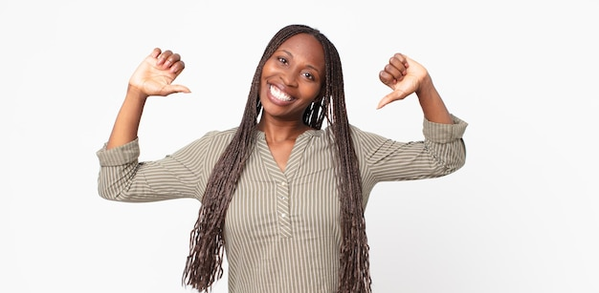
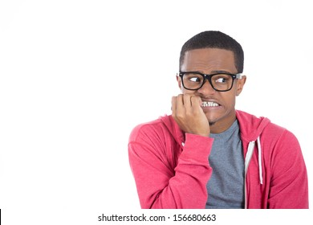
GRAMMAR FOCUS “Make and decline invitations”
Write invitations and refusements in the blanks.
Would you like to go to my mother´s house?
Do you want to go to dinner with me?
Maybe another day
Sorry, but i have planes
How about to go out on Saturday?
Would you like to drink a coffe with me?
Sorry, but i have planes
I appreciate the invite, unfuntunately I can´t go

Slide 10
Listening/SpeakingPractice
Listen, complete and practice the following conversations.
1.- A: Hey Lisa, ________________the new art gallery on the weekend. ________________________with me ?
B:Sorry,_____________________________on the weekend.
2.- A: Some of my friends and I ___________karaoke tonight. __________________________________________________?
B: Thanks, ________________________
3.- A: There’s a technology show at the International Convention Centre. ___________________________?
B: Yes. ______________. Will they have smartphones? I _______________.
4.- A: Hey Jim, ____________a concert tonight at the stadium? I was wondering if _____________?
B: Thanks ____________. But _________________.
I’m going to
Would You like to go
I can’t . I have session study
Are going to sing
Do You want to join us
I’d love to. Sounds like fun
Would You like to go
I’d love to.
I need a new one
We’re going to see
You like to go
For asking. I have to work to night

Slide 11
Vocabulary Practice
Online activity
Click on the links and practice. Then share your results of your practice.
https://www.liveworksheets.com/cg246212to
Insert here your results
https://wordwall.net/es/resource/5496724/friendship/8-s%c4%b1n%c4%b1f-ingilizce-1-%c3%bcnite-friendship-invitation
Insert here your results
https://wordwall.net/es/resource/16860711/accepting
Insert here your results

Slide 12
