Slide 1
UNIT 5
Lesson 2
How about having dinner?
LESSON OBJECTIVE:
Learn language function; make, accept and decline invitations

Slide 2
VOCABULARY “Events”
Workbook pg 25 ex1
Match the words in columns A and B. Write the names of the events
Birthday party
Car race
Class reunion
Medical appointment
Rock concert
Tennis match

Slide 3
VOCABULARY “Events”
Studentbook pg 31 ex4
Complete the chart with words and phrases from the list.
a baseball game
a barbecue
a rock concert
a soccer game
a birthday party
a film festival
a video game tournamente
a class reunion
a musical
a car game
a wedding
a hip hop dance performance

Slide 4
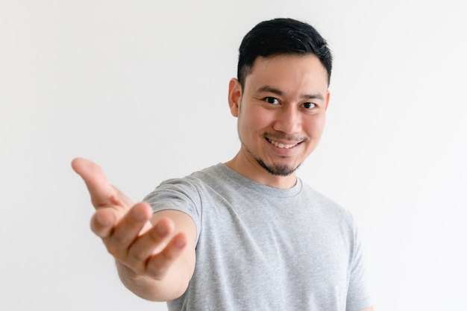
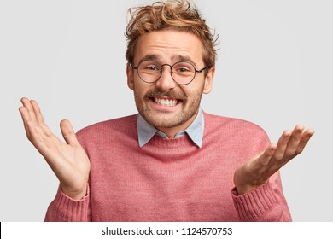
GRAMMAR FOCUS “Make and accept invitations”
Formal and informal ways to make invitations.
Polite Form: Would you like to go out on Friday?
Casual Form: Do you want to go out on Friday?
Why don´t we go out on Friday?
Informal Form: How about going out on Friday?
Let´s go out on Friday.
Formal and informal ways to accept invitations.
Polite Form: Yes, I´d love to.
Casual Form: Sure, what time?
Informal form: That sounds great!
Formal and informal ways to decline invitations.
Polite Form: I appreciate the invite, unfuntunately I can´t go.
I´m sorry, but I have plans.
Casual Form: Maybe another day, I´m busy these days.
Informal Form: Can I take a rain check?
You can apologize
and add an excuse to justify the refuse.

Slide 5
Language functions Practice
studentbook pg 30 ex 1
Read the following article, practice some expressions to decline an invitation politely.

Slide 6
Accept or Decline invitations

Slide 7
SpeakingPractice
studentbook pg 30 ex 2
Practice the following conversation. “Are you doing anything tomorrow?
Where are Alicia and Mike going to have dinner?
Who are they going to meet for dinner?

Slide 8
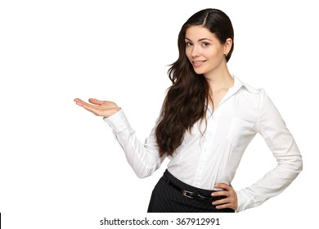
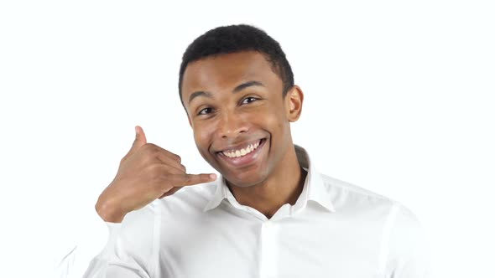
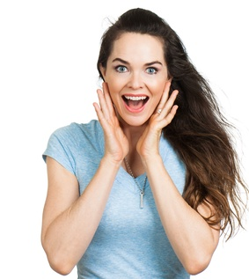
GRAMMAR FOCUS “Make and accept invitations”
Write invitations and acceptances in the blanks.
Would you like to go to the park with me?
Do you want to go out on Friday?
Sure, what time?
Sure, what time?
Would you like to go to see a baseball game?
How about going to a party on Friday?
That sounds great!
Yes, I’d love to.

Slide 9
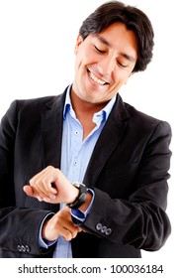
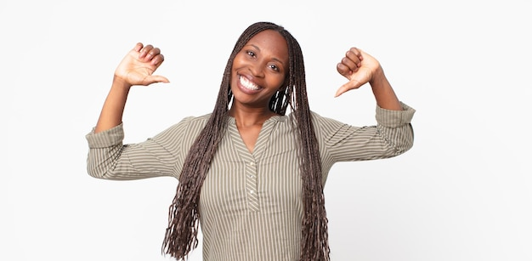
GRAMMAR FOCUS “Make and decline invitations”
Write invitations and refusements in the blanks.
Would you like to go to my mother´s house?
Do you want to go to the cinema?
I appreciate the invite, unfuntunately I can´t go.
I´’m sorry, but I have plans.
Would you like to go to the park with me?
How about going out on Friday?
Maybe another day, I’m busy these days.
I’m sorry, but I have plans.

Slide 10
Listening/SpeakingPractice
Listen, complete and practice the following conversations.
1.- A: Hey Lisa, ________________the new art gallery on the weekend. ________________________with me ?
B:Sorry,_____________________________on the weekend.
2.- A: Some of my friends and I ___________karaoke tonight. __________________________________________________?
B: Thanks, ________________________
3.- A: There’s a technology show at the International Convention Centre. ___________________________?
B: Yes. ______________. Will they have smartphones? I _______________.
4.- A: Hey Jim, ____________a concert tonight at the stadium? I was wondering if _____________?
B: Thanks ____________. But _________________.
I’m going to
Would you like to come
I can’t
going to seen
Do you want to join us
I’d want to, sounds like fun
Would you like to go
I love to
need a new one
Will going to see
you like to go
for asking
I have to work tonight

Slide 11
Vocabulary Practice
Online activity
Click on the links and practice. Then share your results of your practice.
https://www.liveworksheets.com/cg246212to
Insert here your results
https://wordwall.net/es/resource/5496724/friendship/8-s%c4%b1n%c4%b1f-ingilizce-1-%c3%bcnite-friendship-invitation
Insert here your results
https://wordwall.net/es/resource/16860711/accepting
Insert here your results

