Slide 1
UNIT 5
Lesson 2
How about having dinner?
LESSON OBJECTIVE:
Learn language function; make, accept and decline invitations

Slide 2
VOCABULARY “Events”
Workbook pg 25 ex1
Match the words in columns A and B. Write the names of the events
Birthday party
Car race
Class reunión
Medical appointment
Rock concert
Tennis match

Slide 3
VOCABULARY “Events”
Studentbook pg 31 ex4
Complete the chart with words and phrases from the list.
a soccer game
a birthday party
a rock concert
a video game tournament
a barbecue
a hip-hop dance performance
a baseball game
a class reunión
a musical
a wedding
a film festival
a car race

Slide 4
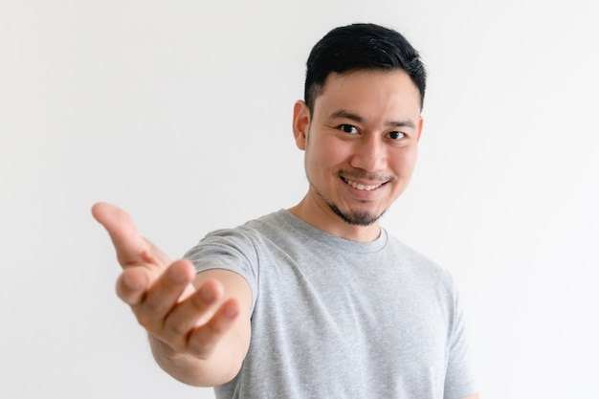
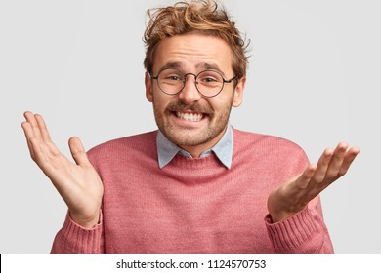
GRAMMAR FOCUS “Make and accept invitations”
Formal and informal ways to make invitations.
Polite Form: Would you like to go out on Friday?
Casual Form: Do you want to go out on Friday?
Why don´t we go out on Friday?
Informal Form: How about going out on Friday?
Let´s go out on Friday.
Formal and informal ways to accept invitations.
Polite Form: Yes, I´d love to.
Casual Form: Sure, what time?
Informal form: That sounds great!
Formal and informal ways to decline invitations.
Polite Form: I appreciate the invite, unfuntunately I can´t go.
I´m sorry, but I have plans.
Casual Form: Maybe another day, I´m busy these days.
Informal Form: Can I take a rain check?
You can apologize
and add an excuse to justify the refuse.

Slide 5
Language functions Practice
studentbook pg 30 ex 1
Read the following article, practice some expressions to decline an invitation politely.

Slide 6
Accept or Decline invitations

Slide 7
SpeakingPractice
studentbook pg 30 ex 2
Practice the following conversation. “Are you doing anything tomorrow?
Where are Alicia and Mike going to have dinner?
Who are they going to meet for dinner?

Slide 8
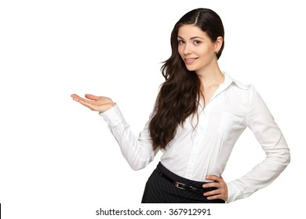
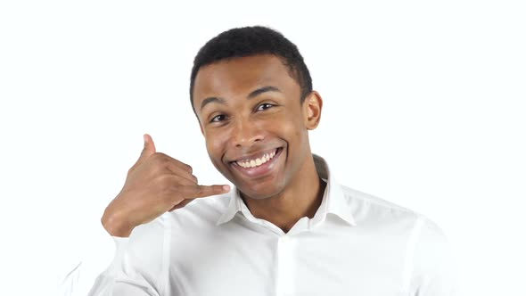
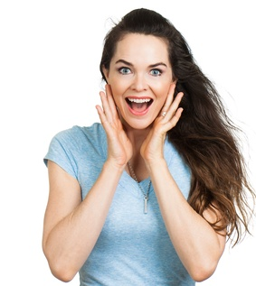
GRAMMAR FOCUS “Make and accept invitations”
Write invitations and acceptances in the blanks.
Do you want to go to the cinema on Saturday.
Do you want to go in alameda?
Great, what time?
Sure,, sounds great
Would you like to go on the friday
Would you like to go in a restaurant?
Yes, I’d love to.
Yeah,sound great.

Slide 9
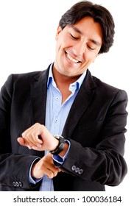
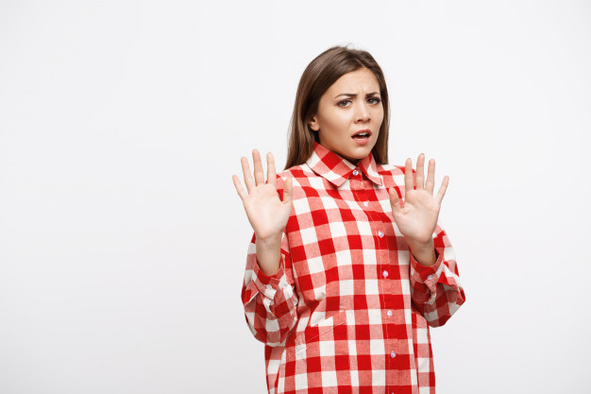
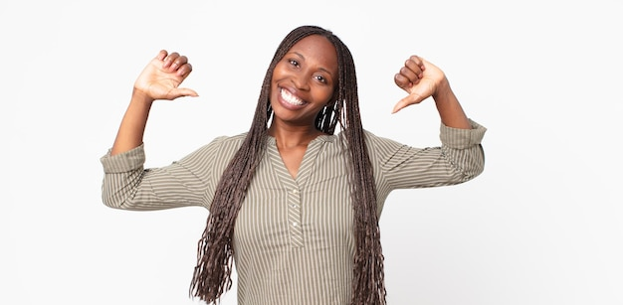
GRAMMAR FOCUS “Make and decline invitations”
Write invitations and refusements in the blanks.
Would you like to go to my mother´s house?
Would you like to go alameda?
I’m sorry, maybe later.
Hanks, but I have plans
Woud you like to go to the doctor?
Woould you like see a movie?
sorry, I have plans
Sorry, but I have plans.

Slide 10
Listening/SpeakingPractice
Listen, complete and practice the following conversations.
1.- A: Hey Lisa, _I’m going to_the new art gallery on the weekend. would you like to come with me ?
B:Sorry,___i can`t _I have ______________on the weekend.
2.- A: Some of my friends and I going to sing_karaoke tonight. __do you want to jon us__?
B: Thanks, __I’d love to, sounds like fun___
3.- A: There’s a technology show at the International Convention Centre. _what do you like to go_________?
B: Yes. _I’d love to_____. Will they have smartphones? I need one__.
4.- A: Hey Jim, _will going to see__________a concert tonight at the stadium? I was wondering if _you like to go ____________?
B: Thanks _for asking___. But _I have to work to night________.

Slide 11
Vocabulary Practice
Online activity
Click on the links and practice. Then share your results of your practice.
https://www.liveworksheets.com/cg246212to
Insert here your results
https://wordwall.net/es/resource/5496724/friendship/8-s%c4%b1n%c4%b1f-ingilizce-1-%c3%bcnite-friendship-invitation
Insert here your results
https://wordwall.net/es/resource/16860711/accepting
Insert here your results

