Slide 1
UNIT 5
Lesson 2
How about having dinner?
LESSON OBJECTIVE:
Learn language function; make, accept and decline invitations

Slide 2
VOCABULARY “Events”
Workbook pg 25 ex1
Match the words in columns A and B. Write the names of the events
Birthday parte
Tennis match
Class reunion
Medical appointment
Rock concert
Tennis match

Slide 3
VOCABULARY “Events”
Studentbook pg 31 ex4
Complete the chart with words and phrases from the list.
A video game tournament
A baseball game
A car race
A soccer game
A birthday party
A class reunion
A wedding
A barbecue
A rock concert
A hip-hop dance performance
A musical
A film festival

Slide 4
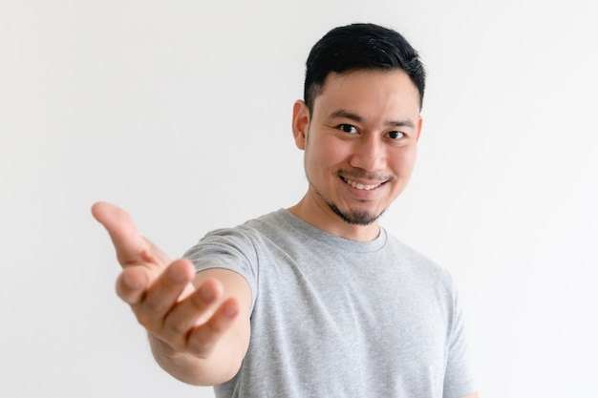
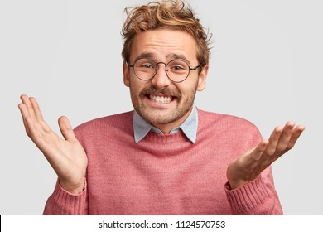
GRAMMAR FOCUS “Make and accept invitations”
Formal and informal ways to make invitations.
Polite Form: Would you like to go out on Friday?
Casual Form: Do you want to go out on Friday?
Why don´t we go out on Friday?
Informal Form: How about going out on Friday?
Let´s go out on Friday.
Formal and informal ways to accept invitations.
Polite Form: Yes, I´d love to.
Casual Form: Sure, what time?
Informal form: That sounds great!
Formal and informal ways to decline invitations.
Polite Form: I appreciate the invite, unfuntunately I can´t go.
I´m sorry, but I have plans.
Casual Form: Maybe another day, I´m busy these days.
Informal Form: Can I take a rain check?
You can apologize
and add an excuse to justify the refuse.

Slide 5
Language functions Practice
studentbook pg 30 ex 1
Read the following article, practice some expressions to decline an invitation politely.
No, i feel bad when i decline it
Me parents doesnt gave me permission,yes

Slide 6
Accept or Decline invitations

Slide 7
SpeakingPractice
studentbook pg 30 ex 2
Practice the following conversation. “Are you doing anything tomorrow?
Where are Alicia and Mike going to have dinner? | Doesn’t mention it
Who are they going to meet for dinner? | Mike’s parents

Slide 8
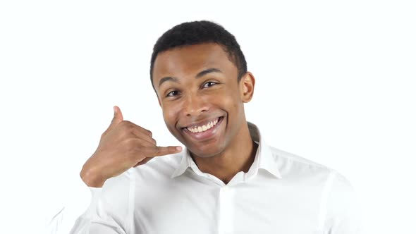
GRAMMAR FOCUS “Make and accept invitations”
Write invitations and acceptances in the blanks.
Hey, Will do YouTube want to Google for a dinner tonight?
Hey samantha whats going on lets go to the park
Of course, Ellie.
Yeah
Hello liz, wanna go for a pizza
Elizabeth do YouTube want to go to saltillo
Fine, lets go
Gratis idea,lets eat some pizza

Slide 9
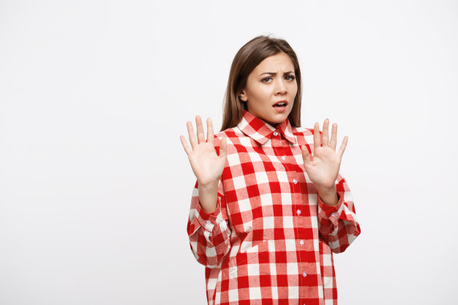
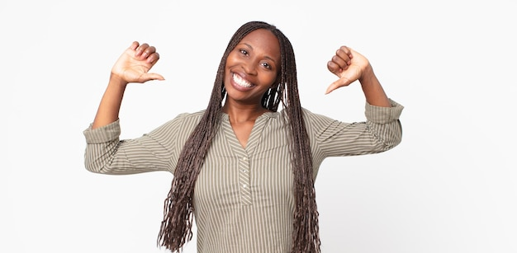
GRAMMAR FOCUS “Make and decline invitations”
Write invitations and refusements in the blanks.
Would you like to go to my mother´s house?
Do you want to go to my house
Mmm, maybe another day
Maybe later i cant now
Lets go for a dinner tomorrow
Hey lets play soccer
I cant,i dont want to go with you
I prefere basketball, thank you

Slide 10
Listening/SpeakingPractice
Listen, complete and practice the following conversations.
1.- A: Hey Lisa, ________________the new art gallery on the weekend. Do you like to go__with me ?
B:Sorry, I have to study for exam on the weekend.
2.- A: Some of my friends and I going to_karaoke Do you enjoy_?
B: Thanks, I would love to, its sounds like fine
3.- A: There’s a technology show at the International Conventio Centre. Would you like go_?
B: Yes. __I would love__. Will they have smartphones? I need a new one_________.
4.- A: Hey Jim, we going to_a concert tonight at the stadium? I was wondering if __you like to go_?
B: Thanks for asking. But ____I hace to a work tonight
I am going to

Slide 11
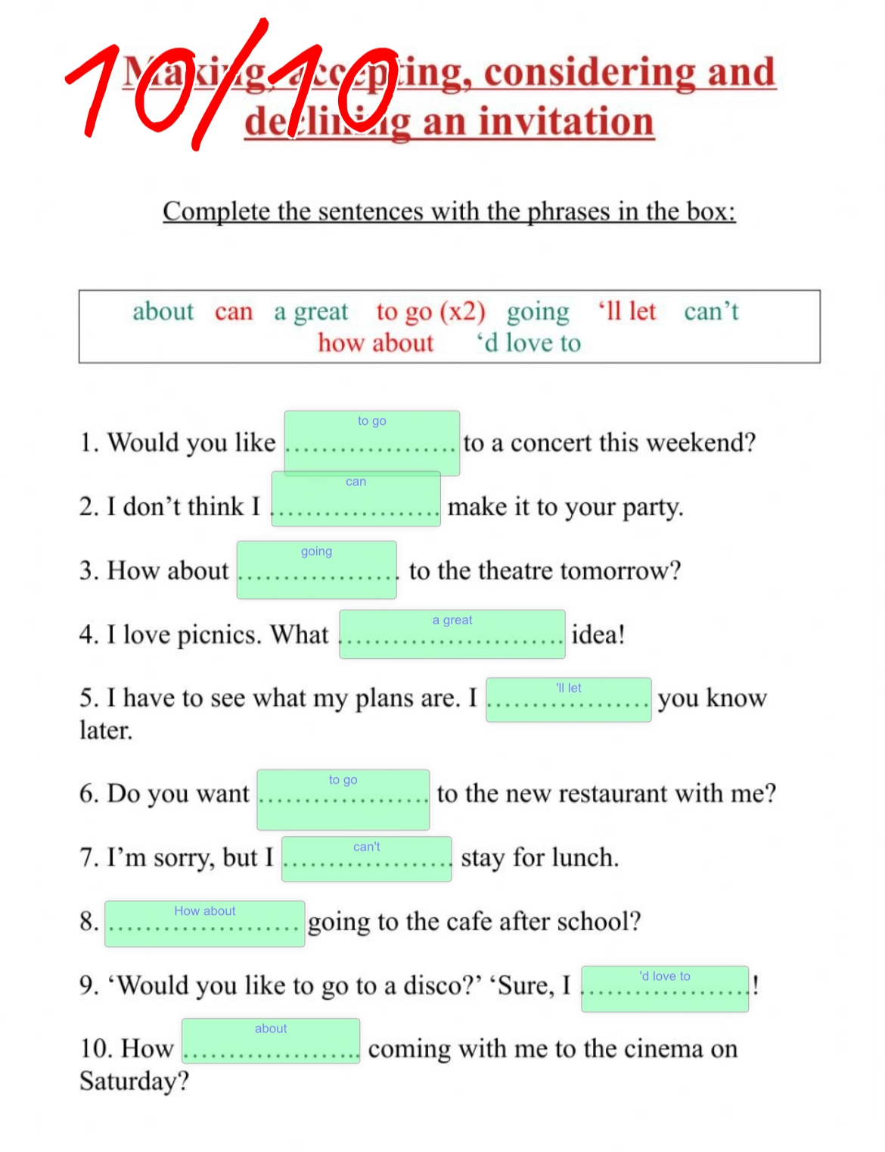
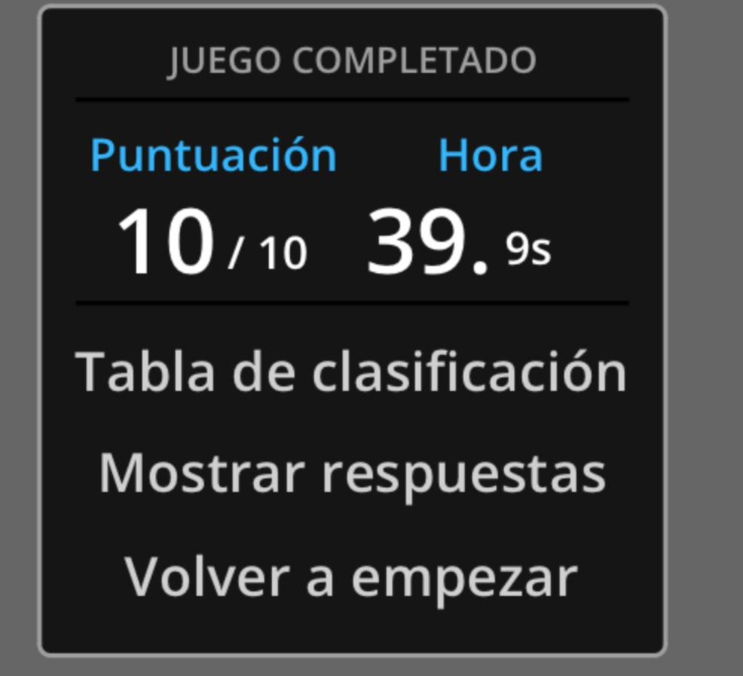
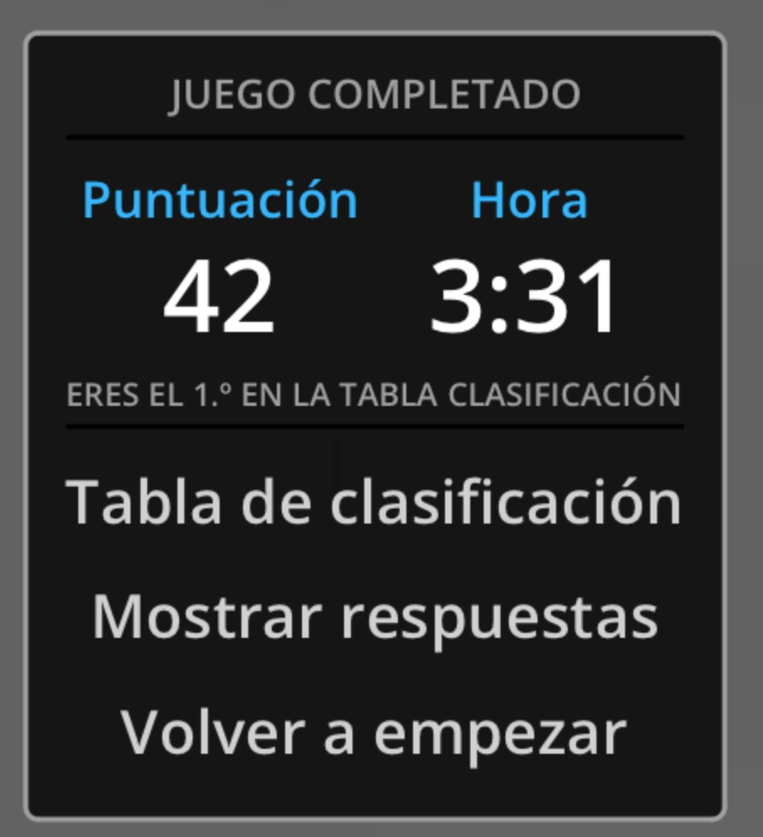
Vocabulary Practice
Online activity
Click on the links and practice. Then share your results of your practice.
https://www.liveworksheets.com/cg246212to
Insert here your results
https://wordwall.net/es/resource/5496724/friendship/8-s%c4%b1n%c4%b1f-ingilizce-1-%c3%bcnite-friendship-invitation
Insert here your results
https://wordwall.net/es/resource/16860711/accepting
Insert here your results

