Slide 1
UNIT 5
Lesson 2
How about having dinner?
LESSON OBJECTIVE:
Learn language function; make, accept and decline invitations

Slide 2
VOCABULARY “Events”
Workbook pg 25 ex1
Match the words in columns A and B. Write the names of the events
Birthday party
Car race
Class reunion
Medical appointment
Rock concert
Tenni macth

Slide 3
VOCABULARY “Events”
Studentbook pg 31 ex4
Complete the chart with words and phrases from the list.
A soccer game
A car race
A beseball game
A video game tournament
A birthday party
A barbecue
A class reunion
A wdding
A rock concert
A musical
A hip-hop dance perfomance
A film festival

Slide 4
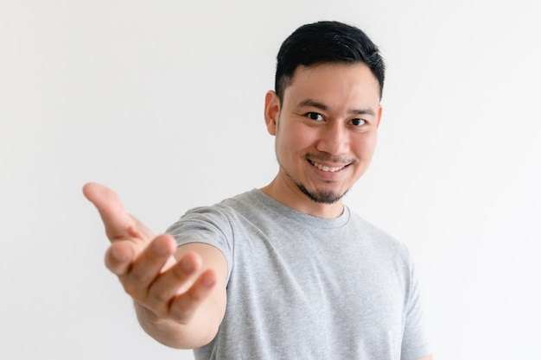
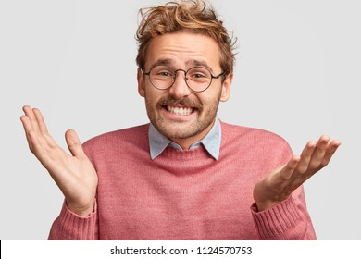
GRAMMAR FOCUS “Make and accept invitations”
Formal and informal ways to make invitations.
Polite Form: Would you like to go out on Friday?
Casual Form: Do you want to go out on Friday?
Why don´t we go out on Friday?
Informal Form: How about going out on Friday?
Let´s go out on Friday.
Formal and informal ways to accept invitations.
Polite Form: Yes, I´d love to.
Casual Form: Sure, what time?
Informal form: That sounds great!
Formal and informal ways to decline invitations.
Polite Form: I appreciate the invite, unfuntunately I can´t go.
I´m sorry, but I have plans.
Casual Form: Maybe another day, I´m busy these days.
Informal Form: Can I take a rain check?
You can apologize
and add an excuse to justify the refuse.

Slide 5
Language functions Practice
studentbook pg 30 ex 1
Read the following article, practice some expressions to decline an invitation politely.

Slide 6
Accept or Decline invitations

Slide 7
SpeakingPractice
studentbook pg 30 ex 2
Practice the following conversation. “Are you doing anything tomorrow?
Where are Alicia and Mike going to have dinner? | Korean house
Who are they going to meet for dinner? | Garrett

Slide 8
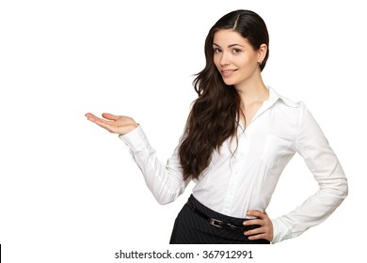
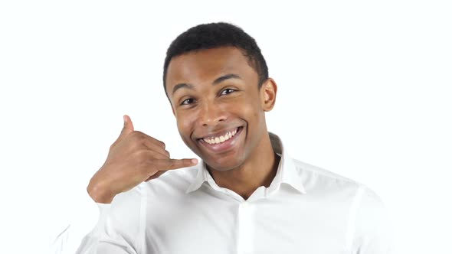
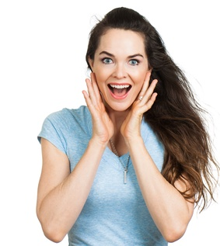
GRAMMAR FOCUS “Make and accept invitations”
Write invitations and acceptances in the blanks.
Would you like to go a rock concert on Friday?
How about watching a soocer game?
Yes, i’d love to
Sure, when?
Why don`to see a muscal?
Do you want to shopping on Sunday?
That sounds awesome
Sure, it’s a Good idea

Slide 9
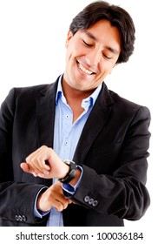
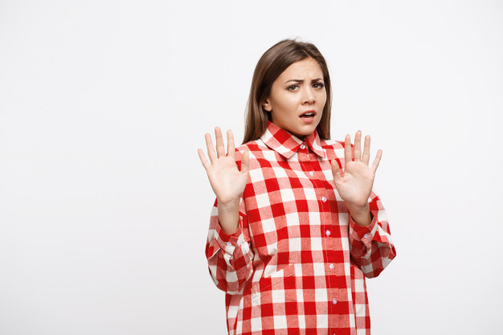
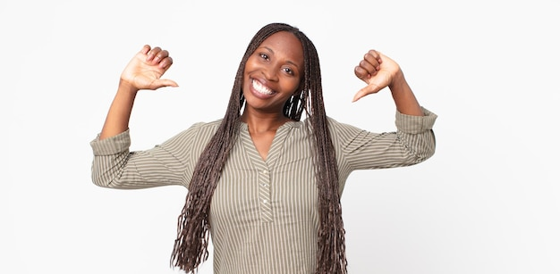
GRAMMAR FOCUS “Make and decline invitations”
Write invitations and refusements in the blanks.
Would you like to go to my mother´s house?
Do you want to go a restaurant at night?
Sory, but i’m really busy these days
I appreciatethe invite, but i have plans
Let’s go a party tomorrow
Why don’t we go a rock concert on saturday?
Can i take a rain check?
Sorry, but i have somethig else going on that day

Slide 10
Listening/SpeakingPractice
Listen, complete and practice the following conversations.
1.- A: Hey Lisa, ___Im going to_____the new art gallery on the weekend. ________would you like come________________with me ?
B:Sorry,___i can’t have to study for exam______on the weekend.
2.- A: Some of my friends and I ___going to sing_______karaoke tonight. _____Do you want to join us__________________________________?
B: Thanks, ___id love too. I sounds fine____________________
3.- A: There’s a technology show at the International Convention Centre. ____would you like to go_________?
B: Yes. ___i’d love too__________. Will they have smartphones? I ___need a new one___.
4.- A: Hey Jim, ___going to see a concert___a concert tonight at the stadium? I was wondering if ____you like to go____?
B: Thanks ______for asking______. But ___I have it to work to night_______.

Slide 11
Vocabulary Practice
Online activity
Click on the links and practice. Then share your results of your practice.
https://www.liveworksheets.com/cg246212to
Insert here your results
https://wordwall.net/es/resource/5496724/friendship/8-s%c4%b1n%c4%b1f-ingilizce-1-%c3%bcnite-friendship-invitation
Insert here your results
https://wordwall.net/es/resource/16860711/accepting
Insert here your results

