Slide 1
UNIT 5
Lesson 2
How about having dinner?
LESSON OBJECTIVE:
Learn language function; make, accept and decline invitations

Slide 2
VOCABULARY “Events”
Workbook pg 25 ex1
Match the words in columns A and B. Write the names of the events
Birthay party
Birthay party
Birthay party
Birthay party
Birthay party
Birthay party

Slide 3
VOCABULARY “Events”
Studentbook pg 31 ex4
Complete the chart with words and phrases from the list.
A soccer game
Barbecue
A rock concert
A video game tournament
A wedding
A hip-hop dance preformance
A car race
A birthday party
A film festival
A baseball game
A class reunion
A musical

Slide 4
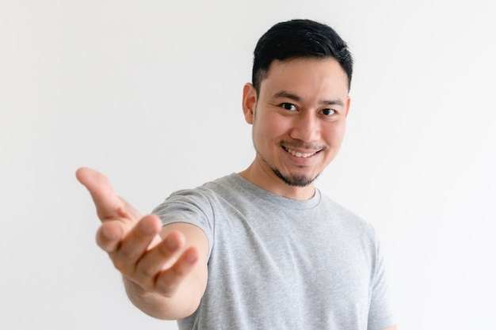
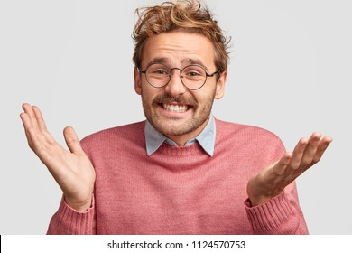
GRAMMAR FOCUS “Make and accept invitations”
Formal and informal ways to make invitations.
Polite Form: Would you like to go out on Friday?
Casual Form: Do you want to go out on Friday?
Why don´t we go out on Friday?
Informal Form: How about going out on Friday?
Let´s go out on Friday.
Formal and informal ways to accept invitations.
Polite Form: Yes, I´d love to.
Casual Form: Sure, what time?
Informal form: That sounds great!
Formal and informal ways to decline invitations.
Polite Form: I appreciate the invite, unfuntunately I can´t go.
I´m sorry, but I have plans.
Casual Form: Maybe another day, I´m busy these days.
Informal Form: Can I take a rain check?
You can apologize
and add an excuse to justify the refuse.

Slide 5
Language functions Practice
studentbook pg 30 ex 1
Read the following article, practice some expressions to decline an invitation politely.

Slide 6
Accept or Decline invitations

Slide 7
SpeakingPractice
studentbook pg 30 ex 2
Practice the following conversation. “Are you doing anything tomorrow?
Where are Alicia and Mike going to have dinner?
Who are they going to meet for dinner?

Slide 8
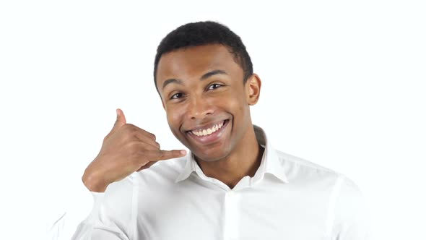
GRAMMAR FOCUS “Make and accept invitations”
Write invitations and acceptances in the blanks.
Lets go out on friday
Would you like go to dinner?
That sounds great!
Yes, I´d love to.
Lets go the gym on friday
Why don´t we go to the party?
Sure, what time?
That sounds great!

Slide 9
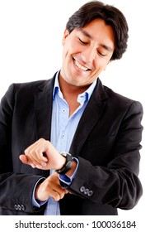
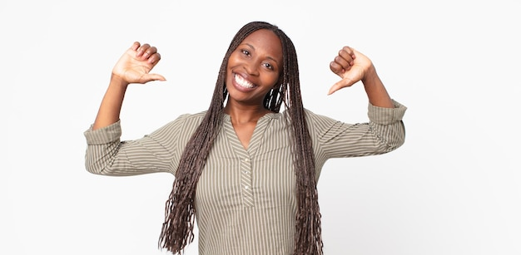
GRAMMAR FOCUS “Make and decline invitations”
Write invitations and refusements in the blanks.
Would you like to go to my mother´s house?
Let´s go to cinema on monday.
I´m sorry, but I have plans.
Can I take a rain check?
Do you want to go a bar?
Maybe another day, I´m busy these days.
:I appreciate the invite, unfuntunately I can´t go.
Can I take a rain check?

Slide 10
Listening/SpeakingPractice
Listen, complete and practice the following conversations.
1.- A: Hey Lisa, ________________the new art gallery on the weekend. ________________________with me ?
B:Sorry,_____________________________on the weekend.
2.- A: Some of my friends and I ___________karaoke tonight. __________________________________________________?
B: Thanks, ________________________
3.- A: There’s a technology show at the International Convention Centre. ___________________________?
B: Yes. ______________. Will they have smartphones? I _______________.
4.- A: Hey Jim, ____________a concert tonight at the stadium? I was wondering if _____________?
B: Thanks ____________. But _________________.
Im going
Would you like to going
I cant
Are going to sing
Do you want to jping us
Id love to sounds like fun
Would you like to go
Id love to
Need a new one
Were go to see
You loke to go
For asking
I have to wok

Slide 11
Vocabulary Practice
Online activity
Click on the links and practice. Then share your results of your practice.
https://www.liveworksheets.com/cg246212to
Insert here your results
https://wordwall.net/es/resource/5496724/friendship/8-s%c4%b1n%c4%b1f-ingilizce-1-%c3%bcnite-friendship-invitation
Insert here your results
https://wordwall.net/es/resource/16860711/accepting
Insert here your results

