Slide 1


Slide 2


Escuela Normal de Preescolar
English III.
Sharing information and ideas
School year 2022-2023
CEFR Level A2.1
Term I
Number of hours/ Credits: 4/4.5
Class schedule: Mondays 7.45 to 9 15 a.m. Tuesdays 11.15 to 12.45 p.m.
Teacher: Beatriz Eugenia Valdés Rodríguez

Slide 3
Course purpose
The English Language Course for Escuelas Normales is designed to develop students’ ability to communicate effectively in English contexts that will be important for them. As future teachers in a society where English is increasingly important for engaging successfully with professional and social activities, it is essential that all students develop a good level of proficiency in English.

Slide 4
English is growing in importance for accessing information, making useful contacts, understanding other cultures and participating in cultural activities.
As UNESCO has said: Linguistic competencies are fundamental for the empowerment of the individual in democratic and plural societies, as they condition school achievement, promote access to other cultures and encourage openness to cultural exchanges (UNESCO 2007:13). English is particularly important for students because of its role un multinational communicative settings (Hyland 2011).

Slide 5
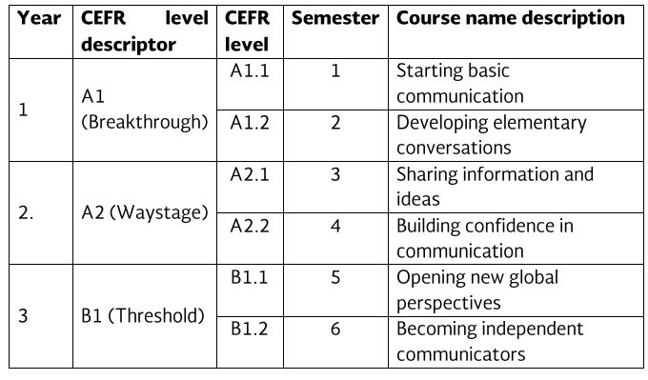
Course Progression
Previous course
Subsequent course

Slide 6
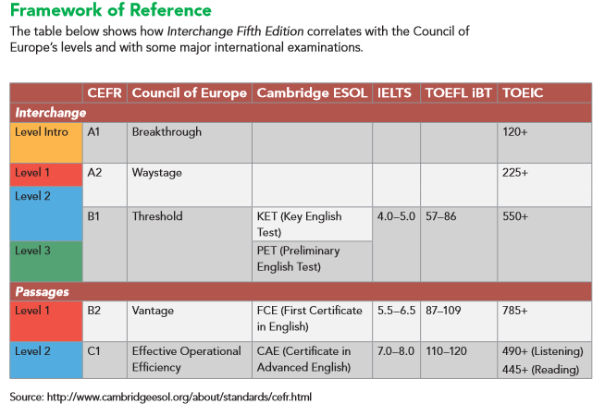

Slide 7
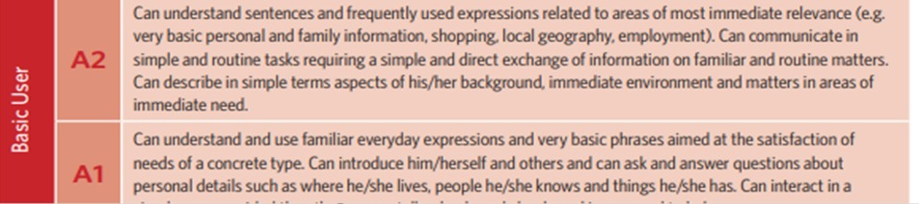
Common European Framework of Reference (CEFR)
BASIC USER

Slide 8
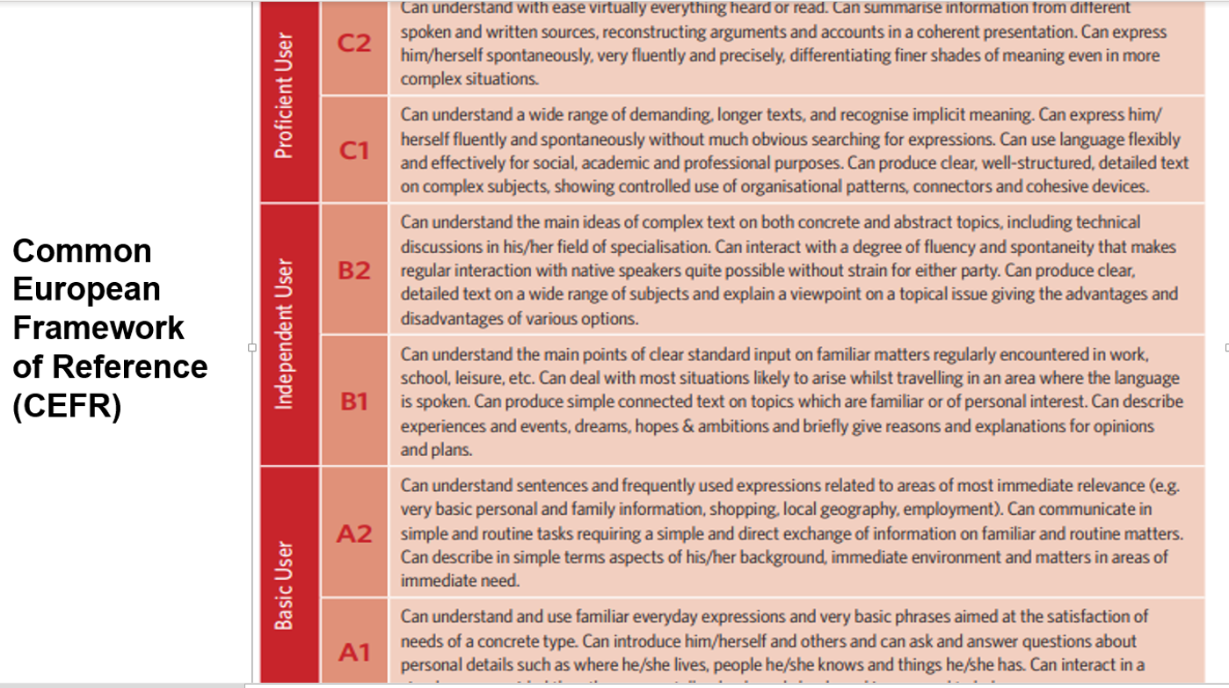

Slide 9
The course has three main objectives:
Develop their ability to use English in personal and social communications, to develop relationships, complete transactions and meet everyday needs.
Increase their engagement with cultural and intercultural activities in English, in order to develop a better understanding of their own culture as well as other cultures around the world.
Develop their ability to teach in a school environment where English is an important aspect of the school’s approach. Schools are expected to use English increasingly for various teaching and learning activities, and future teachers need to be confident in using English in the school environment.

Slide 10
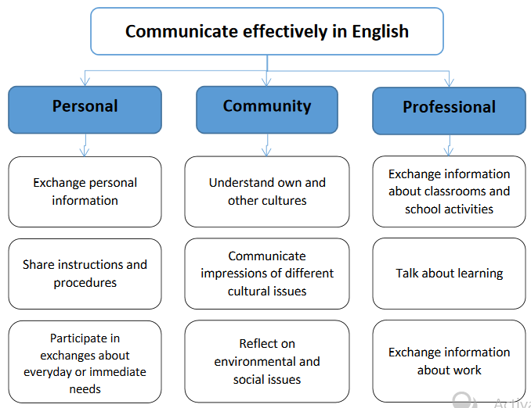

Slide 11
Course Description
The English language course is based on the communicative approach to language learning in line with the Common European Framework of Reference form the Council of Europe. More specifically, there are five main principles of language learning that underpin this curriculum:
Focus on meaningful communication
Teach authentic English.
Students learn most effectively through doing.
Students lean best when motivated and engaged
Differentiate the teaching according to different interests and needs among each group of students.

Slide 12
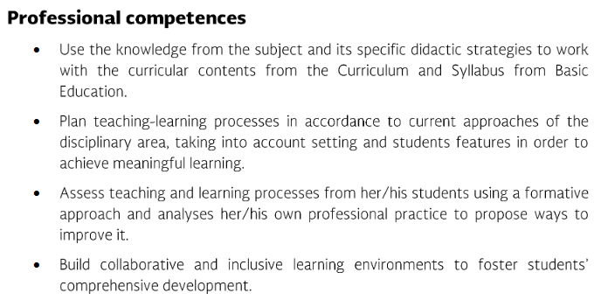
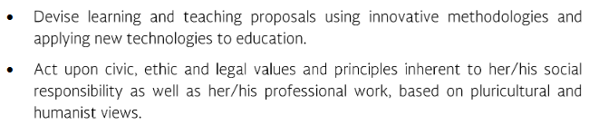

Slide 13
Competences of the degree profile developed by the course
SUBJECT-SPECIFIC
Describe ways of living from different cultures to appreciate their diversity.
Use language to establish harmonious and responsible relationships when exercising citizenship.
Reflect on one´s own learning process to act consciously in communicative exchanges.
Understand and produce texts to participate in a variety of everyday and concrete situations.
Exchange basic information about personal and professional experiences.
Recognize cultural differences when participating in brief and common exchanges.

Slide 14
Course structure
PERIOD | BOOK UNITS | CONTENTS | LEARNING EVIDENCES
1 | 1.-Where are you from? | Introductions and Greetings, names, countries and nationalities | Project “This is me!”
 | 2.- What do you do? | Jobs, workplaces, and school, daily schedules; clock time | Project “What do you do?”
2 | 3.- How much are those? | Shopping and prices; clothing and personal ítems; colors and materials | Project “How much is this?”
 | 4.- Do you play the guitar? | Talking about likes and dislikes; giving opinions; making invitations and excuses | Project “Radio Show”
3 | 5.- What an interesting family! | Family members; typical families | Project “Family Song”
 | 6.- How often do you run? | Sports, fitness activities, and exercise routines. | Project “Sports Star”

Slide 15
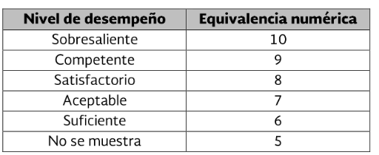
Assessment Criteria
Criterios de Evaluación por unidad | Porcentajes de Evaluación Formativa Sumativa
Classwork and homework | 30%
Platform (Cambridge and ELL) | 20%
Projects |  | 25%
Exam |  | 25%

Slide 16
Assessment Criteria
Attendance, punctuality, attitude, complete materials, respect, and
classwork
EVALUATION OF THE SEMESTER
AVERAGE OF LEARNING UNITS | 50%
FINAL EVIDENCE (INTERVIEW) | 50%

Slide 17


Global Evaluation
NOTE:
In case you fail one of the learning units, you will not be allowed to present the final evidence losing 50% of your global evaluation. In which case, you will have to present the extraordinary exam.
In order to have two opportunities to regularize your status you must attend 85% of class hours.
50%
50%
Average of learning units 1-3
Final Evidence
(Speaking)

Slide 18
NOTA IMPORTANTE
El estudiante acreditará el curso cuando obtenga como mínimo en la evaluación global del nivel de desempeño, su equivalencia numérica de 6.
El estudiante acreditará el nivel una vez que evidencie el desarrollo de las habilidades propias del nivel de inglés con base en el CEFR mediante una entrevista realizada al final del ciclo escolar.
En caso de que el estudiante no logre el desarrollo de las habilidades necesarias para obtener el nivel de inglés que esté cursando, se evaluará con base en el desempeño del estudiante, sin embargo, tendrá que cursar nuevamente el nivel.

Slide 19
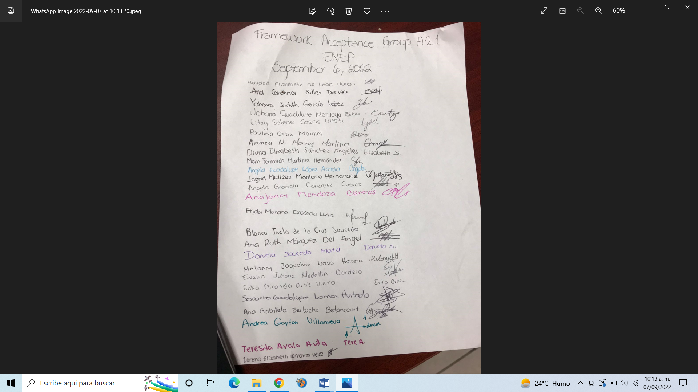
Signature agreement for framework

Slide 20
Course policies
Course Materials: Failure to bring the book results in losing points per day.
Homework: There will be regular online homework tasks, as well as homework related to textbook material. If you are absent for any reason, it is your responsibility to find out the homework assigned.
Late homework: It is your responsibility to turn in homework assignments on time. In case you present homework assignments or projects after the stablished due date, The maximum grade will be 70
Grading: Your course grade will depend on performance on tests, speeches given, and participation. Satisfactory participation means completing the tasks assigned in class and interacting with your classmates in English at all times. Quizzes, tests, speeches, and other presentations cannot be made up unless the student has an excuse absence by ENRE. This means that if a student is not in class for this work, he or she will receive a grade of 0 for the missed work.

Slide 21
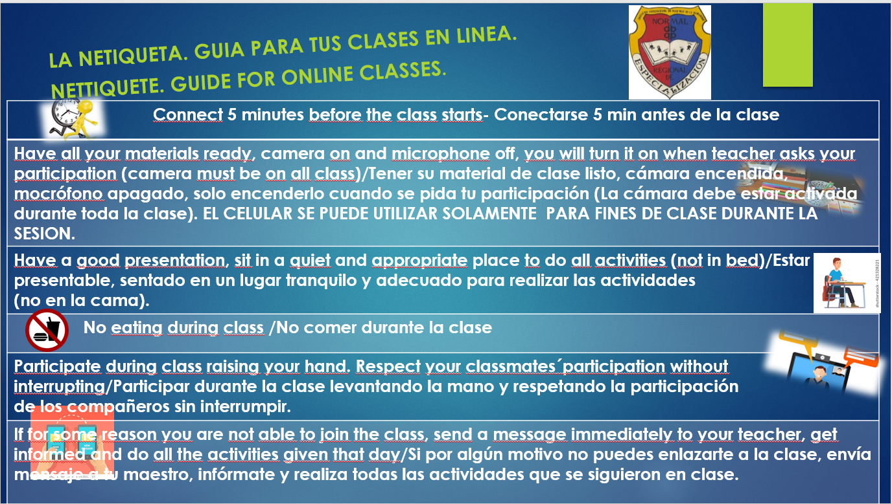

Slide 22
Policies about being late and being absent.
In accordance to ENEP ‘s policies, you must attend 85% of class time hours.
Class participation grade will be affected if you:
Arrive late or leave early.
Miss class.
Sleep during a class.
Read anything during class which is not related to class activities.
Speak Spanish in class.
Disrespect teacher or classmates during the class.
Please turn off cell phones during class!
Cell phones should be turned off in class; no texting may be done in class. In addition, students may not use electronic devices with earphones in class nor may they do recreational activities on computers. Electronic dictionaries may be used in class but not during tests.

Slide 23

Treat each other with LOVE
BE….
Respectful
Honest
Patient Neat
Tolerant
Participative
Receptive
Confident
Positive
INTERESTED
CONCENTRATE
AND
HAVE FUN!

Slide 24
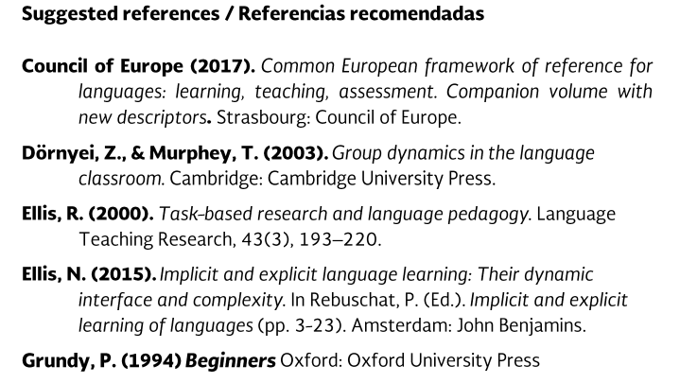
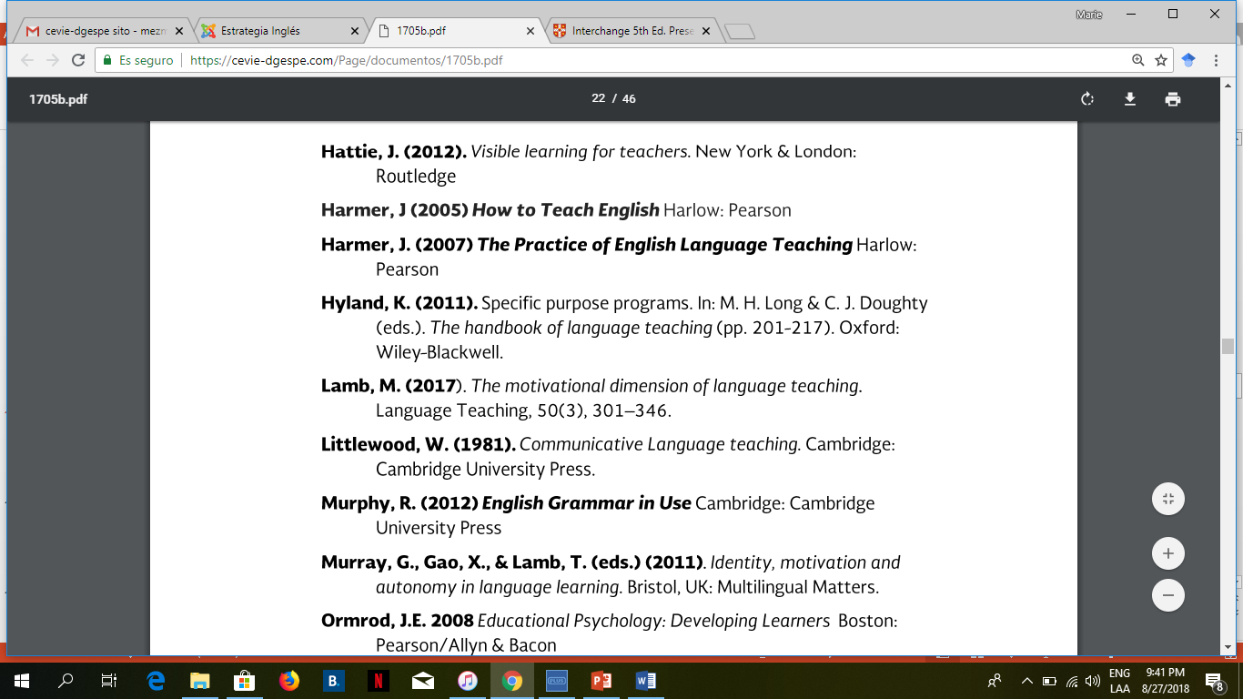
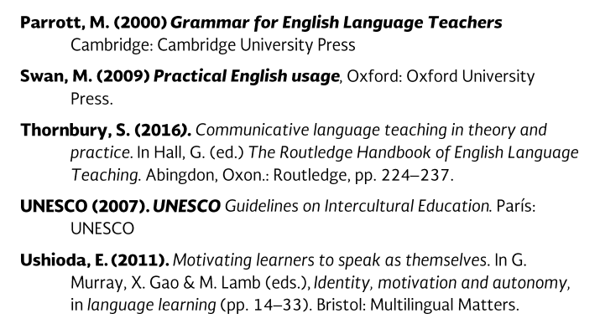

Slide 25




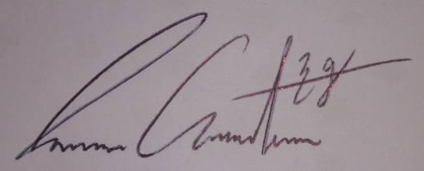


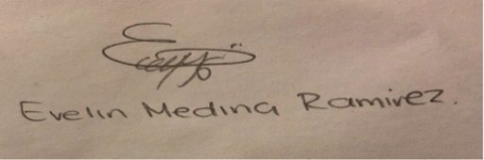


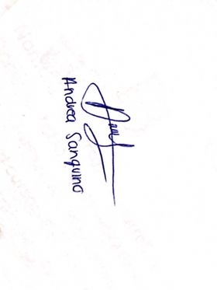
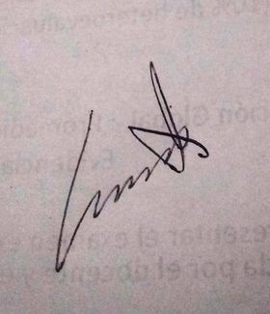


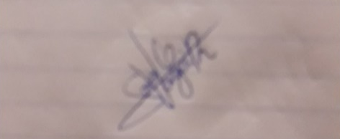
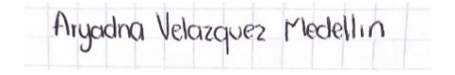

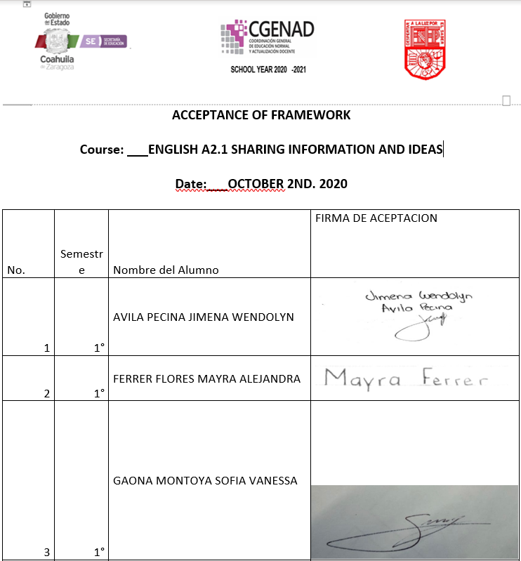
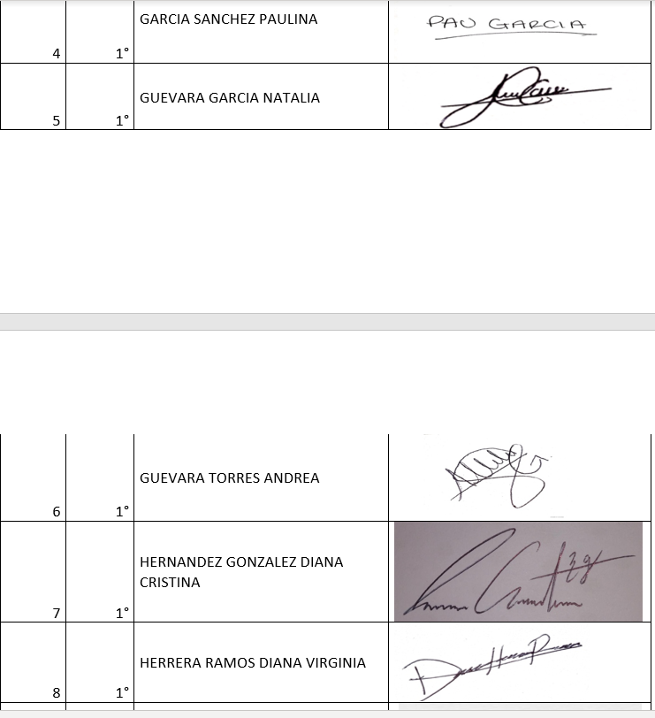

Slide 26
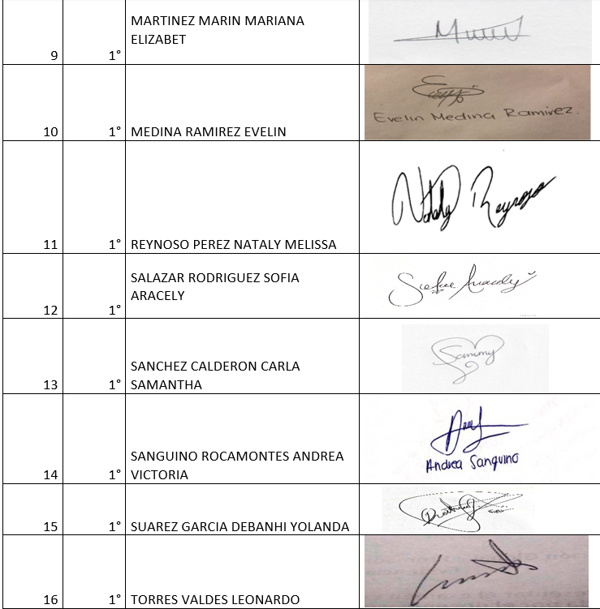
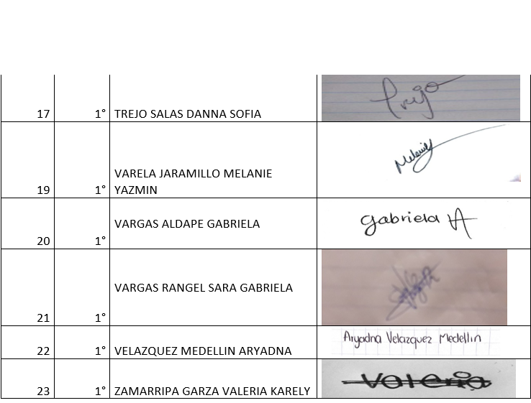

Slide 27
Additional online references and resources
Learning English. http://www.bbc.co.uk/learningenglish
Teaching adults. https://www.teachingenglish.org.uk/teaching-adults
Adult learners. https://elt.oup.com/learning_resources/courses/adultlearners/?cc=mx&selLanguage=en
Learning English. https://www.cambridgeenglish.org/learning-english/
Teacher’s corner. https://americanenglish.state.gov/teachers-corner
Classroom resources. Pearson. https://www.pearsonelt.com/professional-development/resources.html
Teaching adults. Oxford. https://elt.oup.com/teachersclub/courses/teachingadults/?cc=mx&selLanguage=en
For teachers. BBC. http://www.bbc.co.uk/worldservice/learningenglish/teach/
Onestop English. http://www.onestopenglish.com/
The digital teacher. https://thedigitalteacher.com/
https://visuwords.com/
https://www.eslvideo.com/
https://es.lyricstraining.com/
https://www.busuu.com/es
http://intermediatelow.blogspot.com/
https://www.englishclub.com/
http://www.topics-mag.com/
http://www.readableblog.com/
https://dictionary.cambridge.org/es/
http://www.bbc.co.uk/learningenglish
https://www.tefl.net/
http://www.elllo.org/

