Slide 1
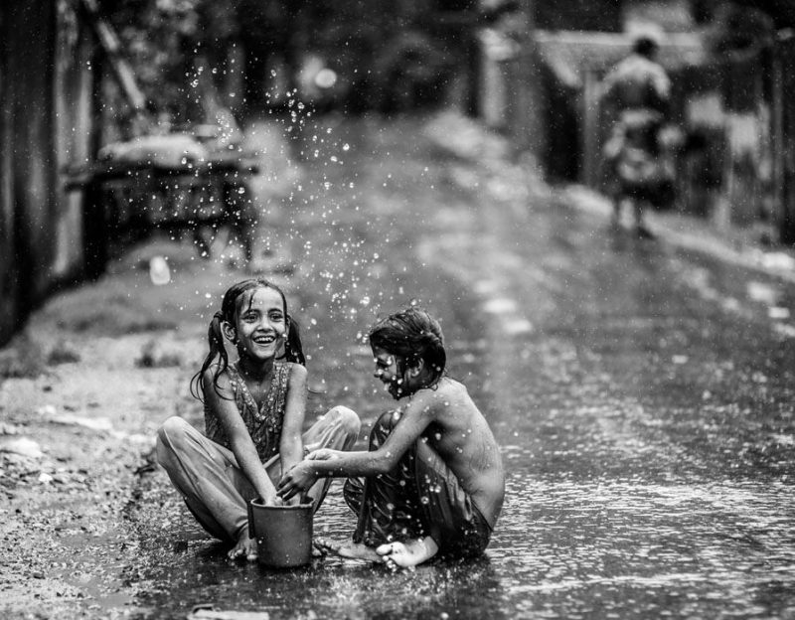
It is rainy today, ______ Melissa and Bob ___________ raincoats.
Melissa ___________ a t-shirt ______ pants. And Bob ___________ jeans _____ he ____________ a t-shirt

Slide 2
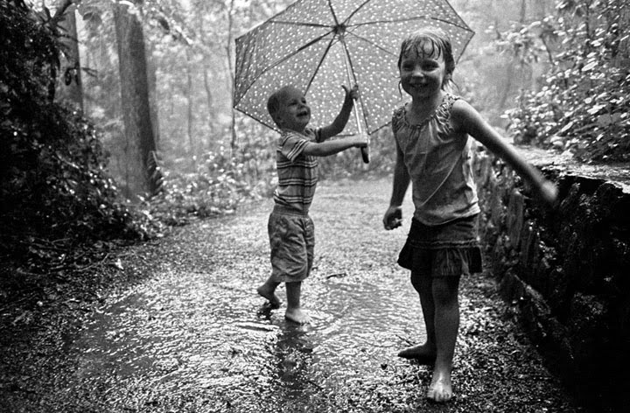
It is ___________ today, ______it is warm.
They ___________ raincoats, ______ they__________t-shirts, shorts ______ an umbrella.

Slide 3
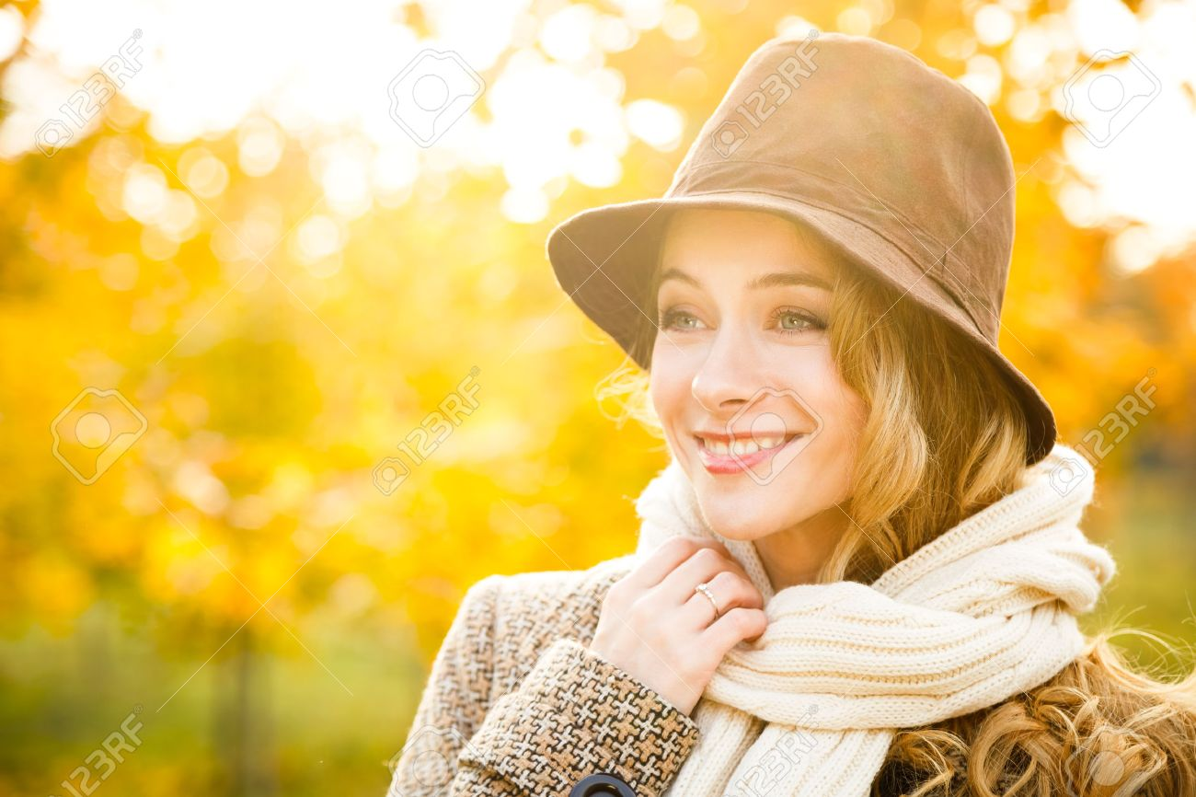
It is fall, it is ________ today, _________it is cold, __________she ___________ hat, a coat, _______ a scarf.

Slide 4
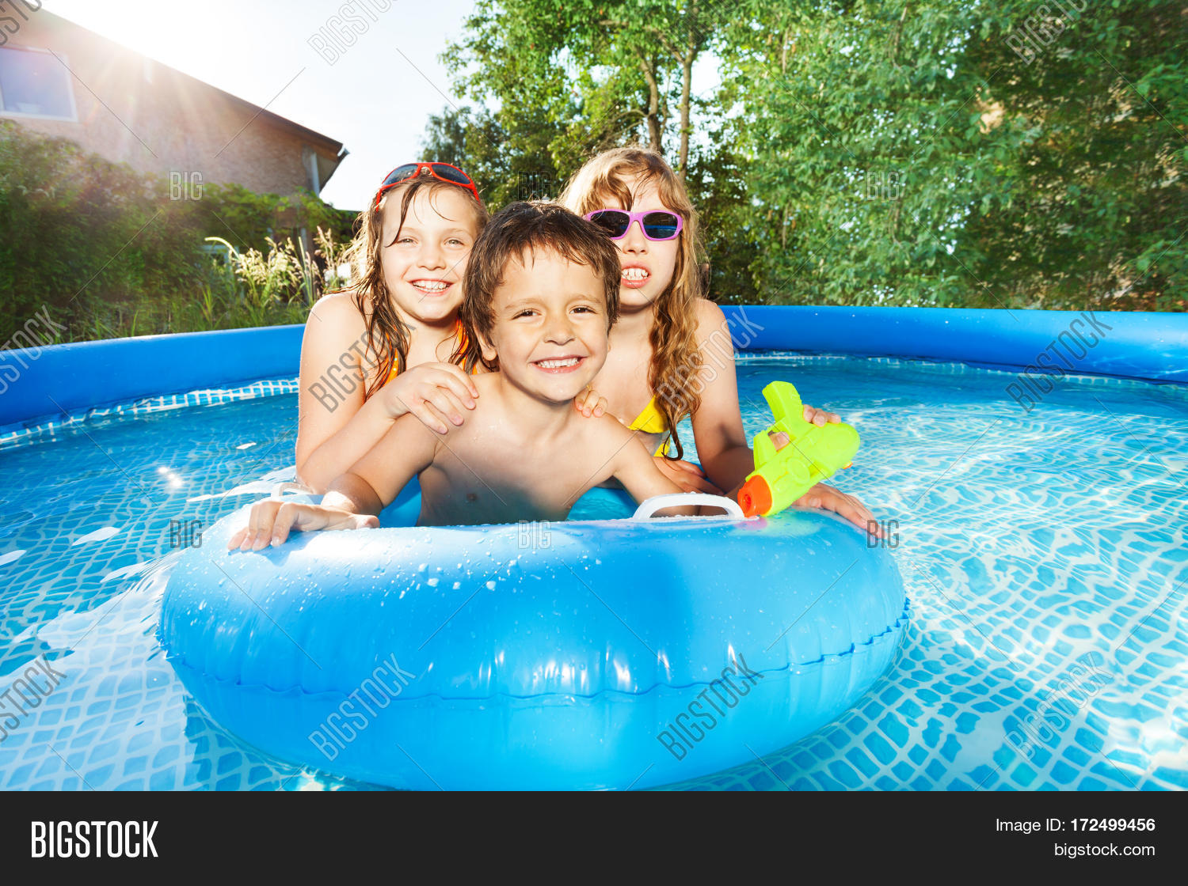
_______ sunny today, and ________ hot. ________ they ________ sunglasses _______ swimsuits.

Slide 5
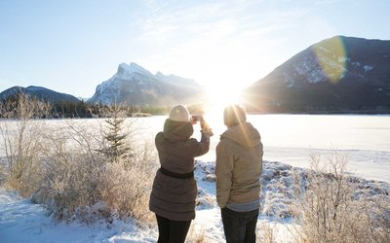
It is winter, it is snowy. ________ today, _________it is cold. They_____________ hats, boots ____ coats,

Slide 6
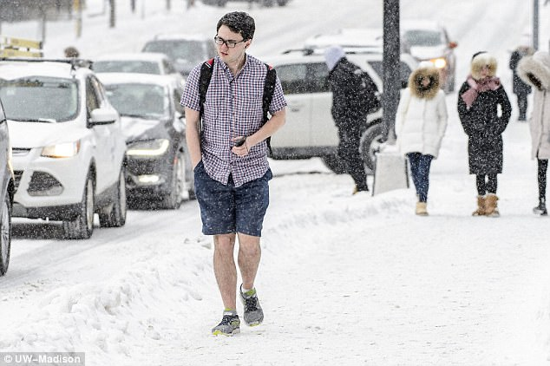
It is Winter.
It is snowy, ________ cold, ___ he _____________ winter clothes, he_______ a shirt ____ shorts,

Slide 7
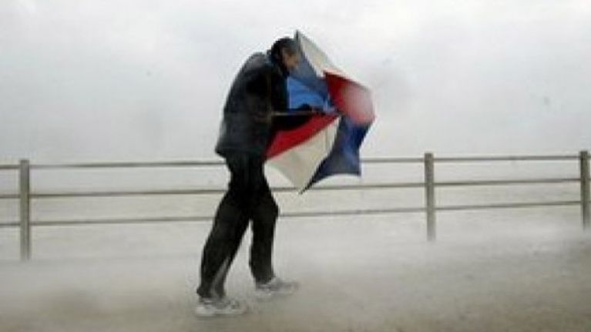
It is ___________and __________ today.
________cool, _____
He ___________ a raincoat, _____ an umbrella.

