Slide 2
Answer the following questions
What does Victor do in his free time?
What sports does victor like?
How often does victor practice sports?

Slide 3
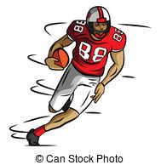
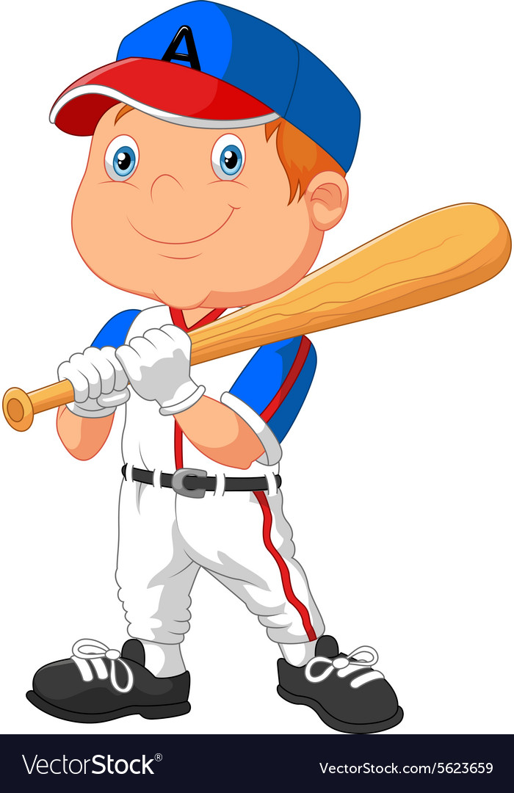
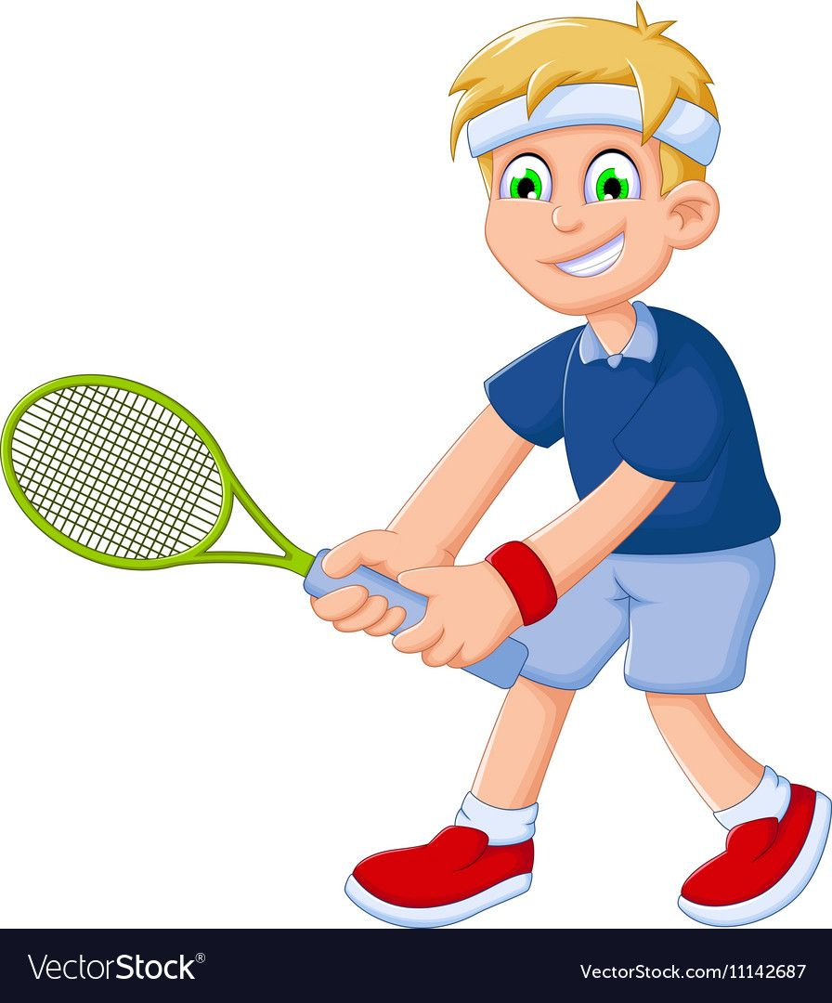
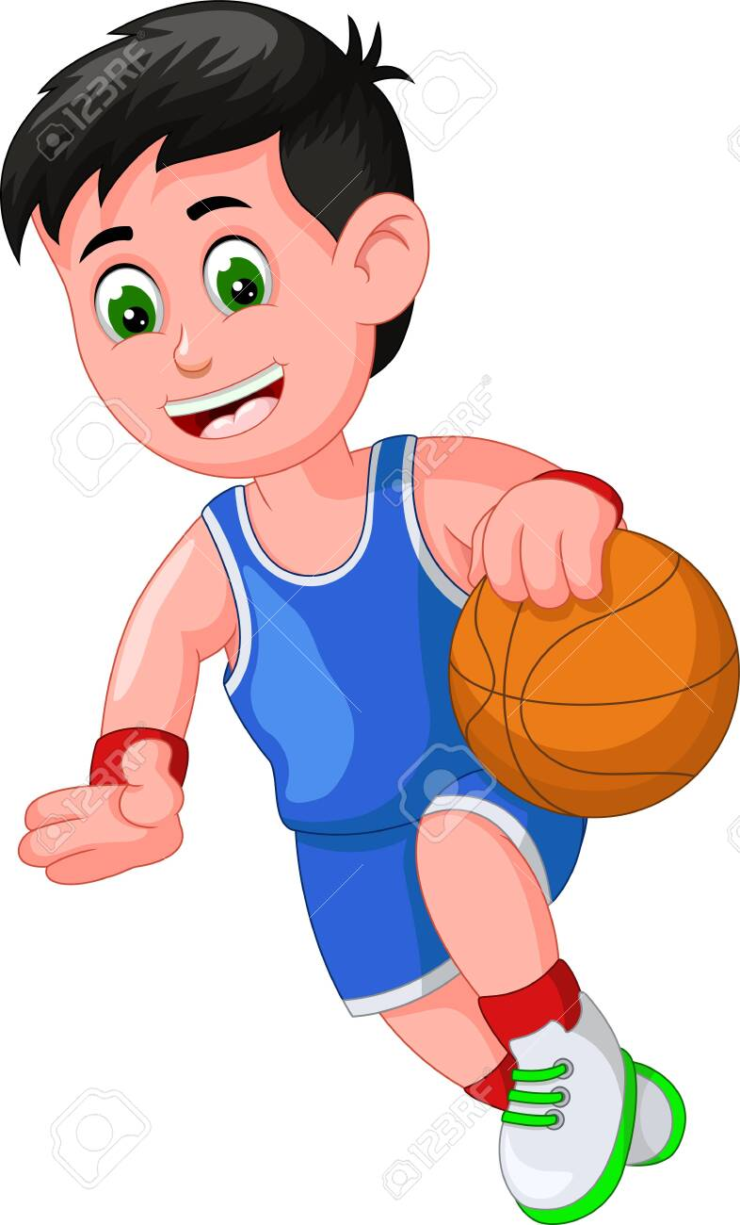
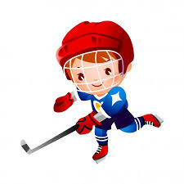
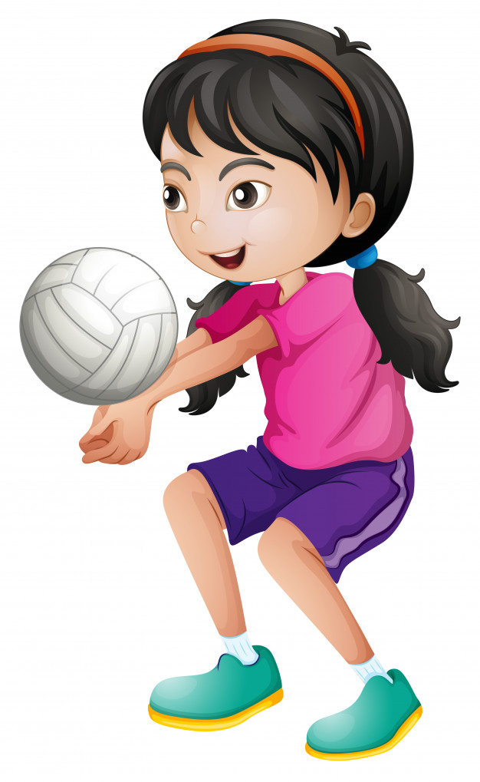
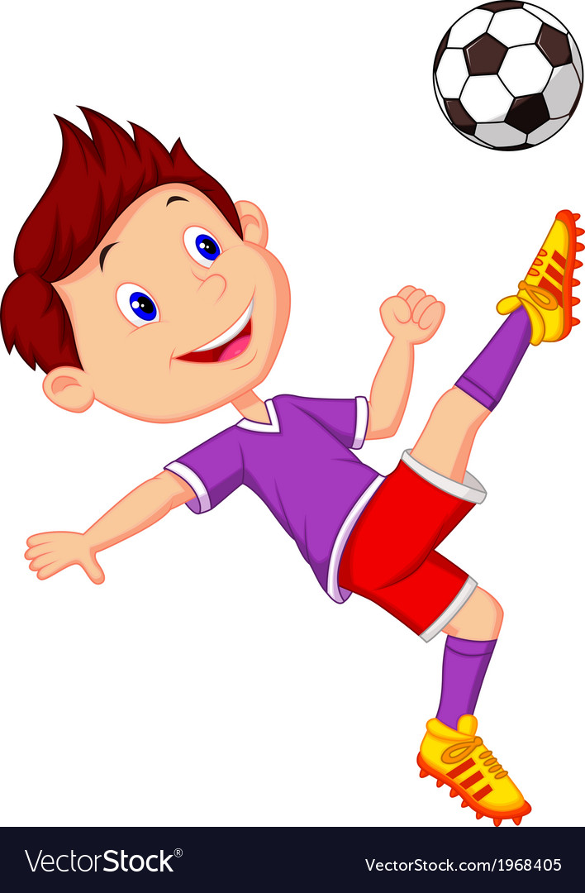
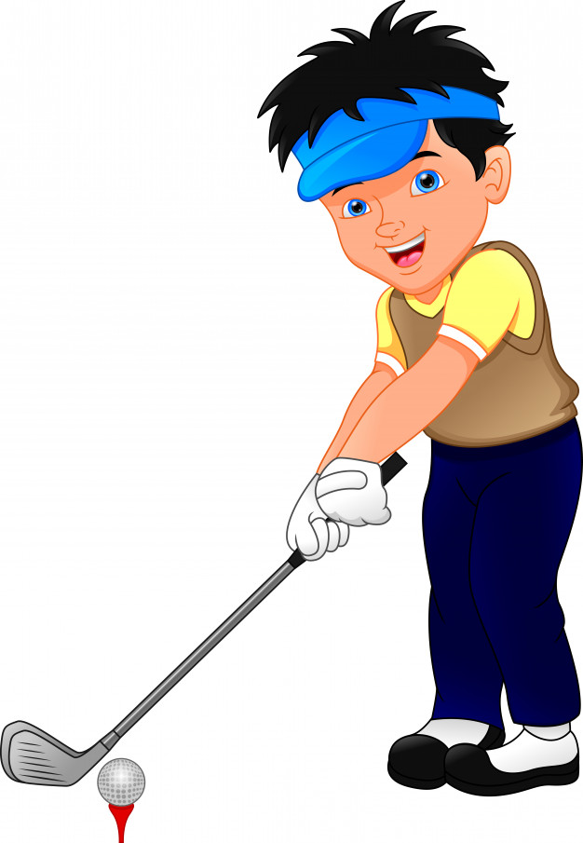
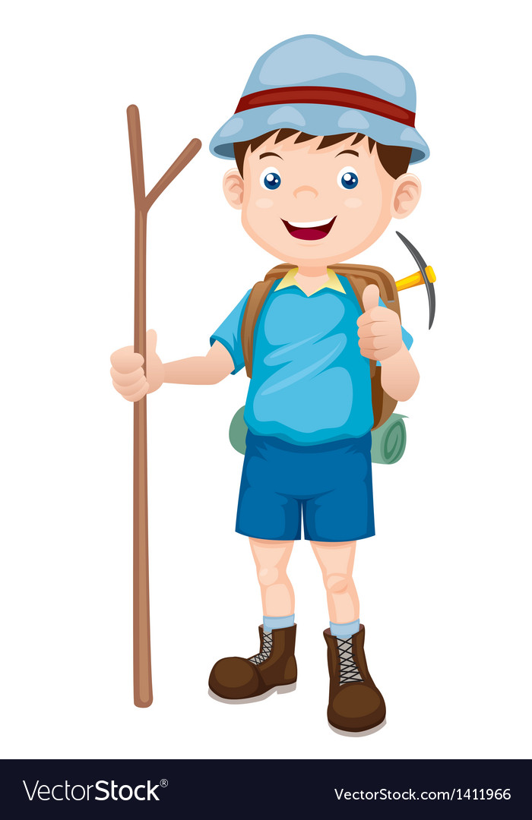
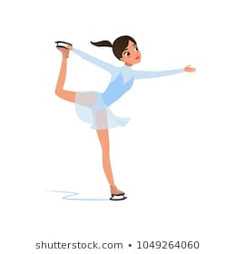
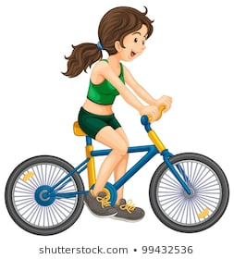
Writedown the name to the sport.

Slide 4
Answer the following questions
Do you like sports?
What sports do you like?
What sports do you practice?
What sports are popular in your country?

Slide 5
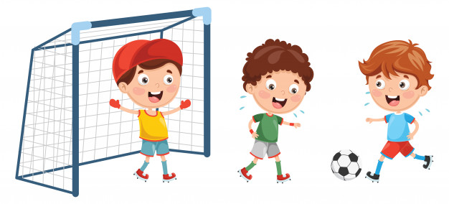
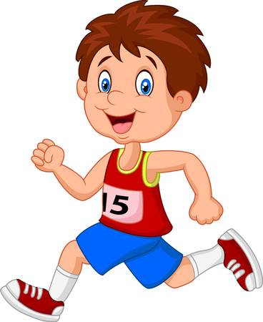
Play or Go ?
When do we use play or go with sports?
1. Use PLAY for team sports or sports played with a ball:
Football baseball
2. Use GO for sports that end in –ing
Swimming running

Slide 6
Go |  | Play

