Slide 3
LA NETIQUETA. GUIA PARA TUS CLASES EN LINEA.
NETTIQUETE. GUIDE FOR ONLINE CLASSES.
Connect 5 minutes before the class starts / Conectarse 5 min antes de la clase
Have all your materials ready, camera on and microphone off, you will turn it on when teacher asks your participation (camera must be on all class) / Tener su material de clase listo, cámara encendida, micrófono apagado, solo encenderlo cuando se pida tu participación (La cámara debe estar activada durante toda la clase). EL CELULAR SE PUEDE UTILIZAR SOLAMENTE PARA FINES DE CLASE DURANTE LA SESION.
Have a good presentation, wear your uniform, sit in a quiet and appropriate place to do all activities (not in bed)/Estar Presentable con el uniforme escolar (o ropa en colores similares), sentado en un lugar tranquilo y adecuado para realizar las actividades (no en la cama).

Slide 4
No eating during class /No comer durante la clase
Participate during class raising your hand. Respect your classmates´participation without interrupting/Participar durante la clase levantando la mano y respetando la participación de los compañeros sin interrumpir.
If for some reason you are not able to join the class, send a message immediately to your teacher, get informed and do all the activities given that day/Si por algún motivo no puedes enlazarte a la clase, envía mensaje a tu maestro, infórmate y realiza todas las actividades que se siguieron en clase.

Slide 5
PENDING ACTIVITIES

Slide 6
ESCUELA NORMAL DE EDUCACIÓN PREESCOLAR ENGLISH B2+ ONLINE UNIT 1: CALENDAR OF ACTIVITIES
WEEK | DAY | CLASS HOURS | ACTIVITIES ASSIGNED
Week 1 October 5th – 9th | Monday | Class hour 1 | EFS Platform Unit 1 Lessons 1 and 2
 |  | Class hour 2 | EFS Platform Unit 1 Lessons 3 and 4
 | Wednesday | Class hour 3 | EFS Platform Unit 1 Lesson 5
 |  | Class hour 4 | Escuela en Red Activity U1/L1-5
 | Friday | Class hour 5 | Zoom meeting
 |  | Class hour 6 | Assessment activity
Week 2 October 12th - 16th | Monday | Class hour 1 | EFS Platform Unit 1 Lessons 5 and 7
 |  | Class hour 2 | EFS Platform Unit 1 Lessons 8 and 9
 | Wednesday | Class hour 3 | EFS Platform Unit 1 Lessons 10 and 11
 |  | Class hour 4 | Escuela en Red Activity U1/6-11
 | Friday | Class hour 5 | Zoom meeting
 |  | Class hour 6 | Unit 1 test

Slide 7
ESCUELA NORMAL DE EDUCACIÓN PREESCOLAR ENGLISH B2+ ONLINE UNIT 2: CALENDAR OF ACTIVITIES
WEEK | DAY | CLASS HOURS | ACTIVITIES ASSIGNED
Week 3 October 19th – 23rd | Monday | Class hour 1 | EFS Platform Unit 2 Lessons 1 and 2
 |  | Class hour 2 | EFS Platform Unit 2 Lessons 3 and 4
 | Wednesday | Class hour 3 | EFS Platform Unit 2 Lesson 5
 |  | Class hour 4 | Escuela en Red Activity U2/L1-5
 | Friday | Class hour 5 | Zoom meeting
 |  | Class hour 6 | Assessment activity
Week 4 October 26th – 30th | Monday | Class hour 1 | EFS Platform Unit 2 Lessons 5 and 7
 |  | Class hour 2 | EFS Platform Unit 2 Lessons 8 and 9
 | Wednesday | Class hour 3 | EFS Platform Unit 2 Lessons 10 and 11
 |  | Class hour 4 | Escuela en Red Activity U2/6-11
 | Friday | Class hour 5 | Zoom meeting
 |  | Class hour 6 | Unit 2 test

Slide 8
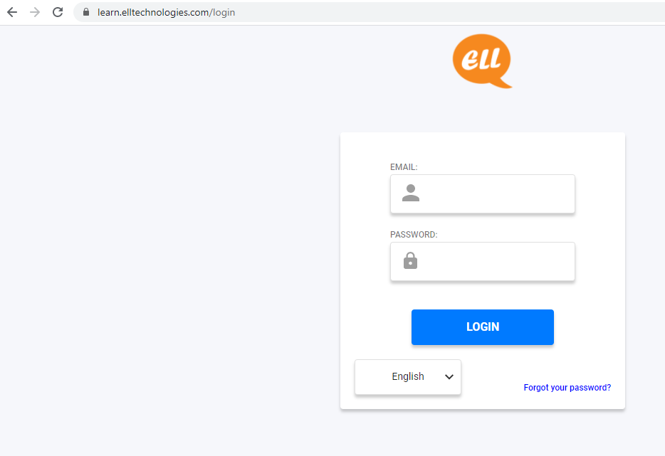
EFS LOG IN

Slide 9
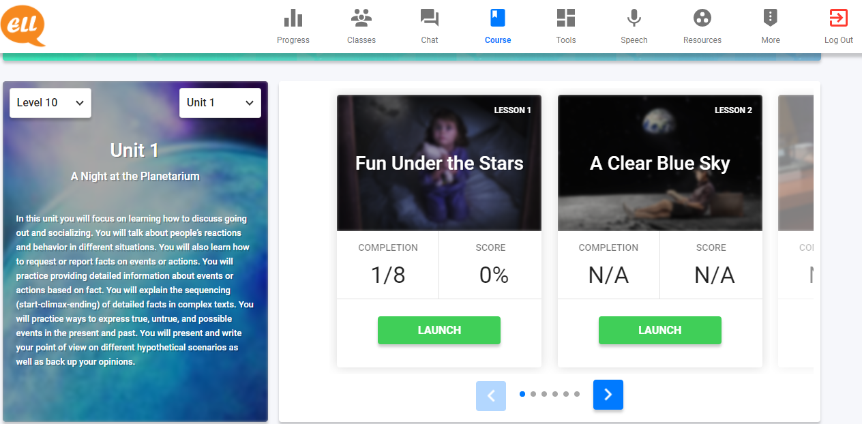
EFS UNITS AND LESSONS

Slide 10
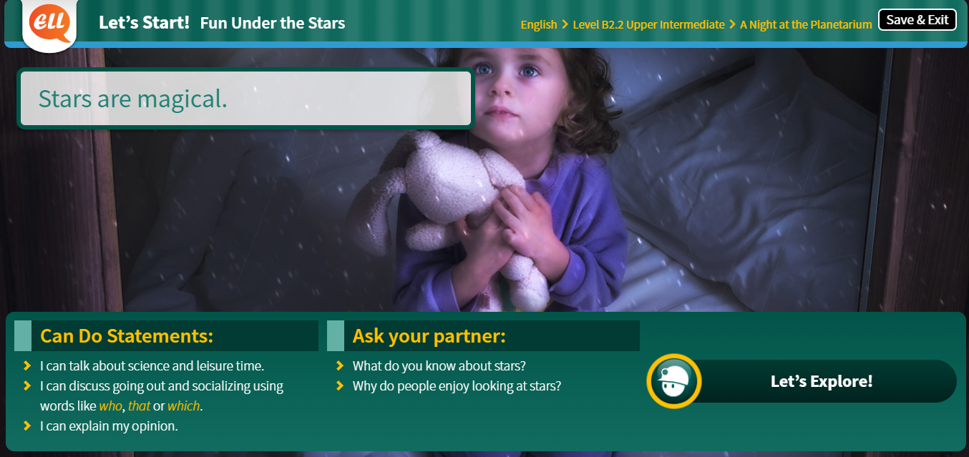
LET’S START! ONLINE SESSION

Slide 11
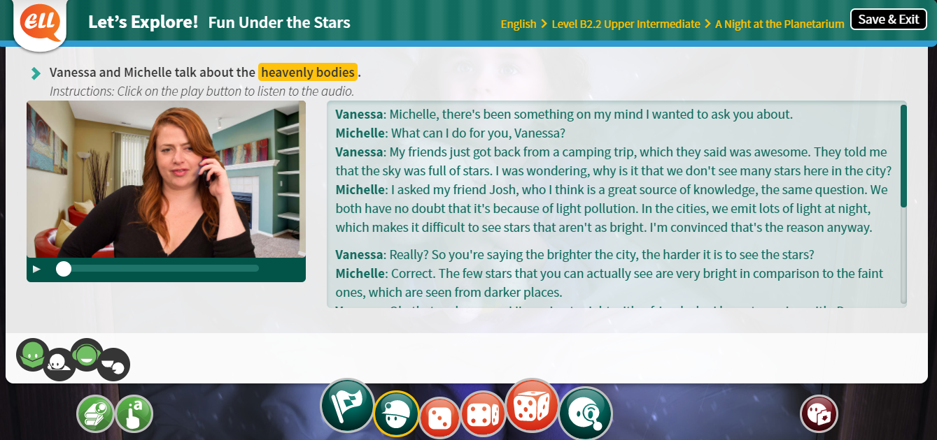
LET’S EXPLORE! ONLINE SESSION / AT HOME

Slide 12
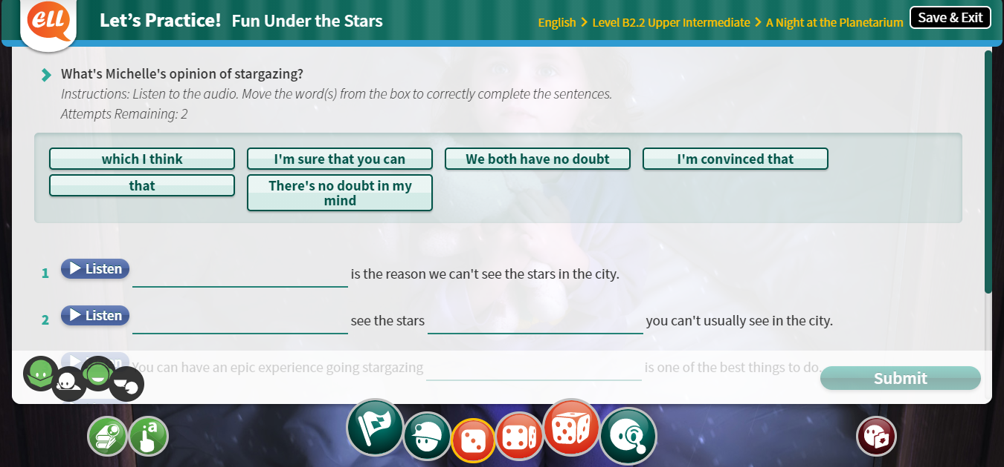
LET’S PRACTICE! AT HOME

Slide 13
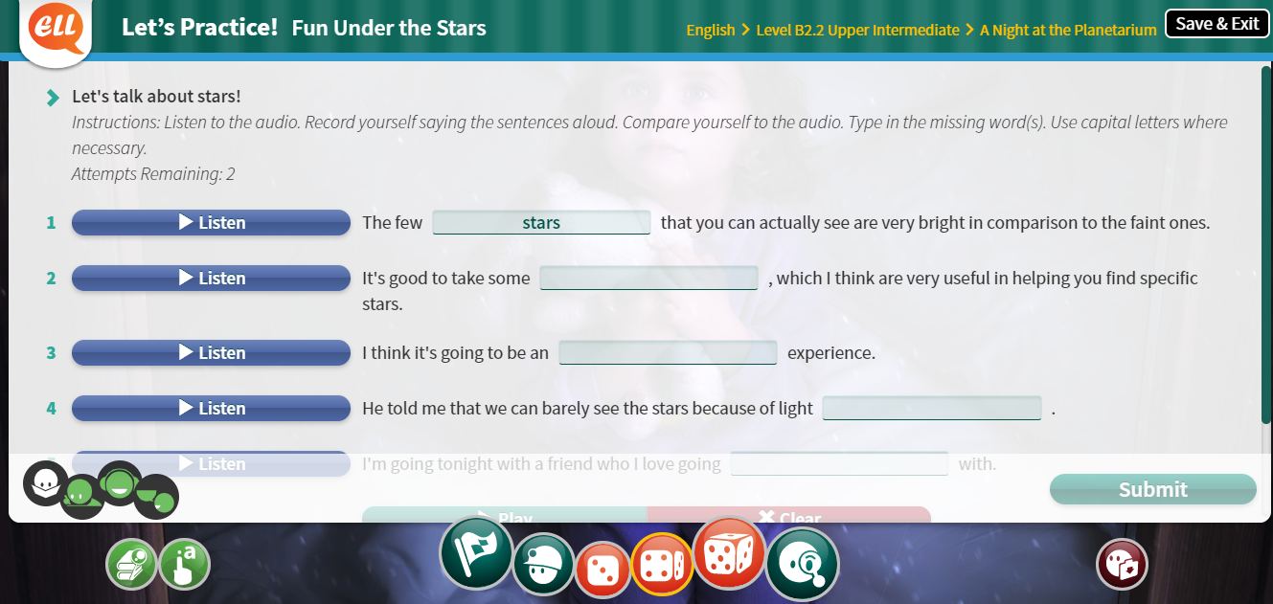
LET’S PRACTICE! (SPK) AT HOME

Slide 14
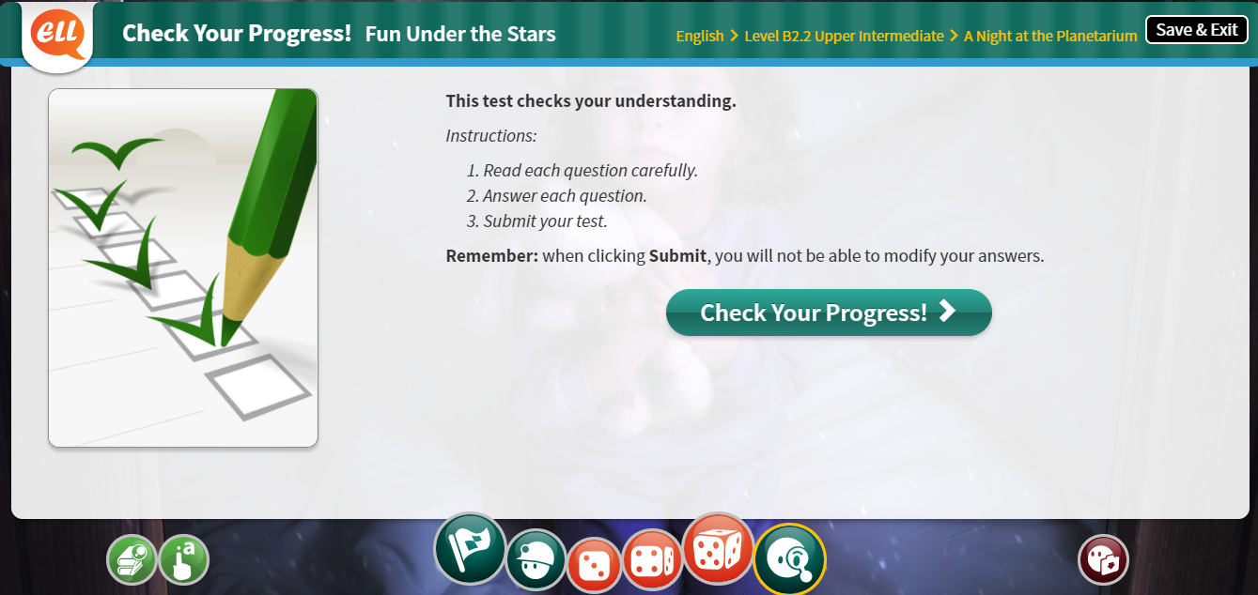
CHECK YOUR PROGRESS! AT HOME

Slide 15
TYPES OF EXERCISES

Slide 16
GRADING ACTIVITIES

Slide 17
GRADING ACTIVITIES

Slide 18
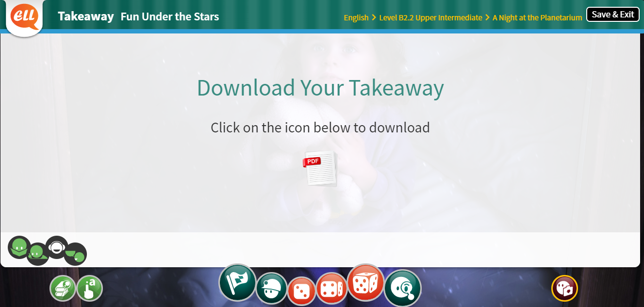
EXTRA RESOURCES LEARNING POINTS TARGET WORDS TAKEAWAY

Slide 19
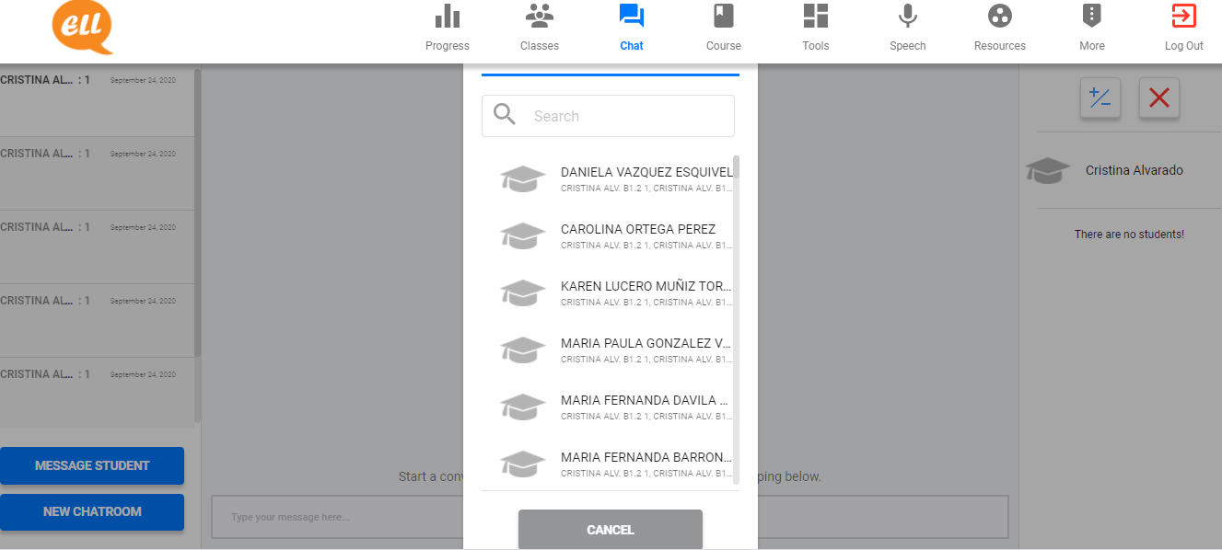

Slide 20
ESCUELA NORMAL DE EDUCACIÓN PREESCOLAR ENGLISH B2+ ONLINE CALENDAR OF ACTIVITIES
WEEK | DAY | CLASS HOURS | ACTIVITIES ASSIGNED
Week 1 October 5th – 9th | Monday | Class hour 1 | EFS Platform Unit 1 Lessons 1 and 2
 |  | Class hour 2 | EFS Platform Unit 1 Lessons 3 and 4
 | Wednesday | Class hour 3 | EFS Platform Unit 1 Lesson 5
 |  | Class hour 4 | Escuela en Red Activity U1/L1-5
 | Friday | Class hour 5 | Zoom meeting
 |  | Class hour 6 | Assessment activity

