Slide 1
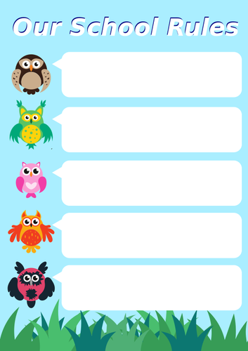
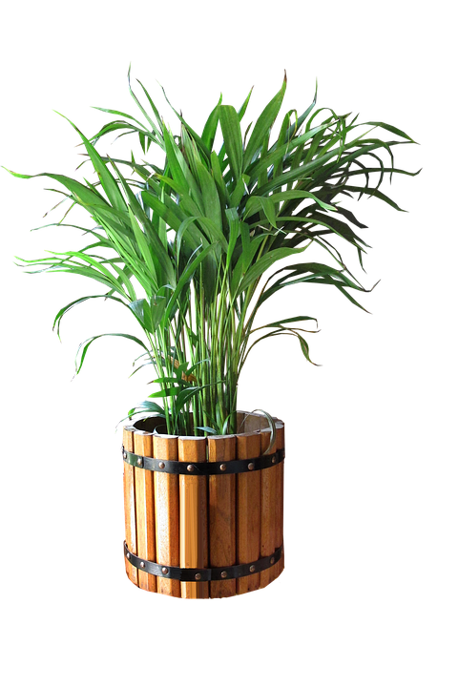
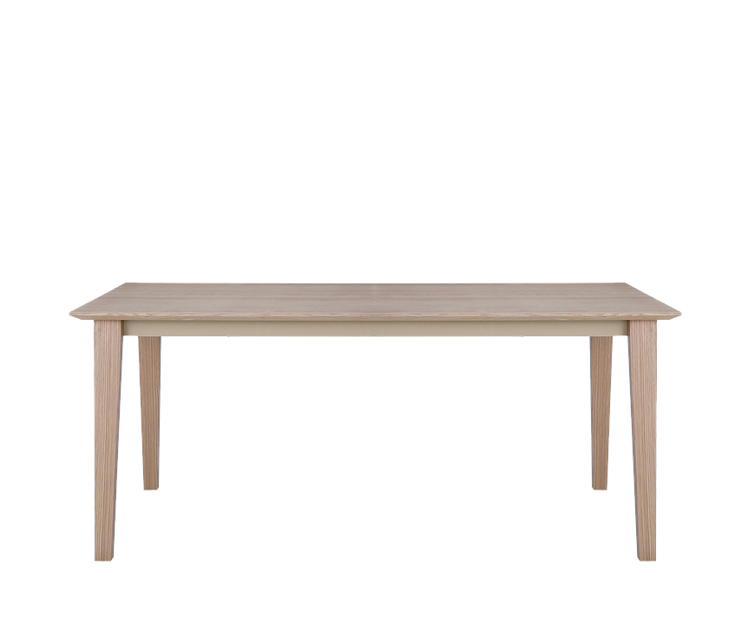
INSTRUCTIONS:
Click on the video
Click on video Task 1/complete
Click on video Task 2/complete
Click on video Task 3/complete
Click on video Task 4 to check answers
Study the alphabet in Task 5 Prepare for the SPELLING QUIZ!
task 1
task 2
task 3
task 4
task 5

