Slide 1
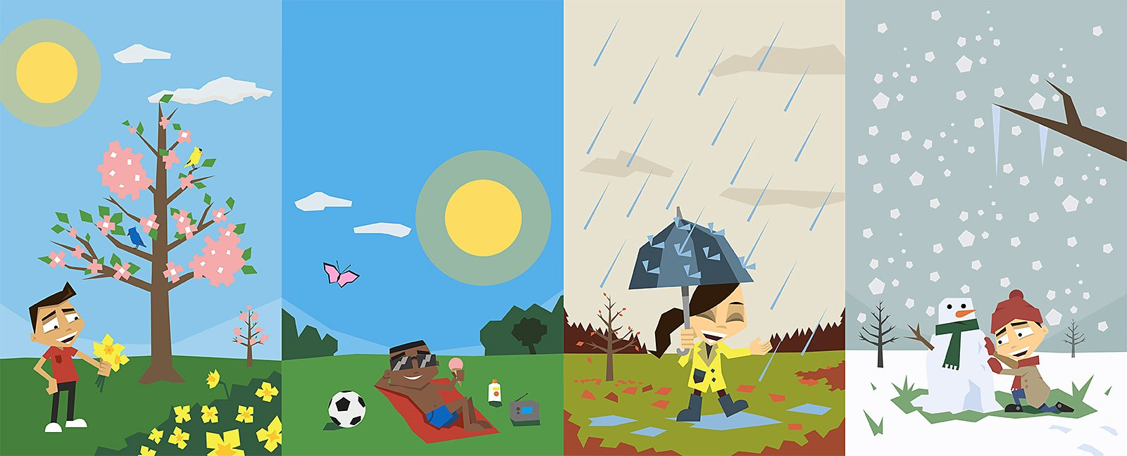
Vocabulary “Seasons of the year”
Spring
Summer
Fall
Winter
Click on the following link to learn the seasons
https://www.youtube.com/watch?v=E66bQWHDAs0

Slide 2
Vocabulary “Weather”
How is the weather today?
Listen and repeat
Listen and repeat
It´s sunny
It´s rainy
It´s stormy
It´s cloudy
It´s snowing
It´s windy
Click on the following link to learn how is the weather today
https://www.youtube.com/watch?v=I8GeA3anPdo

Slide 3
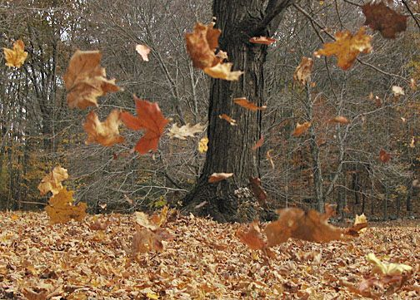
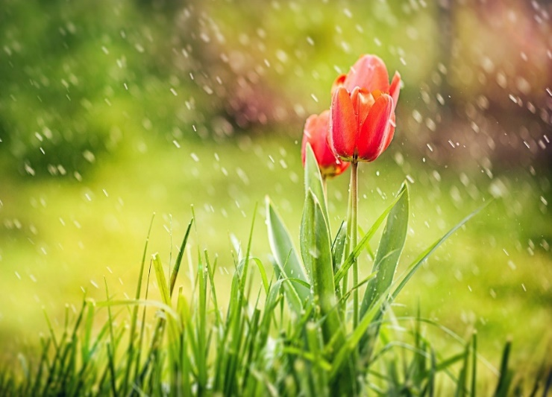
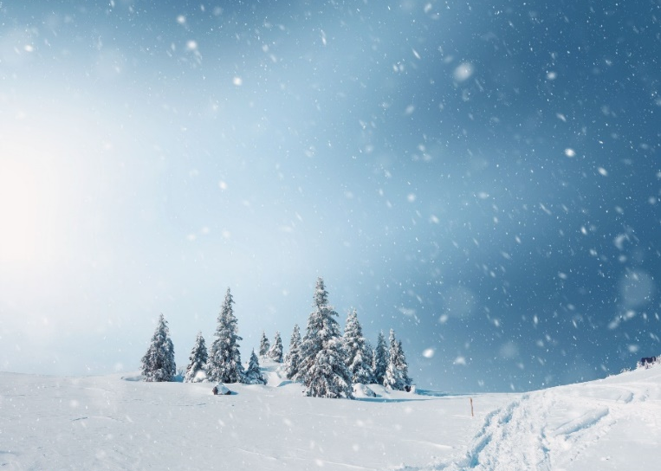
What season is it? How is the weather? Write two sentences for each picture record your voice with your practice. Escribe dos oracionespara cada fotografía. Que estación del año es, como está el tiempo? Graba tu voz con tu practice

Slide 4
Listen and circle the season and weather

Slide 5
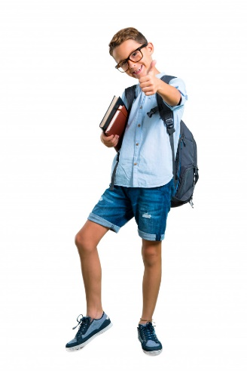
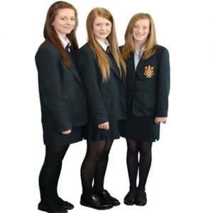
GRAMMAR “PRESENT CONTINUOUS STATEMENTS”
(+) AFFIRMATIVE | (-) NEGATIVE STATEMENTS
She is wearing uniform She´s wearing uniform | She is not wearing uniform She´s not wearing uniform
He is wearing uniform He´s wearing uniform | He is not wearing uniform He´s not wearing uniform
They are wearing uniform They´re wearing uniform | They are not wearing uniform They´re not wearing uniform

Slide 6
Writing practice
Change the affirmative sentences in to negative sentences, Change the negative sentences in to affirmative sentences cambia las oraciones positivas a negativas y viceversa
(+) AFFIRMATIVE | (-) NEGATIVE STATEMENTS
The students are wearing uniforms | The students are not wearing uniforms
 | It´s not swowing
I´m wearing Winter clothes
 | David is not wearing a cap
It´s raining
 | Sandy is not wearing boots

Slide 7
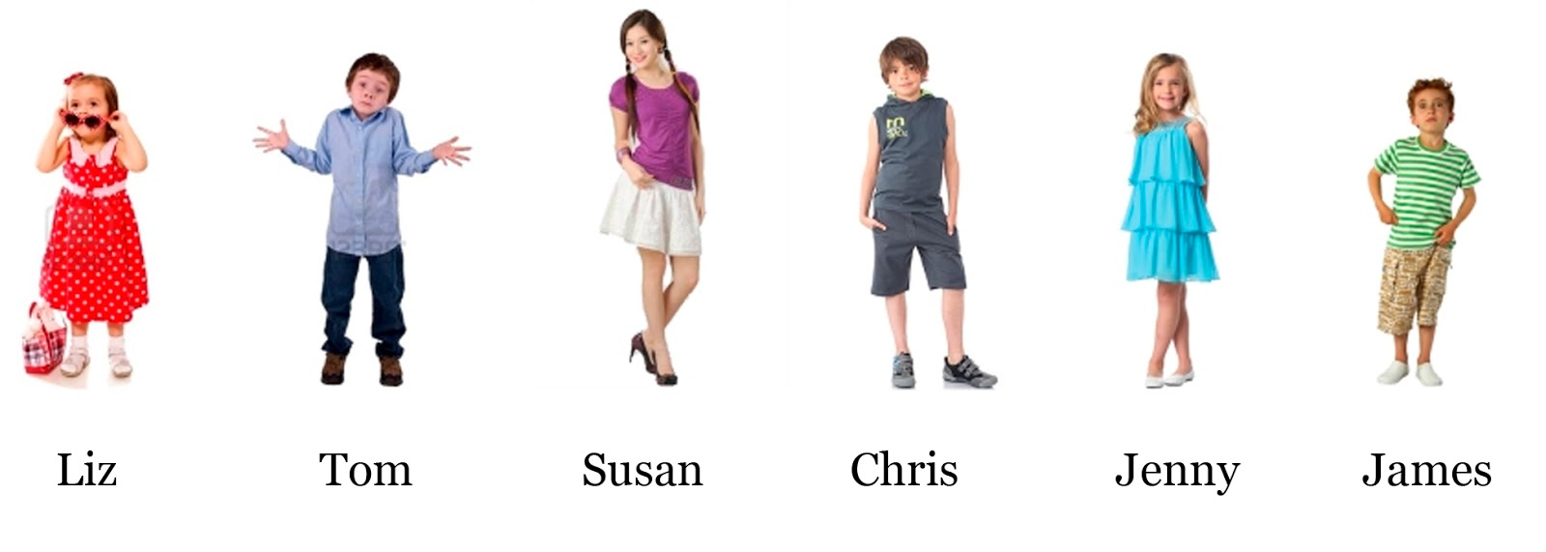
Correct the false statements, corrige las oraciones falsas.
Susan is wearing boots | She´s not wearing boots, she´s wearing high heels
Chris is wearing blue jeans
Jenny is wearing a red dress
Tom is wearing shorts
Susan is wearing a sweater

Slide 8
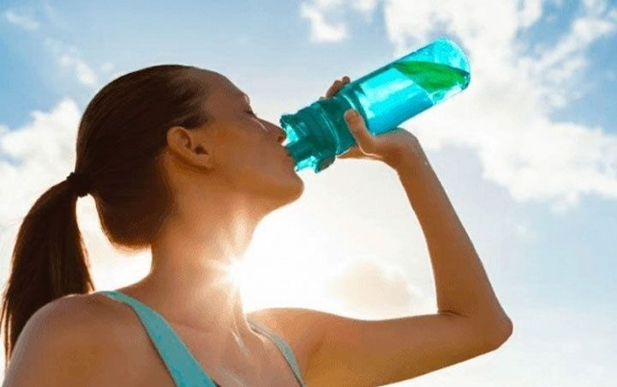
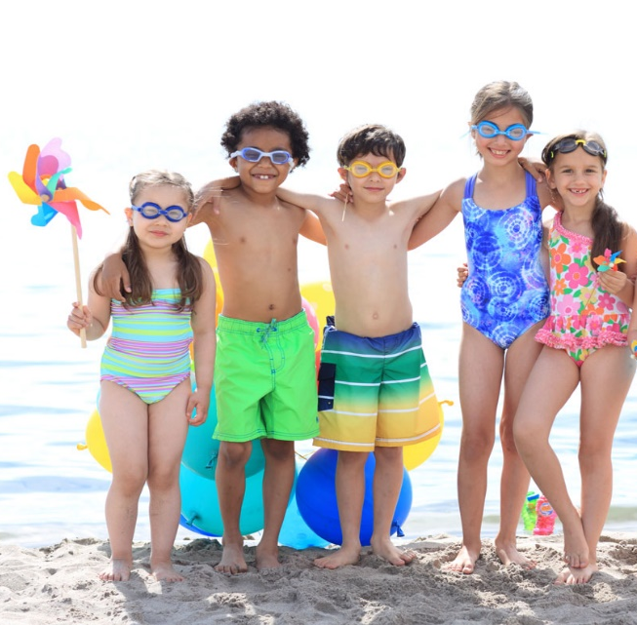
GRAMMAR “USE OF CONECTORS”
Conjuctions are used to join words, phrases or clauses.
Las conjunciones se utilizan para unir palabras, frases o cláusulas.
AND To connect similar ideas Para conectar ideas similares | BUT To connect opposite ideas Para conectar ideas opuestas | SO A connect cause and effect Para conectar causa y efecto
It´s hot and sunny | It´s hot but she´s not wearing a hat | It´s hot so they are wearing swimsuits

Slide 9
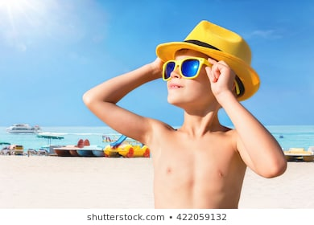
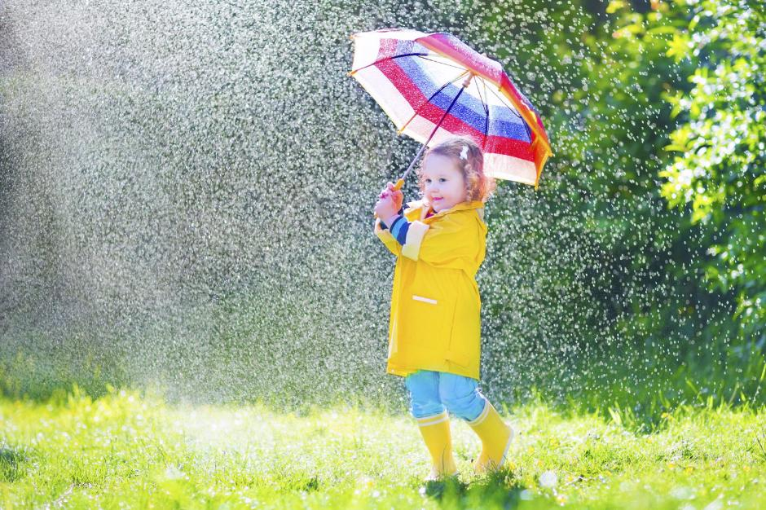
Complete the following sentences using connectors and, but, so
Completa las siguientes oraciones usando los conectores and, but, so
It´s _____
It´s sunny ___ hot.
____ He´s wearing a cap _____sunglasses
It´s spring
It´s warm ___ it´s raining. ___ She´s wearing boots___ a raincoat.

Slide 10
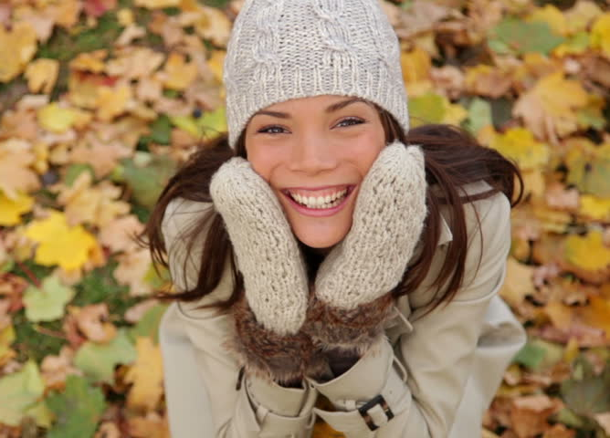
It´s _______, it´s cold today.
_____she´s wearing a hat, a coat, ____ gloves.
It´s _______,
It´s snowing ____ it´s cold,
___ they´re not wearing winter clothes.

