Slide 1

GRAMMAR FOCUS “ PRESENT CONTINUOUS”
The present countinuous tenese is used to talk about actions that are happening right now
I´m texting a friend
What are you doing?

Slide 2
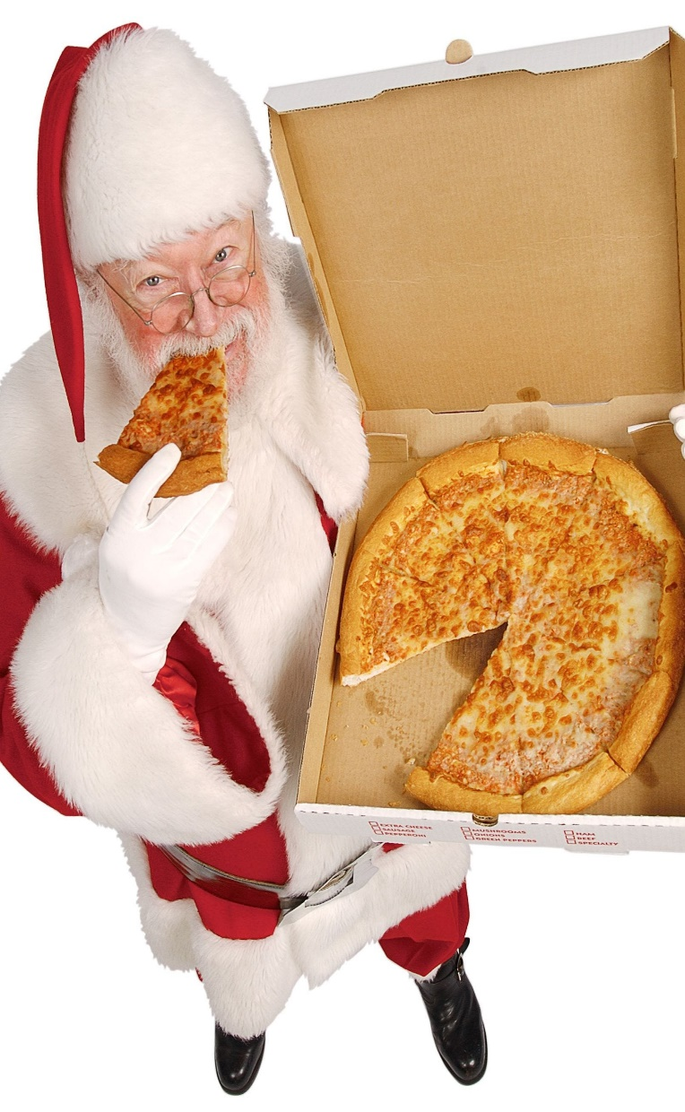
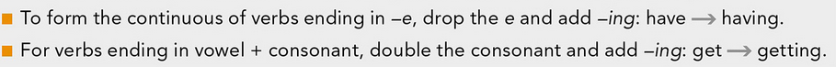
GRAMMAR FOCUS “ PRESENT CONTINUOUS”
Clues to form present continuous
To be
ing
Santa is eating pizza
Spelling | Clue words
sleep = sleeping | At the moment
get = getting (+ t) | These days, this year
have = having (- e) | Now

Slide 3

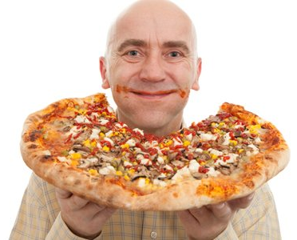

PRESENT CONTINUOUS “statements”
Subject
+
To be
+
Verb- ing
Form
He is
eating pizza
More examples:
She is eating pizza
We are eating pizza
They are eating pizza
PRONUNCIATION “Falling intonation in statements”
Listen and practice. Notice the statements ususally have a falling intonation.
She´S working in Camerun | He´s traveling in Thailand

Slide 4
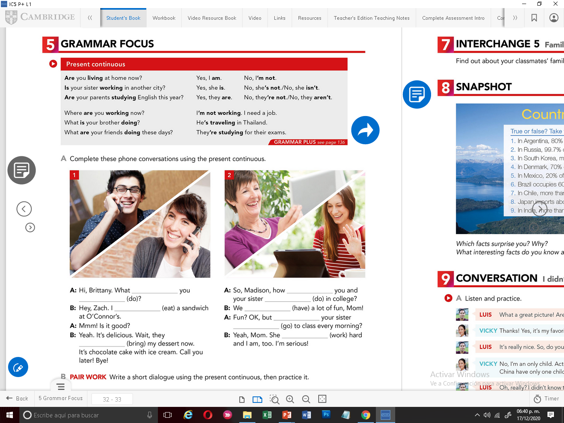
PRESENT CONTINUOUS “ yes/no questions”
To be
+
Subject
+
Verb- ing
Form
Is he
eating pizza?
More examples:
PRONUNCIATION “Rising intonation in yes/no questions”
Listen and practice. Notice the yes/ no questions usually have a rising intonation.
Is he cooking? | Are they sleeping?

Slide 5
PRESENT CONTINUOUS “ Wh.. questions”
+
+
+
Verb- ing
Wh
To be
Subject
Form
What
is he
eating?
More examples:
PRONUNCIATION “Falling intonation in Wh questions”
Listen and practice. Notice the Wh questions usually have a falling intonation.
What´s he making? | What are they doing?

Slide 6
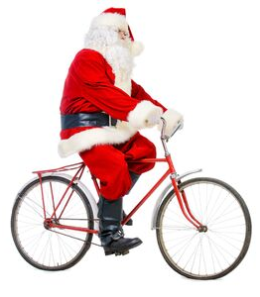
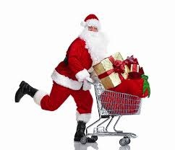
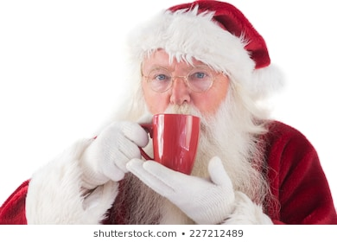
Practice statements
Write complete present continuous statements, then record your voice practice the falling intonation of the statements
Santa is riding his bike

Slide 7
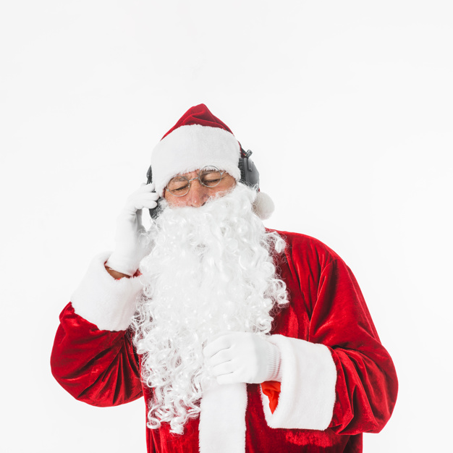
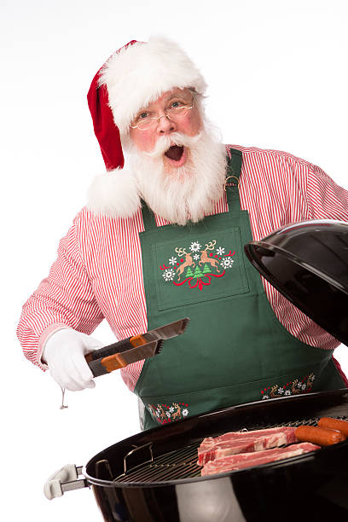

Practice Yes/No questions
Write present continuous yes/no questions and respond them
Then record your voice practice the rising intonation of the yes/no questions
Q: Is he watching TV? A: _________________ | Q: ? A: _________________ | Q: ? A: _________________

Slide 8
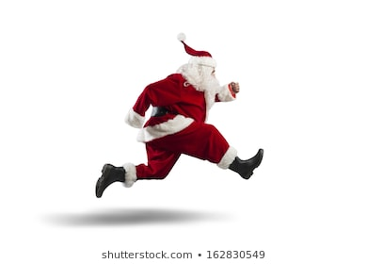
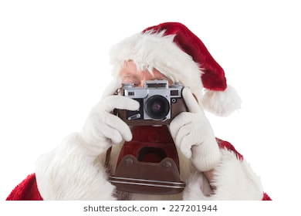
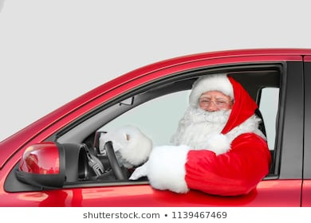
Practice Wh questions
Complete the following present continuous wh questions and respond them
Then record your voice practice the falling intonation of the yes/no questions
Q: What ? A: _________________ | Q: Where ? A: _________________ | Q: What ? A: _________________

Slide 9
Click on the following link to practice present continuous tense
https://en.islcollective.com/video-lessons/embed/331548
Share your score here:

Slide 10
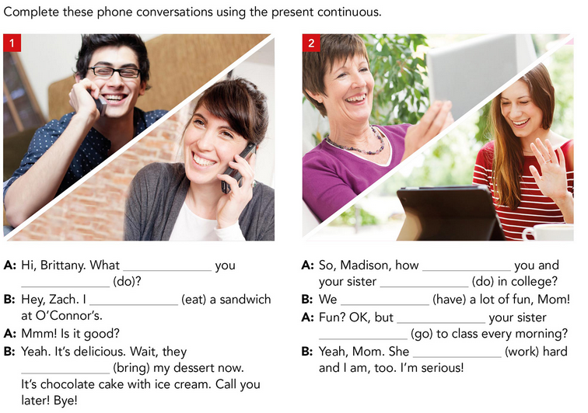

Slide 11
