Slide 1



Slide 2

Escuela Normal de Educación Preescolar
English A2.2
Sharing information and ideas
Number of hours/ Credits: 6/ 6.75
Teacher: Brenda Bollain y Goytia de la Peña

Slide 3






Course Purpose

Slide 4
This course has three main objectives:
The students will develop their ability to use English in personal and social communications, to develop relationships, complete transactions and meet everyday needs.
The students will increase their engagement with cultural and intercultural activities in English, in order to develop a better understanding of their own culture as well as other cultures around the world
The students will develop their ability to teach in a school environment where English is an important aspect of the school approach. Schools are expected to use English increasingly for various teaching and learning activities, and future teachers need to be confident in using English in the school environment

Slide 5
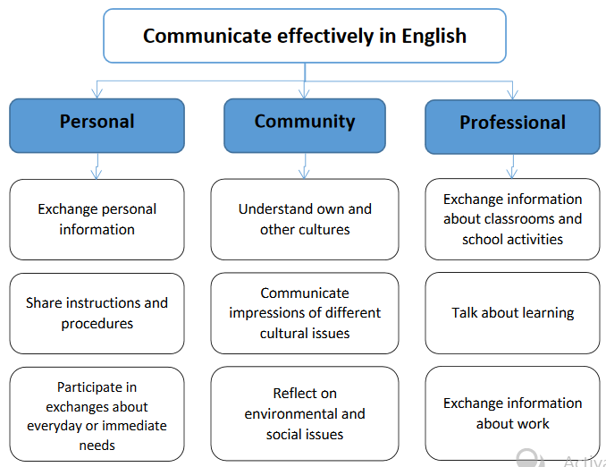

Slide 6
Evaluation Calendar
EVALUATION | DATE
1ST EVALUATION | 19-23 APRIL
2ND EVALUATION | 24-28 MAY
3RD EVALUATION | 5-9 JULY
GLOBAL EVALUATION | 19-23 JULY
FINAL EVALUATION INTERVIEW | JULY (DATE TO CONFIRM)

Slide 7
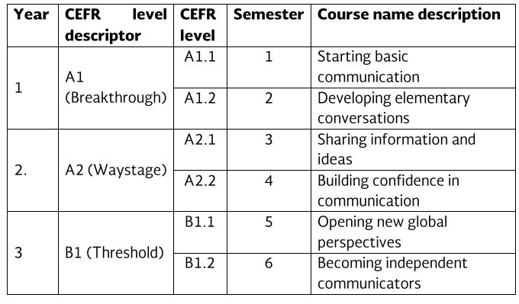
Course Progression

Slide 8
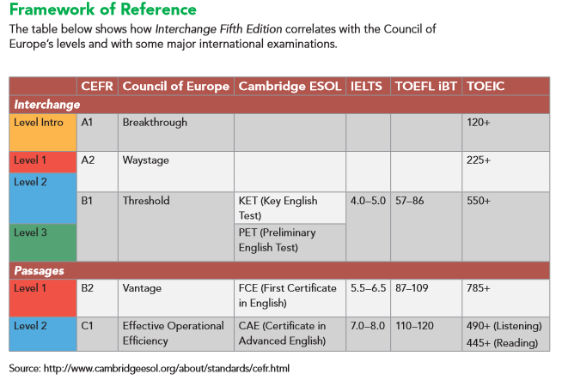

Slide 9
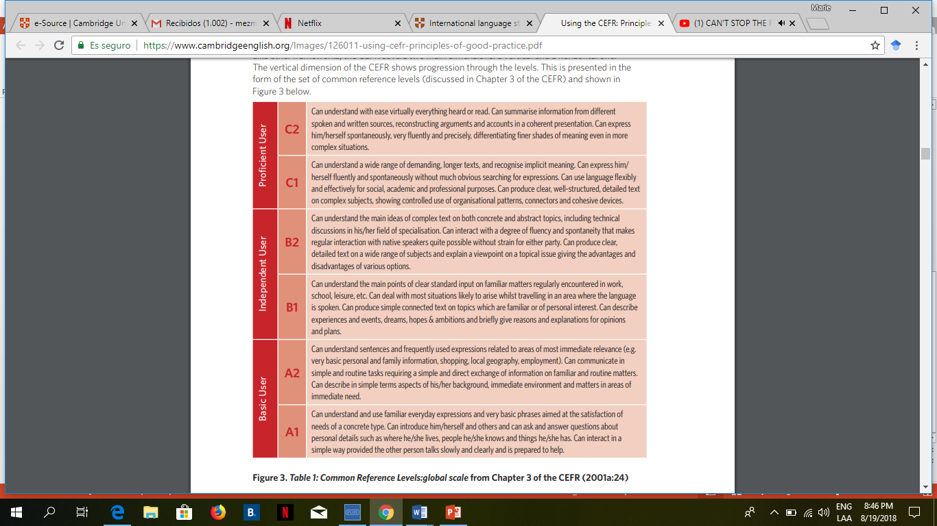


Slide 10
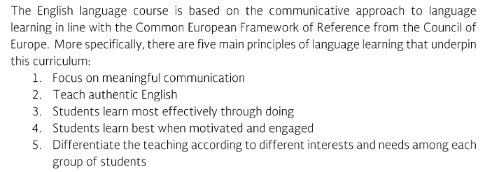
Course Description

Slide 11
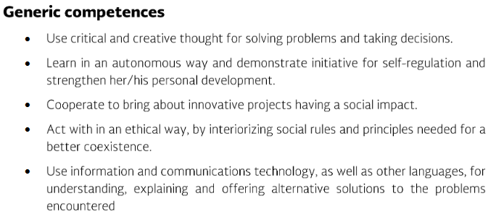
Competences of the degree profile developed by the course

Slide 12
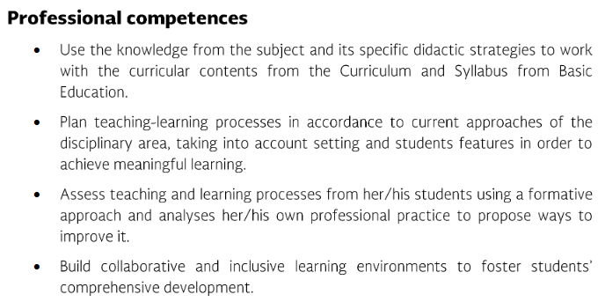
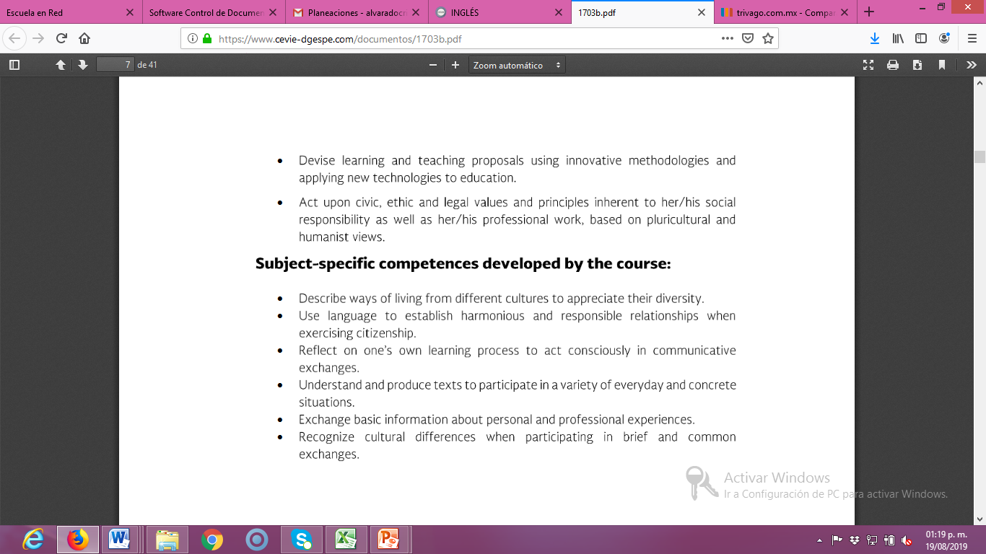

Slide 14
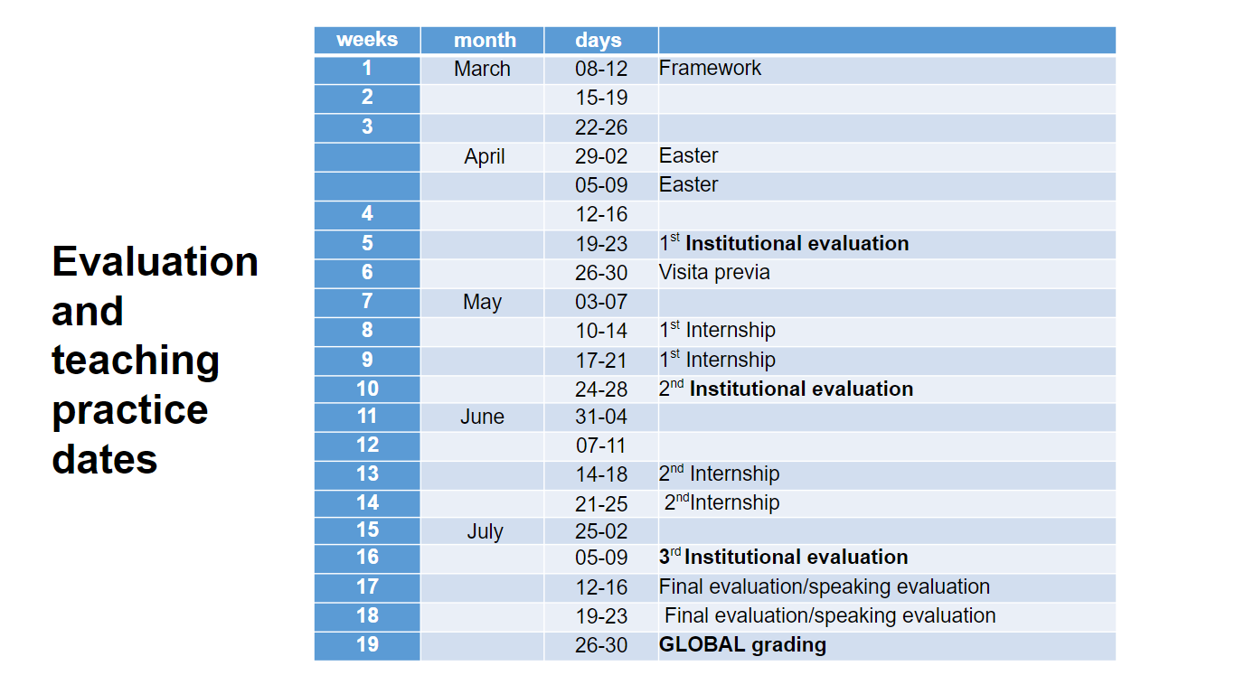

Slide 15
Course structure
PERIOD | BOOK UNITS | CONTENTS | LEARNING EVIDENCES
1 | 7. We went dancing! 8. How’s the neighborhood? | Free-time and weekend activities Stores and places in a city; neighborhoods; houses and apartment | Project “Wish you were here” Project “The perfect neighborhood”
2 | 8.What does she look like? 9.Have you ever been there? | Appearance and dress; clothing and clothing styles; people Past experiences; unusual activities | Project “What should I wear?” Project “What have they done?”
3 | 10. It’s a really nice city. 11. It’s important to get rest. | Cities; hometowns; countries Health problems; medication and remedies; products in a pharmacy | Project: Grandma’s advice

Slide 16
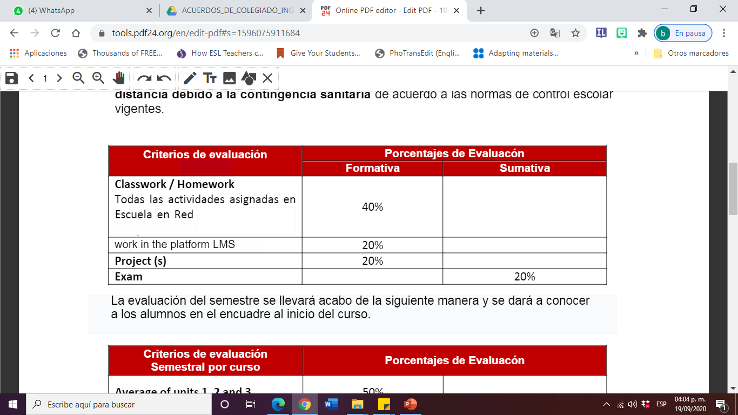
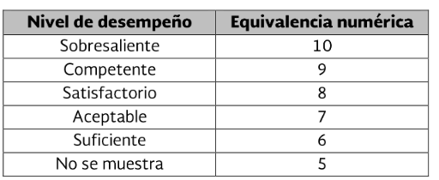
Assesment Criteria
Attendance (camera on), punctuality, attitude, participation, respect, and classwork.

Slide 17


Global Evaluation
NOTE:
In case the student fails (5 or lower grade) the Final Evidence, he/she will automatically fail the Global Evaluation. Therefore, he/she will have to take a regularization exam.
In order for the student to have (two) opportunities to regularize his/her status, he/she must attend at least 85% of class hours in the semester.
50%
50%
Average of learning units 1-3
Final Evidence
(Speaking)

Slide 18
NOTA IMPORTANTE
En caso de que el estudiante no logre el desarrollo de las habilidades necesarias para obtener el nivel de inglés que esté cursando, se evaluará con base en el desempeño del estudiante, sin embargo, tendrá que cursar nuevamente el nivel.
El estudiante acreditará el curso cuando obtenga como mínimo en la evaluación global del nivel de desempeño su equivalencia numérica de 6.
El estudiante acreditará el nivel una vez que evidencie el desarrollo de las habilidades propias del nivel de inglés con base en el CEFR mediante una entrevista realizada al final del ciclo escolar la cual deberá arrojar unresultado no menor a 8.

Slide 19
Course Policies
Homework: There will be regular online homework tasks, as well as homework related to textbook material.
Late homework: It is your responsibility to turn in homework assignments on time. In case homework assignments or projects are delivered after the stablished due date, the maximum passing grade will be 7.
Grading: Your course grade will depend on performance on tests, and oral presentations . Quizzes, tests, and other presentations cannot be made up unless the student has an excuse absence by ENEP.

Slide 20
VIRTUAL CLASSROOM RULES
https://www.powtoon.com/s/cWYCfv1vmMD/1/m

Slide 21
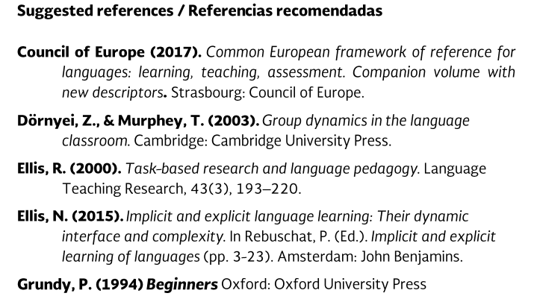
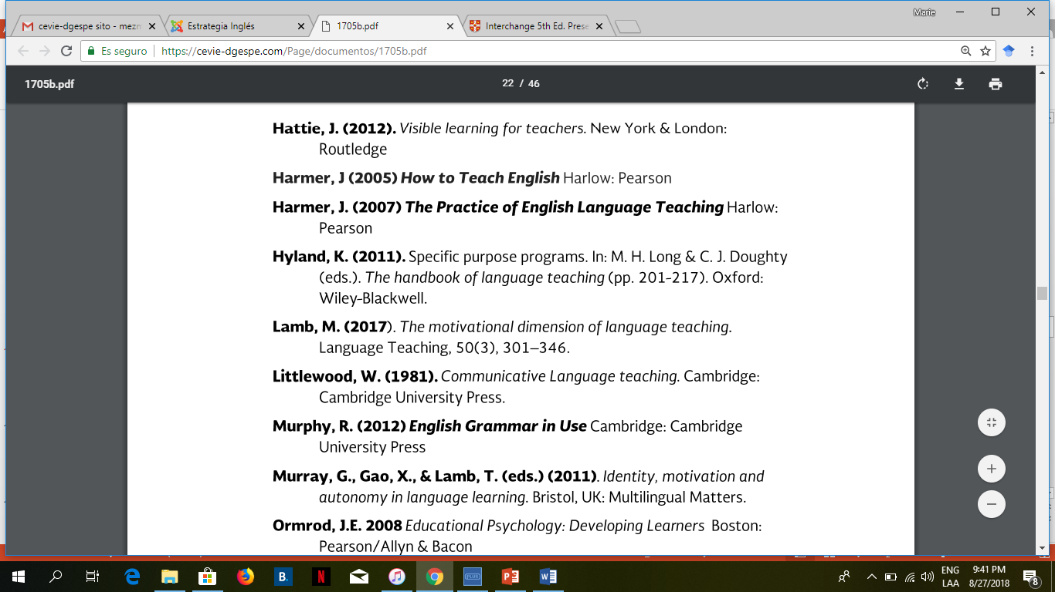
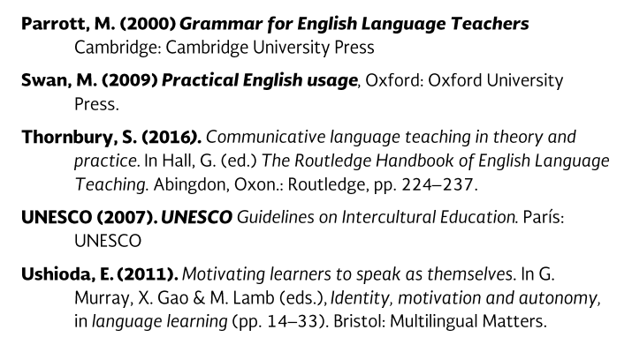

Slide 22
Additional online references and resources
Learning English. http://www.bbc.co.uk/learningenglish
Teaching adults. https://www.teachingenglish.org.uk/teaching-adults
Adult learners. https://elt.oup.com/learning_resources/courses/adultlearners/?cc=mx&selLanguage=en
Learning English. https://www.cambridgeenglish.org/learning-english/
Teacher’s corner. https://americanenglish.state.gov/teachers-corner
Classroom resources. Pearson. https://www.pearsonelt.com/professional-development/resources.html
Teaching adults. Oxford. https://elt.oup.com/teachersclub/courses/teachingadults/?cc=mx&selLanguage=en
For teachers. BBC. http://www.bbc.co.uk/worldservice/learningenglish/teach/
Onestop English. http://www.onestopenglish.com/
The digital teacher. https://thedigitalteacher.com/
https://visuwords.com/
https://www.eslvideo.com/
https://es.lyricstraining.com/
https://www.busuu.com/es
http://intermediatelow.blogspot.com/
https://www.englishclub.com/
http://www.topics-mag.com/
http://www.readableblog.com/
https://dictionary.cambridge.org/es/
http://www.bbc.co.uk/learningenglish
https://www.tefl.net/
http://www.elllo.org/

