Slide 1
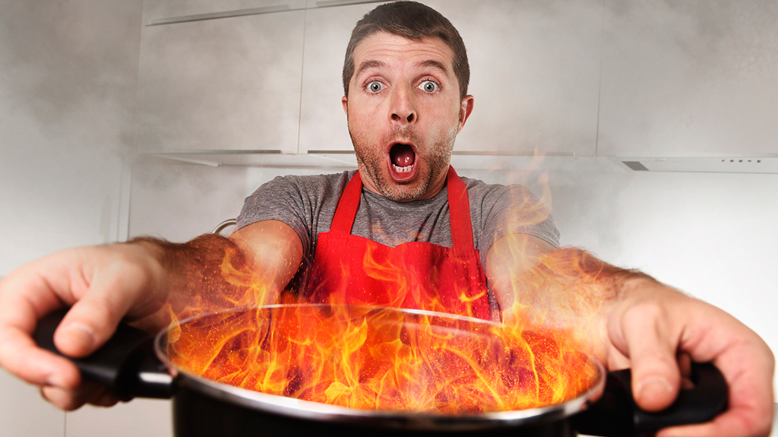
UNIT 10
Lesson 2
What can you do?
Discuss sports to watch and play
Discuss skills, abilities and talents

Slide 2
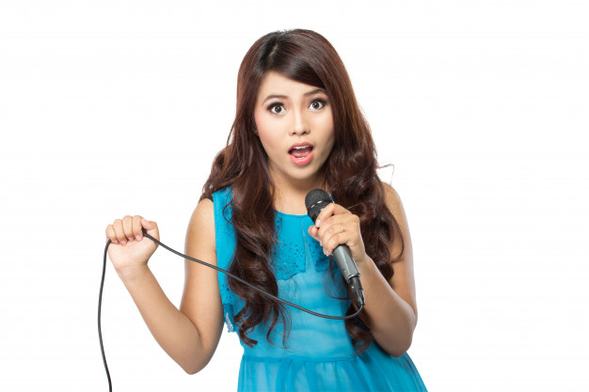
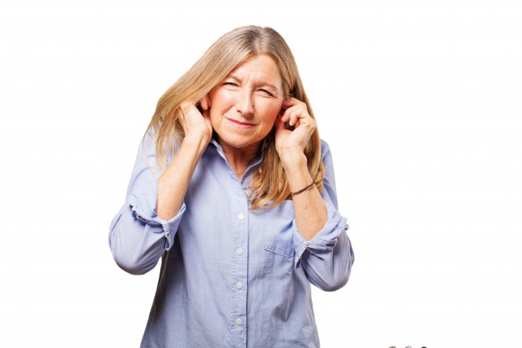
Use of can - can´t
CAN shows ability Eg. I can sing. (This means that I have the ability or the skill)
CAN'T shows inability. Eg. I cannot sing. (This means that I do not have the ability or the skill)
Negative form of CAN is either “cannot” or “can not” and its negative contraction is “Can’t”.
She can sing
She can´t sing

Slide 3
Use of can - can´t in statements
I You We They He She It | Can (+affirmative statements) Can´t ( - negative statements) | sing dance play football swim cook
Complete with can or can´t

Slide 5
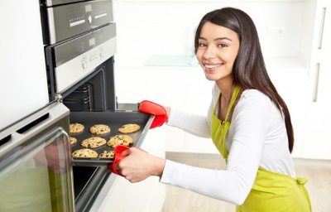
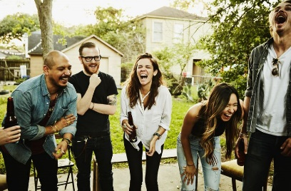
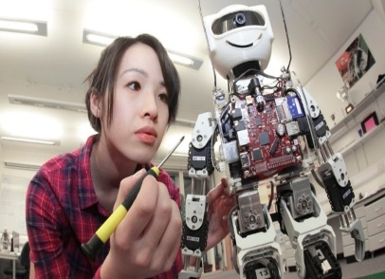
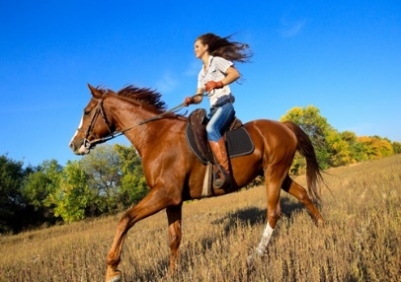
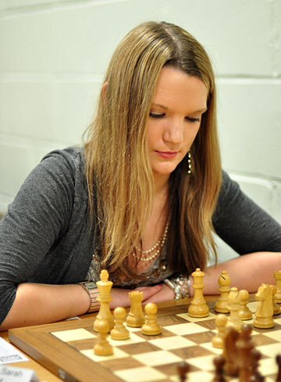
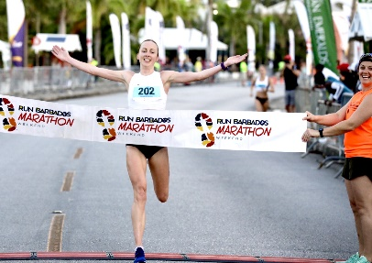
Practice the following vocabulary
bake cookies
tell good jokes
edit a video
fix a computer
build a robot
ride a horse
play chess
do math in your head
run a marathon
Write complete statements of what you can or can´t do
(use the picture vocabulary).
1.
2.
3.
4.
5.
6.

Slide 6
Use of “coordinating conjuctions”
Coordinating conjunctions coordinate or join two or more sentences, which are of the same syntactic importance.
and | or | but
I can sing and I can ski | I can sing or I can ski | I can sing but I can´t ski.

Slide 7
Practice the following vocabulary
abilities wordbox
Write 4 sentences about what these people can or can´t do. Use can or can´t with coordinating conjuction “and” Use the abilities wordbox
1 | Eg. A chef can bake and cook
2
3
4

Slide 8
Write statements. Use can or can´t with the coordinating conjuction “but”.

Slide 9
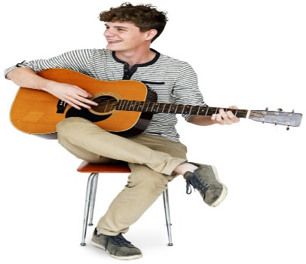
Write statements. Use can or can´t with coordinating conjuctions.
And
Or
but

Slide 10
Use of can - can´t in questions
Can | I You He She It We They | sing dance play football swim cook | Yes, I,you,he,she,.. can No, I,you,he,she,.. can´t
?
What | can | You/he/she/we | Do ?
Who | can | / play chess/ edit a video | ?
Answer the following questions
Can your mother play chess?
Who can tell good jockes in your family?
Can you drive a car?
Can your father fix a computer?
Who bake a cake?
What can your brother do?
What can you do?

Slide 11
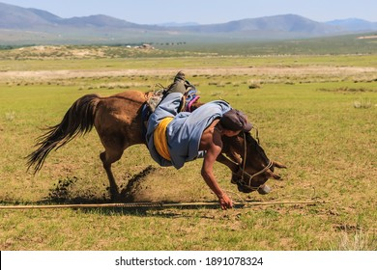
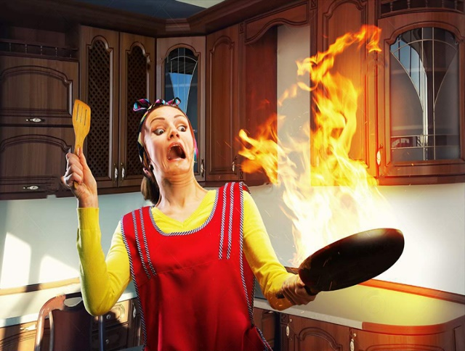
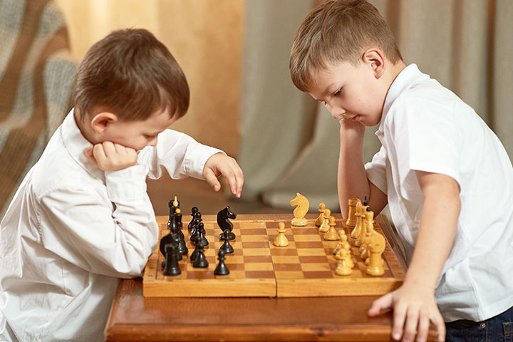
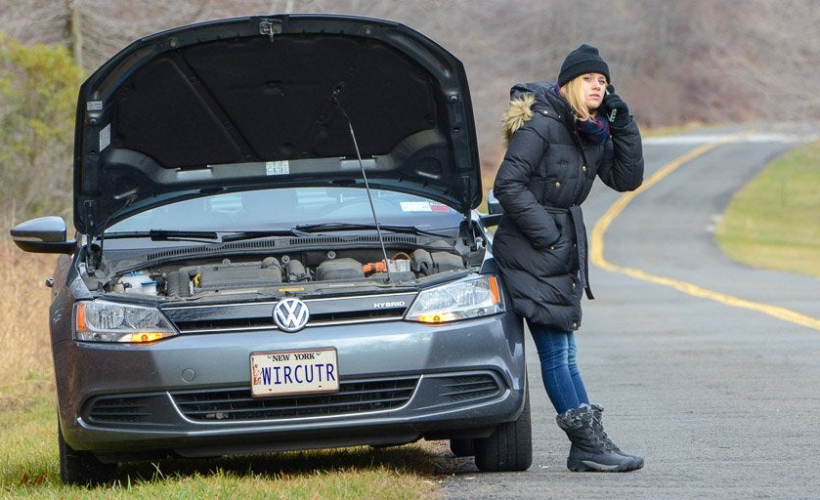
1.- Can Maddie run a marathon? Yes, she can
Maddie
Doug
Mary
Matt
Peter and Paul
Anie

Slide 12
