Slide 1
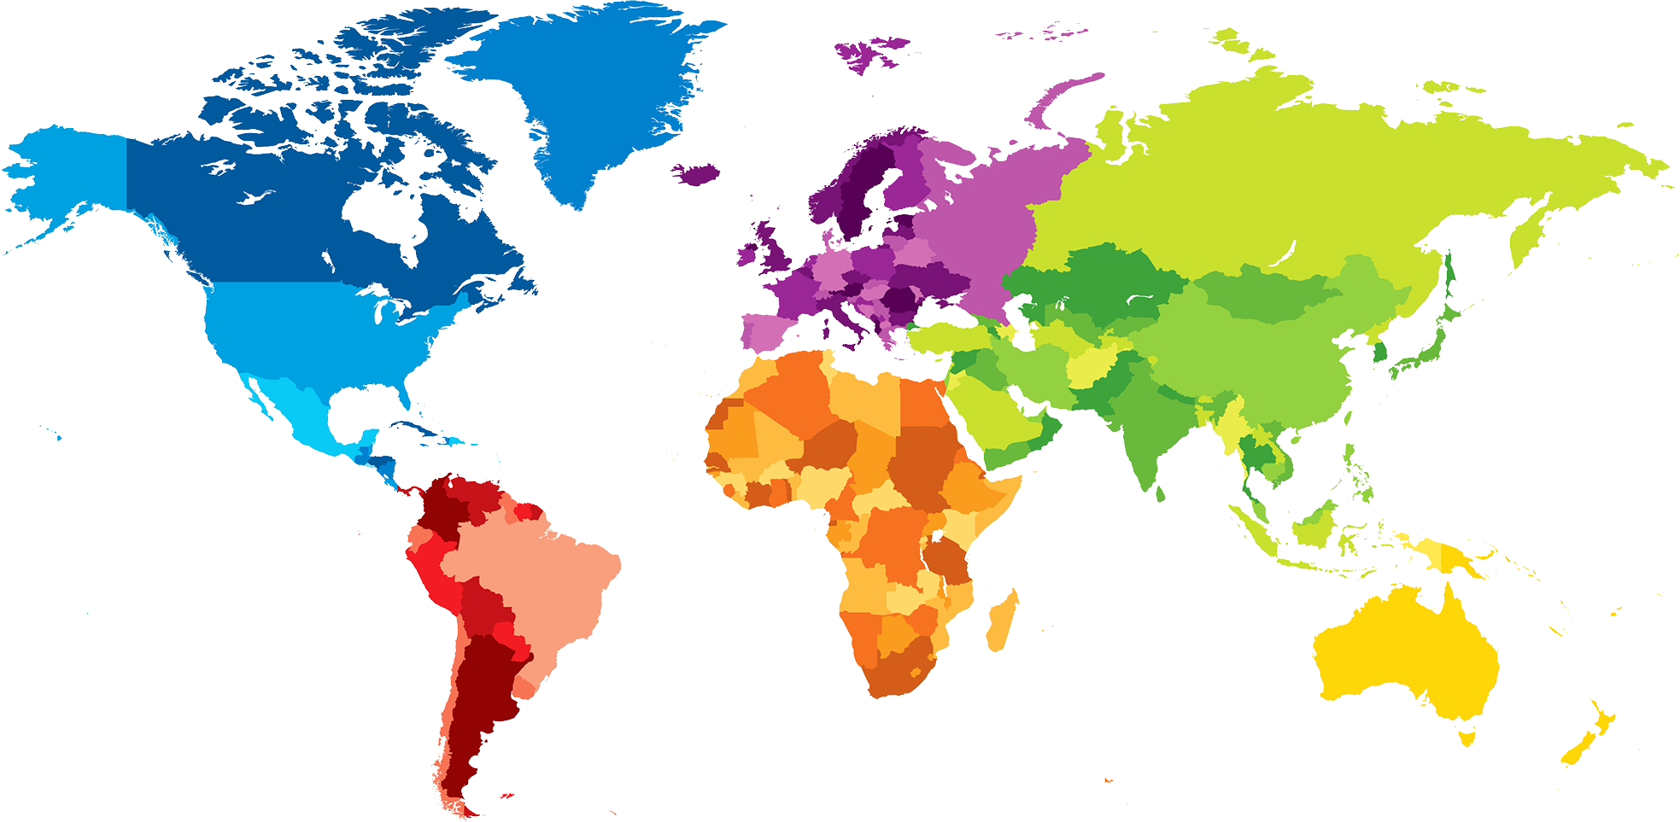
ENGLISH A2.1
UNIT 1 “WHERE ARE YOU FROM?”
SEPTEMBER 8TH

Slide 2

OBJECTIVES
To use be and possessive adjectives in a conversation about people meeting for the first time.
To make statements/contractions with be; use possessive adjectives to describe oneself and others; ask and answer Wh-questions with be

Slide 3
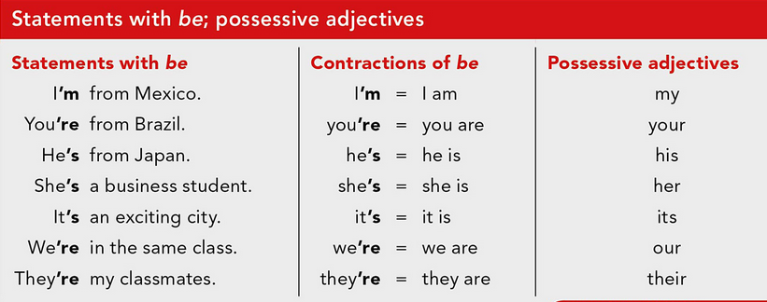

Slide 4
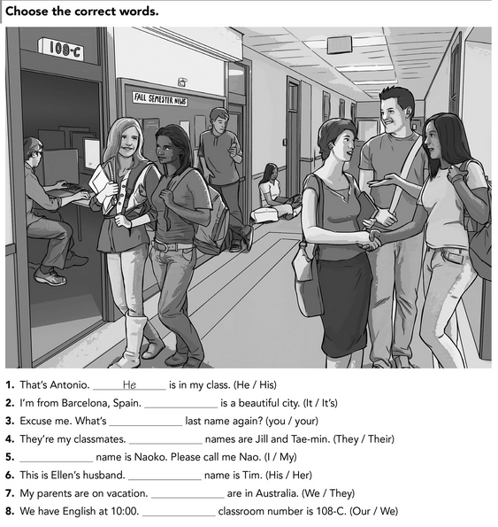

Slide 5
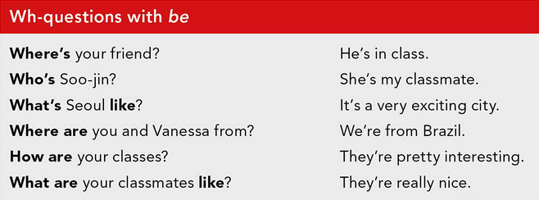
WH- WORD +. VERB BE (AM, IS, ARE) + COMPLEMENT?

Slide 6
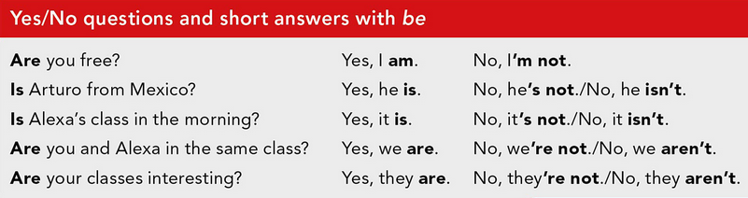
VERB BE (AM, IS, ARE) + SUBJECT + COMPLEMENT?

Slide 7
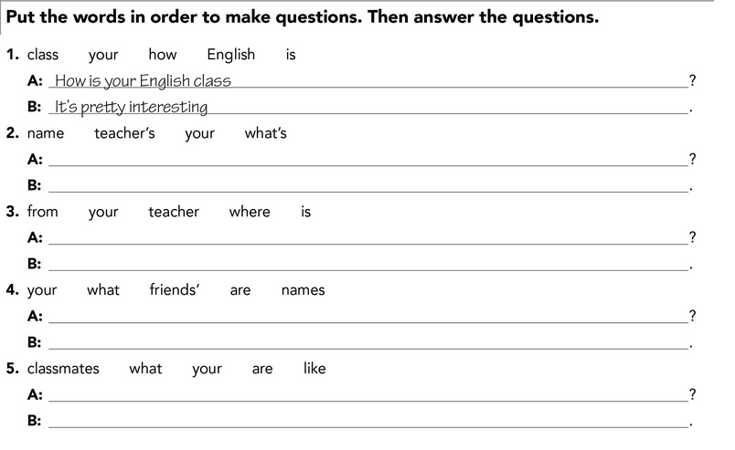

Slide 8
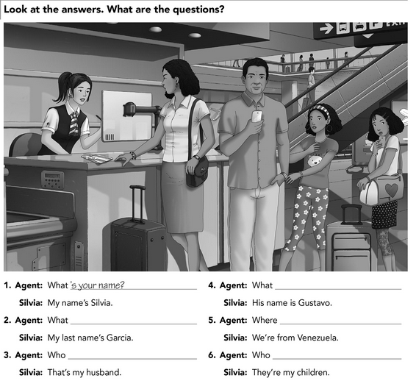

Slide 9
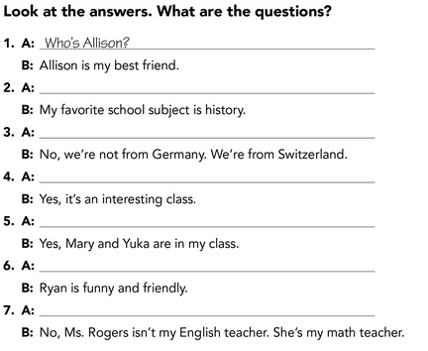

Slide 10


Slide 11

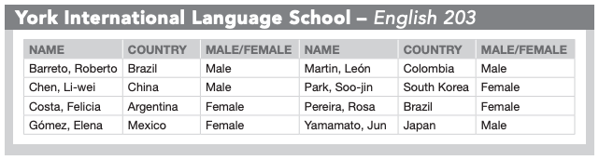

Slide 12


Slide 13


