Slide 1
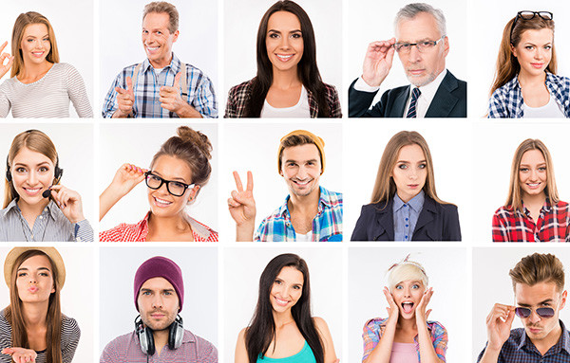
Lesson 3
DESCRIBING PEOPLE
Lesson objective:
Use adjectives to describe people
Use adjectives of personality and physical appearance
Ask and respond to yes/no and wh questions with be

Slide 2
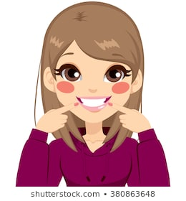
Vocabulary, adjectives of physical apearance
Adjectives are words used to decribe the appearance or personality of a person
Adjectives of physical appearance
Old
young
heavy
thin
pretty
handsome
Tall
short
Good looking

Slide 3
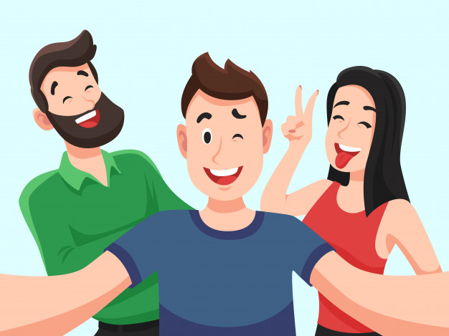
Vocabulary, adjectives of personality and physical apearance
Adjectives are words used to decribe the appearance or personality of a person
Adjectives of personality
talkative
serious
kind
shy
friendly

Slide 4
Vocabulary

Slide 5
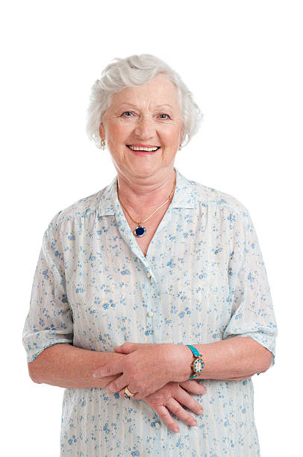
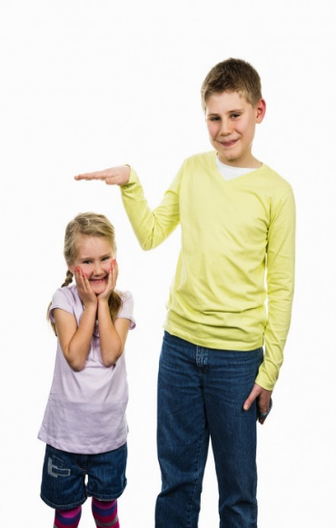
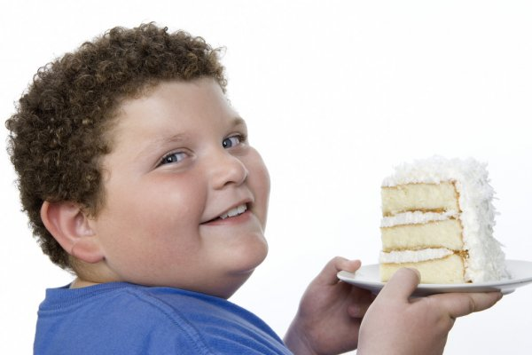
Speaking practice
Is she young?
Is she tall?

Slide 6
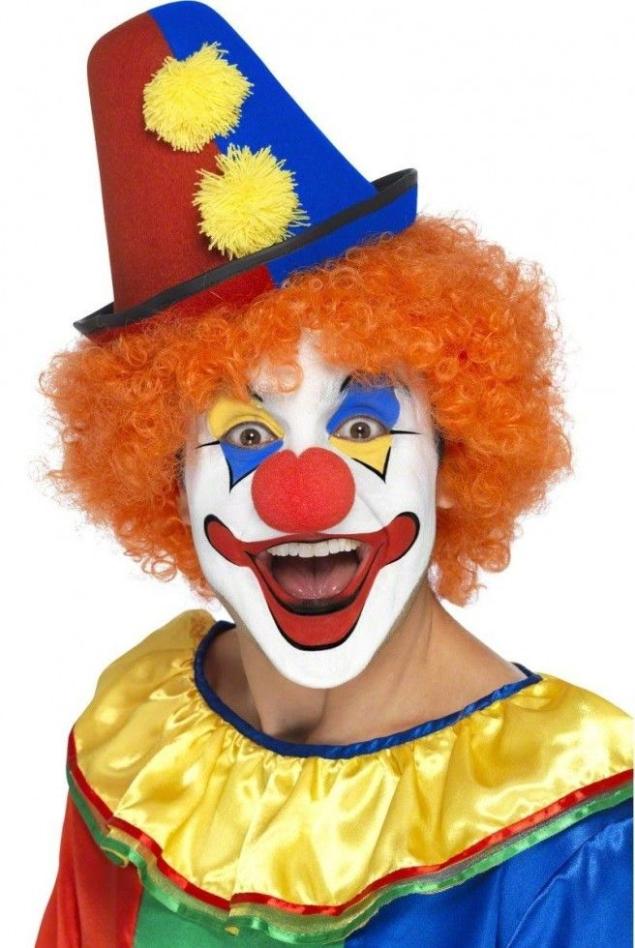
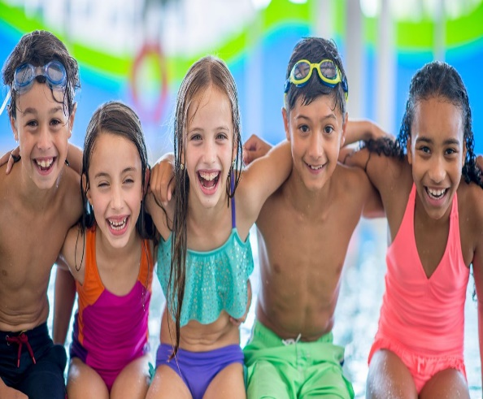
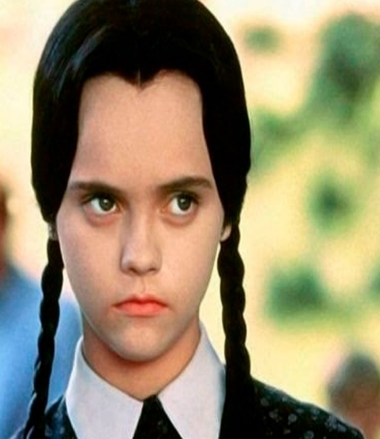
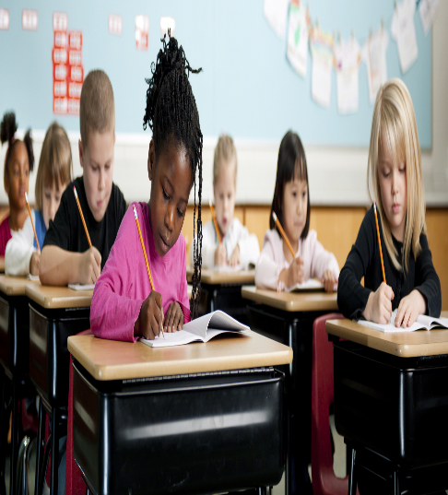
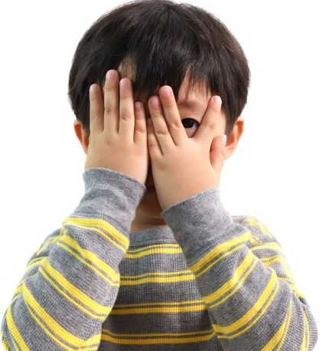
Speaking practice
What is she like?
What is he like?
What are they like?

Slide 7
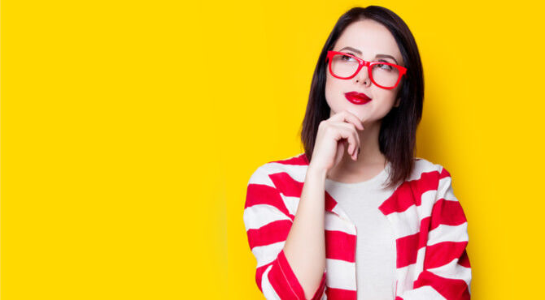
Speaking Practice What are you like?
Describe your appearance and personality, record your practice
I´m……..

Slide 8
A. Listen to three descriptions. Check the two correct words for each description

Slide 9
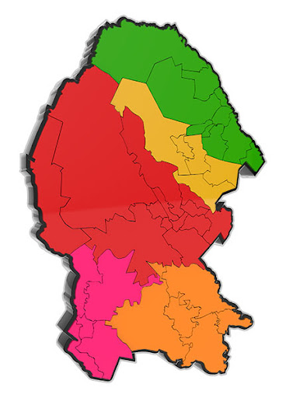
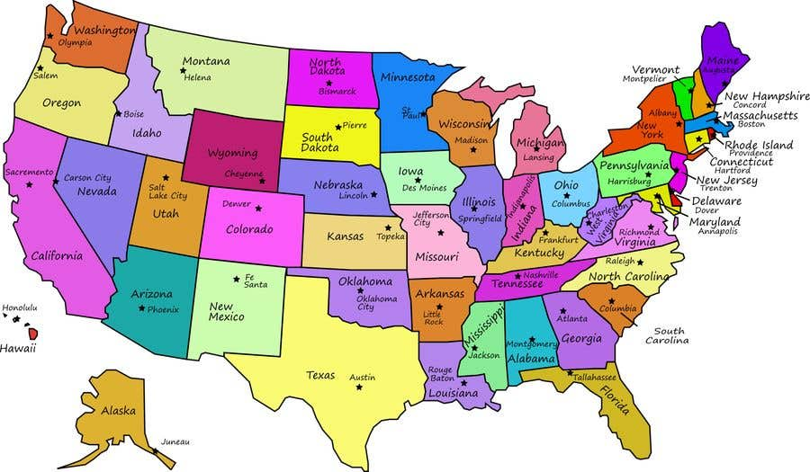
Speaking Practice
What is your City like?
What is United States like?

Slide 10
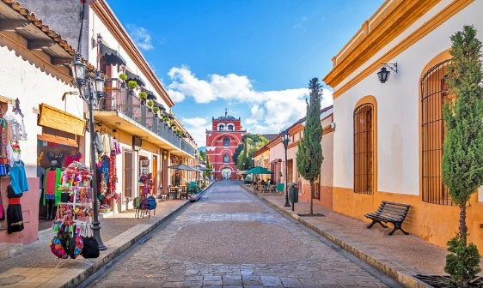
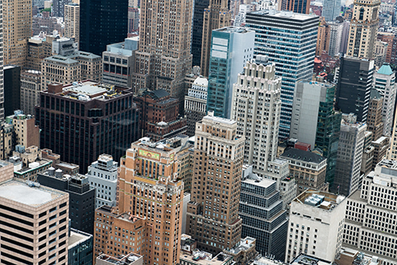
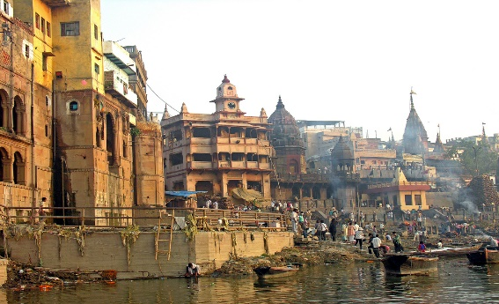
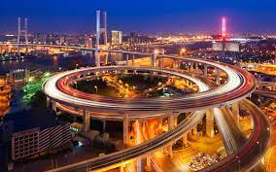
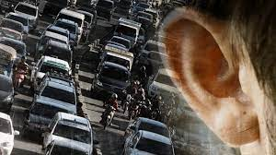
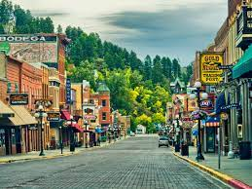
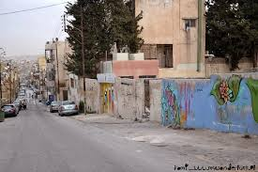
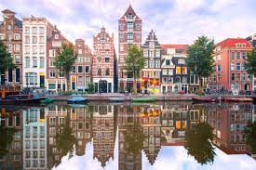
Vocabulary Adjectives to describe cities
small / big
old / modern
noisy / quiet
ugly / beautiful

Slide 11
Student book and work book practice
Practice on workbook pg
Practice on student book pg. 118 speaking activity

