Slide 1
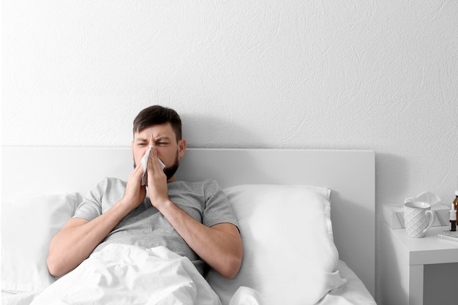
UNIT 7
Lesson 3
Did he go to the party last night?
LESSON OBJECTIVE:
Learn and practice YES/NO questions in simple past

Slide 2
GRAMMAR FOCUS
YES / NO QUESTIONS
Yes/No questions are questions that can be answered by a simple yes or no.
Did he go to the party last night?

Slide 3
GRAMMAR FOCUS
YES / NO questions in simple past
To form questions for; I, He, She, It, You, We, They.
Use the following structure: DID + subject + verb + complement.
 |  |  |  | Answer
 |  |  |  | Yes, |  | did.
 |  |  |  | No, |  | didn´t.
Subject/
pronoun
Verb
Auxiliar
Complement
He
She
You
We
They
play
watch
study
eat
get up
basketball last week
cartoons yesterday
for the english test
hamburgers last sunday
early this morning
I
He
She
It
You
We
They
Did

Slide 4
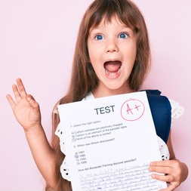
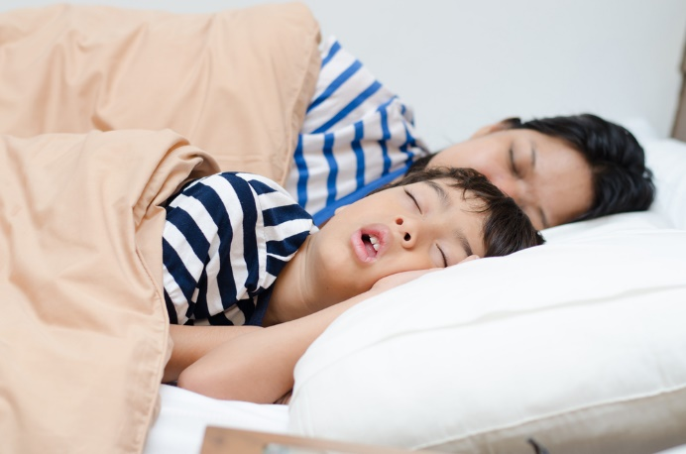
Yes/no questions in simple past tense
Remind: YES/NO questions are answered with yes or no.
Did she pass the english test?
Yes, she did.
Did they get up early yesterday?
No, they didn´t.

Slide 5
GRAMMAR FOCUS
YES / NO QUESTIONS
Study and practice Yes/ No questions in simple past studentbook pg 45

Slide 6
SPIN THE WEEL speaking practice
Click on the following link to practice yes/no quesrtions in simple past
http://wheeldecide.com/index.php?id=659885

Slide 7
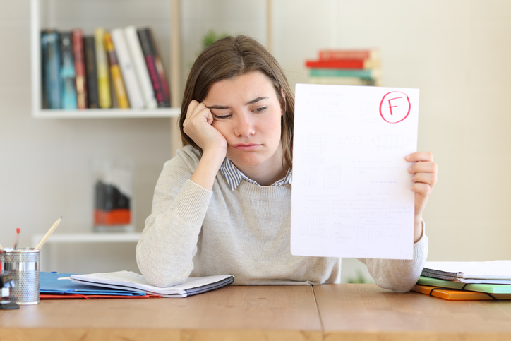
Yes/no questions in simple past tense
Speaking practice, make Yes/No questions and give short answers.
watch
pass
study

Slide 8
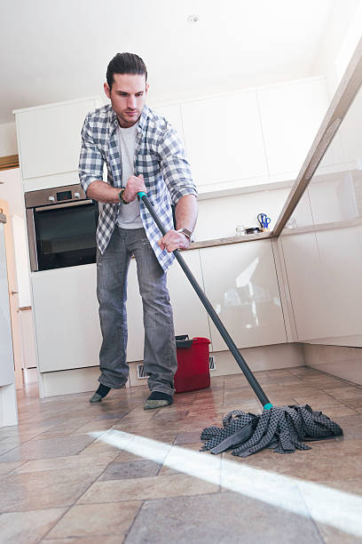
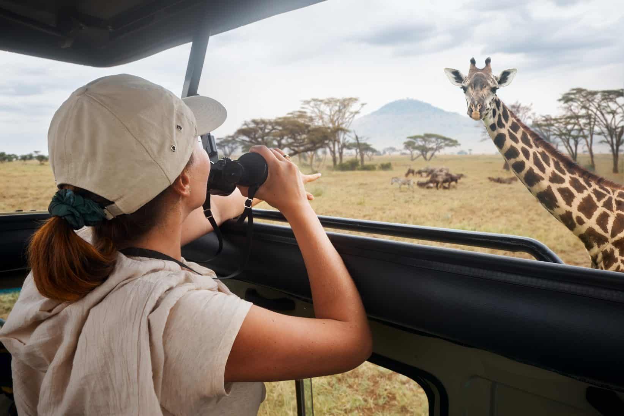
Yes/no questions in simple past tense
Speaking practice, make Yes/No questions and give short answers.
watch
have good time
eat

Slide 9
Wordwall writing practice
Click on the following link to practice yes/no questions in simple past
https://wordwall.net/es/resource/10409306
Insert here your results

Slide 10
Study and practice Yes/ No questions in simple past studentbook pg 90

Slide 11
Writting practice, Answer these questions with negative statements. Then add a possitive statement using the information in the box workbook pg 39 ex5

