Slide 1
UNIT 8
Lesson 3
WHAT DO YOU DO?
WHERE DO YOU WORK?
HOW DO YOU LIKE YOUR JOB?
https://www.youtube.com/watch?v=evWBRJxngXY
LESSON OBJECTIVE
Discuss about Jobs and workplaces using simple present Wh questions

Slide 2
Simple present questions
When we want to ask about someone´s career we say:
Wh question + auxiliar do/does + subject + verb ?
What | do |  | do ?
What | does |  | do?
I
You
We
They
He
She
it
Use what to ask about things
In wh questions use auxiliar do for questions with I / you / we / they, use does for questions with he/ she / it.

Slide 3
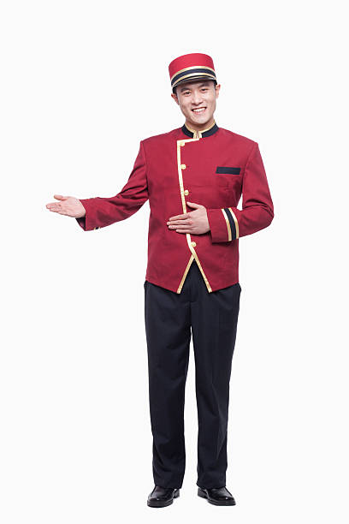
When we want to ask about someone´s career we say:
What do you do?
I´m a bellboy

Slide 4
What do you do?
I´m a doctor
I help people

Slide 5
What do you do?

Slide 6
What do you do?

Slide 7
What do you do?

Slide 8
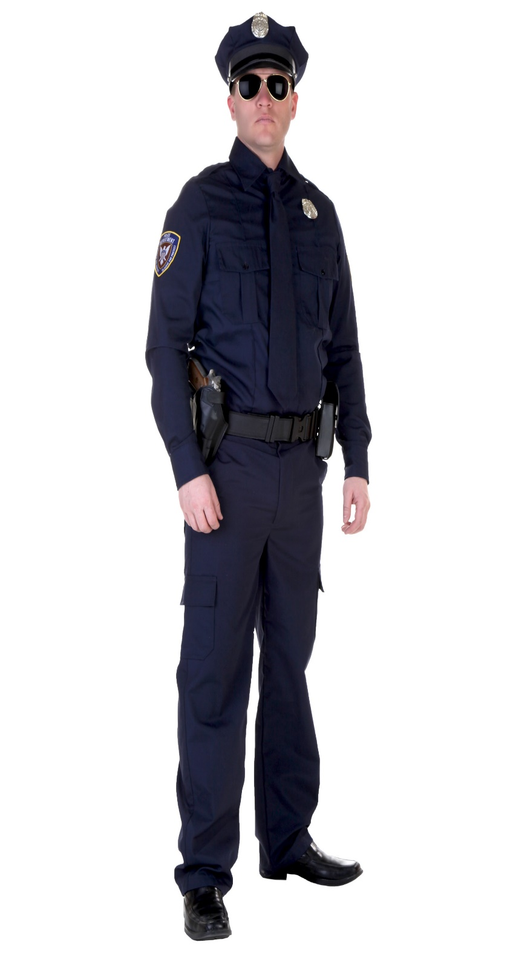
What do you do?

Slide 9
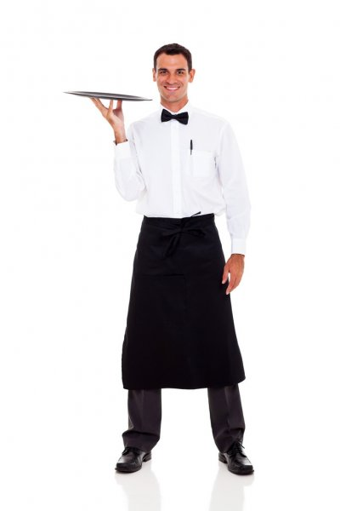
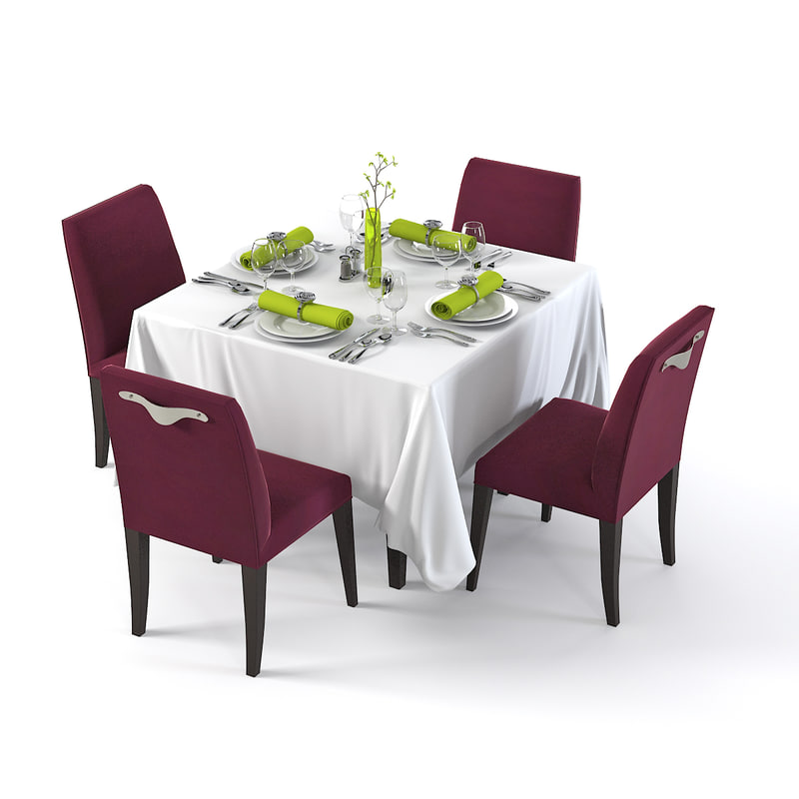
When we want to ask about someone´s career we say:
What does he do?
He is a server/waiter

Slide 10
What ……….…….?

Slide 11
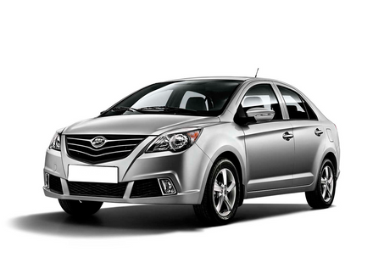
What ……………..?

Slide 12
What ……….…….?

Slide 13
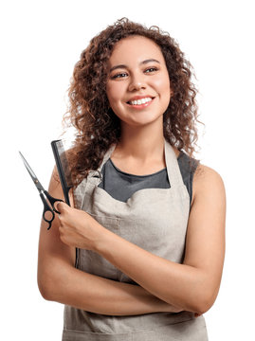
What ……………..?

Slide 14
Simple present questions
When we want to ask about the work place of someone :
Wh question + auxiliar do/does + subject + verb ?
Where | do |  | work ?
Where | does |  | work?
I
You
We
They
He
She
it
Use where to ask about places
In wh questions use auxiliar do for questions with I / you / we / they, use does for questions with he/ she / it.

Slide 15
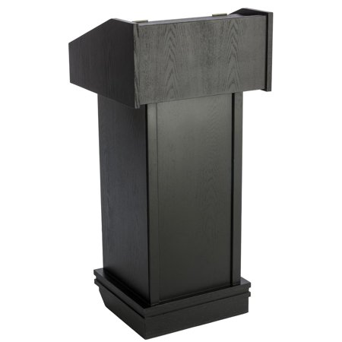
Where does he work?
He works in a restaurant

Slide 16
Where ……………..?

Slide 17
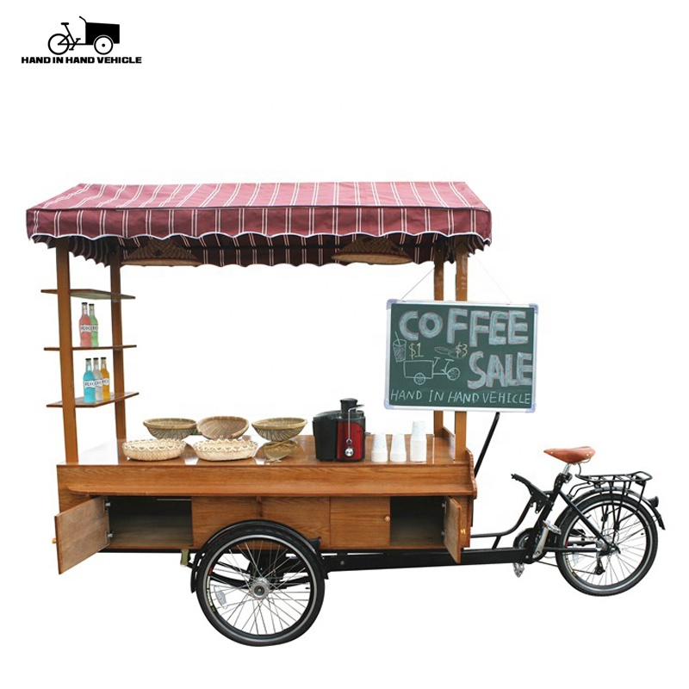
Where ……………..?

Slide 18
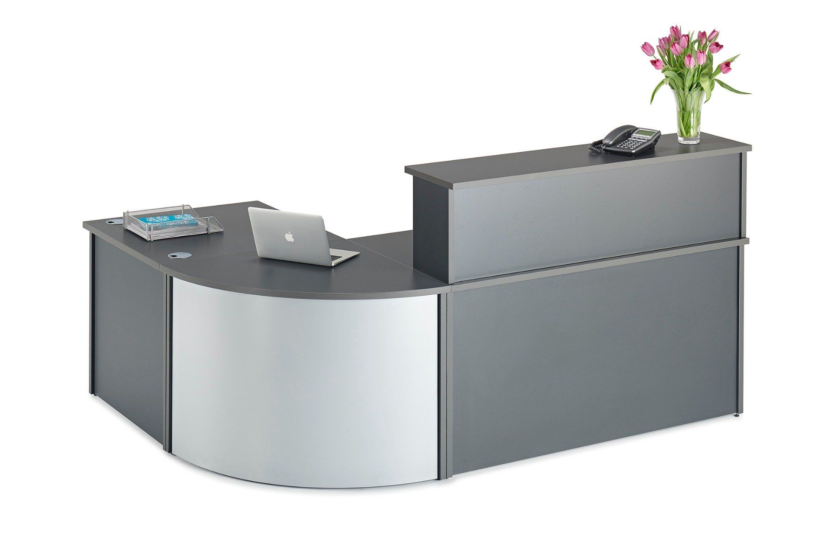
Where ……………?

Slide 19
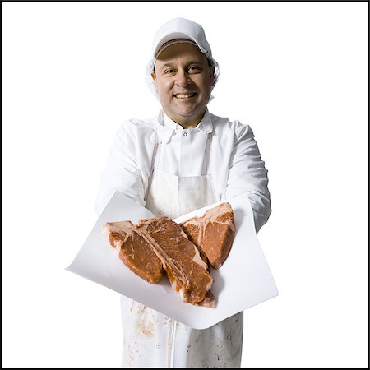
Where ……………..?

Slide 20
Simple present questions
When we want to ask for an oppinion:
How question + auxiliar do/does + subject + verb ?
How | do |  | like it?
How | does |  | like it?
I
You
We
They
He
She
it
Use how do/does …… like……? to ask for oppinion
In how questions use auxiliar do for questions with I / you / we / they, use does for questions with he/ she / it.
Use expressions of like or dislike to give oppinions about your job. I like it very much, I like it a lot, I don´t really like it, I hate it.

Slide 21
How do you like your job?
I love it!
I like it a lot!
I like it very much!

Slide 22
How does she like her job?
She likes it a lot !

Slide 23
How does…………..?

Slide 24
How……………..?

Slide 25
How……………..?

Slide 26
How……………..?

Slide 27
Writing practice
Click on the following lnks to practice Jobs vocabulary and simple present tense
https://es.liveworksheets.com/worksheets/en/English_as_a_Second_Language_(ESL)/Jobs_and_occupations/Jobs_rf1208687ta
Insert here your results
Challenging activity
Click on the following lnks to practice Jobs vocabulary and simple present tense
https://es.liveworksheets.com/gu84928dl
Insert here your results

