Slide 1
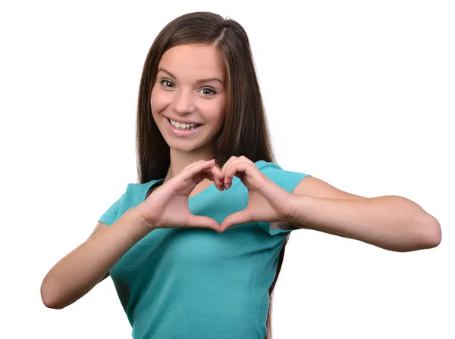
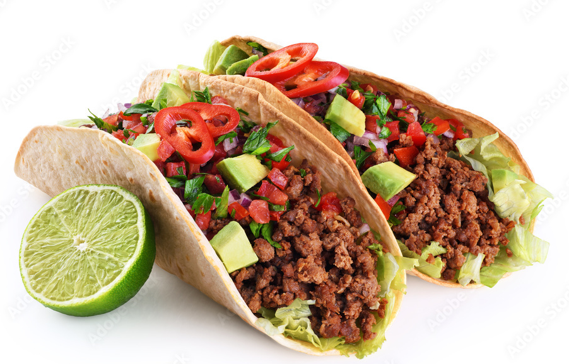
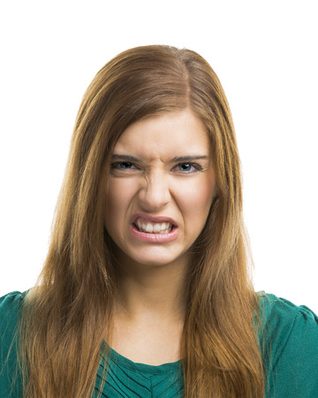
UNIT 3
Lesson 3
I love
Really? I don´t !
LESSON OBJECTIVE:
Learn and practice expressions to disagree.

Slide 2
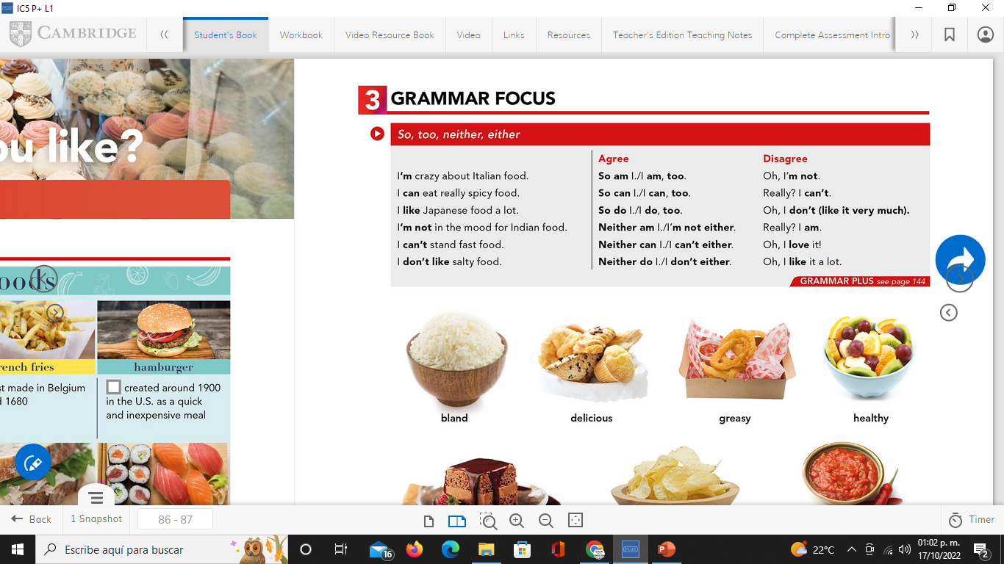
GRAMMAR FOCUS “To disagree” studentbook pg 17
We use expressions as oh, or really?. To introduce our opinion, that may differ from the other person.
Disagree

Slide 3

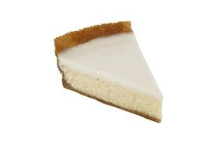
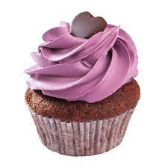
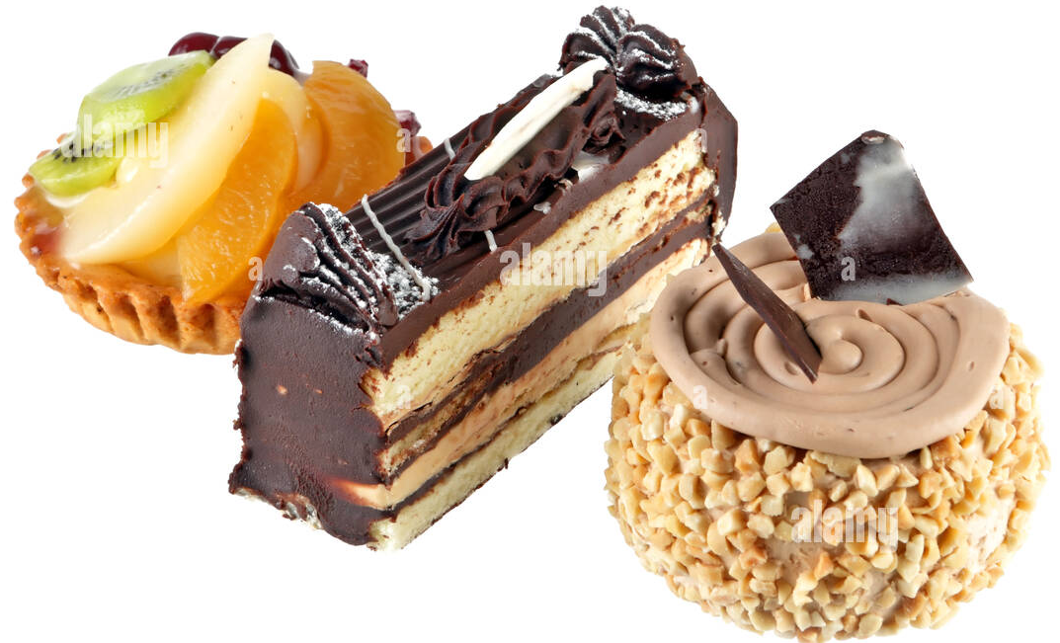
GRAMMAR FOCUS “To disagree”
GRAMMAR FOCUS “To disagree”
We use expressions as oh, or really?. To introduce our opinion, that may differ from the other person.
I´m crazy about…
Really? I´m not

Slide 4

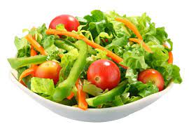

GRAMMAR FOCUS “To disagree”
GRAMMAR FOCUS “To disagree”
We use expressions as oh, or really?. To introduce our opinion, that may differ from the other person.
I love
Oh, I don´t like it very much!

Slide 5
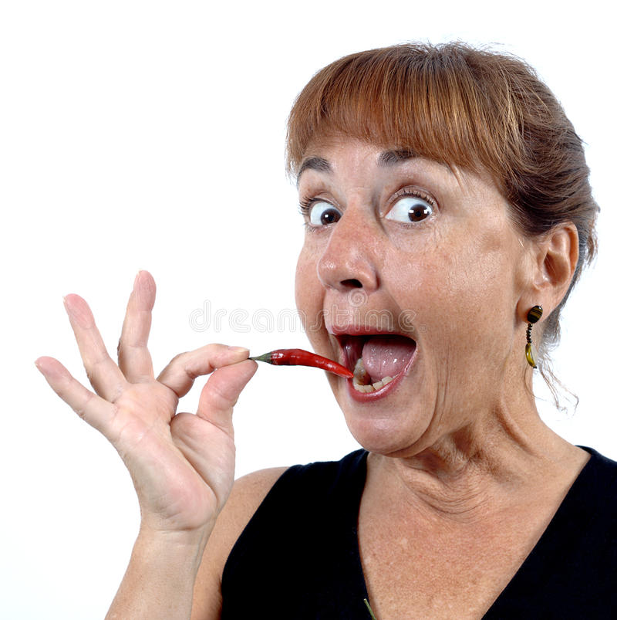
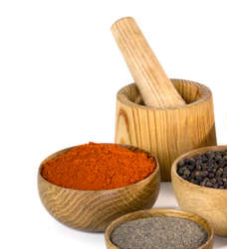
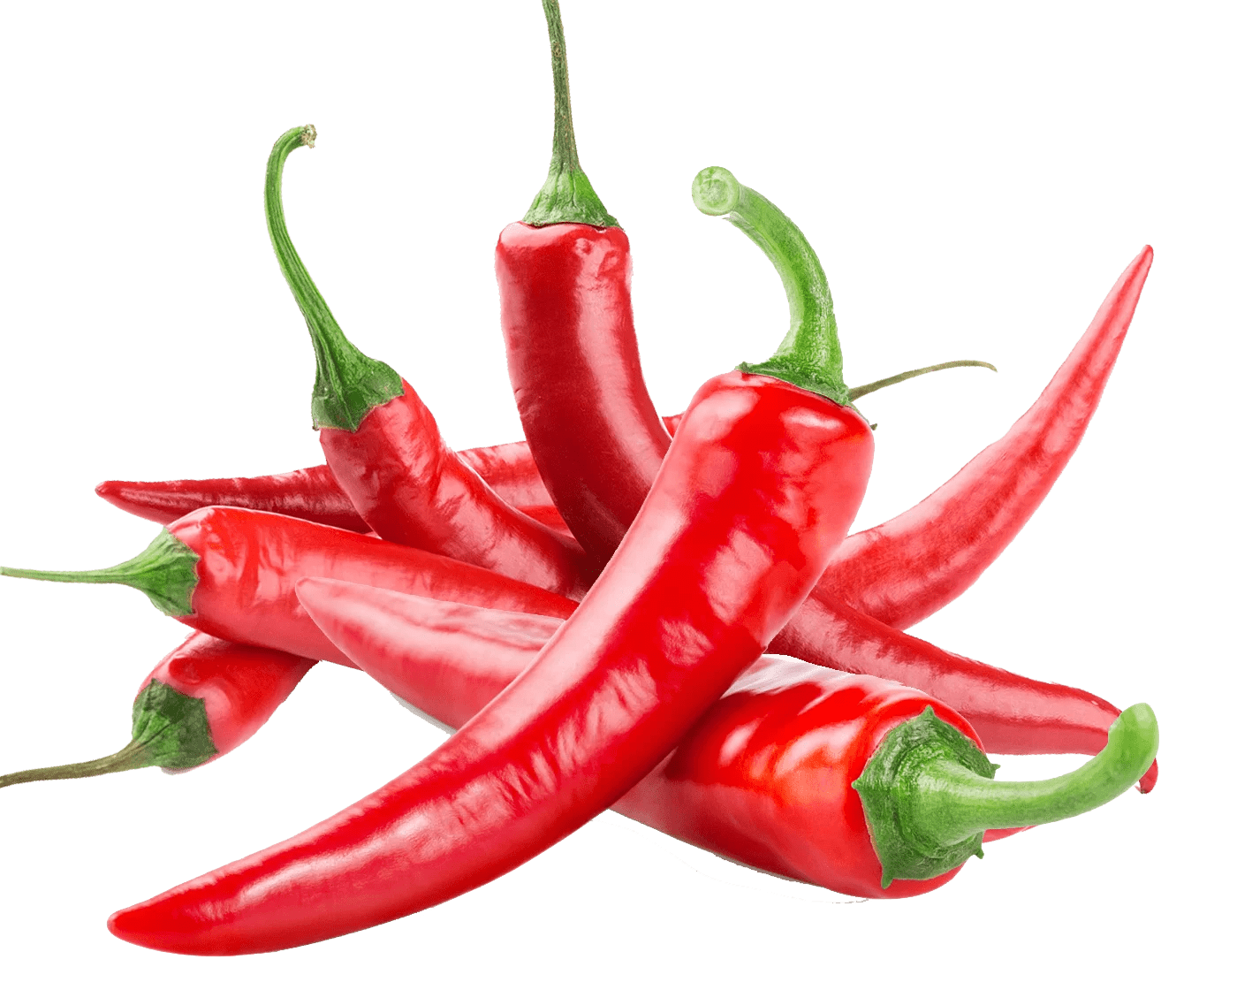

GRAMMAR FOCUS “To disagree”
GRAMMAR FOCUS “To disagree”
We use expressions as oh, or really?. To introduce our opinion, that may differ from the other person.
I can eat spicy ……food !
Really? I can´t eat spicy food at all.

Slide 6
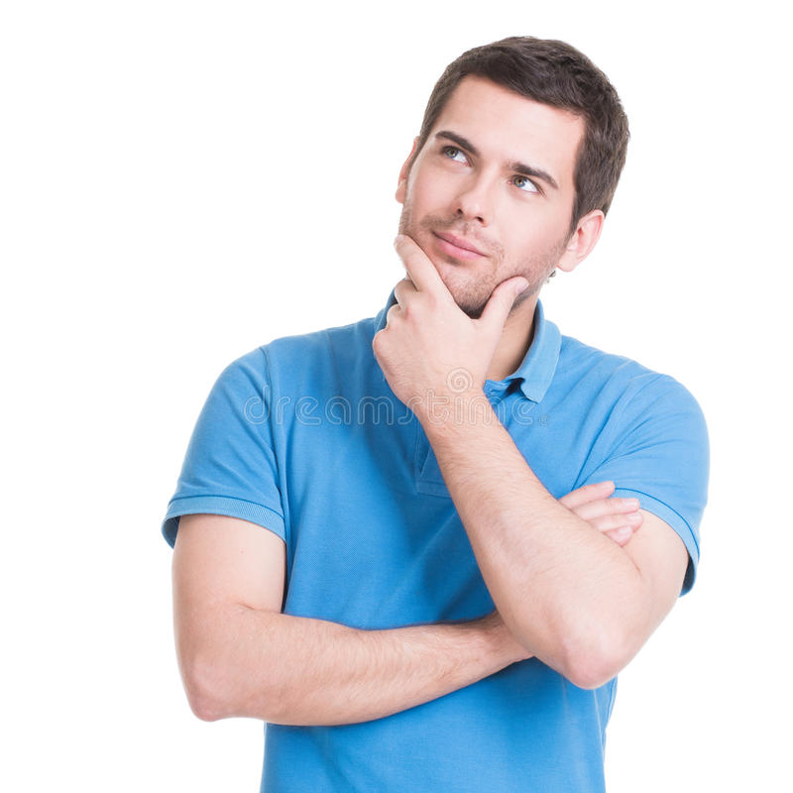
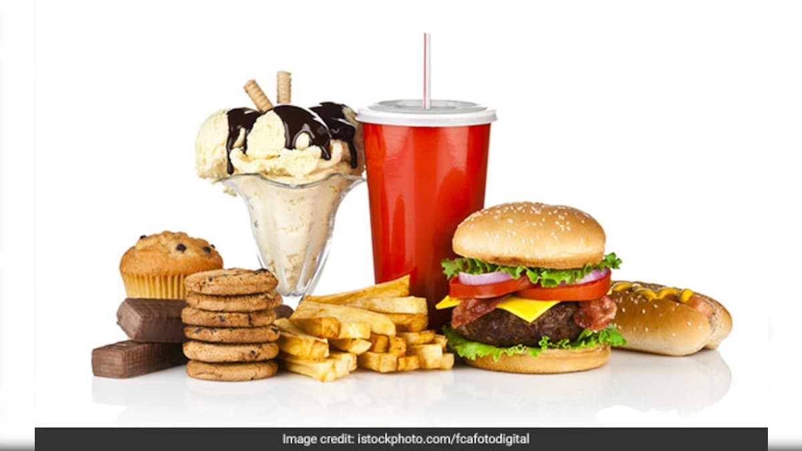
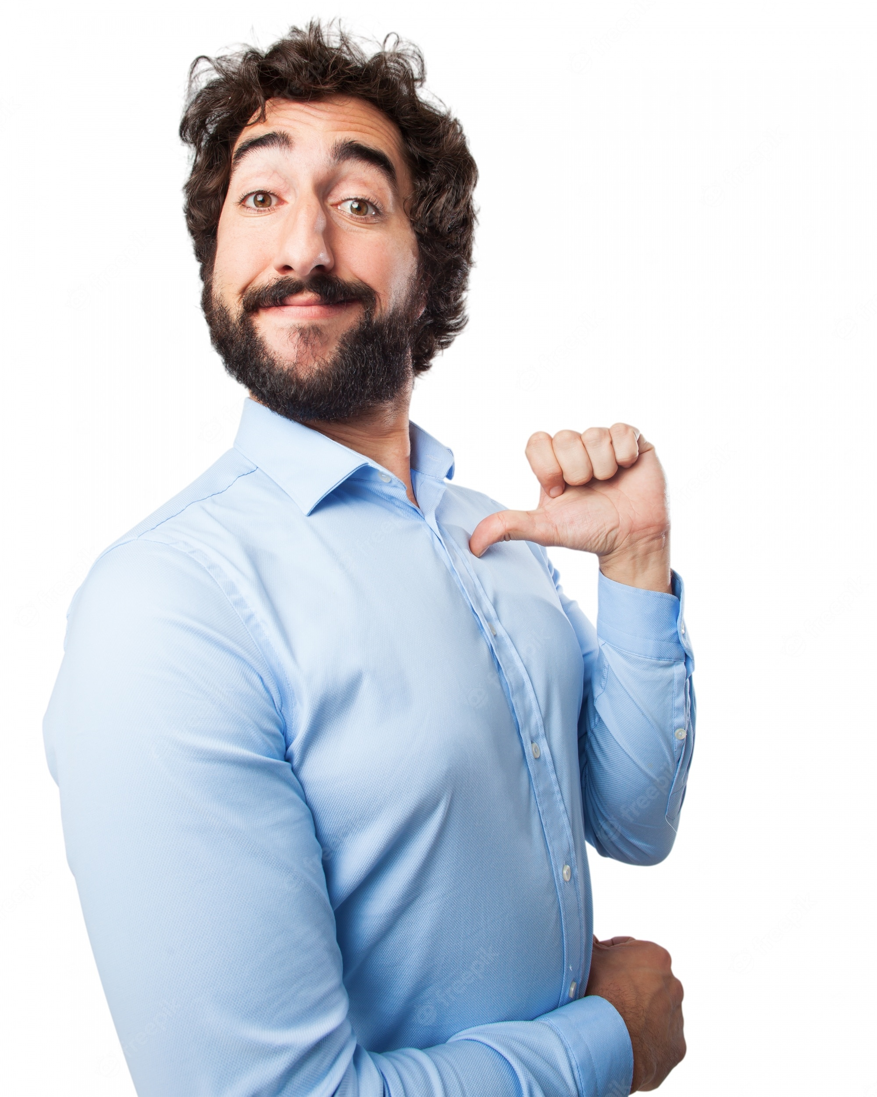
GRAMMAR FOCUS “To disagree”
GRAMMAR FOCUS “To disagree”
We use expressions as oh, or really?. To introduce our opinion, that may differ from the other person.
I´m not
in the mood of
Well, I am

Slide 7

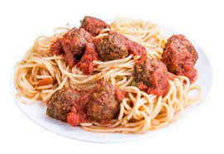
GRAMMAR FOCUS “To disagree”
GRAMMAR FOCUS “To disagree”
We use expressions as oh, or really?. To introduce our opinion, that may differ from the other person.
I don´t like italian food!
Really? I love it!

Slide 8
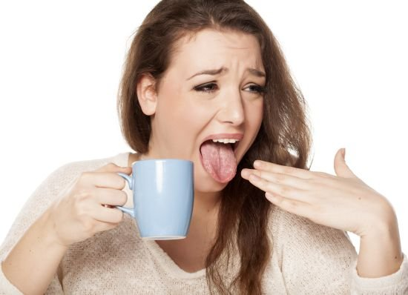
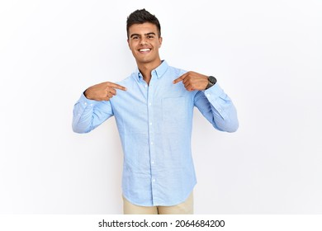
GRAMMAR FOCUS “To disagree”
GRAMMAR FOCUS “To disagree”
We use expressions as oh, or really?. To introduce our opinion, that may differ from the other person.
I can´t drink hot things
Well, I do!

Slide 9
Writing/Speaking Practice
Write statements, give a different opinión showing disagree to the following statements.
I´m on a diet.
I´m a very serious person.
I love onions.
I´m in the mood of octopus coctail.
I can´t eat meat.
I hate hamburguers.
I can play the guitar

Slide 10
Writing/Speaking Practice
Write statements, give a different opinión showing disagree to the following statements.
I´m not in the mood of tacos.
I´m keeon on homemade pizza!
I love garlic.
I like shrimp coctail.
I can´t stand chocolate cake.
I hate ice cream.
I can speak english very well.

Slide 11

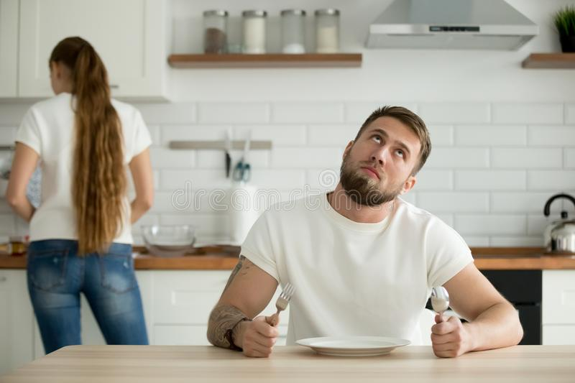
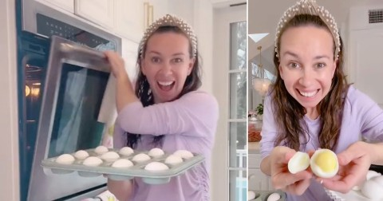
Listening/Speaking Practice
Workbook pg 18
Listen the following conversation. Fill in the blanks with the missing words.
Then take turns and role-play.
Maria: I feel tired tonight. I ______________to cook.
Courtney: ___________Let´s order out. _________Chinese food?
Maria: It´s Delicious! ____________!
Courtney: __________. It´s my favorite. Let´s call Beijing Express for home delivery.
Maria: _______________! Their food is always Good. I eat there a lot.
Courtney: _____________. Well what would you like tonight?
Maria: ______________for some soup.
Courtney: _____________I. And I think I will have orange chiken and fried rice.
Maria:Ok, Let´s order. Oh, wait. They ________credit cards, and I don´t have any __________.
Courtney: Neither________ I. Too bad! What _________ we do?
Maria: Well, let´s look in the refrigerator. Hmm. ___________boiled eggs?
Courtney: I __________ !
Maria: Actually, _____________ I.

Slide 12

Listening Practice “I´m tired of shopping” studentbook pg 16
A. Listen and practice the following conversation. Fill in the blanks with the missing words.
Alan: Hey, ____________to get something to eat?
Kate: Sure. _____________of shopping.
Alan: ___________. What do you think of Thai food?
Kate: I _______, but I´m ___________________for it today.
Alan: Yeah. ____________, I guess. It´s a bit__________.
Kate: ____________Japanese food?
Alan: ________me! __________Japanese food.
Kate: ________. There´s a great restaurant on the first floor. It´s _________ Kyoto Garden.
Alan: Perfect! ____________it.

Slide 13
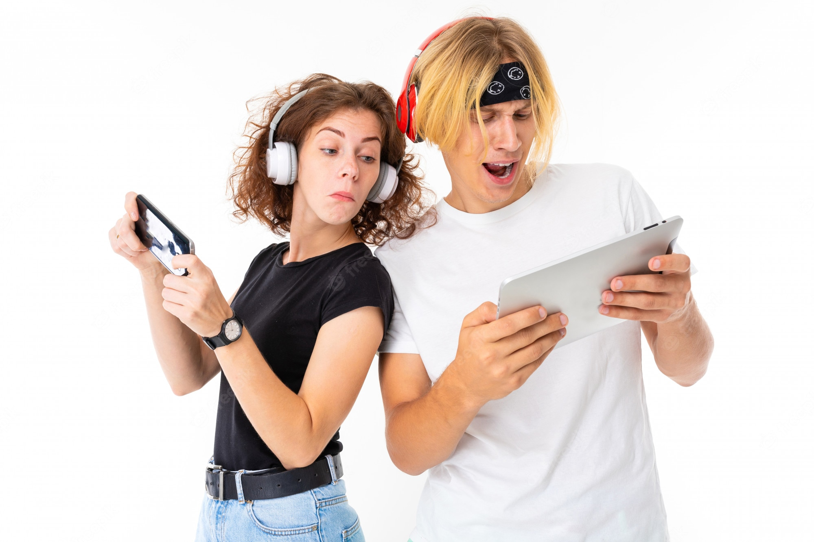
Speaking Practice
Put in order the dialogue, write the numbers from 1 to 7 Then in pairs roleplay the conversation.
5 | Really? Who´s your favorite singer?
 | Sugman Pokhrel. How about you? Do you like him?
7 | He´s OK. But I´m fond of Nima Rumba.
 | Do you like folk music Tina?
 | Well I love pop music a lot.
3 | Yes, I love it. Kumar Basnet is my favorite Singer. What kind of music do you like?
 | No, I don´t like it very much, Do you?

Slide 14

Speaking Practice
Unscramble the following statements. Paste them in the following conversation chart.
Cheescake is fine by me!. What about lasagna? I´m crazy about it!
You know what? I don´t like apples very much. I prefer cheescake pie instead.
Perfect! So, see you in a while!
Good Idea, I´ll bring the salad. I like The Cesar Salad!
Hello Chrys!. Would you like to come around tonight?
Actually, I´m sick of fast food, I prefer homemade food!
Well, I´m not keen on lasagna! But I´m fine with just the salad.
I do too! It´s my favorite! Then I´ll bake an apple pie!
Great! What about ordering something for dinner?

Slide 15
Speaking Practice
Put in order the dialogue, Then in pairs roleplay the conversation.
Matt:
Chrys:
Matt:
Chrys:
Matt:
Chrys:
Matt:
Chrys:
Matt:
Chrys:
Matt:

Slide 16
Writing/Speaking Practice
Write a short conversation, talk about your preferences in food. Use expressions to show like, dislikes, agreement and disagreement.

