Slide 1
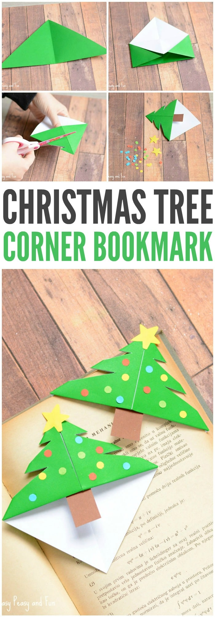
https://www.easypeasyandfun.com/christmas-tree-corner-bookmarks/

Slide 2
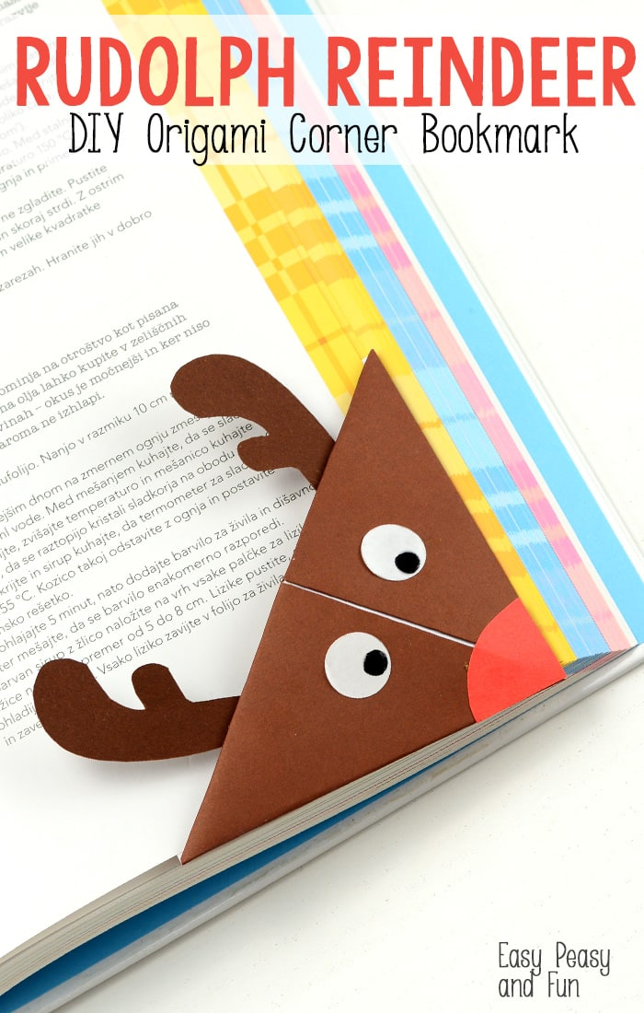
https://www.easypeasyandfun.com/reindeer-origami-corner-bookmark/

