Slide 1
LEARNING UNIT 1 PROJECT
SURVEY

Slide 2
PREPARATION
BRAINSTORM TOPICS
BRAINSTORM WH-QUESTIONS
MAKE TEAMS OF FOUR STUDENTS
RAFFLE TOPICS

Slide 3
DEVELOPMENT
Write a small introduction of your topic
Design a survey with 10 questions with multiple choice answers
Apply the survey to at least 20 people

Slide 4
PRESENTATION
ANALYZE THE INFORMATION OBTAINED FROM THE SURVEY
PREPARE A PRESENTATION TO TALK IN FRONT OF THE CLASS ON MONDAY
Members of the team
Small introduction of the topic
Structure of the survey
Results (quantifiers)
Small conclusion

Slide 5
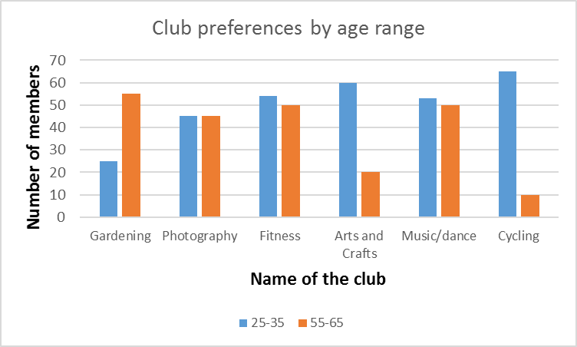

Slide 6
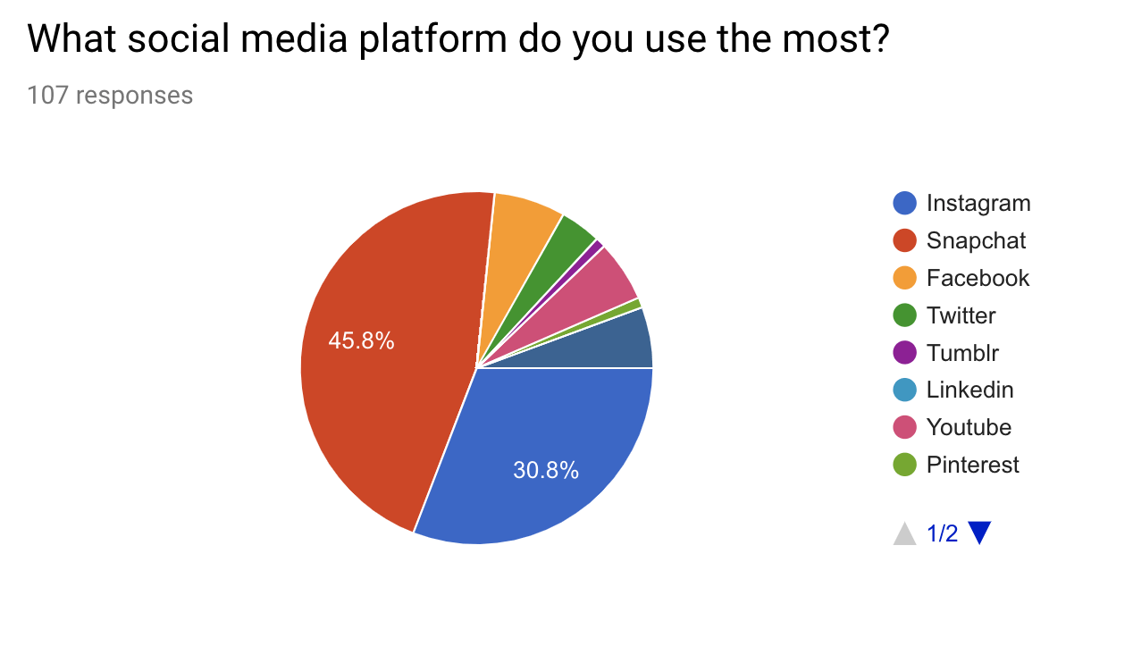

Slide 7
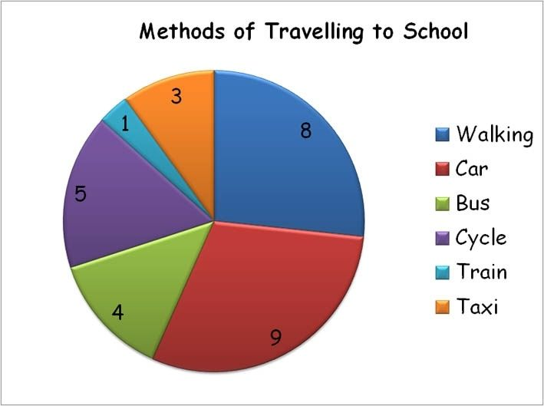

Slide 8
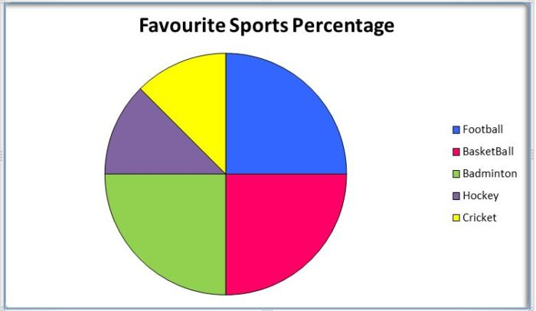

Slide 9
RUBRIC
PREPARATION ACTIVITIES (15%)
CLASSWORK
PRODUCTS (15%)
SURVEY
POWER POINT PRESENTATION
GRAMMAR AND VOCABULARY (30%)
USE OF GRAMMAR (QUESTIONS)
USE OF FREQUENCY ADVERBS
USE OF QUANTIFIERS
SPEAKING PERFORMANCE (40%)
FLUENCY
INTONATION
PRONUNCIATION
COHERENCE

