Slide 1
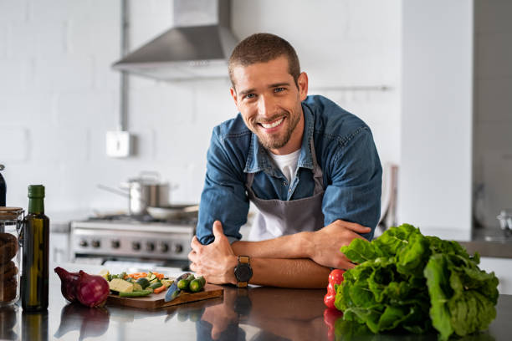
UNIT 3
Lesson 1 “Cooking”
LESSON OBJECTIVE:
Learn and practice cooking vocabulary

Slide 2

VOCABULARY “ Kitchen utensils”
Watch the following video to learn and practice the kitchen utensils
https://www.youtube.com/shorts/rdYEoNGO8ew

Slide 3
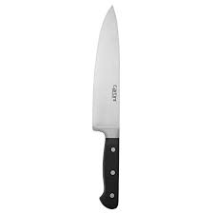
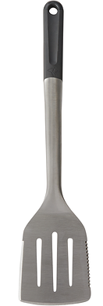
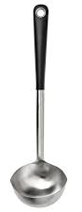
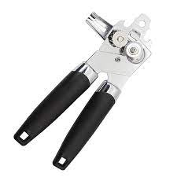
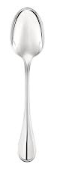
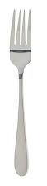
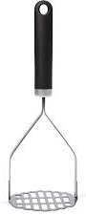
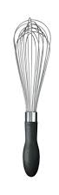
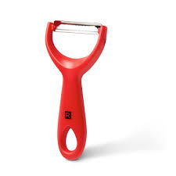
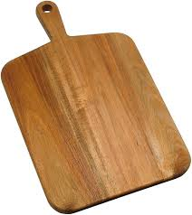
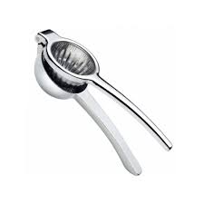
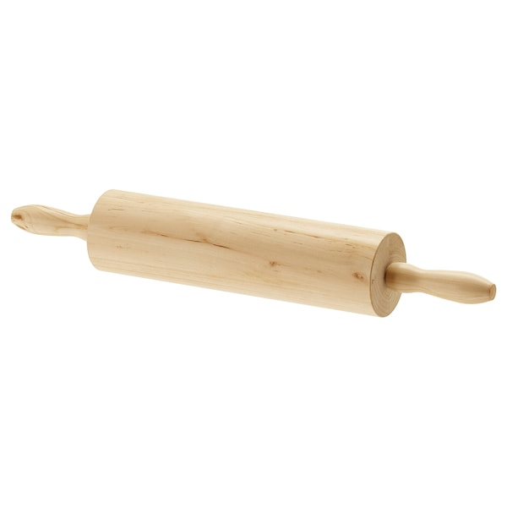
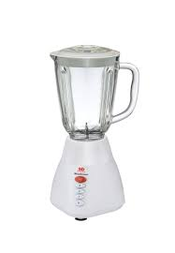
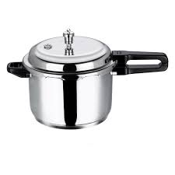
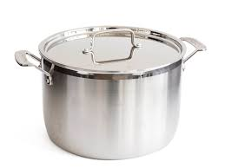
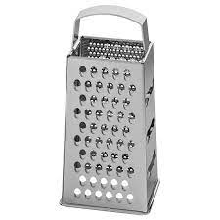
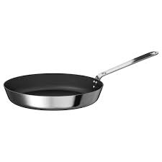
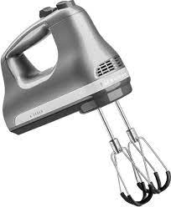
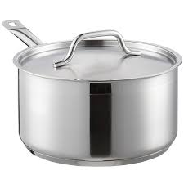
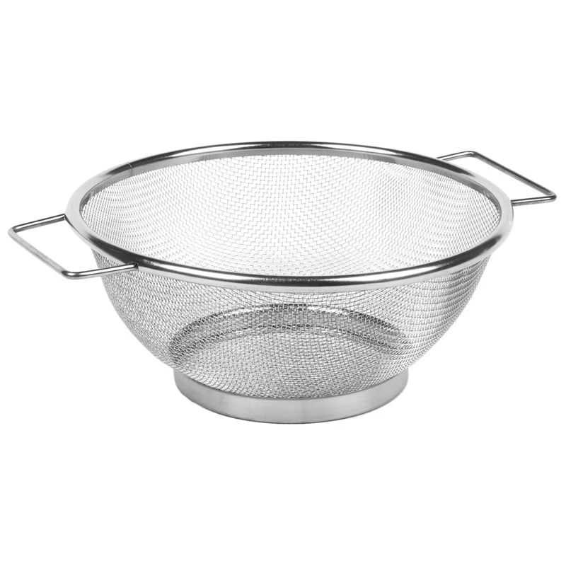
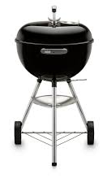
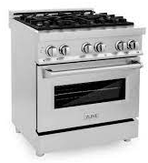
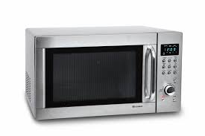
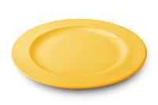
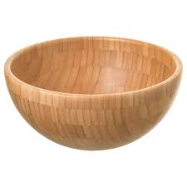
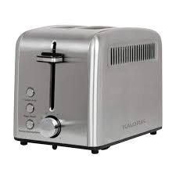
VOCABULARY “ Kitchen utensils”
Label the following pictures

Slide 4
VOCABULARY “ Kitchen utensils”
Match the pictures with the correct name.
cutting board peeler squeezer masher spatula knife rolling pin

Slide 5
VOCABULARY “ Kitchen utensils”
Match the pictures with the correct name.
grater blender pressure cooker pot sauce pan colander mixer

Slide 6
Vocabulary Practice
Online activity
Click on the following links, practice kitchen utensils vocabulary.
Then share your results of your practice.
https://wordwall.net/resource/18414476/kitchen-utensils
Insert here your results
https://wordwall.net/resource/18415525/kitchen-utensils
Insert here your results
https://wordwall.net/resource/21989803/basic-kitchen-utensils
Insert here your results

Slide 7
Vocabulary Practice
Online activity
Click on the following links, practice kitchen utensils vocabulary.
Then share your results of your practice.
https://wordwall.net/resource/9123394/angielski/brainy-6-unit-5-kitchen-equipment
Insert here your results
https://wordwall.net/resource/11789679/english-level-kitchen-utensils
Insert here your results

Slide 8
VOCABULARY “ Kitchen utensils”
Choose 10 utensils and present them in a short video (use the given video as an example)
Insert here your video

