Slide 1
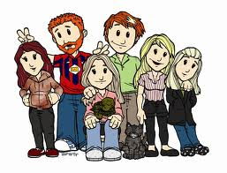
My Family
Write about three members of your family, mention relationship, describe them (use adjectives of personal appearance) give basic information (likes and dislikes) (5 lines min).
Add a memmorable phrase to your family.
________________________________________________________________________________________________________________________________________________________________________________________________________________________________________________________________________________________________________________________________________________________________________________________________________________________________________________________________________________________________________________________
Family…
Like branches on a tree, we all grow in different directions yet our roots remain as one.

Slide 2
Family Talk.
Unscramble the sentences below
your there are in many people How family?
__________________________________________
2. my family. people in There five are
__________________________________________
3. you have? many do brothers How
__________________________________________
4. are your in Who family?
__________________________________________
5. you Are married ?
__________________________________________
6. daughter? have a Do son a you or
__________________________________________
7. your family does live? Where
__________________________________________
8. sisters? Have got you any
__________________________________________
9. uncle your married? Is
__________________________________________
10. do? does father your What
__________________________________________

Slide 3
Family word scramble
Unscramble the following words write them on the line
1. ehfrta________________
2. mehtor________________
3. hobrrte________________
4. ons__________________
5. tuhgdaer_______________
6. rseits________________
7. nuecl________________
8. tuan________________
9. gandetohrrm_____________
10. scunoi________________
11. maeirdr________________
12. fiew__________________
13. dsbahun_______________
14. dntgarfehra_____________
15. famiyl_________________

