Slide 4
Write 8 sentences in present perfect simple using the words below

Slide 5
1.-______________________________________________
2.-______________________________________________
3.-______________________________________________
4.-______________________________________________
5.-______________________________________________
6.-______________________________________________
7.-______________________________________________
8.-______________________________________________

Slide 6
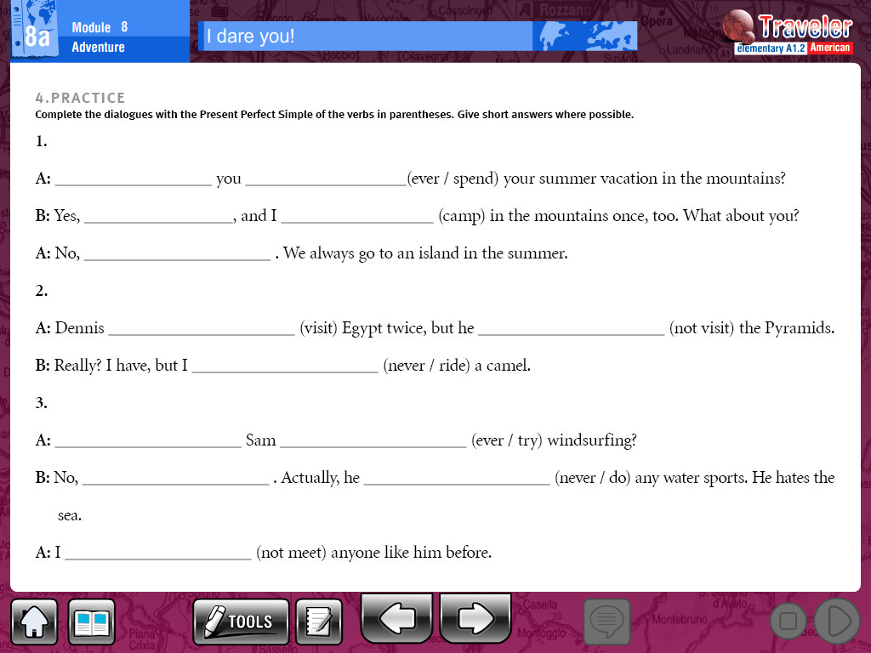

Slide 7
Click on the following link to practice present perfect simple
Then copy paste your results
https://learnenglishkids.britishcouncil.org/en/grammar-games/present-perfect-experiences
http://www.eslkidsworld.com/Interactive%20games/Grammar%20Games/Present%20Perfect/present%20perfect%20quiz.html

