Slide 4
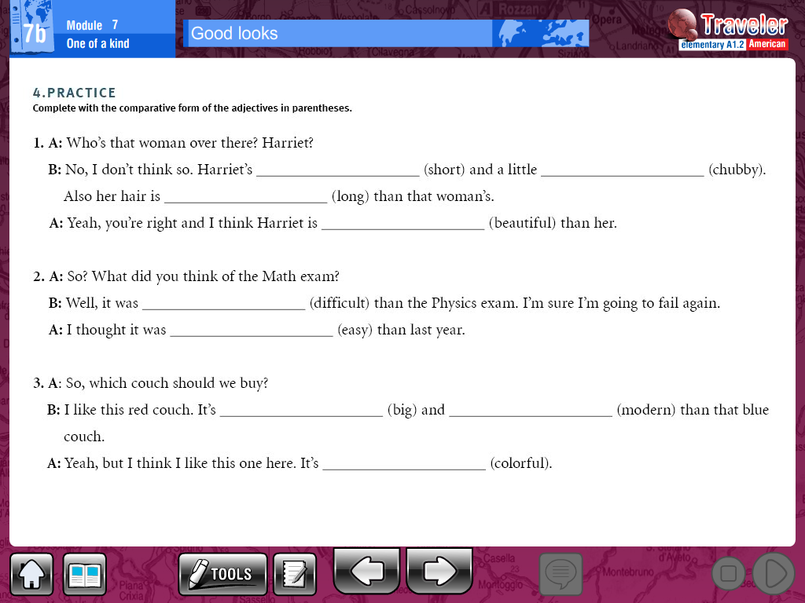

Slide 5
________________________________________________________________________________________________________________________________________________________________________________________________________________________________________________________________________________________________________________________________________________

