Slide 1
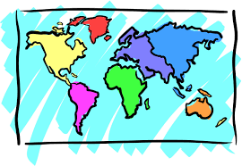
CLOSURE UNIT 3
Where are you from?

Slide 2
MATCH THE QUESTIONS WITH THE CORRECT ANSWER

Slide 3
What´s his name?
Where is your brother from?
How old are your cousins?
What´s Sandy like?
What´s your last name?
Is English your first language?
No, my first language is not English. It´s Spanish.
It´s Morales.
She´s pretty and fun.
He´s from Brazil.
His name is Carlos.
They´re 12.

Slide 4
WRITE QUESTIONS FOR THE ANSWERS
EXAMPLE:
What´s your name?
My name is Ben.

Slide 5
My name is Nate. | No, she´s not from Canada. She´s from Japan. | They´re from India.
I think he´s 22. | No, my first language is not French. It´s English. | Yes, I am. I am from Guadalajara.
She is very serious and smart. | It´s cold and interesting. | It´s L-O-P-E-Z.
She is my sister, Laura. | They´re 10 years old. | It´s Rodríguez.
No, they´re not. They are from Sao Paulo. | It´s Spanish. | Her name is Luisa.

Slide 6
ADJECTIVES & OPPOSITES
ADJECTIVES & OPPOSITES
WORD | ADJECTIVE | OPPOSITE | DRAWING
eitaklva
yldnierf
rhtso
vehay
typter
suories
ndik
WORD | ADJECTIVE | OPPOSITE | DRAWING
eitaklva
yldnierf
rhtso
vehay
typter
suories
ndik

