Slide 1
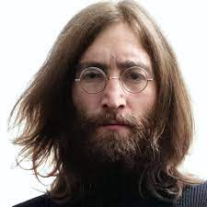
UNIT 1
Lesson 7
Did he use to smoke?
LESSON OBJECTIVE:
Talk about past habits with the used to.

Slide 2
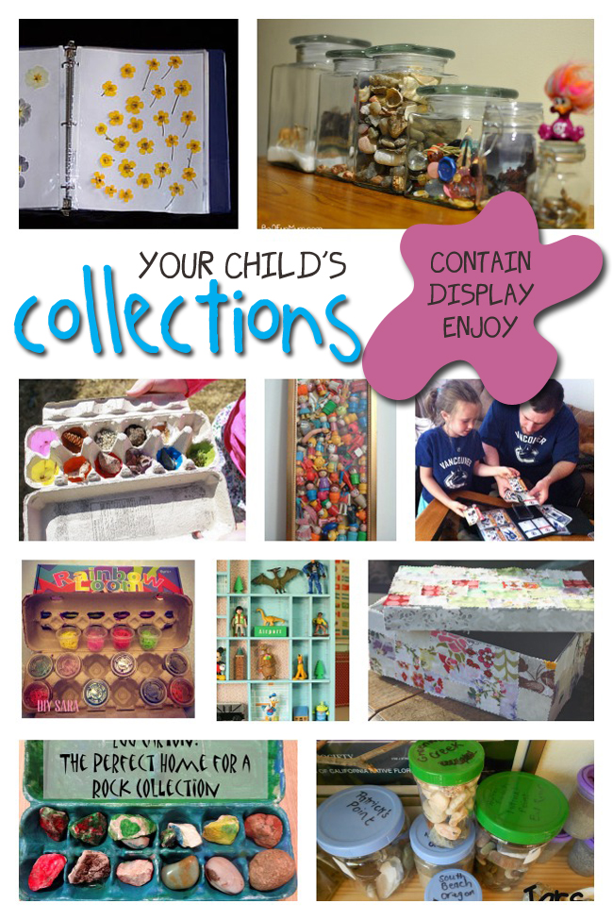
GRAMMAR FOCUS “Used to for past habits”
Used to refers to something that you regularly did in the past but don´t do anymore
Affirmative statements | I used to collect commic books Subject + used to + verb + complement
Negative statements | I didn´t use to collect anything Subject + didn´t use to + verb + complement
Yes/No questions | Did you use to collect things? Did + Subject + use to + verb + complement
Wh questions | What did you use to collect? WH + Did + Subject + use to + verb + complement

Slide 3
GRAMMAR FOCUS “Used to for past habits”
Student´s book pg 5 ex 8
Used to refers to something that you regularly did in the past but don´t do anymore
Did you use to play sports?
What sports did you use to play?
Yes I did, I used to play soccer
I used to play soccer and basketball.
I never used to play sports,
but now I play tennis
I didn´t use to play sports, but now I play tennis

Slide 4
Listening /Speaking Practice “Used to for past habits”
Read the following statements about changes. Check those that are true about you.

Slide 5
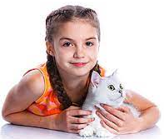
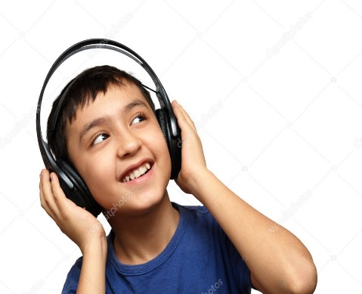
Grammar Practice “Used to for past habits”
Student´s book pg 5 ex 8
Complete these questions and answers. Then compare with a partner.
Used to
Did
Use to
Didn´t use to
Used to
did
Use to
Used to
Did
Use to
Didn´t Used to

Slide 6
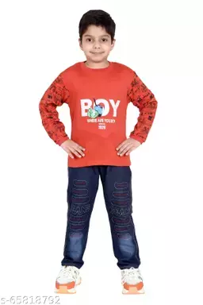
Grammar/Speaking Practice “Used to for past habits”
Student´s book pg 132 ex 2
Complete the following conversations with the correct form of used to.
Then roleplay with a partner.
Used to
Did your
Use to
Used to
Used to
Did
Use to
Used to
Used to
Used to
Used to

Slide 7
Grammar/Speaking Practice “Used to for past habits”
Workbook pg 4 ex 6
Look at these childhood pictures of Allie and her brother Robert.
Complete the sentences using used to.
used to go to the park by bike.
Used to go to the beach
Used to collect commic books
Used to play with their rabit

Slide 8
Writing/Speaking Practice “Used to for past habits”
Student´s book pg 6 ex 11
Write about things you used to do as child. Write sentences using used to or didn´t use to. Then share to the class.
Write here your text:
My favorite childhood memory is when I used to go to my grandmother's house after school, but I don't remember what I used to do afterwards, I remember that when I was a child I used to skate in the street of my house, but I didn't use to ride a bicycle, Since I used to be very skinny, my relatives used to call me Patatina, but I didn't like it very much. For many years I used to go to visit my family in Mazanillo during the holidays, but I never used to go to the United States. I also remember that I used to eat flautitas and pozole, but I didn't usually eat pizza or hamburgers. I used to be a very happy girl.
You can use one of these topics.

Slide 9
Grammar Practice “Used to for past habits”
Choose the correct Word or phrase.
Workbook pg 4 ex 5
pet
Summer camp
playground
How have you changed in the last five years? Write answers to these questions.
Workbook pg 5 ex 8
cook pastry
I go to the cinema every weekend
Now I like rock in Spanish
I used to like reggateon
I used to wear low-cut clothes
Now I wear comfortable clothes

Slide 10
Grammar/Speaking Practice “Used to for past habits”
Workbook pg 5 ex 7
Look at the answers. Write the questions using used to.
what did you used to do at the beach?
Did you use to have a lot of fun at the beach?
sports did you play?
Did you use to lose?

