Slide 1
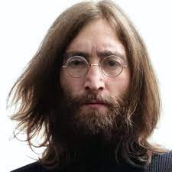
UNIT 1
Lesson 7
Did he use to smoke?
LESSON OBJECTIVE:
Talk about past habits with the used to.

Slide 2
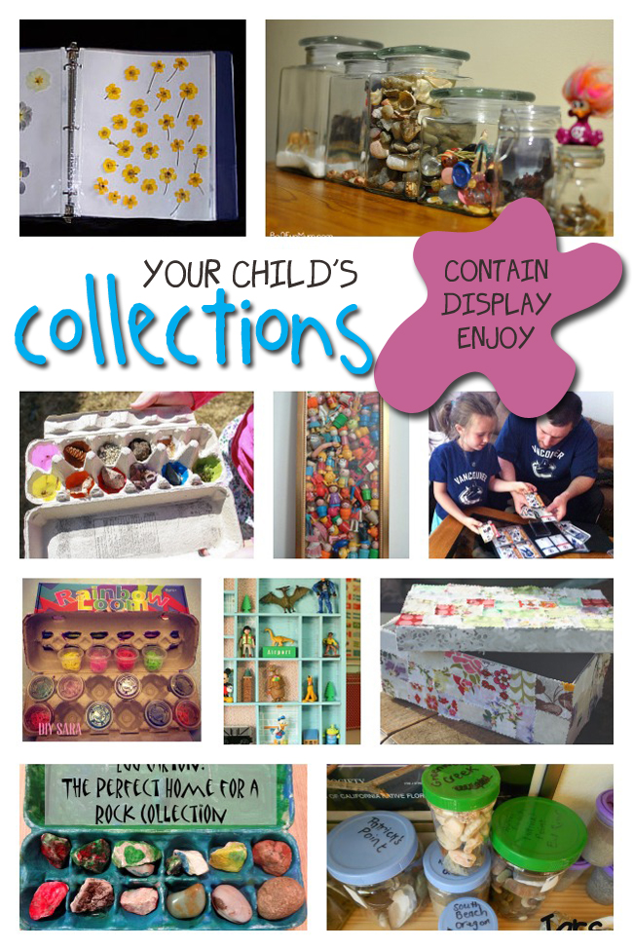
GRAMMAR FOCUS “Used to for past habits”
Used to refers to something that you regularly did in the past but don´t do anymore
Affirmative statements | I used to collect commic books Subject + used to + verb + complement
Negative statements | I didn´t use to collect anything Subject + didn´t use to + verb + complement
Yes/No questions | Did you use to collect things? Did + Subject + use to + verb + complement
Wh questions | What did you use to collect? WH + Did + Subject + use to + verb + complement

Slide 3
GRAMMAR FOCUS “Used to for past habits”
Student´s book pg 5 ex 8
Used to refers to something that you regularly did in the past but don´t do anymore
Did you use to play sports?
What sports did you use to play?
Yes I did, I used to play soccer
I used to play soccer and basketball.
I never used to play sports,
but now I play tennis
I didn´t use to play sports, but now I play tennis

Slide 4
Listening /Speaking Practice “Used to for past habits”
Read the following statements about changes. Check those that are true about you.

Slide 5
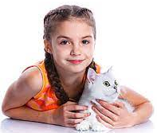
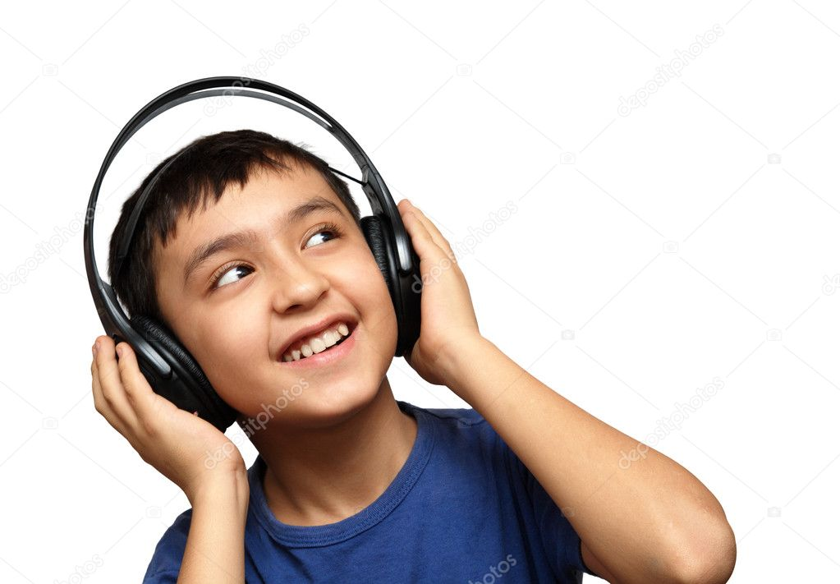
Grammar Practice “Used to for past habits”
Student´s book pg 5 ex 8
Complete these questions and answers. Then compare with a partner.
did
Did
Use to
Didn´t used to
Used to
did
Use to
Used to
did
Use to
didn´t used to

Slide 6
Grammar/Speaking Practice “Used to for past habits”
Student´s book pg 132 ex 2
Complete the following conversations with the correct form of used to.
Then roleplay with a partner.
Used to
Did you
Use to
Used to
Used to
Did
Use to
Used to
Used to
Used to
Used to

Slide 7
Grammar/Speaking Practice “Used to for past habits”
Workbook pg 4 ex 6
Look at these childhood pictures of Allie and her brother Robert.
Complete the sentences using used to.
Used to ride their bicyclies.
Used to go the beach
Used o collect commics
Used to how a pet

Slide 8
Writing/Speaking Practice “Used to for past habits”
Student´s book pg 6 ex 11
Write about things you used to do as child. Write sentences using used to or didn´t use to. Then share to the class.
Write here your text:
My parents used to sing in the birthay’s. I used to play guitar with my father. I used to practice sport karate and I used to have nockname in my familia, It was Katy. I didn´t use to play bnighors because I didn´t use to have time, but my parent didn´t use to go out on th e Street. I didn´t use to eat soup maruchan .
You can use one of these topics.

Slide 9
Grammar Practice “Used to for past habits”
Choose the correct Word or phrase.
Workbook pg 4 ex 5
Pet
Summer camp
Playground
How have you changed in the last five years? Write answers to these questions.
Workbook pg 5 ex 8
Guitar with my father .
Now. I didn´t use to play soccer
I used to like Rock pesado music
I didn´t use to jazz music with now know her.
I use to wear dress and snikers
I didn´t use to wear skirts or shorts.

Slide 10
Grammar/Speaking Practice “Used to for past habits”
Student´s book pg 132 ex 2
Complete the following conversations with the correct form of used to.
Then roleplay with a partner.
Used to
Did you
Use to
Used to
Used to
Did
Use to
Used to
Used to
Used to
Used to

