Slide 1
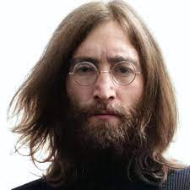
UNIT 1
Lesson 7
Did he use to smoke?
LESSON OBJECTIVE:
Talk about past habits with the used to.

Slide 2
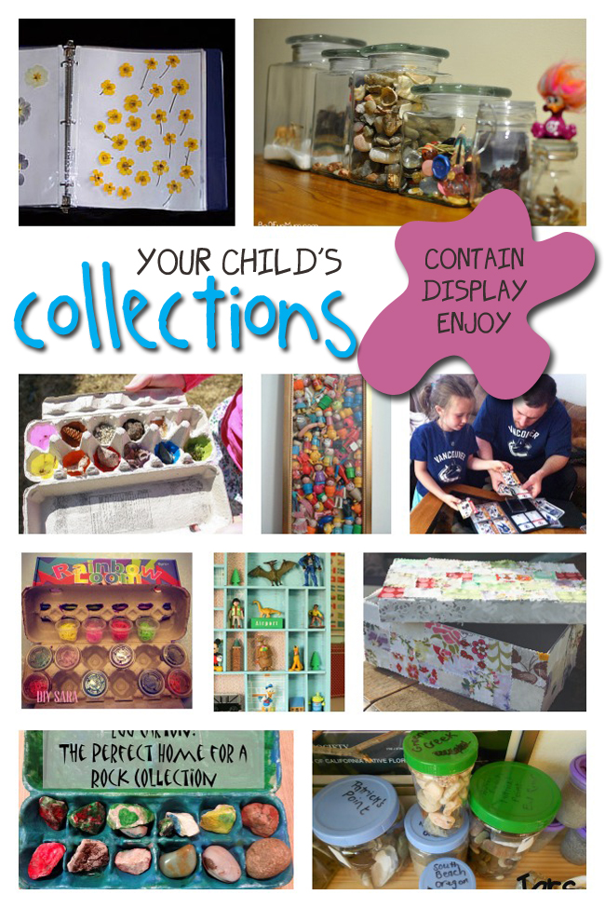
GRAMMAR FOCUS “Used to for past habits”
Used to refers to something that you regularly did in the past but don´t do anymore
Affirmative statements | I used to collect commic books Subject + used to + verb + complement
Negative statements | I didn´t use to collect anything Subject + didn´t use to + verb + complement
Yes/No questions | Did you use to collect things? Did + Subject + use to + verb + complement
Wh questions | What did you use to collect? WH + Did + Subject + use to + verb + complement

Slide 3
GRAMMAR FOCUS “Used to for past habits”
Student´s book pg 5 ex 8
Used to refers to something that you regularly did in the past but don´t do anymore
Did you use to play sports?
What sports did you use to play?
Yes I did, I used to play soccer
I used to play soccer and basketball.
I never used to play sports,
but now I play tennis
I didn´t use to play sports, but now I play tennis

Slide 4
Listening /Speaking Practice “Used to for past habits”
Read the following statements about changes. Check those that are true about you.

Slide 5
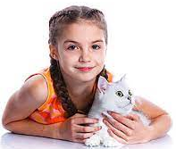
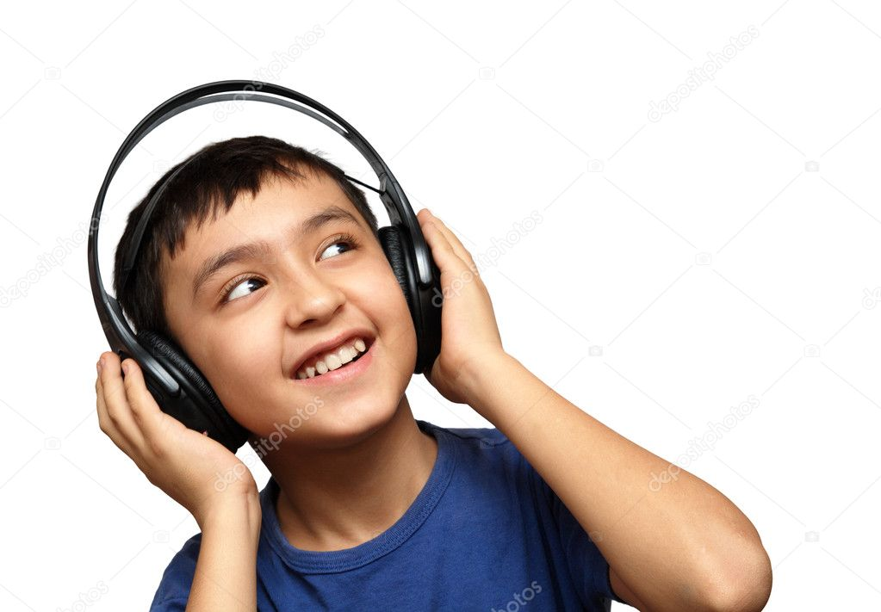
Grammar Practice “Used to for past habits”
Student´s book pg 5 ex 8
Complete these questions and answers. Then compare with a partner.
used to
Did
use to
didn´t use to
used to
did
use to
used to
did
use to
used to

Slide 6
Grammar/Speaking Practice “Used to for past habits”
Student´s book pg 132 ex 2
Complete the following conversations with the correct form of used to.
Then roleplay with a partner.
used to
Did you
used to
used to
used to
Did
used to
used to
used to
used to
used to

Slide 7
Grammar/Speaking Practice “Used to for past habits”
Workbook pg 4 ex 6
Look at these childhood pictures of Allie and her brother Robert.
Complete the sentences using used to.
used to ride their bicycles
used to go to the beach
used to collect comics
used to have a pet

Slide 8
Writing/Speaking Practice “Used to for past habits”
Student´s book pg 6 ex 11
Write about things you used to do as child. Write sentences using used to or didn´t use to. Then share to the class.
Write here your text:
Well, when i was younger i loved to watch the bratz or barbie on saturdays, i used to walk and play with my brother in the park, we used to do a maraton of pelis on weekend and sleep very later.
I never used to go to pijamadas with my Friends or go to any places alone or for myself, my parents took me me everywhere.
On vacations my family and i always used to go to the beach and spend time with us.
You can use one of these topics.

Slide 9
Grammar Practice “Used to for past habits”
Choose the correct Word or phrase.
Workbook pg 4 ex 5
Pet
Summer camp
playground
How have you changed in the last five years? Write answers to these questions.
Workbook pg 5 ex 8
I used to watch movies or do my homework in the afternoon, now i go to work and study all day.
I used to listen just pop music, now i listen a lot of all gender of music.
I used to wear a dresses and skirts, now i wear more trousers and jeans.

Slide 10
Grammar/Speaking Practice “Used to for past habits”
Workbook pg 5 ex 7
Look at the answers. Write the questions using used to.
Did you collect the shells?
Did you use to go to the beach?
did you used to do in the beach?
Did you used to lose the game?

