Slide 1
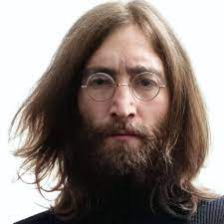
UNIT 1
Lesson 7
Did he use to smoke?
LESSON OBJECTIVE:
Talk about past habits with the used to.

Slide 2
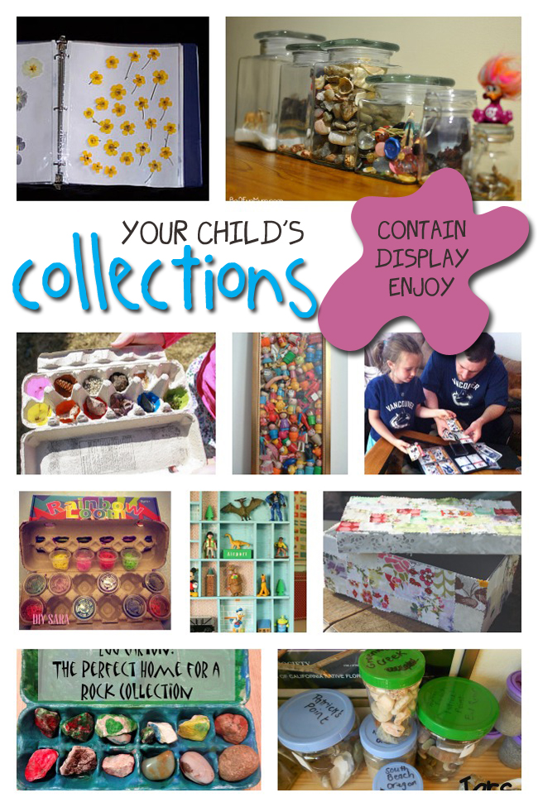
GRAMMAR FOCUS “Used to for past habits”
Used to refers to something that you regularly did in the past but don´t do anymore
Affirmative statements | I used to collect commic books Subject + used to + verb + complement
Negative statements | I didn´t use to collect anything Subject + didn´t use to + verb + complement
Yes/No questions | Did you use to collect things? Did + Subject + use to + verb + complement
Wh questions | What did you use to collect? WH + Did + Subject + use to + verb + complement

Slide 3
GRAMMAR FOCUS “Used to for past habits”
Student´s book pg 5 ex 8
Used to refers to something that you regularly did in the past but don´t do anymore
Did you use to play sports?
What sports did you use to play?
Yes I did, I used to play soccer
I used to play soccer and basketball.
I never used to play sports,
but now I play tennis
I didn´t use to play sports, but now I play tennis

Slide 4
Listening /Speaking Practice “Used to for past habits”
Read the following statements about changes. Check those that are true about you.

Slide 5
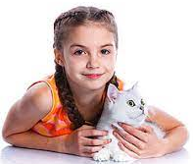
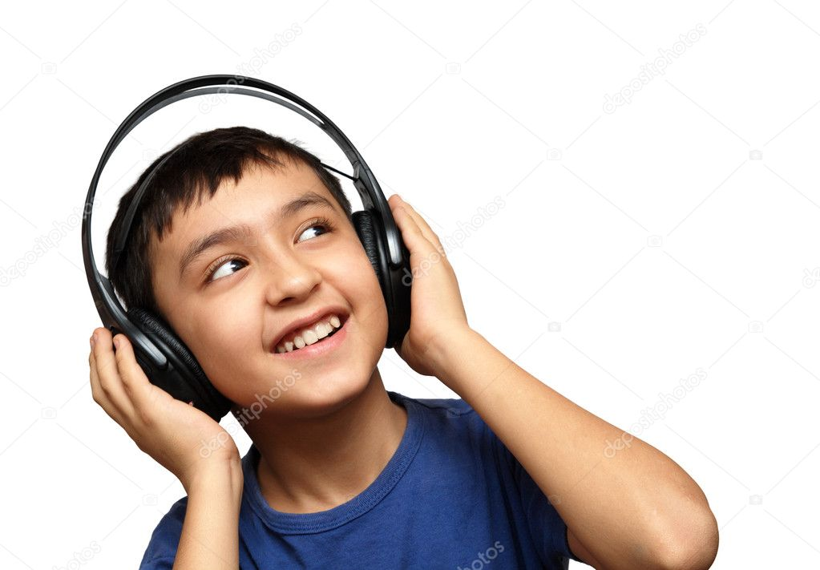
Grammar Practice “Used to for past habits”
Student´s book pg 5 ex 8
Complete these questions and answers. Then compare with a partner.
Used to
Did
Used to
didn’t used to
Used to
did
Used to
Used to
did
Used to
Used to

Slide 6
Grammar/Speaking Practice “Used to for past habits”
Student´s book pg 132 ex 2
Complete the following conversations with the correct form of used to.
Then roleplay with a partner.
Used to
Did your
Used to
Used to
Used to
Did
Used to
Used to
Used to
Used to
Used to

Slide 7
Grammar/Speaking Practice “Used to for past habits”
Workbook pg 4 ex 6
Look at these childhood pictures of Allie and her brother Robert.
Complete the sentences using used to.
Used to ride a bicycle?
Used to go to the beach?
Used to collect commic book?
Used to have a pet?

Slide 8
Writing/Speaking Practice “Used to for past habits”
Student´s book pg 6 ex 11
Write about things you used to do as child. Write sentences using used to or didn´t use to. Then share to the class.
Write here your text:
When i was child, i used to listen music whit my family at morning in weekends and i used to play soccer whit my sister, i used to have a nicknames “Vicky” or my grandmother called me “carita de luna”. I didn’t used to get out in my vacations and I used to like the Mole, but i now like the Picadillo.
You can use one of these topics.

Slide 9
Grammar Practice “Used to for past habits”
Choose the correct Word or phrase.
Workbook pg 4 ex 5
pet
Summer camp
playground
How have you changed in the last five years? Write answers to these questions.
Workbook pg 5 ex 8
play soccer and tochito
I play volleyball and basketball
I used to listen Daddy Yanke
Now I listen Adele and Duelo
I used to like wear dress and heels
Now I like wear jeans and tennis

Slide 10
Grammar/Speaking Practice “Used to for past habits”
Workbook pg 5 ex 7
Look at the answers. Write the questions using used to.
Did you use to collect shells?
Did you use to bathe in the sea?
Did you use to play?
Did you use to lose?

