Slide 1
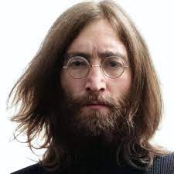
UNIT 1
Lesson 7
Did he used to smoke?
LESSON OBJECTIVE:
Talk about past habits with the used to.

Slide 2
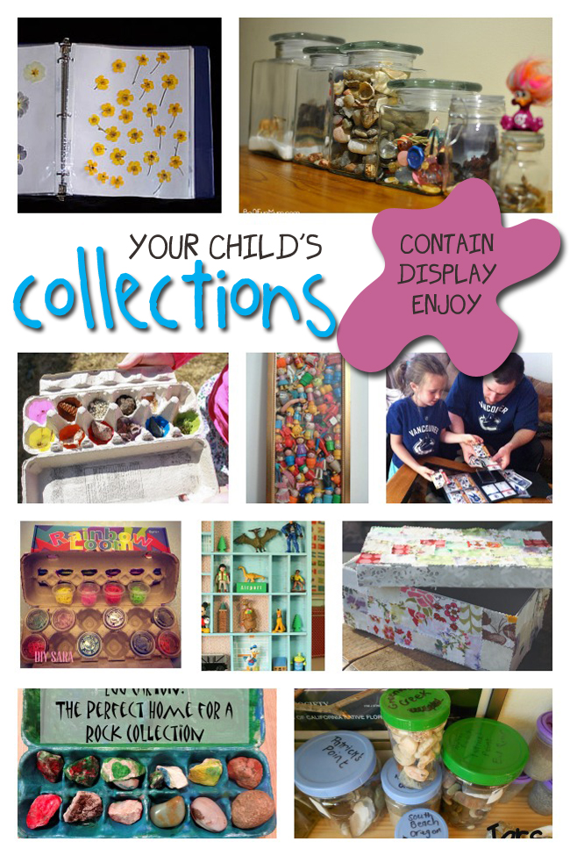
GRAMMAR FOCUS “Used to for past habits”
Used to refers to something that you regularly did in the past but don´t do anymore
Affirmative statements | I used to collect commic books Subject + used to + verb + complement
Negative statements | I didn´t use to collect anything Subject + didn´t use to + verb + complement
Yes/No questions | Did you use to collect things? Did + Subject + use to + verb + complement
Wh questions | What did you use to collect? WH + Did + Subject + use to + verb + complement

Slide 3
GRAMMAR FOCUS “Used to for past habits”
Student´s book pg 5 ex 8
Used to refers to something that you regularly did in the past but don´t do anymore
Did you use to play sports?
What sports did you use to play?
Yes I did, I used to play soccer
I used to play soccer and basketball.
I never used to play sports,
but now I play tennis
I didn´t use to play sports, but now I play tennis

Slide 4
Listening /Speaking Practice “Used to for past habits”
Read the following statements about changes. Check those that are true about you.
X
X
X

Slide 5
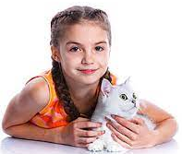
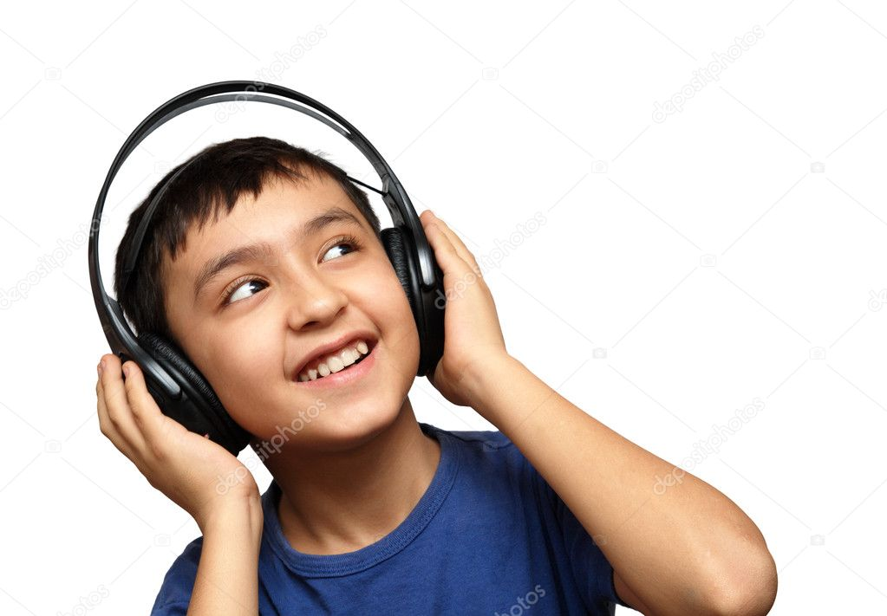
Grammar Practice “Used to for past habits”
Student´s book pg 5 ex 8
Complete these questions and answers. Then compare with a partner.
Used to
did
Used to
Didn´t
Use to
Did
Used to
Used to
did
Used to
Used to

Slide 6
Grammar/Speaking Practice “Used to for past habits”
Student´s book pg 132 ex 2
Complete the following conversations with the correct form of used to.
Then roleplay with a partner.
Used to
Did your
Used to
Used to
Used to
did
Used to
Used to
Used to
Used to
Used to

Slide 7
Grammar/Speaking Practice “Used to for past habits”
Workbook pg 4 ex 6
Look at these childhood pictures of Allie and her brother Robert.
Complete the sentences using used to.
Used to theri byciclets
Used to go to the beach
Used to collect comics
Used to have a pet

Slide 8
Writing/Speaking Practice “Used to for past habits”
Student´s book pg 6 ex 11
Write about things you used to do as child. Write sentences using used to or didn´t use to. Then share to the class.
Write here your text:
- I used to go on vacation with my family to my favorite restaurant. I used drawing, I used to listen music - my mother used to have a nickname for me, I used to like it, not now. - I didn´t play sports because of health problems. - I used to not eat vegetables, now I eat everything.
You can use one of these topics.

Slide 9
Grammar Practice “Used to for past habits”
Choose the correct Word or phrase.
Workbook pg 4 ex 5
pet
Summer camp
pleygroung
How have you changed in the last five years? Write answers to these questions.
Workbook pg 5 ex 8
slepping
Listen to music, read books
I used to listen banda, baladas
And now, listen to pop y jrock
Used to pants and now dress

