Slide 1
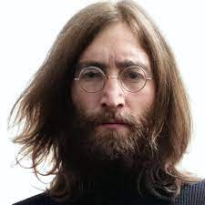
UNIT 1
Lesson 7
Did he use to smoke?
LESSON OBJECTIVE:
Talk about past habits with the used to.

Slide 2
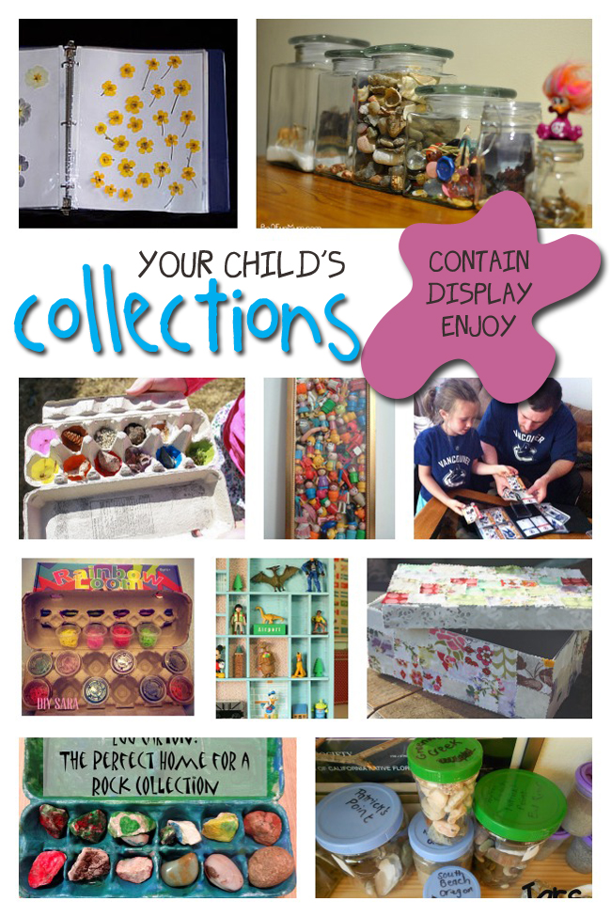
GRAMMAR FOCUS “Used to for past habits”
Used to refers to something that you regularly did in the past but don´t do anymore
Affirmative statements | I used to collect commic books Subject + used to + verb + complement
Negative statements | I didn´t use to collect anything Subject + didn´t use to + verb + complement
Yes/No questions | Did you use to collect things? Did + Subject + use to + verb + complement
Wh questions | What did you use to collect? WH + Did + Subject + use to + verb + complement

Slide 3
GRAMMAR FOCUS “Used to for past habits”
Student´s book pg 5 ex 8
Used to refers to something that you regularly did in the past but don´t do anymore
Did you use to play sports?
What sports did you use to play?
Yes I did, I used to play soccer
I used to play soccer and basketball.
I never used to play sports,
but now I play tennis
I didn´t use to play sports, but now I play tennis

Slide 4
Listening /Speaking Practice “Used to for past habits”
Read the following statements about changes. Check those that are true about you.

Slide 5
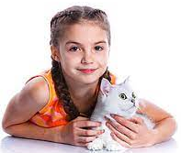
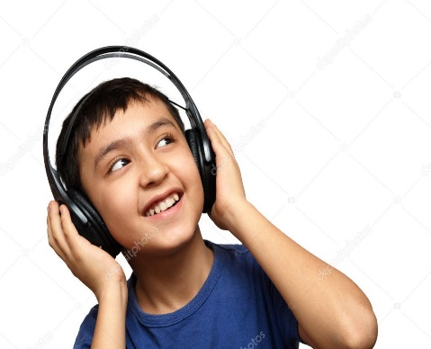
Grammar Practice “Used to for past habits”
Student´s book pg 5 ex 8
Complete these questions and answers. Then compare with a partner.
did
Did
use to
didn’t
use to
did
use to
used to
did
use to
didn’t use to

Slide 6
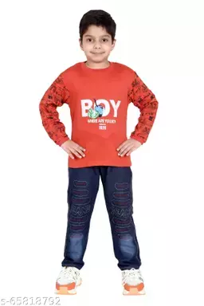
Grammar/Speaking Practice “Used to for past habits”
Student´s book pg 132 ex 2
Complete the following conversations with the correct form of used to.
Then roleplay with a partner.
Used to
Did your
Use to
Used to
Used to
Did
Use to
Used to
Used to
Used to
Used to

Slide 7
Grammar/Speaking Practice “Used to for past habits”
Workbook pg 4 ex 6
Look at these childhood pictures of Allie and her brother Robert.
Complete the sentences using used to.
used to ride their bicycles
used to go to the beach
used to go to collect commics
used to have a pet

Slide 8
Writing/Speaking Practice “Used to for past habits”
Student´s book pg 6 ex 11
Write about things you used to do as child. Write sentences using used to or didn´t use to. Then share to the class.
Write here your text:
Many years ago, I used to have a nickname very funny, it was Moso. I grew up in a very old neighborhood, thats the reason why i didn’t used to play out. I used to like eat many candies and fries, I didn't used to eat vegetables. Now I use to like much the food my mom cooks.
You can use one of these topics.

Slide 9
Grammar Practice “Used to for past habits”
Choose the correct Word or phrase.
Workbook pg 4 ex 5
pet
Summer camp
playground
How have you changed in the last five years? Write answers to these questions.
Workbook pg 5 ex 8
play with my dogs
I draw and paint
I used to like a pop music and boybands like “Big time Rush”
Now i like a balads music
I used to like wear t-shirts and dress
Now i love to use jeans

Slide 10
Grammar/Speaking Practice “Used to for past habits”
Workbook pg 5 ex 7
Look at the answers. Write the questions using used to.
Did we collect shells?
Did we use to swim much?
hobbies did use to do in the beach?
Did we use to lose?

