Slide 1
Escuela Normal De Educación Preescolar English Project: A life in paintings Student´s name: María Guadalupe Salazar Martínez Teacher´s name: Guadalupe del Rocío Robledo Corpus. Saltillo, Coahuila. March 2023

Slide 2
PROJECT UNIT I : A LIFE IN PAINTINGS
PROJECT UNIT I : A LIFE IN PAINTINGS
Competences: Devise learning and teaching proposal using innovative methodologies and applying new technologies to education.
Reflect on one´s own learning process to act consciously in communicative exchanges.
Instructions: Choose a famous painter and research about his/her life.
You have to write his/her biography, childhood, his/her work, then with the information create a collage and use it to explain his/her life to your classmates.
Remember that you have to use the past tense, auxiliar did and the used to.

Slide 3
Category | Unsatisfactory 2 | Satisfactory 3 | Proficient 4 | Excellent 5
On time | Doesn’t deliver the project | Deliver the project out of time. | Deliver the project out of time but show a formal excuse. | Deliver the project on time
Creativity | Not creative or original | It is creative and original enough | It is quite creative and original | It is very creative and original
Contents | Insufficient or improper contents. Doesn’t show evidence of knowledge. | Show evidence of knowledge. Enough contents. | Enough contents Show mastery of knowledge. | Outstanding content Show excellent knowledge.
Presentation | Information and ideas are poorly sequenced (the author jumps around). | Information and ideas are presented in an order that the audience can follow with minimum difficulty. | Information and ideas are presented in a logical sequence which is followed by the reader with little or no difficulty. | Information and ideas are presented in a logical sequence which flows naturally and is engaging to the audience.

Slide 4
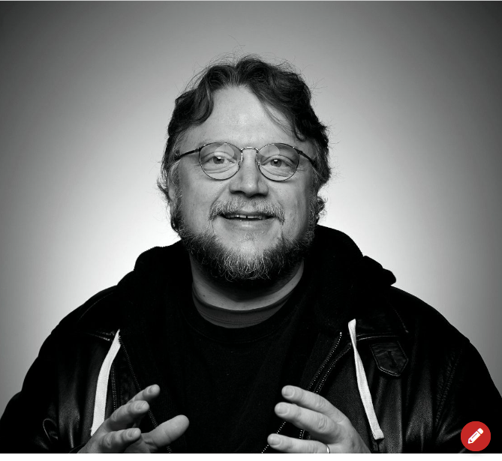
Guillermo del Toro
Guillermo del Toro
The director, producer, screenwriter and novelist Guillermo del Toro was born in Mexico on October 9, 1964, in the city of Guadalajara, Jalisco.
He started filming in his hometown as a teenager. He made the short films "Doña Lupe" (1985 thousand nine hundred eighty-five) and "Geometry" (1987 thousand nine hundred eighty-seven). For ten years he specialized in the direction of make-up design works he created his own company "Necropia“
He created the production company Tequila Gang.
His debut, “Cronos” (1993 One thousand, nine hundred and ninety-three), won nine Ariel Awards, including Best Film and Best Director, and won Best Screenplay and Best Actor at the Sitges Festival.
“Mimic” (1997), was his second feature film and his first work produced in the United States.
He undertook new projects fusing effects, such as “El espinazo del diablo” (2002 two thousand and one), a film that had the collaboration of the brothers Agustín and Pedro Almodóvar in the production, and “El Laberinto Del Fauno” (2006), winner of three Oscars. (Best Photography, Best Art Direction and Best Makeup).

Slide 5
In addition to his directing work, he has produced projects for other directors, including the films "The Orphanage," "The Book of Life," "The Thin Yellow Line," and the animated series "Trollhunters.
"He returned to directing with the sci-fi action film “Pacific Rim” (2013 two thousand and thirteen) and then released “Scarlet Summit” (2015)."The Shape of Water" (2017), his most recent film, won more than 90 awards around the world, including a Golden Globe and two Oscars.

Slide 6
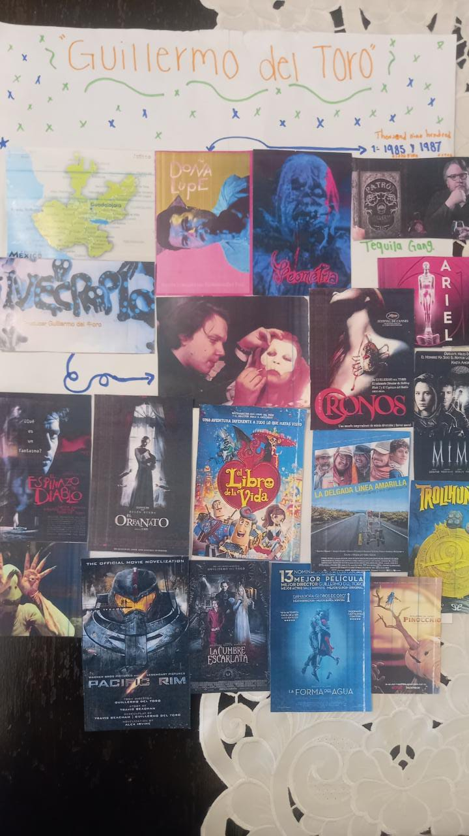
COLLAGE
COLLAGE

Slide 7
VIDEO
VIDEO
https://youtu.be/GVhNXwnNssQ

