Slide 1
ESCUELA NORMAL DE EDUCACIÓN PREESCOLAR
TITLE OF THE PROJECT: “This (tuna salad) will knock your socks off”
ENGLISH LEVEL A2.2 LEARNING EVIDENCE
TEACHER: MAYELA ALEJANDRA GAONA GARCÍA
TEAM: BRICIA FERNANDA GONZÁLEZ GONZÁLEZ
GABRIELA BERENICE GUTIÉRREZ CISNEROS

Slide 2
CONVERSATION

Slide 3
G: Hello welcome to our program cooking well
B: Great! the name of today's recipe is tuna salad will knock your socks off
g: yes of course, the recipe is easy and fast. Have you tried it before?
B: I've never had a tuna salad before.
G: Seriously, last night I made this recipe.
B: did you like it?
g: Yes, I liked it a lot, the cooking time is 5 minutes
The utensils are:
·Spoon
·Dish
·Fork
·Knife
·Cutting board
·Strainer
·bowl

Slide 4
Okay the ingredients are:
·1 can of natural tuna
·onion
··sweet corn
·mayonnaise

Slide 5
The process is
1.First open the can of corn and drain the juice
2.Then cut the onion
3.Stir fry the tuna only if you prefer
4.Next in a container we are going to add the tuna, the onion,, the sweet corn, and we mix very well,
5.After that add a little salt, a little pepper, the mayonnaise, stir until integrated
6.We serve on a plate and we already have our delicious tuna salad ready!!
Thanks for seeing us

Slide 6
RUBRIC

Slide 7
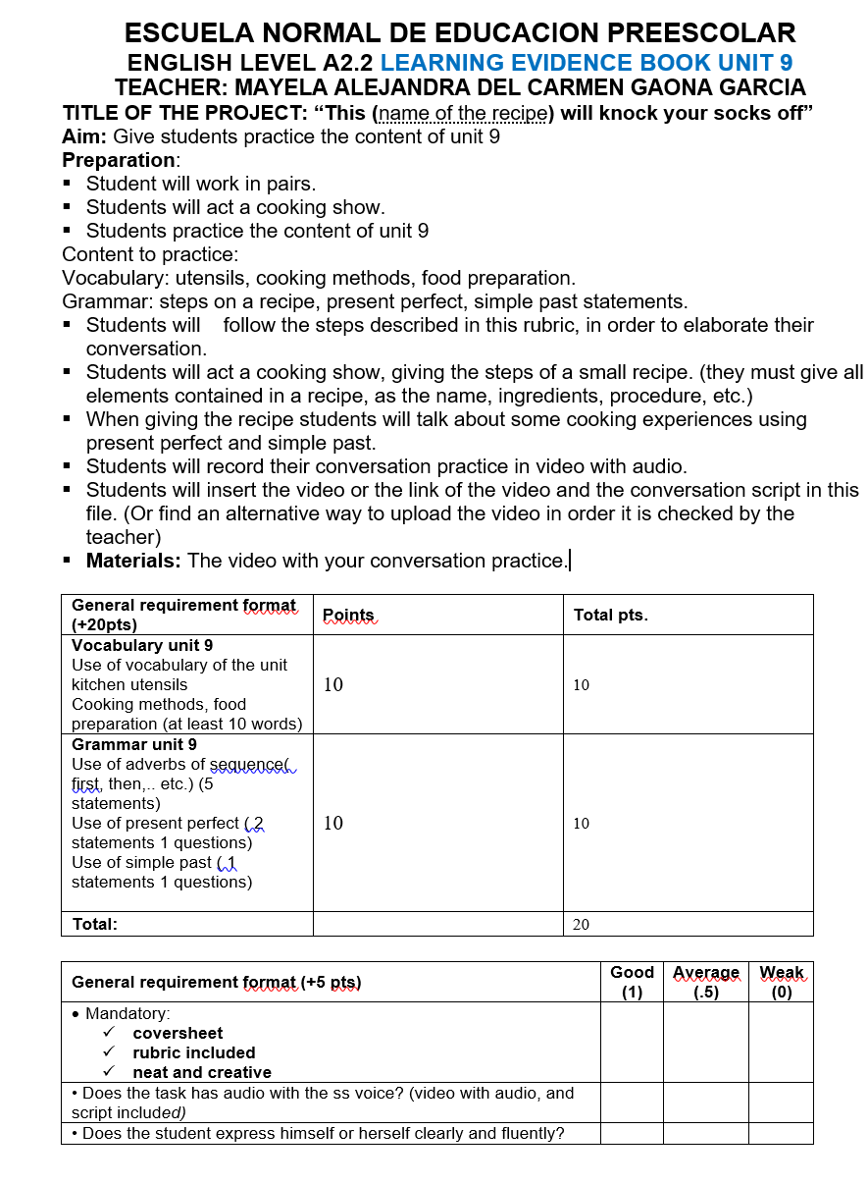

Slide 8
LINK:
https://youtu.be/PGi-puQY1ck

