Slide 1
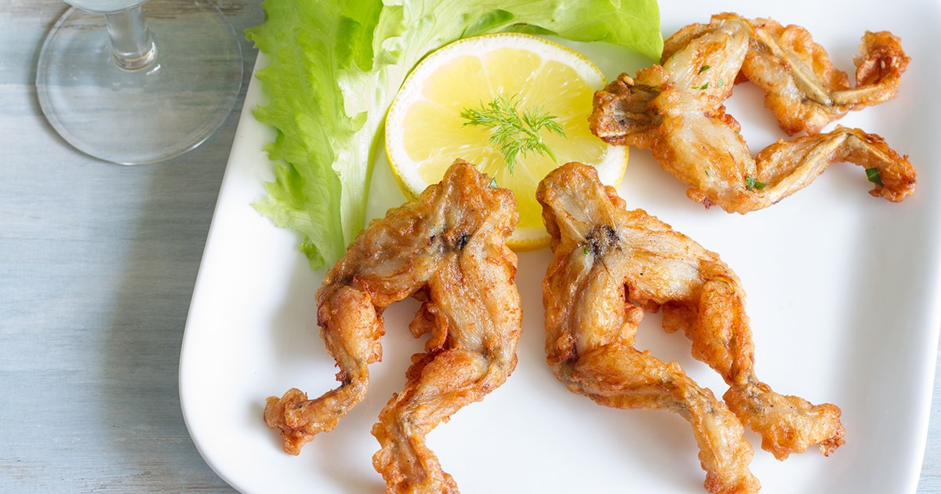
UNIT 3
Lesson 4
Have you ever eaten frog legs?
LESSON OBJECTIVE:
Learn and practice present perfect questions.

Slide 2
Warm up “Have you…?”
Students think about this question and share answers.
Have you ever eaten frog legs?

Slide 3
Warm up “Have you…?”
Students think about this question and share answers.
Have you ever taken pictures of your food?

Slide 4
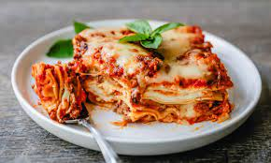
Grammar practice “Present Perfect”
We use the present perfect to talk about past actions (or recent past action) that has a connection to now.
We often use the present perfect to talk about periods of time that have not finished (as today, this week, this month.. etc) or to say that something has happened several times
He has had five cups of coffee today.
My mother has cooked lasagna three times this week.

Slide 5
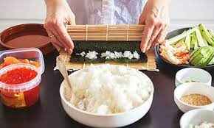
Grammar practice “Present Perfect”
We also use present perfect to talk about life experiences, at an unspecified time in the past. We often use never in negative sentences.
We often use the adverb ever to ask about life experiences and make questions.
I have never made sushi
Have you ever been to a vegetarian restaurant?

Slide 6
Grammar practice “Present Perfect”
The present perfect is formed with the verb have + the past participle
Affirmative statements | I´ve eaten sushi many times
Negative statements | She has not made sushi lately.
Questions | Have you been to a vegetarian restaurant? Yes, I have been to, several times. No, I´ve not been to a vegetarian restaurant. No, I´ve never been to one.
 | Has Mario taken cooking classes? Yes, he´s taken cooking classes. No, he has not taken cooking classes. No, he has never taken cooking classes.

Slide 7
Grammar practice “Present Perfect”
Write the form of the past participle on each space
Affirmative statements | He has cooked many times this weekend I have danced folklore many times
Negative statements | I haven’t cleaned my room this week
Questions | Have you cooked lasaña? Has she ever cooked lasaña?
You can use phrases of frequency to complement the present perfect statements
You can use contractions

Slide 8
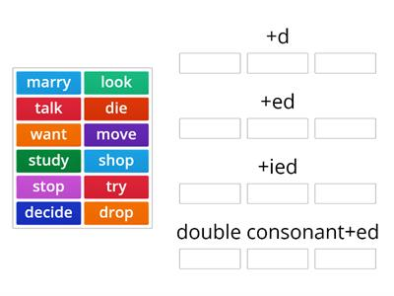
Grammar practice “Present Perfect”
The present perfect is formed with the verb have + the past participle (of regular or irregular verbs)
Past participle of regular verbs
Past participle of irregular verbs
died
moved
looked
talked
wanted
married
studied
tried
droped
shoped
stoped

Slide 9
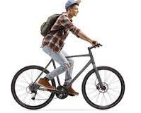
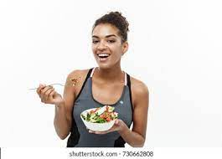
Grammar practice “Present Perfect”
Match the verbs in the column of the base form with the verbs in the column of participle form .

Slide 10
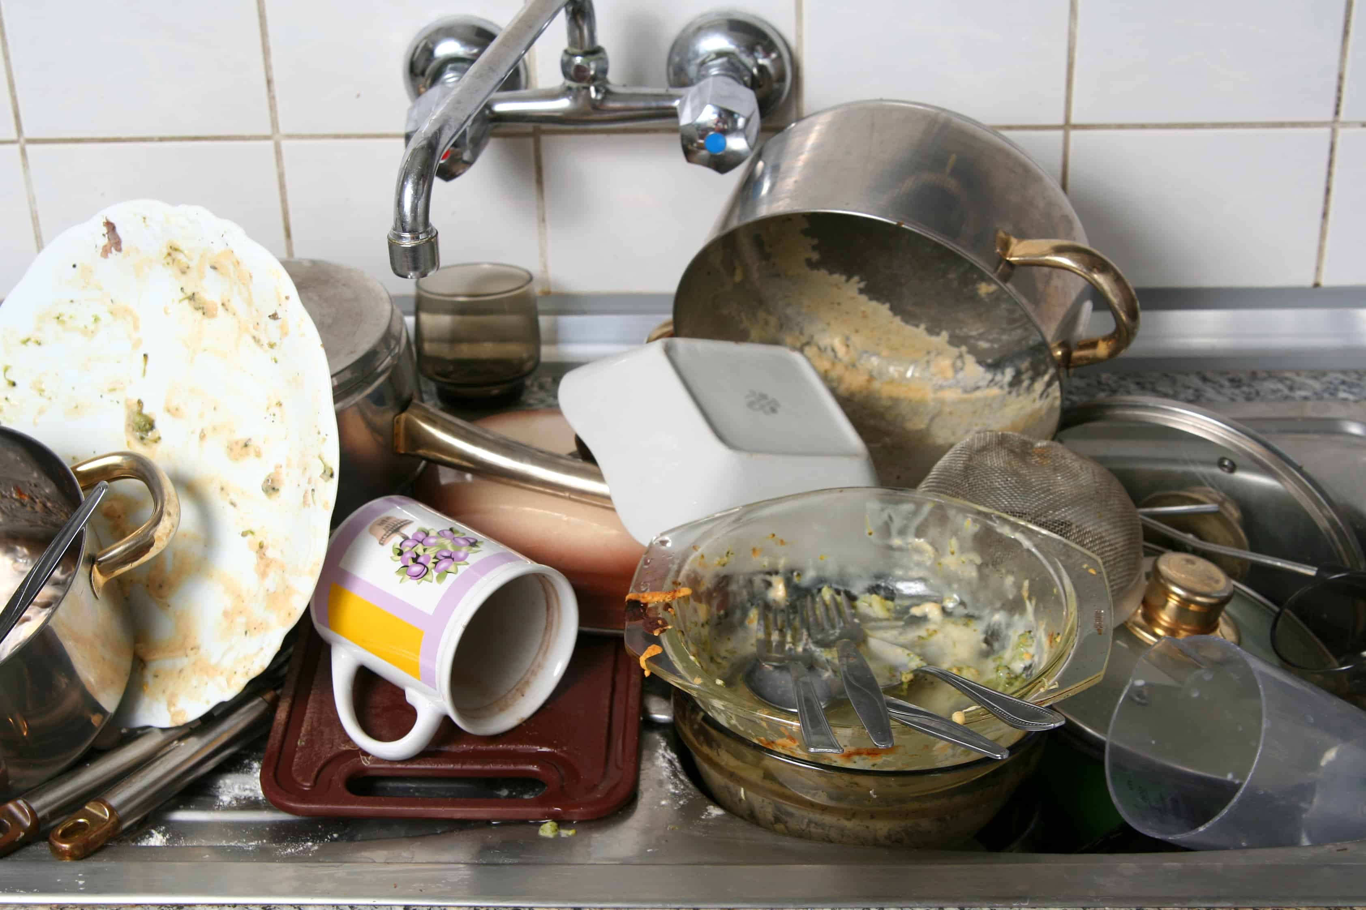
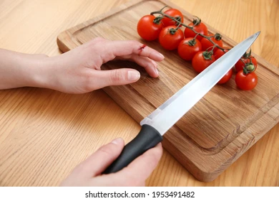
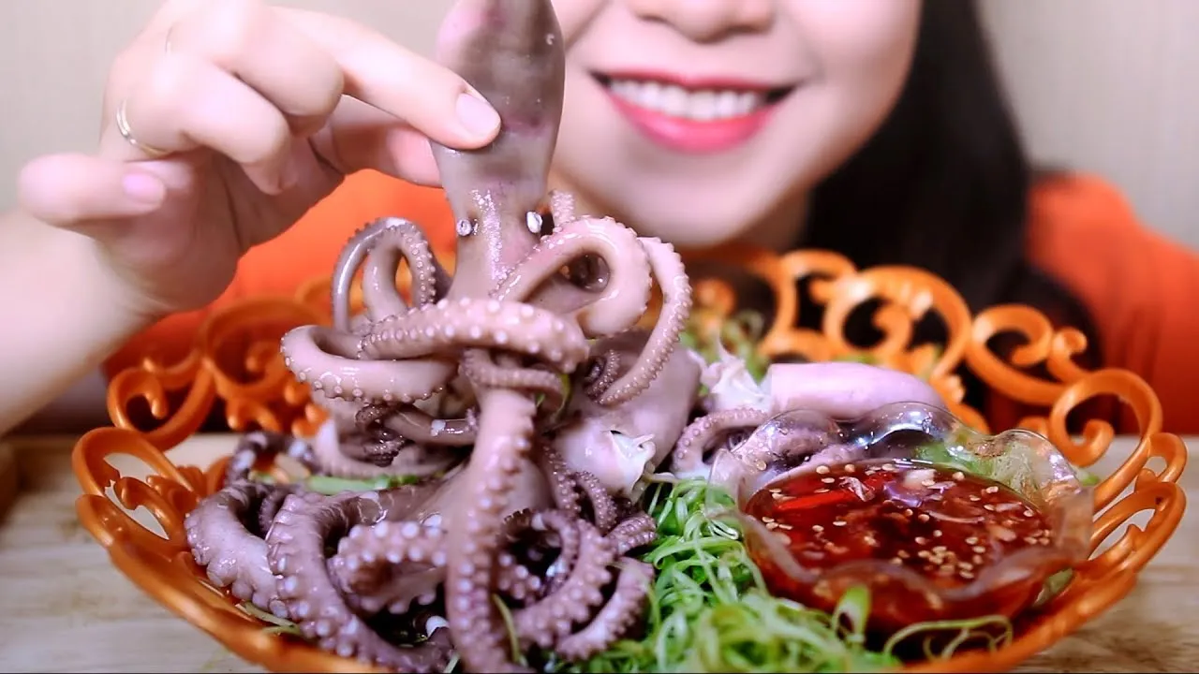
Grammar practice “Present Perfect”
Complete the following present perfect statements.
My mother has never washed (never wash) the dishes a week after
My brother _has cut (cut) a finger several times chopping tomatoes.
Have you put on (put) salt in the coffee?
I have never ate (never eat) octopus.

Slide 11
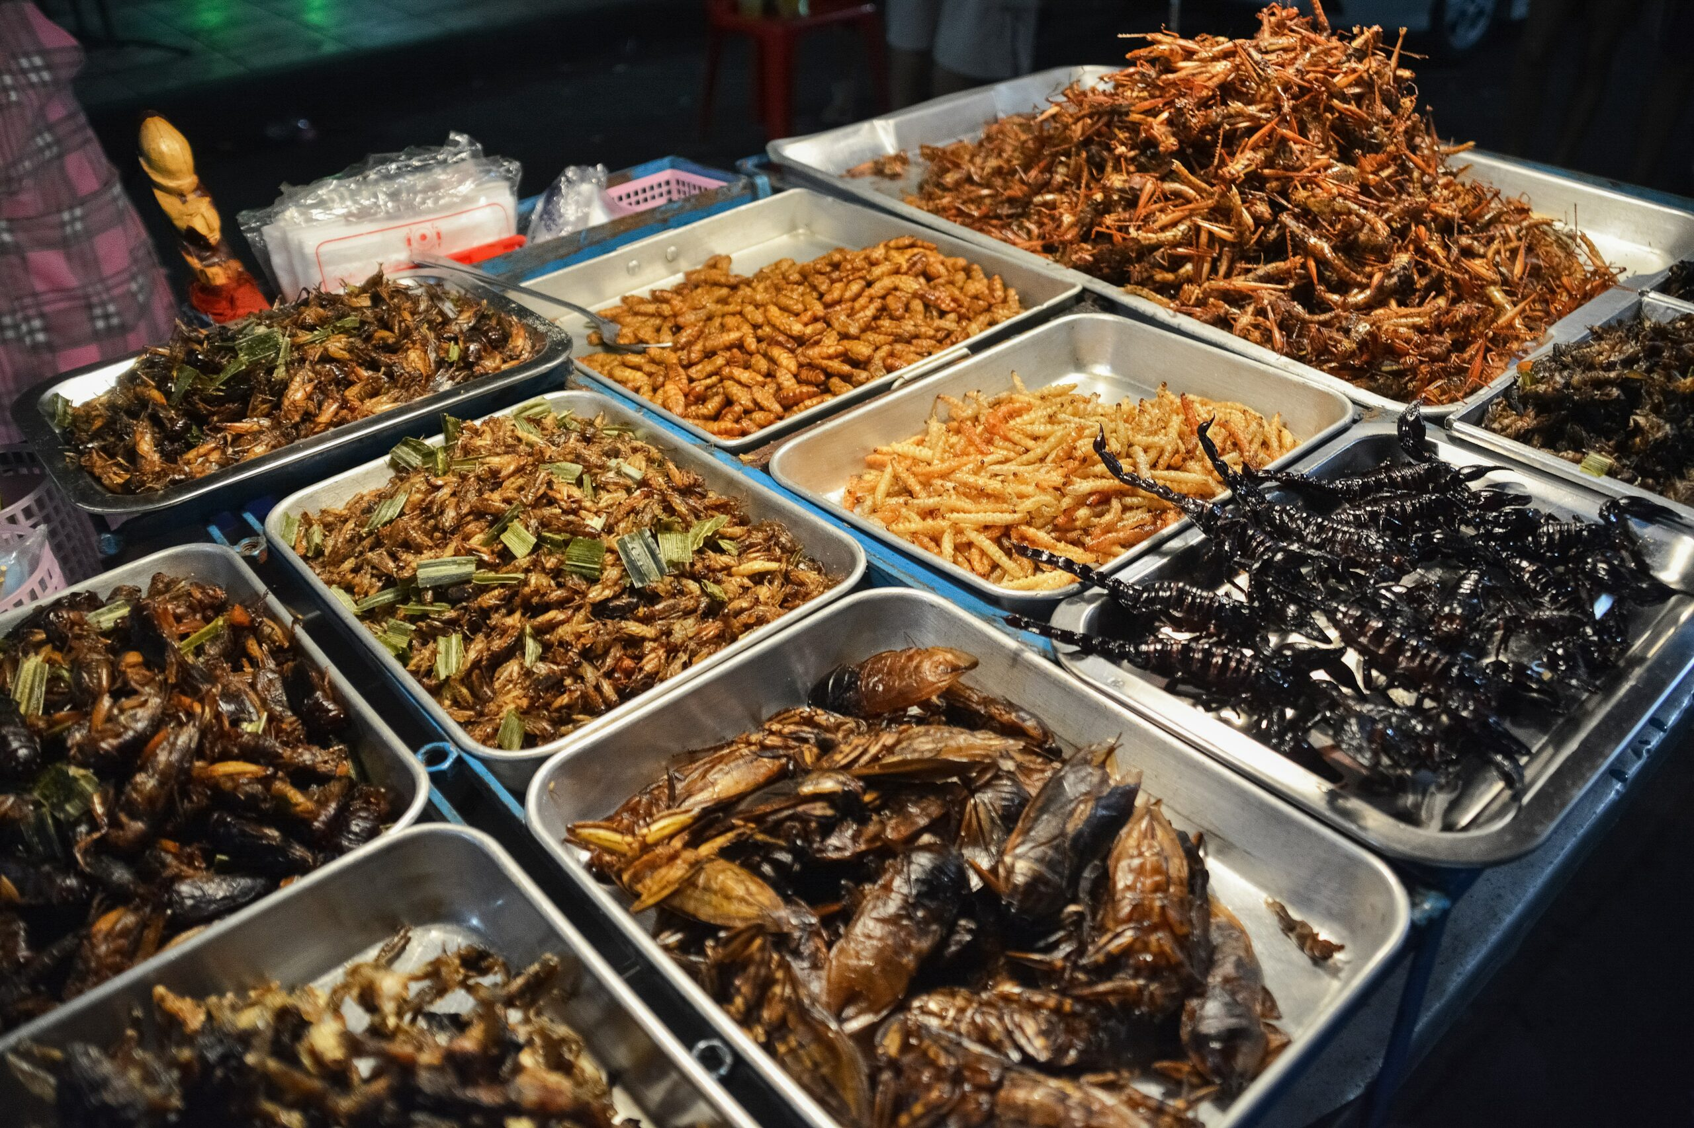
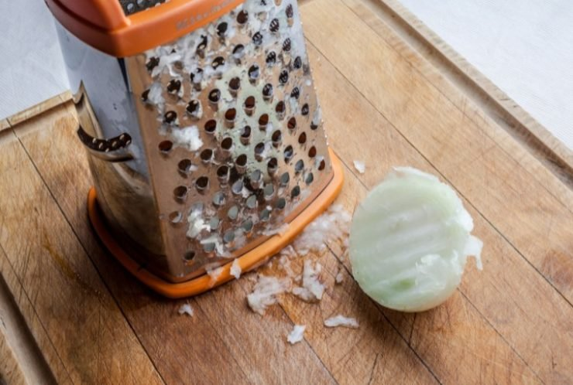
Grammar practice “Present Perfect”
Look at the pictures and write present perfect affirmative statements (use the given cues).
(go to a vegetarian restaurant)
I have goine to a vegetarian restaurant the week
(try insects)
She has tried insects many times
(skip steps on a recipe)
Julian has skipped the steps of the récipe
(grate onions)
My mother has grated onions for the sala

Slide 12
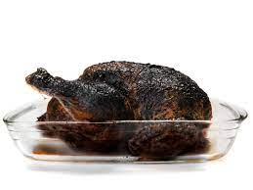
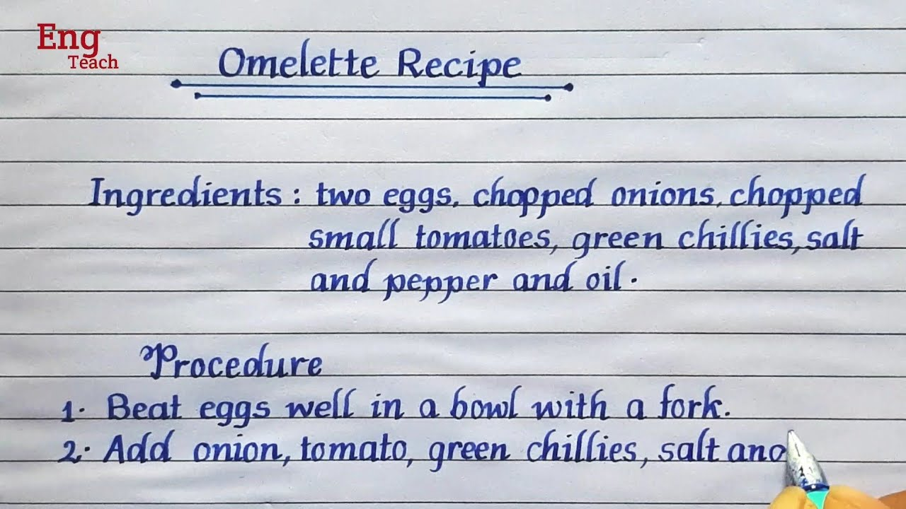
Grammar practice “Present Perfect”
Look at the pictures and write present perfect negative statements (use the given cues).
(burn the food)
I haven’t burnt the food sometimes
(write a recipe in english)
She hasn’t written a recpe in english
(see a cooking show)
I haven’t see a cooking show three or four tmes this week
(take cooking classes)
He hasn’t taken cooking class three times this week

Slide 13
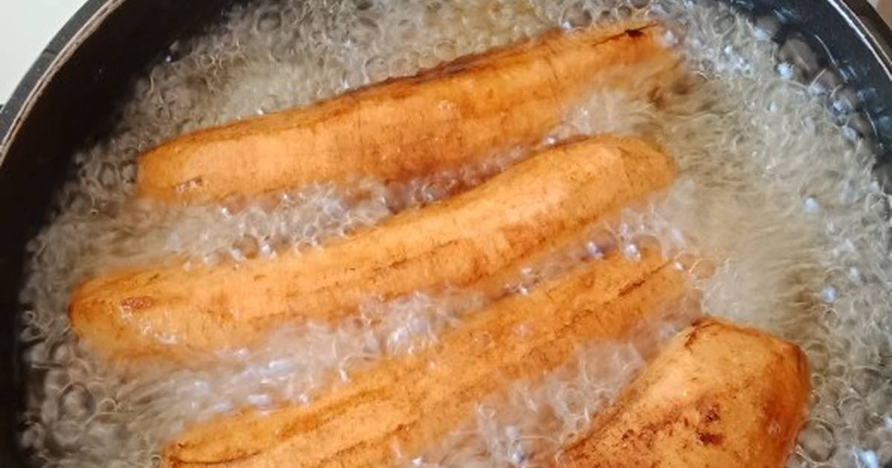
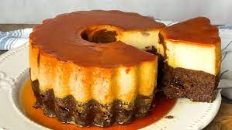
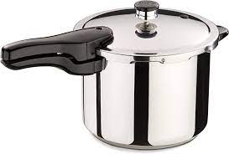
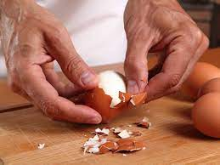
Grammar practice “Present Perfect”
Look at the pictures and write present perfect questions (use the given cues).
(fry bananas)
I have fried bananas this morning
(bake an imposible cake)
She has baked an imposible cake in my birthday
(use a pressure coker)
I have used a pressure coker three times this week
(peel boiled eggs)
He has peeled boiled eggs

Slide 14
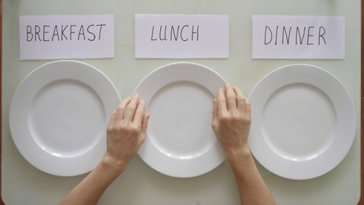
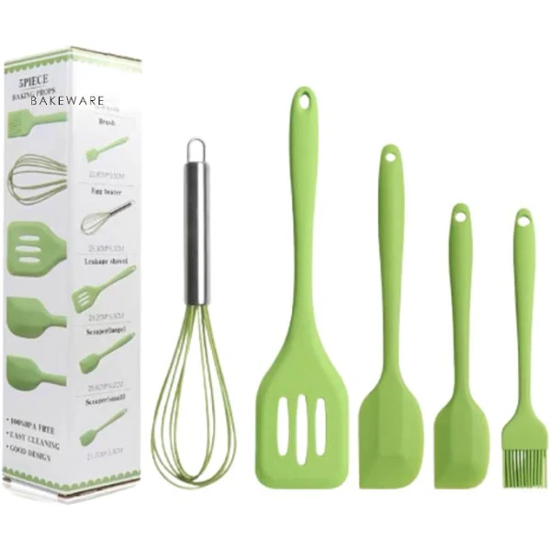
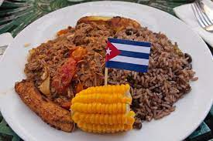
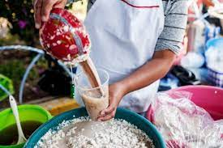
Grammar practice “Present Perfect”
Unscramble the following present perfect statements.
a meal / ever / have / skipped / you / ?
Have you ever skipped a meal?
kitchen / utensils / has / bought / My mother /
My mother has bought kitchen utensils
cuban / Alex / never / has / eaten / food / ?
Alex has never eaten cuban food?
ever / tejate / have / drunk / you / ?
Have you ever drunk tejate?

Slide 15
Grammar practice “Present Perfect”
Online activity
Click on the following links, practice present perfect.
Then share your results of your practice.
https://wordwall.net/es/resource/32454166/present-perfect
Insert here your results
https://wordwall.net/es/resource/55822814/ingl%c3%a9s/present-perfect-positive-and-negative-sentences
Insert here your results
https://wordwall.net/es/resource/4553199/present-perfect
Insert here your results

Slide 16
Grammar practice “Present Perfect”
Online activity
Click on the following links, practice present perfect.
Then share your results of your practice.
https://wordwall.net/es/resource/4060879/present-perfect
Insert here your results
https://wordwall.net/es/resource/3056667/present-perfect
Insert here your results
https://wordwall.net/es/resource/55822677/ingl%c3%a9s/present-perfect-affirmative-sentences-
Insert here your results

