Slide 2
Escuela Normal de Educación Preescolar English B2
Number of hours/ Credits: 6/ 6.75
TEACHER: BRENDA BOLLAIN Y GOYTIA DE LA PEÑA

Slide 3
Course Purpose

Slide 4
This course has three main objectives:
The students will develop their ability to use English in personal and social communications, to develop relationships, complete transactions and carry out every day needs.
The students will increase their engagement with cultural and intercultural activities in English, in order to develop a better understanding of their own cultures as well as other cultures around the world.
The students will develop their ability to teach in a school environment where English is an important aspect of the school´s approach.

Slide 6
Course Progression

Slide 9
Course Description

Slide 10
Competences of the degree profile developed by the course

Slide 13
Course structure
PERIOD | BOOK UNITS | WEEK | LEARNING EVIDENCES
1 | Relationships Overcoming difficulties Enrichment 1 | W1 W2 W3 | Platform Activities in Escuela en Red
2 | 4. Business as Usual 5. The Great Outdoors 6. Enrichment 2 | W4 W5 W6 | Platform Activities in Escuela en Red
3 | 7. Exceptional Women 8. Truth and Lies 9. Believe it or Not 10. Enrichment 3 | W7 W8 W9 W10 | Platform Activities in Escuela en Red
4 | 11. Strong Feelings 12. Learning and Technology 13. Entreperenurs | W11 W12 W13 | Platform Activities in Escuela en Red

Slide 14
Assessment Criteria
EVALUATION OF EACH LEARNING UNIT (1-3)
English Discoveries Platform and extra activities | 100%
EVALUATION OF THE SEMESTER
AVERAGE OF LEARNING UNITS | 50%
FINAL EVIDENCE (INTERVIEW) | 50%

Slide 15
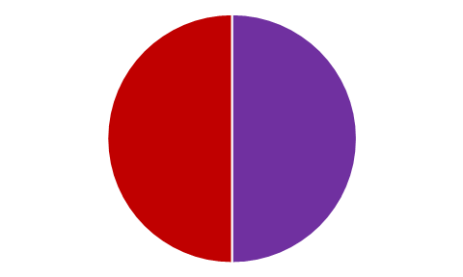
Global Evaluation
NOTE:
In case you fail one of the learning units, you will not be allowed to present the final evidence losing 50% of your global evaluation. In which case, you will have to present the extraordinary exam.
50%
50%
Average of learning units 1-3
Final Evidence
(Speaking)

Slide 16
NOTA IMPORTANTE
En caso de que el estudiante no logre el desarrollo de las habilidades necesarias para obtener el nivel de inglés que esté cursando, se evaluará con base en el desempeño del estudiante, sin embargo, tendrá que cursar nuevamente el nivel.
El estudiante acreditará el curso cuando obtenga como mínimo en la evaluación global del nivel de desempeño su equivalencia numérica de 6.
El estudiante acreditará el nivel una vez que evidencie el desarrollo de las habilidades propias del nivel de inglés con base en el CEFR mediante una entrevista realizada al final del ciclo escolar.

Slide 18
Additional online references and resources
Learning English. http://www.bbc.co.uk/learningenglish
Teaching adults. https://www.teachingenglish.org.uk/teaching-adults
Adult learners. https://elt.oup.com/learning_resources/courses/adultlearners/?cc=mx&selLanguage=en
Learning English. https://www.cambridgeenglish.org/learning-english/
Teacher’s corner. https://americanenglish.state.gov/teachers-corner
Classroom resources. Pearson. https://www.pearsonelt.com/professional-development/resources.html
Teaching adults. Oxford. https://elt.oup.com/teachersclub/courses/teachingadults/?cc=mx&selLanguage=en
For teachers. BBC. http://www.bbc.co.uk/worldservice/learningenglish/teach/
Onestop English. http://www.onestopenglish.com/
The digital teacher. https://thedigitalteacher.com/
https://visuwords.com/
https://www.eslvideo.com/
https://es.lyricstraining.com/
https://www.busuu.com/es
http://intermediatelow.blogspot.com/
https://www.englishclub.com/
http://www.topics-mag.com/
http://www.readableblog.com/
https://dictionary.cambridge.org/es/
http://www.bbc.co.uk/learningenglish
https://www.tefl.net/
http://www.elllo.org/

