Slide 1
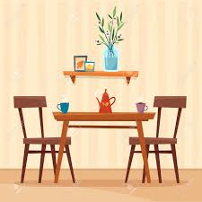
Listen to the romos in a house and number them in the picture
https://www.123listening.com/freeaudio/house1-1.mp3

Slide 2
stove
microwave
bookcase
desk
armchair
curtains
Coffee maker
refrigerator

Slide 3
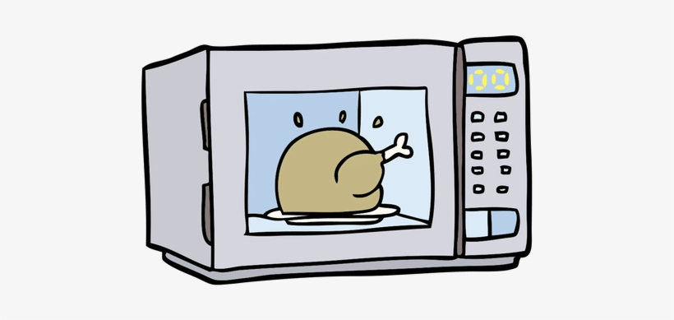
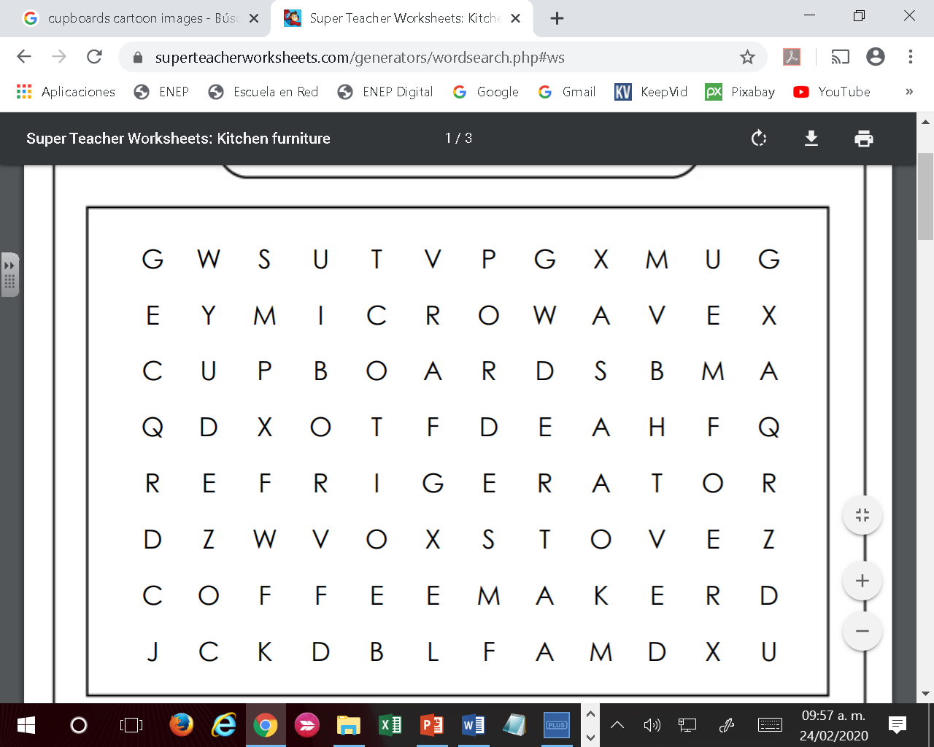
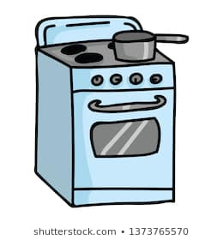
Find the picture words in the letter soup

Slide 4
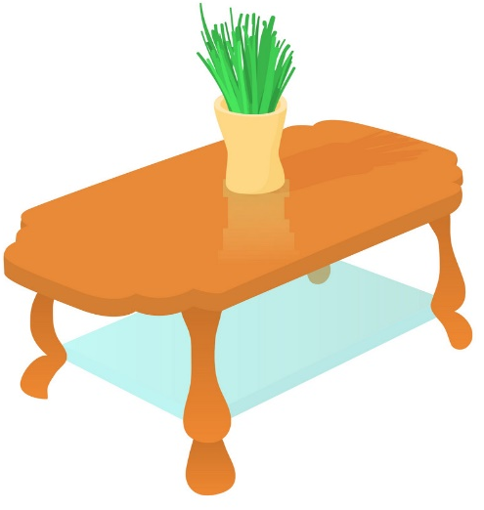
Label the pictures with furniture vocabulary

Slide 5
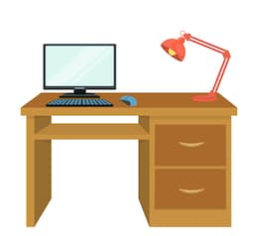
Label the pictures with furniture vocabulary

